Slide 1
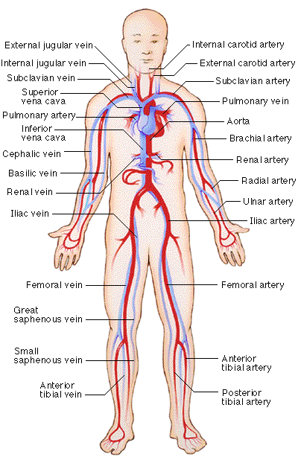
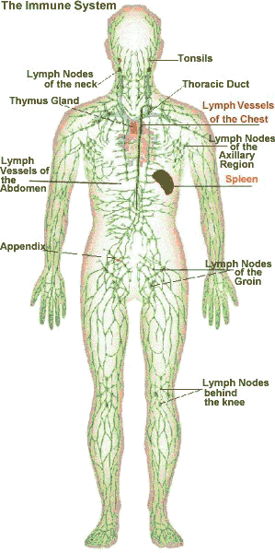
From Blood to Host Defense Adaptive Host Defense
Gregory J. Bagby, Ph.D.
gbagby@lsuhsc.edu
Office: 310 (CSRB)

Slide 2
From Blood to Host Defense
Blood
Components and function
Hemostasis and clotting
The host defense system
General overview
Innate immune system
pathogen recognition
inflammatory response
Adaptive immune system
Humoral immune system and antibodies
Cell-mediated immune system

Slide 3
Adaptive Host Defense System
Overview of the adaptive immune system
Functions of B and T lymphocytes (cells)
B lymphocyte receptors and antibodies
Ag-binding sites diversity
T lymphocyte receptors
Antigen presentation to B and T cells
B cells – Ag can bind to B cell receptor
T cells – Ag must be presented to the T cell receptor
Development of immune tolerance
Antibody-mediated immune response
Defenses against virus-infected cells and cancer cells
Role of NK cells and macrophages

Slide 4
Overview of Adaptive Host Defense System
Lymphocytes are the cells of the adaptive immune system
Any molecule that triggers an adaptive response against itself or a cell bearing it, is called an antigen (immunogen)
Protein, protein fragment, polysaccharide
Host recognizes as non-self
Highly specific and adaptive
Lymphocyte organs – Where do the lymphocytes hang out?
Lymphocyte origins
Three stages of acquired response
Recognition – one lymphocyte, one antigen
Activation – lymphocyte clonal expansion
Attack – eliminate antigen or kill antigen-bearing cell.

Slide 5
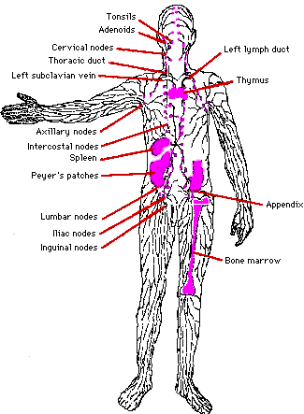
Anatomy of the Adaptive Immune System: Lymphoid Organs
Primary lymphoid organs:
Supply secondary lymphoid organs with mature lymphocytes
Bone marrow
Thymus
Secondary lymphoid organs:
Areas where lymphocytes from 1° lymphoid organs divide and reside
Lymph nodes, tonsils
Spleen
Mucosal-associated lymphoid tissue (MALT) – intestines, respiratory, genital & urinary

Slide 6
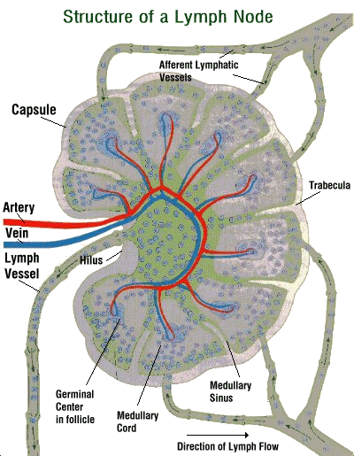
Anatomy of the Adaptive Immune System – Lymphatics and Lymph Nodes
Function
Filter particulates and microbes
Antigen presentation
Components
Cortex – B cell rich
Paracortex – T cell rich
Accessory cells (macrophages, dendritic cells, others) located in each
Medulla - Macrophages

Slide 7
Maturation & Differentiation of Lymphocytes
Pluropotent stem cell
Bone marrow
Lymphoid
Myeloid
Naïve T cell
Mature B cell
Secondary lymphoid organ
Activated by antigen
Thymus
Plasma cell
Antibodies
(maturation)
Naïve Helper T cell
Effector & Memory Cells
Naïve CTL cell

Slide 8
Recognition, Activation and Attack
Recognition
Antigen
Free
Presented
B cell
Helper T cell
Cytotoxic T cell
Activation
Cytokines
Cytokines
Plasma cell
Antibodies
Attack
Guide phagocytes, complement, and NK cells to free antigen and Ag-bearing cells
Attack antigen-bearing cells

Slide 9
Lymphocytes Are the Cells of the Adaptive Immune System
B lymphocytes (cells):
Naïve B cells – B cell receptor
Memory B Cells – B cell receptor
Plasma Cells – Ab secreting
T lymphocytes (cells):
T helper cells
Cytotoxic T cells
Naïve T cells (helper and CTL)
Effector T cells (helper and CTL)
Memory T cells (helper and CTL)
T regulatory cell

Slide 10
Functions of B Cells
B cells participate in antibody-mediated responses (humoral)
Extremely wide diversity of molecular targets.
B cells recognize antigens via B cell receptor. Each B cell has a unique receptor for a specific antigen (Ag)
Major defense against bacteria, viruses in extracellular fluid
B cells differentiate into plasma cells which secrete antibodies (Ab)
Secreted Ab enter the blood.
If form an Ab-Ag complex lead to neutralization and/or removal of the Ag

Slide 11
B Cell Receptors Are Immunoglogulins (Ig)
B cell receptor - copies of specific Ig on its plasma membrane
Glycoprotein acts as receptor for its antigen
Receptor also called an Ig
Not secreted therefore B cell receptor not an antibody
B cell receptor and antibodies are Ig and composed of 4 interlinked polypeptide chains.
5 major Ab classes – IgA, IgD, IgE, IgG, IgM
Ag-binding site - variable region (millions of unique amino acid sequences) each capable of binding one specific Ag
Fc stem – identical within Ab classes
Plasma cells are clones of B cells with identical variable regions
Specific antigen binding sites
Variable end
Light chain
Heavy chain
Constant end
Fc stem

Slide 12
B Cell Receptor Diversity
Human genome contains about 200 genes that code Ig
How does body produce millions of different Ag-binding sites?
Answer – type of genetic recombination unique in developing lymphocytes
Process requires enzyme only found in developing lymphocytes to perform the task during development
Variable region cut into segments and randomly rearranged
Varies from B cell to B cell resulting in millions of different unique sequences each capable of binding to a single Ag

Slide 13
Functions of T Cells
T cells play a variety of roles to include cell-mediated as opposed to humoral responses.
Different kinds of T cells (CD3+)
Helper T cells – CD4+
Cytotoxic T cells – CD8+
Regulatory T cells – CD4+
Cytotoxic T cells are attack cells
Travel in blood and tissues to seek out and bind to antigen-bearing target cells
Kill target cells by secreting chemicals
Cancerous or infected cells are killed by CD8+ cells
Helper T cells assist in activation and function of B cells, CD8+ cells and macrophages (dendritic cells) – Th1, Th2, Th17
Regulatory T cells believed to suppress activities of B and CD8+ cells

Slide 14
Antigen Recognition by T Lymphocytes Requires Presentation to the T cell Receptors
T cell receptor: Two-chained proteins are similar to B cell Ig on cell surface
Each T cell has receptor specific for one particular Ag. Similar variable region to B cell receptor and Ab
As in B cells, multiple DNA rearrangement result it millions of distinct T cell clones
T cell receptor remains embedded in plasma membrane of all T cells
T cell receptor can only bind to its Ag that is “presented” to it in combination with a bodies own plasma membrane proteins (self proteins)
Group of proteins collective called major histocompatibility complex (MHC) or human leukocyte associated antigens (HLA Ag)
No two humans, except identical twins, have the same MHC genes
Markers of biological self

Slide 15
Major Histocompatibility Complex (MHC)
MHC proteins are called “restriction elements” because ability of T cell receptors to identify Ag is restricted to the Ag complexed to an MHC protein
Two classes of MHC:
Class I:
On surface of virtually all nucleated cells
Required for Ag presentation to cytotoxic T cells
Class II:
Only on surface of macrophages, macrophage-like cells, B cells, and dendritic cells.
Required for presentation to helper T cells.
Ag are recognized by T cells only when complexed with MHC of an antigen presenting cell (APC)

Slide 16
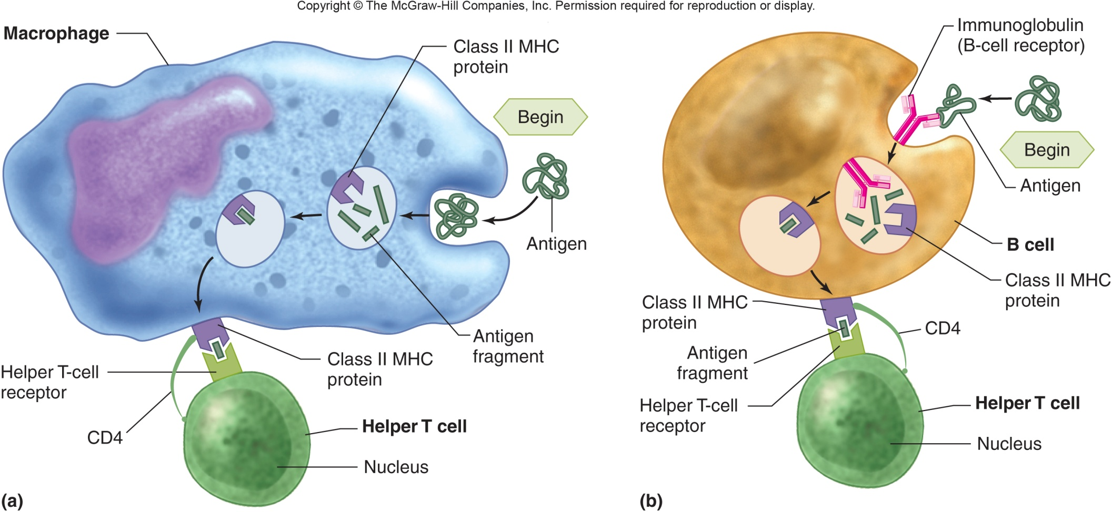
APC Presentation of Ag to Helper T Cells

Slide 17
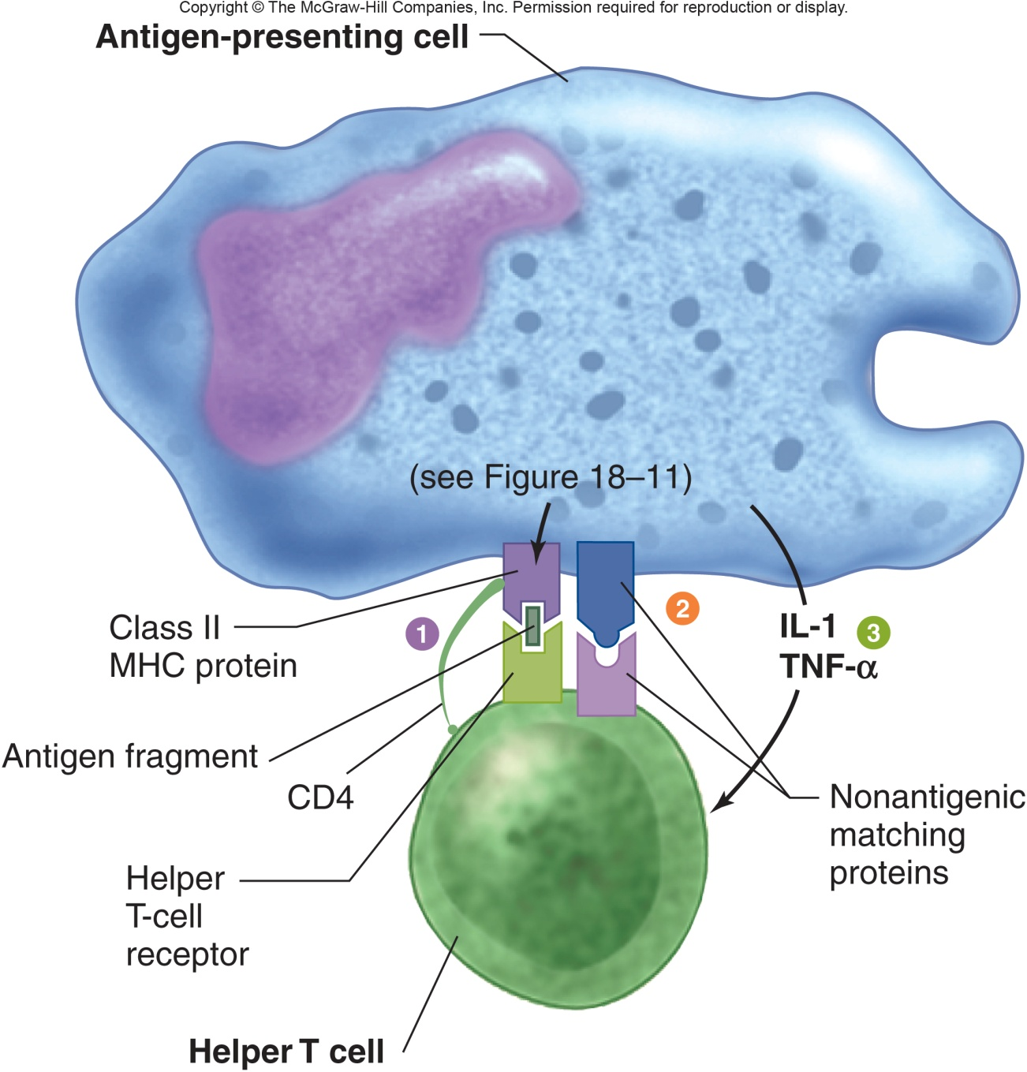
Additional Requirements for APC to Present Ag to Helper T Cells
Ag complexed with Class II MHC
Costimulus with nonantigenic matching proteins
APC secretion of IL-1 and TNF
Activated helper T cell then secretes cytokines with autocrine and paracrine effects on nearby cells
B cells
Cytotoxic T cells
NK cells
Macrophages

Slide 18
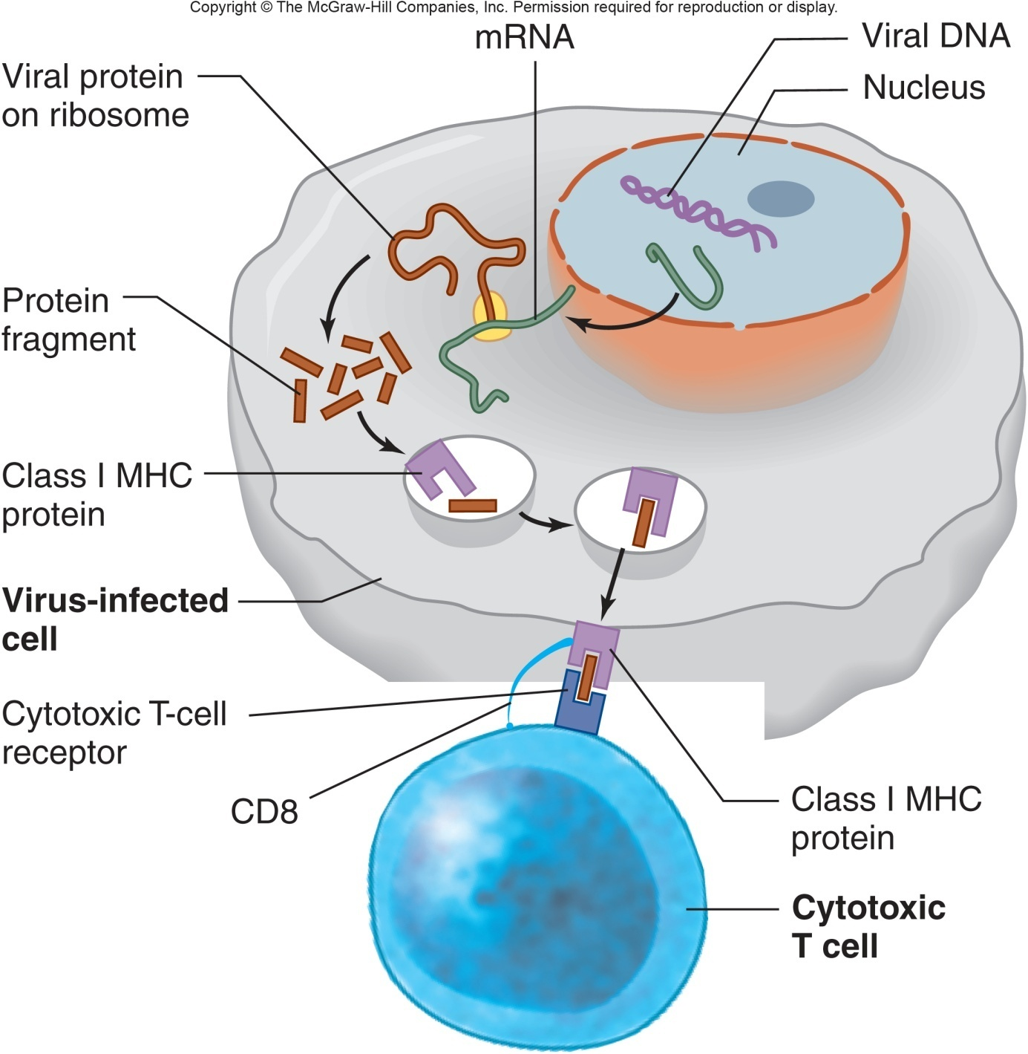
APC of Ag to Cytotoxic T Cells

Slide 19
Development of Immune Tolerance
Diverse lymphocyte receptors result from random DNA cutting and recombination. Recognize both self and nonself molecules.
Immune tolerance occurs in early life resulting in lymphocytes that lack immune responsiveness to self molecules/proteins.
Clonal deletion via programmed cell death (apoptosis)
Clonal inactivation or anergy – render cells nonresponsive
Self molecule presentation occurs in thymus (T cells) and bone marrow (B cells) during cell development
Ag presentation to helper T cells occurs without costimulation which results in cell death or permanent inactivation.
Immature B cells only express IgM. If they bind self molecule during in bone marrow they undergo clonal deletion

Slide 20
Sequence of Events in Antibody-Mediated Immunity Against Bacteria
Bacterial Ag bind to B cell receptor on B cell in secondary lymphoid organ.
Simultaneously and in the same microenvironment, B cells, and possibly APCs, present Ag complexed with MHC II to helper T cells via T cell receptor.
Helper T cell secrete IL-2, IL-4, etc.
Stimulates helper T cell to proliferate
Stimulates Ag-bound B cells to proliferate and differentiate into B memory cells, plasma cells.
Plasma cells secrete antibodies specific for Ag that initiated the process.
Antibodies circulate and combine with Ag on the surface of bacteria or free in the extracellular fluid or possibly on cells.
Ab-Ag complex causes conformational change in the Fc-stem
Facilitates phagocytosis by neutrophils and macrophages
Activates the complement system which also facilitates phagocytosis and directly kills bacteria via MAC
Induces antibody-dependent cellular toxicity via NK cells.

Slide 21
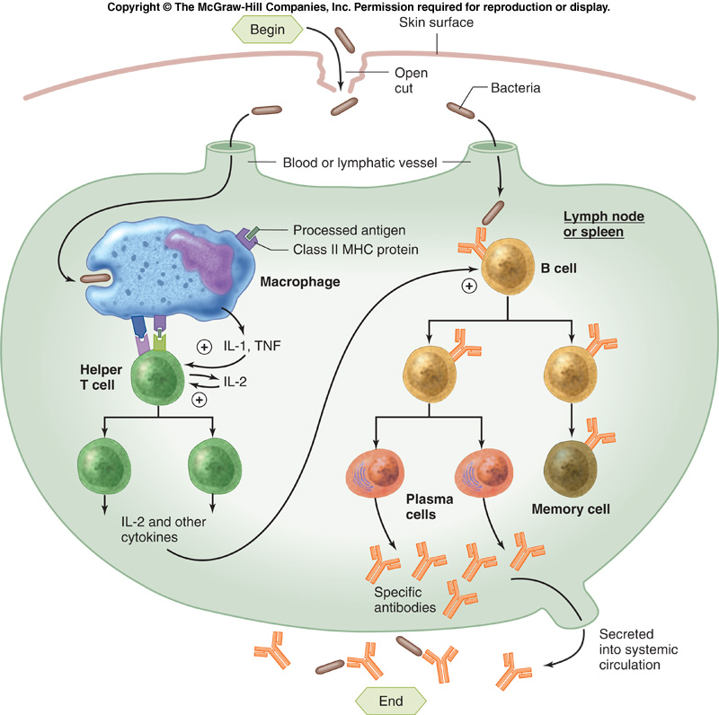
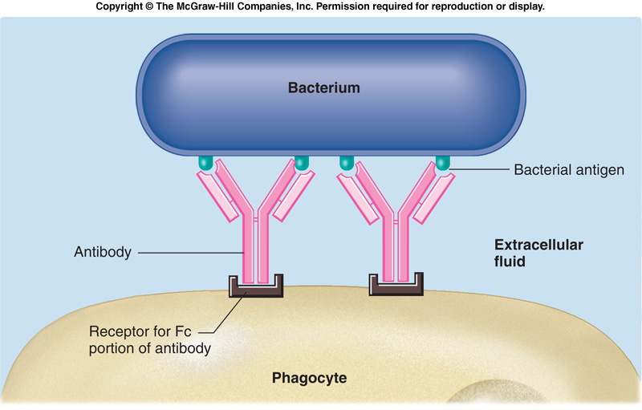
Antibody-Mediated Host Defense Against Bacteria

Slide 22
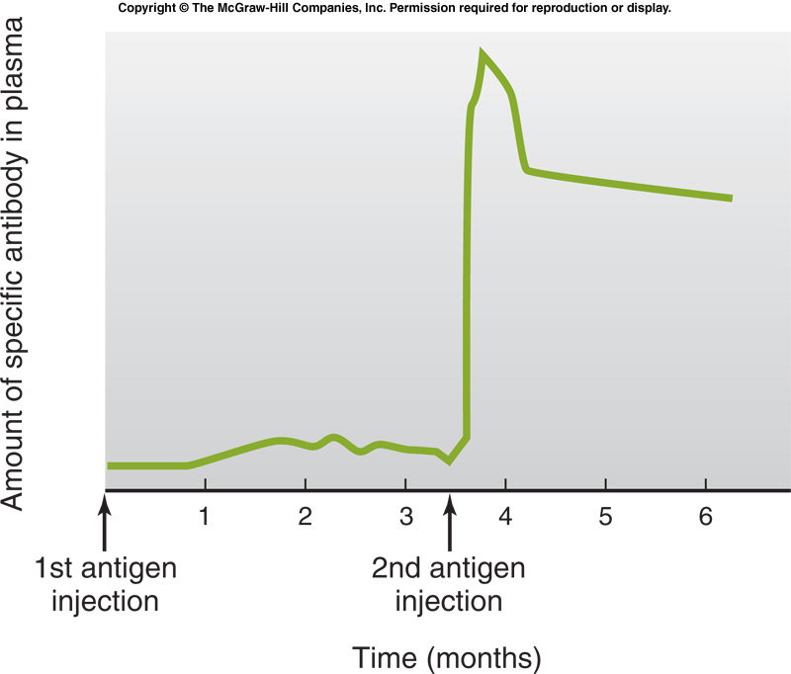
Antibody Production Kicks into High Gear with 2nd Exposure to Ag
Memory cells, produced along with plasma cells during the first infection, quickly generate large numbers of antibody molecules during a second infection.

Slide 23
Consequences of Antibody Binding to Antigen
Antibodies do not kill on their own
Can “neutralize” cell-free viruses, protein or toxins
Ab link microbes to actual killing mechanisms
Opsonization for phagocytosis
Activation of the complement system – MAC attack
Antibody-dependent cellular cytotoxicity
NK cells bind to Ab-antigen complex

Slide 24
Sequence of Events in Cytotoxic T Cell-Mediated Immunity Against Cells Infected with Virus
Viral Ag complexed to MHC I is presented (binds) to T cell receptor on CTL
Simultaneously, viral processed by APC and its Ag:MHC II complex presented to helper T cell.
Helper T cell secretes cytokine like IL-2 & IFNγ which stimulate viral Ag activated cytotoxic T cells
CTL proliferate/differentiate into effector and memory CTL.
Helper T cells proliferate/differentiate into effector and memory helper T cells
CTL attack and kill virus infected cells via secreted proteins (perforin).
Liberated virus opsonized (Ab or complement) and phagocytized (macrophages or neutrophils)

Slide 25
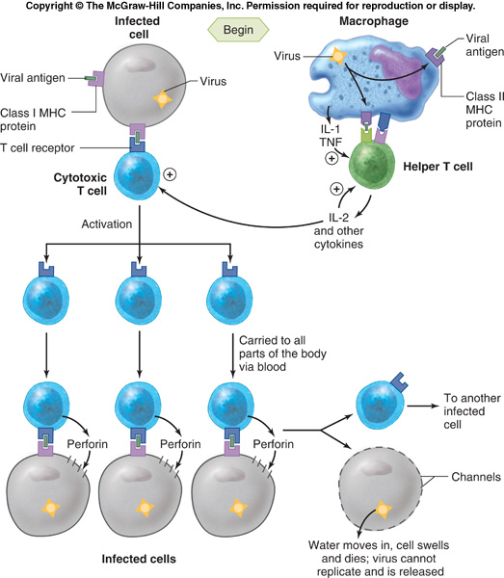
Cell-Mediated Host Defense against Virus Infected Host Cells
Virus infected cells present a viral antigen to be attacked by cytotoxic T-cells, which release a protein (perforin) that results in the perforation of the infected cell, leading to the leakage of its contents and cell death.

Slide 26
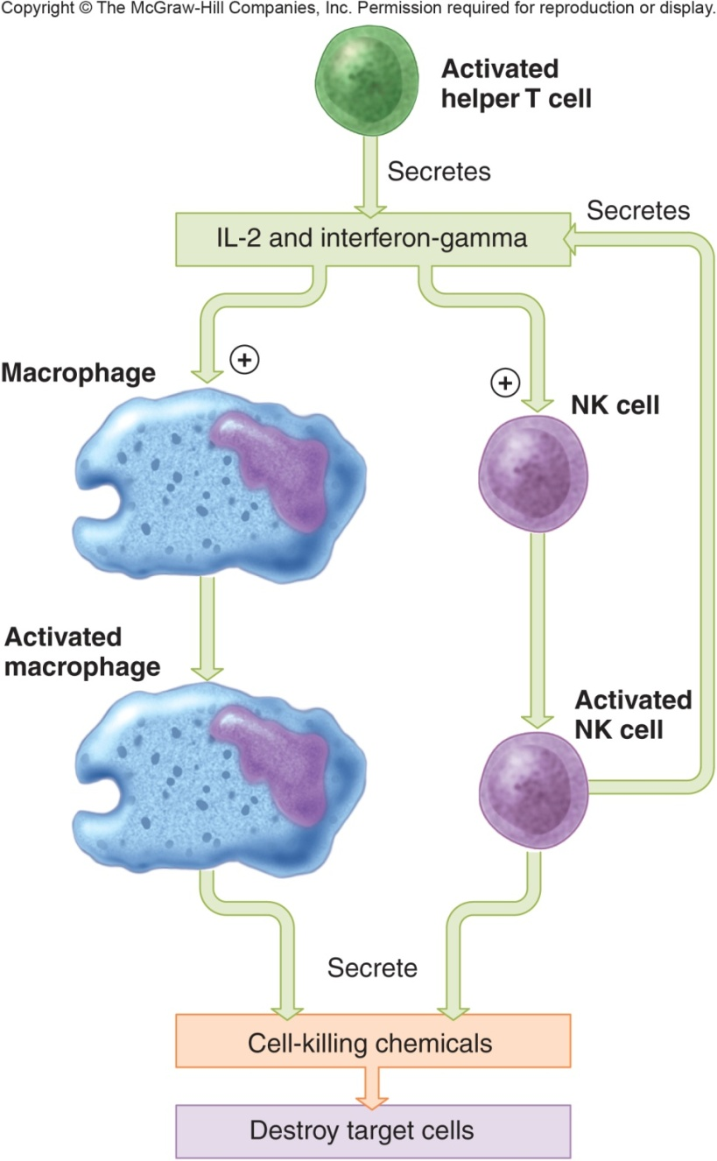
Role of NK Cells and Macrophages in the CTL Attack
Activated NK cells and macrophages participate in destroying virus-infected or cancer cells tagged with CTL
IL-12 and IFN-γ are the signals for activation
System is a positive feedback system because activated NK cells secrete IFN-γ
Both Secrete toxic chemicals
Macrophages - phagocytosis

