Slide 1
CSI 202 Skills Lab 5
GU (Foley) Catheterization, Breast, Testicular, Pelvic & Rectal Examinations
Daryl P. Lofaso, Ph.D., M.Ed, RRT
Alicia Tate, NRP

Slide 2
Urethral Catheterization
Indications
  Long Term
    Refractory bladder outlet obstruction
    Neurogenic bladder with urinary retention
    Complications of incontinence
      Skin breakdown
      Terminally ill
  Short Term
    Urologic or pelvic surgery
    Acute urinary retention
    Urinary output monitoring in critically ill

Slide 3
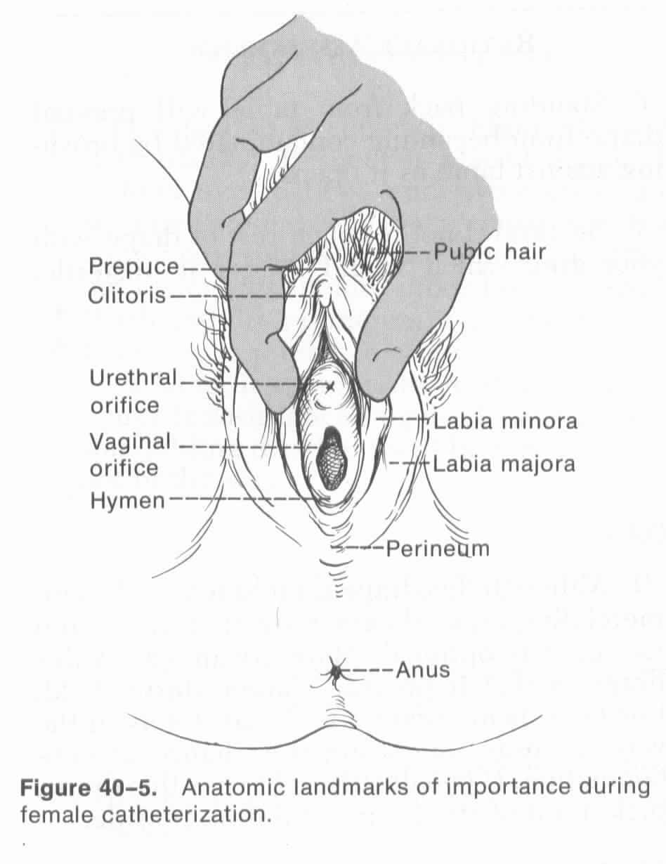
Anatomic Landmark for Female Catheterization

Slide 4
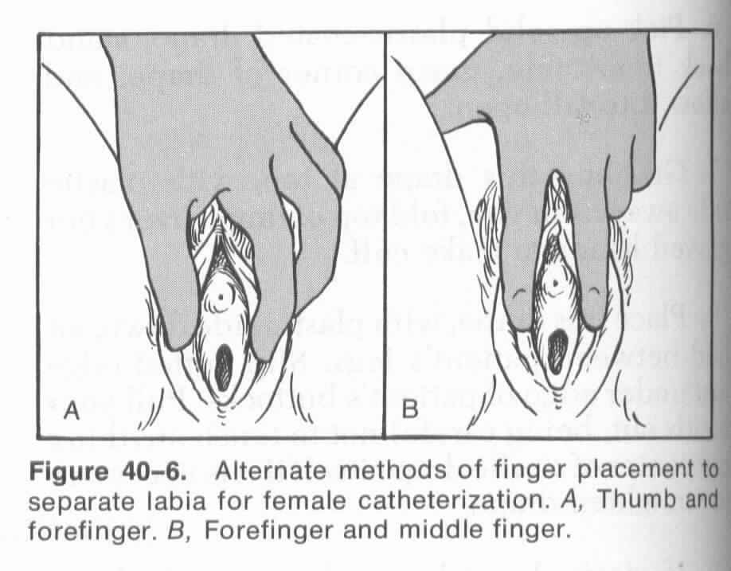
Female Cath: Hand positions

Slide 5
Male Catheterization
Uncircumcised male -pull foreskin back
Visualize the meatus
Maintain hand position throughout procedure

Slide 6
Nosocomial UTI
80% associated w/urinary catheters
Common Organisms
  E. coli
  Enterococcus species*
  Pseudomonas aeruginosa*
  Candida albicans
  * Antibiotic resistance may lead to increased morbidity

Slide 7
Pelvic Examination
Indications:
    Physical Exam
    Abdominal pain
    Pelvic pain
    Yearly screening (pap smear)

Slide 8
Pelvic Cancers
Endometrial Cancer
    3% in Lifetime
    Average age diagnosed: 60 years old
    68,000 Diagnosed Annually
Cervical Cancer
    Most frequently Dx: 30-64, average 50.
    13,490 Diagnosed Annually
    About 4,200 will die from cervical cancer
https://www.cancer.org/

Slide 9
Breast Examination
Indications:
    Physical Exam
    Breast Pain
    Lumps
    Breast Development- adolescent

Slide 10
Breast CA
NCI recommends mammograms every 1-2 years at 40 yrs. of age
Mammograms yearly at age 50
Mammograms as early as 25 yrs. of age for pt. with high risk of breast CA
Studies suggest Breast CA could be cut by 36-44% if mammography performed annually

Slide 11
Breast CA - Statistics
In 2024
  1 in 8 U.S. woman (about 13%) will develop breast cancer over the course of her lifetime.
  310,720 women in the US were diagnosed with breast cancer
  42,250 women in the US died from breast cancer
  2,790 new cases of invasive breast cancer are expected to be diagnosed in men.
https://Breast Cancer Facts & Figures 2024-2025

Slide 12
Rectal Examination
Indications:
    Physical Exam
    Abdominal pain
    Rectal pain
    Urogenital dysfunction (complaints)
    Screening for Colon CA and Prostate CA

Slide 13
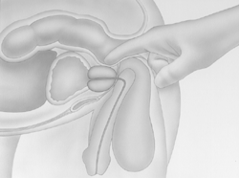
Prostate Examination

Slide 14
Charting: Rectal Examination
Tone – normal, decrease or absent
Masses
Stool color, Hemoccult examination of stool
Prostate – size, texture

Slide 15
Prostate CA
About 1 in 8 diagnosed with prostate cancer during his lifetime.
2nd leading cause of death in American men (1 in 44)
Only 3 men in 100 will actually die of it
Elevated Risk with family history and inherited genes*
African American men: very high risk
High fat diet and diary associated with ↑ risk
Prostate Cancer Risk Factors | Risk Factors for Prostate Cancer | American Cancer Society
*inherited gene BRCA1 or BRCA2 gene

Slide 16
Testicular Examination
Indications:
    Physical Exam
    Urogenital dysfunction (complaints)

Slide 17
Testicular CA
Incidence of testicular cancer is low, about 1 of every 250 males
Average age: 33 yrs.
Lifetime risk: 1 in 5,000
Testicular Self-examination (TSE)
https://www.cancer.org/cancer/testicular-cancer/about/key-statistics.html

Slide 18
Professional Conduct
Introduce yourself
Explain the procedure/exam to pt.
Ask pt. if they have any questions
Cover pt. with a sheet. Only expose area which you are examining, then cover again
While performing the procedure/exam, explain to the pt., you may or may not have some discomfort associated with the exam, but you will be as gentle as possible.

