Slide 1
CSI 201 Skills Lab 4
Airway Management /
O2 Delivery Devices / Nasogastric Tube (NGT)
Daryl P. Lofaso, Ph.D., M.Ed., RRT

Slide 2
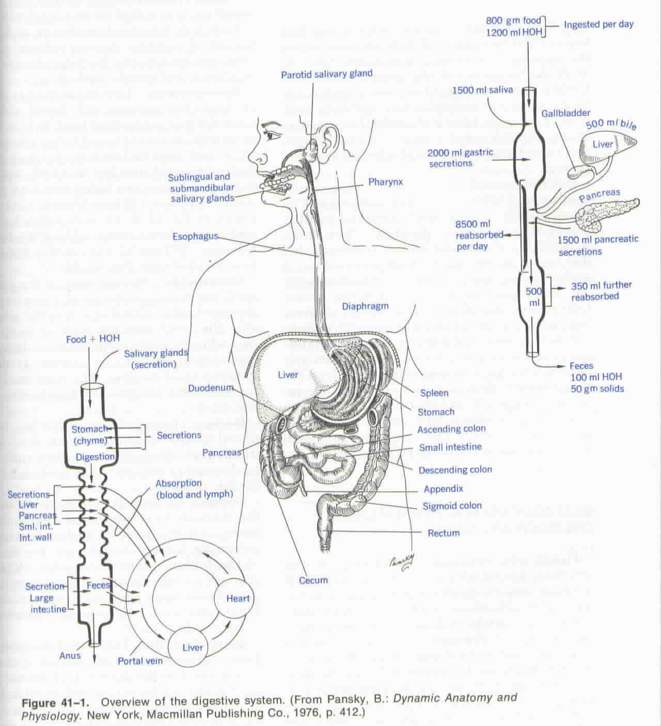
Overview of the Digestive System

Slide 3
Indications for Naso-Oral Gastric Tube Intubation (NGT)
Decompression
removing gaseous and liquids in GI
Compression
applying pressure (esophageal varicies)
Gavage
feeding
Lavage
wash out stomach
Gastric Analysis
laboratory examination of stomach content

Slide 4
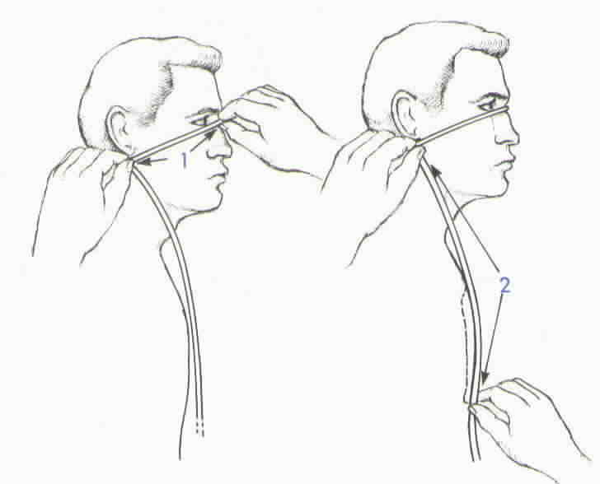
Measurement of NGT: Insertion Distance

Slide 5
NGT Insertion Recommendations:
Advance the tube when patient swallows
Stop if there is marked resistance. DO NOT FORCE.
Excessive gasping or coughing or cyanosis; tube may be in the trachea

Slide 6
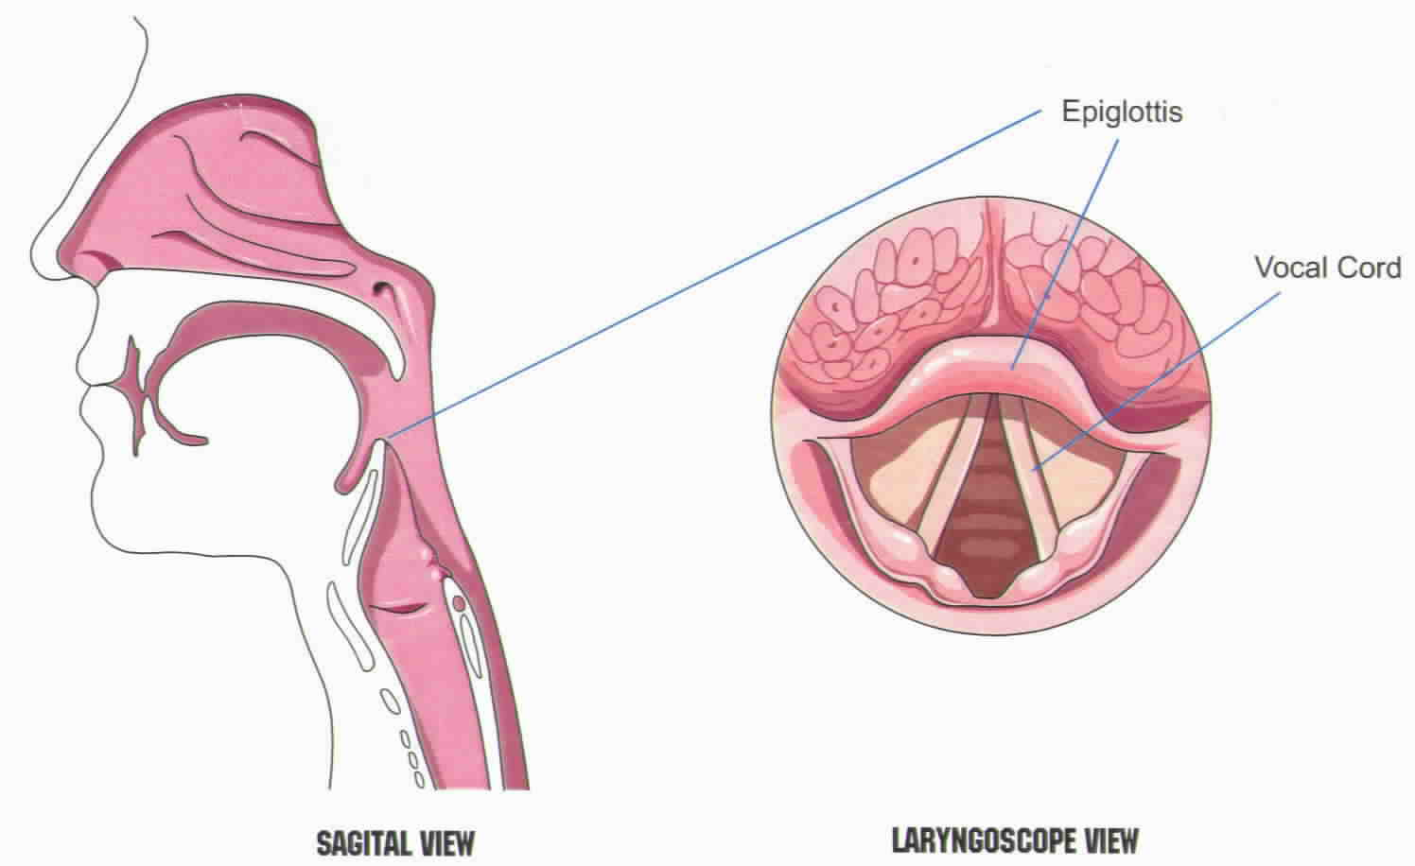
Airway Anatomy

Slide 7
Indications for Artificial Airways
To relieve airway obstruction
To facilitate removal of secretions
To protect the lower airways for aspiration
To facilitate the application of positive pressure ventilation

Slide 8
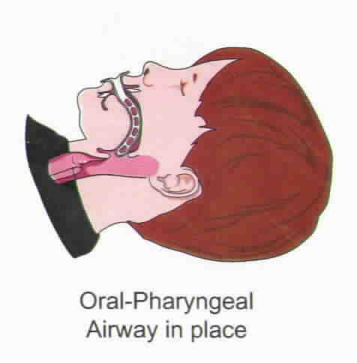
Oral Airway Placement

Slide 9
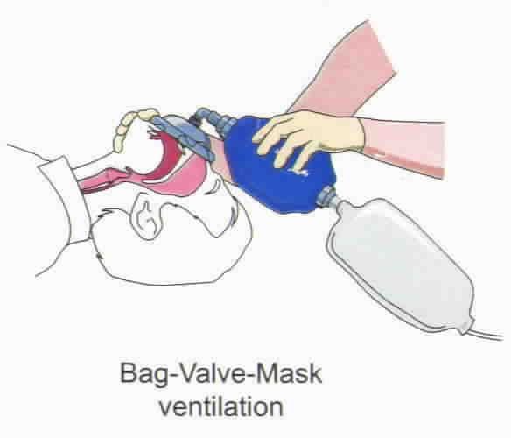
Bag-Valve-Mask (BVM) Ventilation

Slide 10
BVM Failure
Air leak
Improper mask size
Poor contact points – nasal bridge, malar eminence, mandible
Airway obstruction
Head and neck positioning
Tongue

Slide 11
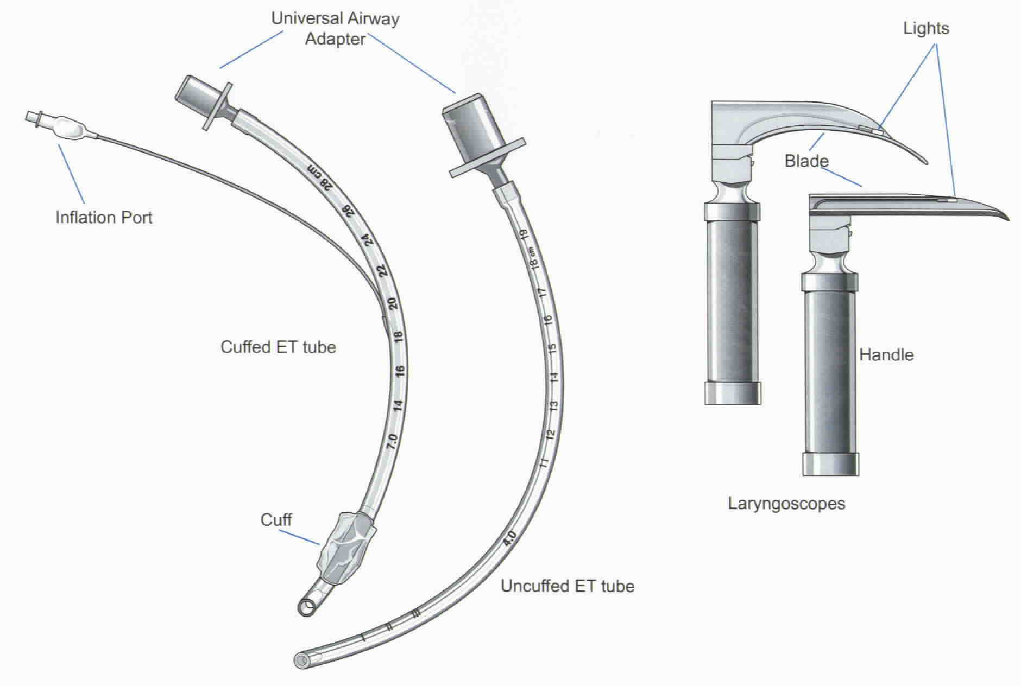
Intubation Equipment

Slide 12
Types of Artificial Airways
Oral ET tube
Quickest and easiest to place
Offers less resistance the Nasal ET (shorter)
Discomfort & gagging common
Accidental extubation
Oral hygiene is difficult

Slide 13
Types of Artificial Airways (cont.)
Nasal ET tube
More difficult to insert the oral ETT
Blind insertion
More stable and better oral hygiene
May cause necrosis of nasal septum, turbinates and external meatus
May block sinuses or eustachian tubes causing otitis media or sinusitis

Slide 14
Types of Artificial Airways (cont.)
Tracheostomy tube
Most efficient airway (↓ WOB)
Device of choice for airway obstruction and trauma
Allows oral feeding
Requires surgery - Invasive
Indications for prolonged artificial airway
Complications - hemorrhage, scarring, greater bacterial colonization rate

Slide 15
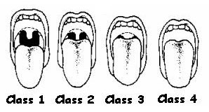
Airway Assessment Mallampati Classification
Class I: soft palate, fauces,
uvula, pillars
Class II: soft palate, fauces,
portion of uvula
Class III: soft palate, base of
uvula
Class IV: hard palate only

Slide 16
Indications for Intubation
Cardiac arrest – Respiratory arrest
Inability to ventilate
Inability for patient to protect airway
Inability for rescuer to ventilate unconscious patient (BVM)

Slide 17
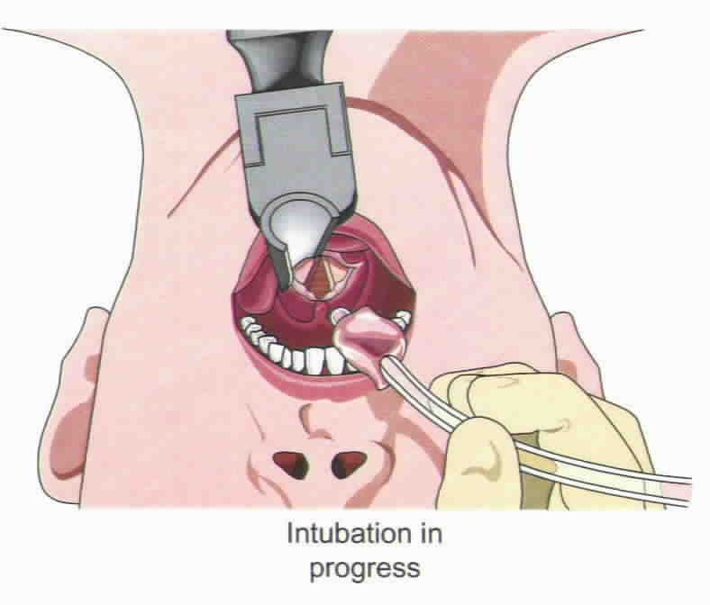
Endotracheal Intubation

Slide 18
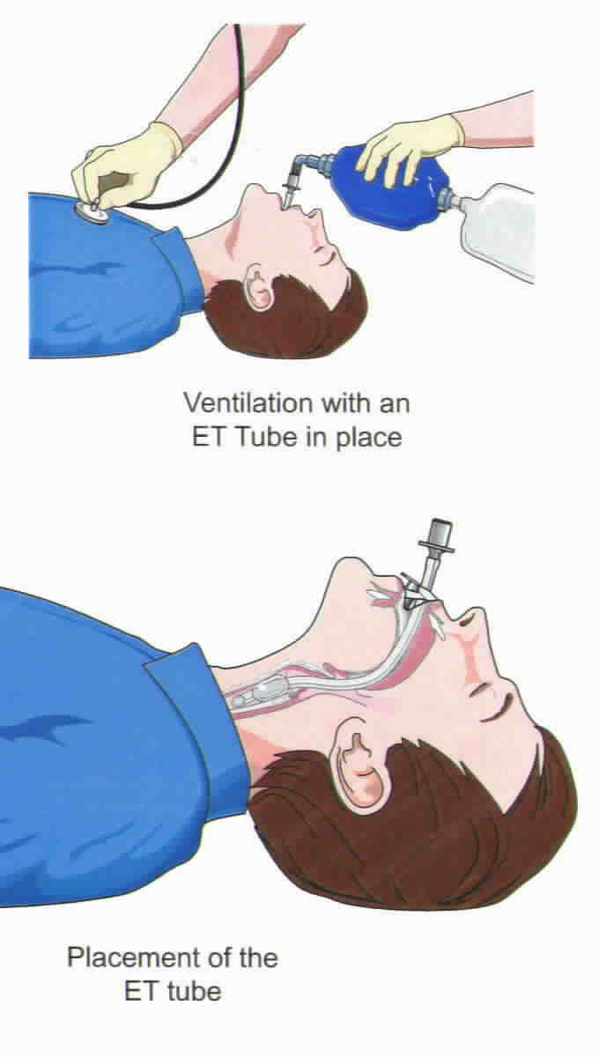
Confirmation of ET Placement
Visualization
Auscultation
ETCO₂
Chest X-ray (CXR)

Slide 19
Respiratory Failure
Inability to remove CO₂ and deliver O₂ to the pulmonary capillary bed
Acute or Chronic
Two main groups
Hypoxia respiratory failure
Hypercapnic-hypoxic respiratory failure

Slide 20
Symptoms of Hypoxia
Tachypnea
Tachycardia
Anxiety
Alterations in BP
Confusion
Somnolence

Slide 21
Symptoms of Hypercapnia
Restlessness
Tremor
Slurred speech
Lethargy
Somnolence
Coma

Slide 22
Signs of Impending Respiratory Failure
Respiratory rate > 35
PaO₂ < 55 on FiO₂ > 50%
Hemodynamic instability

Slide 23
Infections
Endotracheal intubation and tracheostomy are the major risk factors for nosocomial Lower Respiratory Infections (LRI).
Nosocomial LRIs are the most dangerous of nosocomial infections with a case fatality rate of 30%.

Slide 24
Infections
Stethoscopes have been shown to be colonized by bacteria in research studies. Over 80% of stethoscopes examined in one study were colonized by microbacteria, the majority of which was Methicillan-resistant Staph aureus (MRSA), and physician’s stethoscopes were proven to be the most contaminated.

Slide 25
Prevention of Nosocomical Infections
Hand washing, barrier isolation materials, and decontamination of respiratory equipment can prevent Nosocomial LRI.

