Slide 1
CSI 202 Skills Lab 4
Heart Sounds
Daryl P. Lofaso, Ph.D.,M..Ed., RRT

Slide 2
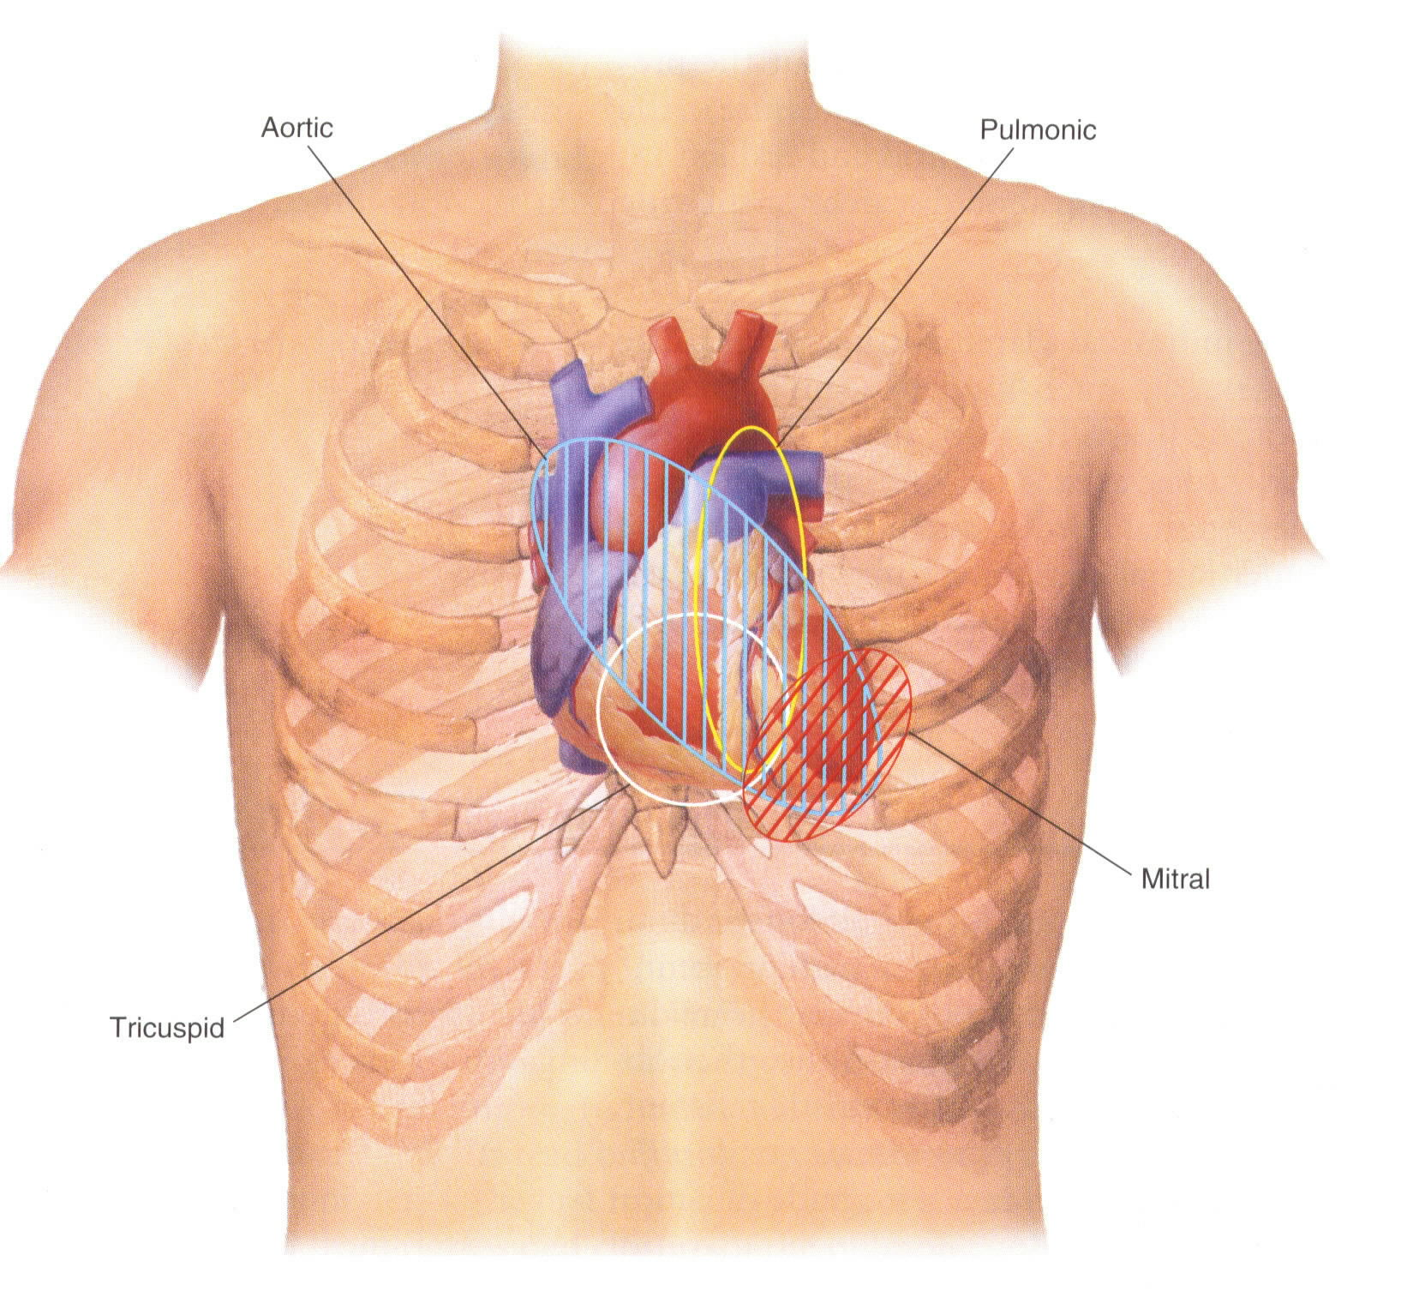
Heart Sound Locations

Slide 3
Heart Sounds
S₁: “lub” occurs at the beginning of systole (mitral and tricuspid close)
S₂: “dub” marks the start of diastole,
(aortic and pulmonic close)
S₃: early signs of CHF (ventricular gallop)
S₄: pulmonic stenosis, aortic stenosis, hypertension, MI & cardiomyopathy (atrial gallop)

Slide 4
Cardiac Murmurs
Three Main Factors
High flow rate through normal or abnormal orifices
Forward flow through a constricted or irregular orifice or into a dilated vessel or chamber
Backward or regurgitant flow through an incompetent valve, septal defect, or patent ductus arteriosus.

Slide 5
Timing of Heart Sounds
Systolic: Between S₁ and S₂
Diastolic: Between S₂ and S₁
Holosystolic: continuous throughout systole

Slide 6
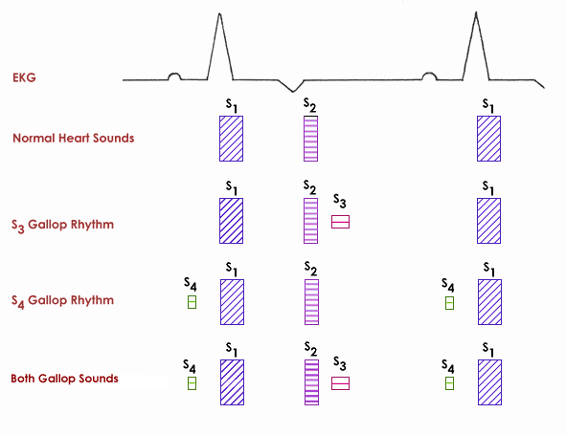
Heart Murmurs with EKG

Slide 7
Loudness Scale: 1-6 Grade
Grade 1: Very faint
Grade 5: Loud with palpable precardical thrill
Grade 6: Audible even when the stethoscope is lifted off chest

Slide 8
Heart Sounds: Pitch
Low-velocity – low pitched rumbling (mitral stenosis)
Large diastolic pressure gradient – high pitched murmur (aortic regurgitation)

Slide 9
Systolic Murmurs
Systolic murmurs can be divided into
Mid-systolic
Holo-systolic (pan-systolic)

Slide 10
Systolic Murmur Mid-Systolic Murmurs
Aortic Stenosis
Radiates to carotid arteries; harsh or barking
Pulmonic Stenosis
Note: blood flow in a normal direction across a valve that is narrowed or calcified.
Hypertrophic cardiomyopathy
Flow murmur
Note: valve is normal but the flow is increased and this causes turbulence.

Slide 11
Systolic Murmur Holo-systolic murmurs
Mitral regurgitation
Medium-pitched blowing
Tricuspid regurgitation
Ventricular septal defect (VSD)
Note: blood flowing the wrong way when the ventricle contracts

Slide 12
Diastolic Murmurs
Diastolic murmurs can be divided into
Early diastolic murmurs
Diastolic rumbles

Slide 13
Diastolic murmur Early Diastolic Murmurs
Early Diastolic Murmurs (decrescendo)
Aortic Insufficiency (Regurgitation)
Blowing early diastolic
Pulmonic Insufficiency
Accentuated P2
Note: blood flowing the wrong way (backwards) during diastole

Slide 14
Diastolic Murmurs Diastolic Rumbles
Diastolic Rumbles (low-pitched rumble)
Mitral stenosis
Opening snap with mid-diastolic rumble
Tricuspid stenosis
Mid-diastolic rumble, louder with inspiration & decrease with exhalation
Note: blood flow is normal, but across a narrowed valve opening

