Slide 1
CSI 201
Skills Lab 4
Heart Sounds
Daryl P. Lofaso, Ph.D., M.Ed., RRT
Alicia Tate, NRP, CHSE

Slide 2
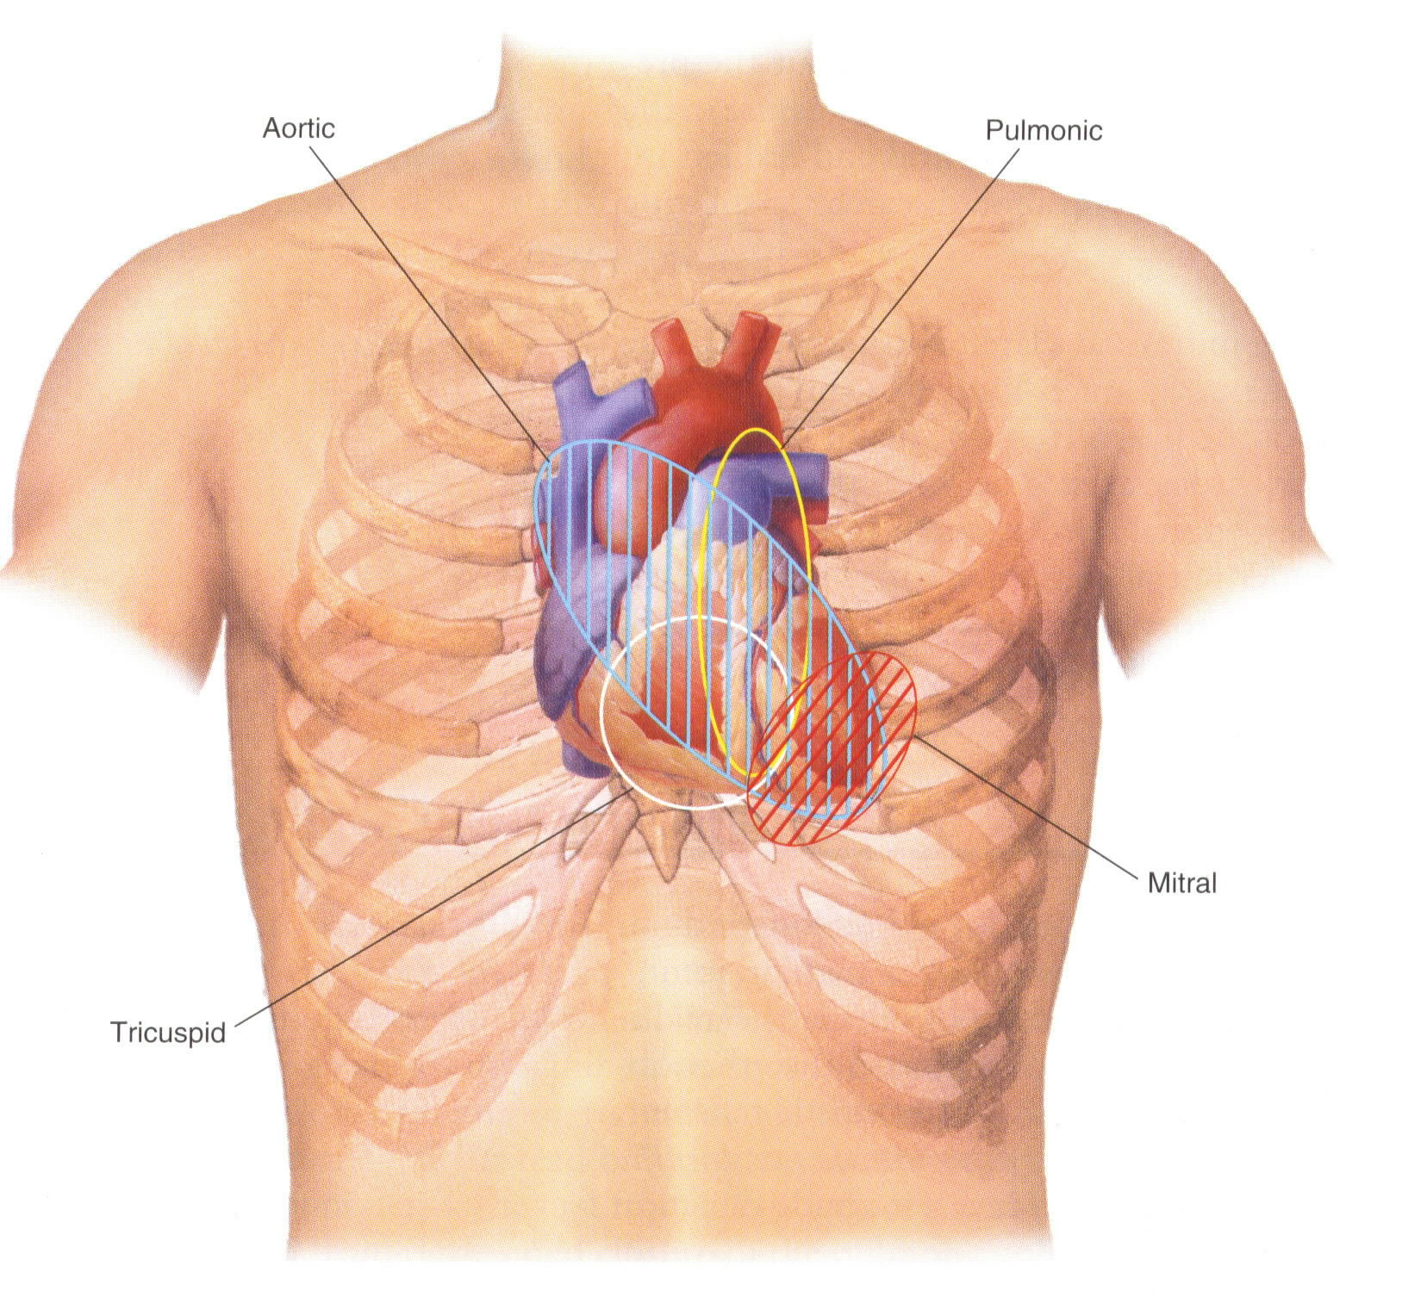
Heart Sound Locations
Bate’s Guide to Physical Examination 14e. Copyright © Wolters Kluwer

Slide 3
Heart Sounds
S₁: “lub” occurs at the onset of systole (atrioventricular valves: mitral and tricuspid close)
S₂: “dub” marks the onset of diastole,
    (semilunar valves: aortic and pulmonic close)
S₃: Associated with rapid filling of the ventricles. Normal in young and pregnant individuals, or early signs of CHF (ventricular gallop)
S₄: Associated with atrial contraction. pulmonic stenosis, aortic stenosis, hypertension, MI & cardiomyopathy (atrial gallop)

Slide 4
Cardiac Murmurs
Three Main Factors
    High flow rate through normal or abnormal orifices
    Forward flow through a constricted or irregular orifice or into a dilated vessel or chamber
    Backward or regurgitant flow through an incompetent valve, septal defect, or patent ductus arteriosus.

Slide 5
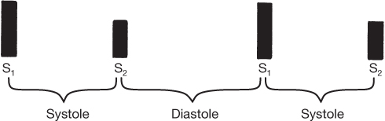
Timing of Heart Sounds
Systolic: Between S₁ and S_{2.}
Diastolic: Between S₂ and S₁. Longer interval.
Holosystolic: continuous throughout systole
Bate’s Guide to Physical Examination 14e. Copyright © Wolters Kluwer

Slide 6
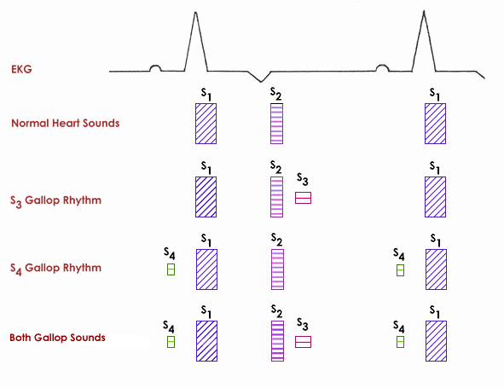
Heart Murmurs with EKG

Slide 7
Loudness Scale: 1-6 Grade
Grade 1: Very faint
Grade 5: Loud with palpable precardical thrill
Grade 6: Audible even when the stethoscope is lifted off chest

Slide 8
Heart Sounds: Pitch
Low-velocity – low pitched rumbling (mitral stenosis)
Large diastolic pressure gradient – high pitched murmur (aortic regurgitation)

Slide 9
Systolic Murmurs
Systolic murmurs can be divided into
  Mid-systolic
  Holo-systolic (pan-systolic)

Slide 10
Mid-Systolic Murmurs
Aortic Stenosis
  Radiates to carotid arteries; harsh or barking
Pulmonic Stenosis
Note: blood flow in a normal direction across a valve that is narrowed or calcified.
Hypertrophic cardiomyopathy
Flow murmur
Note: valve is normal, but the flow is increased and this causes turbulence.

Slide 11
Holo-systolic Murmurs
Mitral regurgitation
  Medium-pitched blowing
Tricuspid regurgitation
Ventricular septal defect (VSD)
Note: blood flowing the wrong way when the ventricle contracts

Slide 12
Diastolic Murmurs
Diastolic murmurs can be divided into
  Early diastolic murmur
  Diastolic rumbles

Slide 13
Diastolic murmur
Early Diastolic Murmurs
Early Diastolic Murmurs (decrescendo)
  Aortic Insufficiency (Regurgitation)
    Blowing early diastolic
  Pulmonic Insufficiency
    Accentuated P2
Note: blood flowing the wrong way (backwards) during diastole

Slide 14
Diastolic Murmurs
Diastolic Rumbles
Diastolic Rumbles (low-pitched rumble)
Mitral stenosis
  Opening snap with mid-diastolic rumble
Tricuspid stenosis
  Mid-diastolic rumble, louder with inspiration & decrease with exhalation
Note: blood flow is normal, but across a narrowed valve opening

