Slide 1



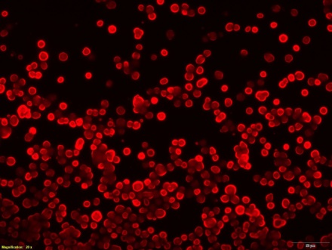
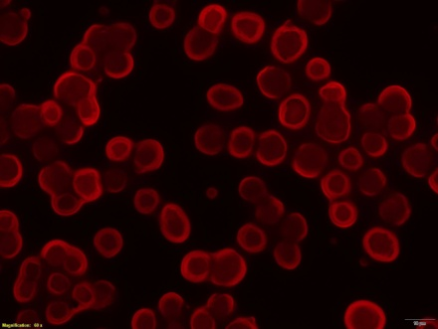
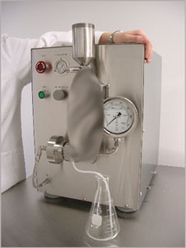
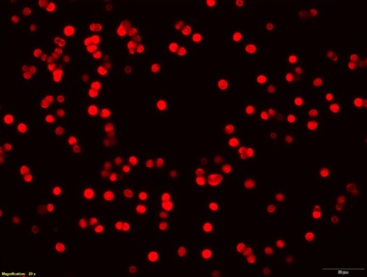
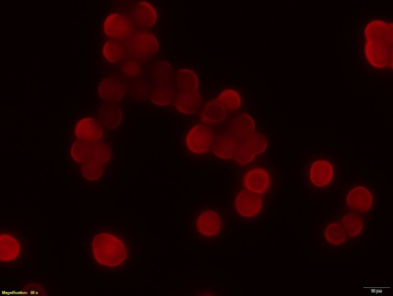
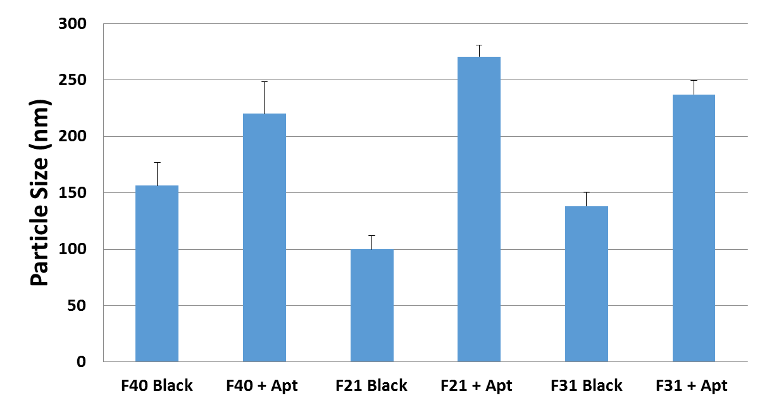
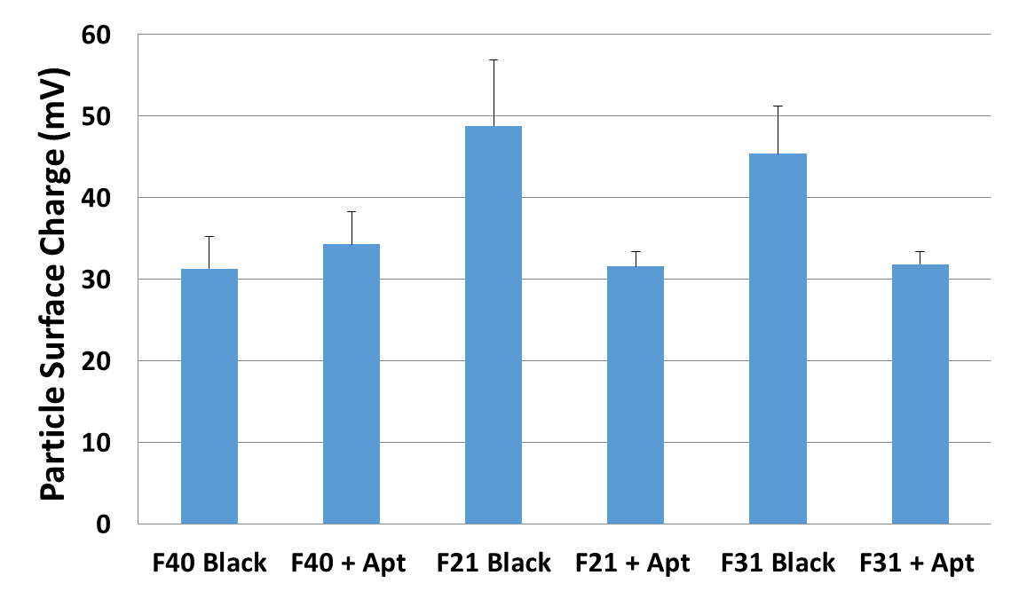
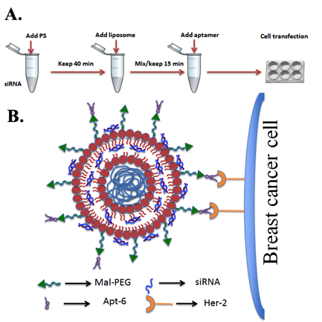
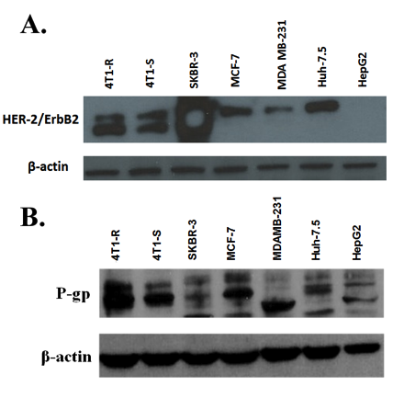
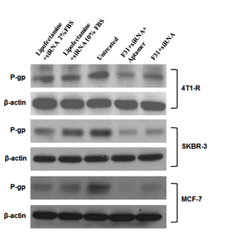

Overcoming Multidrug Resistance in Breast Cancer: Targeting MRP Proteins for Enhanced Therapeutic Efficacy
Camryn Tims, Rajib Biswas, Treiveanna Jenkins, Anup Kundu PhD.
Biology Department, Xavier University; Tulane University Health Sciences Center
Introduction
Data
Assays
In this project, the MDR proteins will be targeted as the major resistant protein in the cancer cell lines. When MRP-1/P-gp is highly expressed, it creates an extremely resistant cell environment for the breast cancer cells. This protein has the ability to dispel a huge list of anti-cancer drugs including doxorubicin. We anticipate that knocking down MRP-1/P-gp by siRNA encapsulated nanoparticles could enhance the delivery of doxorubicin (Dox) into the breast cancer cells. The preliminary study has been focused on the development of an aptamer-labeled nanoparticle system for effective delivery of MRP-1/P-gp siRNA into breast cancer cells.
Figure 2. The expression of MRP-1 in 4T1-R and 4T1-S breast cancer cells by immunofluorescence.
Western Blot
  Western Blot tests were conducted to confirm the presence and size of the MRP-1 (Multi-drug Resistant Protein) in the dox-resistant cells.
qPCR
  Additionally, qPCR tests were ran to identify and compare RNA concentrations amongst the 4T1-R and MDA-231 cell lines.
20X
60X
4T1-R
4T1-S
Figure 3. Comparison of particle size (a) and zeta potential (b) between blank and siRNA nanoparticles (with aptamer)
Exp. Design
(a)
(b)
Conclusion
For targeted delivery, Aptamer-A6 has been used which can bind to Her-2 receptors on breast cancer cells. The particles were prepared by high pressure homogenization (HPH) using different amount of DOTAP, cholesterol, PLGA or PLGA-PEG and Mal-PEG. After siRNA encapsulation, the particles were incubated with aptamer-A6 for surface labeling. The liposomal particles were characterized for their size, surface charge and cytotoxicity. The delivery of siRNA into different breast cancer cells has been assessed by immunofluorescence and FACS analysis.
The prior study has shown that the uptake of Dox by Dox-resistant 4T1-R is significantly less than Dox-sensitive 4T1-S which is partly attributed to the higher expression of drug-efflux pump (i.e. ABC transporter proteins P-gp, MRP-1, BCRP etc.) on the surface of the resistant cells. The targeted knockdown of P-gp or MRP-1 has been enhanced when the particles carrying P-gp siRNA or MRP-1 siRNA, respectively were labeled with aptamer. Concurrently, the uptake of Dox into the Dox-resistant 4T1-R breast cancer cells has increased significantly when the MDR proteins were knockdown by appropriate siRNA-encapsulated aptamer-labeled nanoparticles.
Figure 4. The expression of Her-2 and P-gp (left panel) and the knockdown of P-gp in 4T1-R, SKBR-3 and MCF-7 cells with/without aptamer labeled nanoparticles (right panel).
Figure 1. Schematic diagram showing the organization of the nanoparticles
References
Powell, D., Chandra, S., Dodson, K., Shaheen, F., Wiltz, K., Ireland, S., Syed, M., Dash, S., Wiese, T., Mandal, T., & Kundu, A. (2017). Aptamer-functionalized hybrid nanoparticle for the treatment of breast cancer. European Journal of Pharmaceutics and Biopharmaceutics, 114, 108–118. https://doi.org/10.1016/j.ejpb.2017.01.011
Kundu, A. K., Iyer, S. V., Chandra, S., Adhikari, A. S., Iwakuma, T., & Mandal, T. K. (2017). Novel sirna formulation to effectively knockdown mutant p53 in osteosarcoma. PLOS ONE, 12(6). https://doi.org/10.1371/journal.pone.0179168
Chowdhury, N., Chaudhry, S., Hall, N., Olverson, G., Zhang, Q.-J., Mandal, T., Dash, S., & Kundu, A. (2020). Targeted delivery of doxorubicin liposomes for her-2+ Breast Cancer treatment. AAPS PharmSciTech, 21(6). https://doi.org/10.1208/s12249-020-01743-8
This research project was supported by the Stanley S. Scott Cancer Center.

