Slide 1


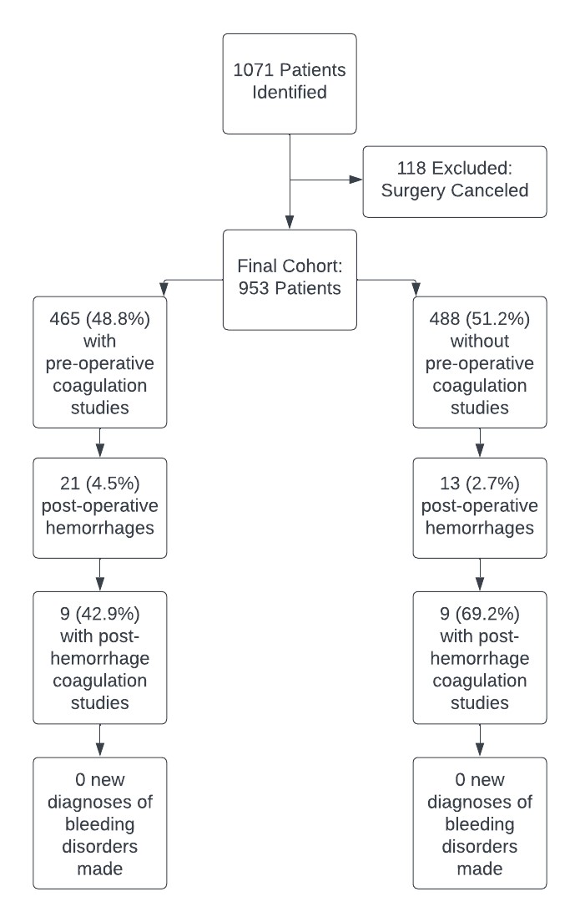

Evaluation of Preoperative Coagulation Factor Screening in Pediatric Tonsillectomy Patients
Andrew J. Malek, BS¹; Connor J. Robin, BS¹; Adam J. Blancher, MD²; Jairo I. Torres, MD²;
Joel W. Jones, MD, MBA²; Dan Spangler, MD²; John N. Poche, MD²; Leslie S. Son, PhD²; Belinda A. Mantle, MD²
1. LSU Health Sciences Center, School of Medicine, New Orleans, LA
2. Department of Otolaryngology – Head and Neck Surgery, LSU Health Sciences Center, New Orleans, LA
Introduction
Table 1. Demographics
Table 2. PTH Characteristics
Tonsillectomy is a commonly performed procedure in the pediatric population to reduce the risk of recurrent tonsillitis and improve breathing-related sleep disorders
Post-tonsillectomy hemorrhage (PTH) is a well-recognized complication of this procedure
Risk of PTH increases with age and history of chronic tonsillitis
The decision to routinely undergo preoperative coagulation studies varies by surgeon
Characteristic​ | Male​ | Female​ | Overall
Number of patients | 438 (45.9%) | 512 (54.1%) | 953
Avg. age at surgery (years) | 6.3 | 7.9 | 7.2
Prior personal history of bleeding disorder | 29 | 40 | 69 (7.2%)
Pre-op. coagulation study | 203 | 262 | 465 (48.8%)
Post-op. hemorrhage | 16 | 17 | 33 (3.5%)
Characteristic​ | Value​
Average age | 11.6
Prior personal history of bleeding disorder | 2 (6%)
Abnormal pre-operative labs | 1 (3%)
Extracapsular technique | 30 (91%)
Intracapsular technique | 3 (9%)
Post-PTH cauterization in OR | 19 (57.6%)
Objectives
Figure 1. Cohort Traits
To assess the proportion of occult bleeding disorders diagnosed preoperatively through routine coagulation studies
To determine the rate of PTH at Children’s Hospital New Orleans (CHNO)
Results
The overall PTH rate was 3.5%
The average age at surgery for patients experiencing PTH was 11.6 years, which was significantly greater than the overall mean for this patient group of 7.2 years (p<.0001)
No new diagnoses of coagulopathies were made for patients experiencing PTH
Methods
Retrospective review of all patients with records of tonsillectomy with or without adenoidectomy at CHNO from January 2019 - June 2021
PTH defined as any mention of bleeding that required intervention or return to ED for observation within 2 weeks of surgery
Extracted variables included: age, gender, age at surgery, family and personal history of bleeding, comorbidities, method of surgery and instruments used, pre-operative coagulation lab values (PT, PTT, INR), new diagnosis of bleeding disorder, post-operative bleed, bleeding interventions, post-operative labs, and admission/readmission information
Conclusion
Our reported hemorrhage rate (3.5%) is within established literature ranges
Hemorrhage risk is known to increase with age, and this trend is represented in our results
The decision to undergo pre-operative screening should be more strongly considered for older patients in our population
Additional treatments may be considered before surgery to ensure bleeding risks are minimized.
Perioperative treatment involved in patients that undergo screening may have acted in a prophylactic manner to reduce the risk of bleeding post-operatively

