Slide 1
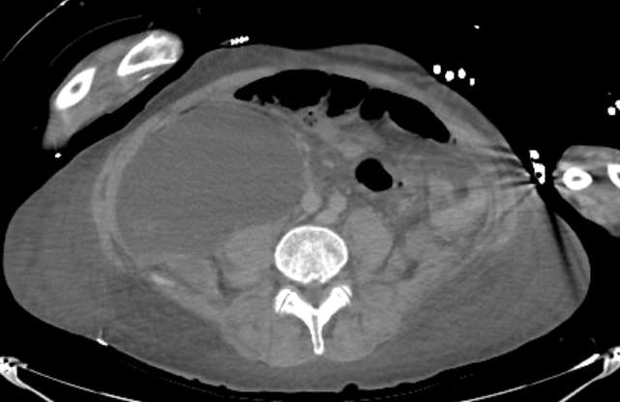
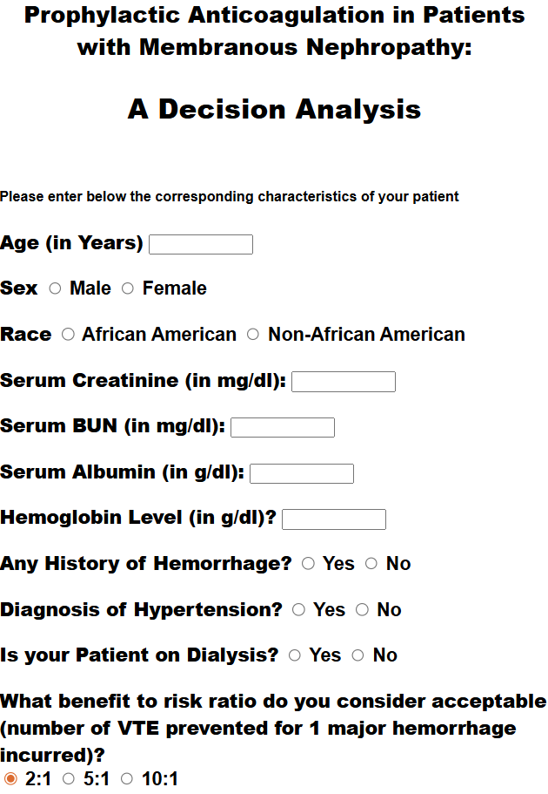
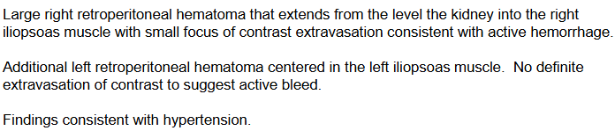


Insidious Retroperitoneal Hemorrhage in Refractory Steroid-Dependent
Nephrotic Syndrome on Full Dose Anticoagulation
Elise Peyroux1, Angel R. Castro Seda, MD2
1School of Medicine, Louisiana State University Health Sciences Center, New Orleans, LA;
2Department of Medicine, Louisiana State University Health Sciences Center, New Orleans, LA
Introduction
Case Presentation
Nephrotic syndrome is defined by proteinuria exceeding 3.5 g per 24 hours, hypoalbuminemia (serum albumin <3 g/dL), and hyperlipidemia resulting from increased glomerular permeability and urinary protein loss. Among its etiologies, minimal change disease (MCD) most commonly affects children and is typically treated with corticosteroids and rituximab, with many patients achieving remission by adulthood. However, approximately one-third of adults with MCD develop relapsing, steroid-dependent disease. Prolonged glucocorticoid therapy increases the risk of complications such as steroid-induced diabetes, particularly in patients with underlying renal damage. Additionally, nephrotic syndrome gives rise to a hypercoagulable state, often requiring prophylactic or therapeutic anticoagulation depending on if there is a positive history for major VTE in the setting of it including: Renal vein thrombosis, pulmonary embolism, hepatic vein thrombosis, among others.
While anticoagulation reduces thromboembolic risk, it increases the potential for major hemorrhagic complications, including retroperitoneal hematoma. Retroperitoneal hematomas are frequently spontaneous and insidious, with reported mortality rates of 15–25% if not promptly managed with anticoagulation reversal, fluid resuscitation, and blood transfusion.
A 60-year-old African American man with refractory minimal change disease (MCD) since childhood and steroid-induced type 2 diabetes mellitus (HbA1c 16.9%) with biopsy proven diabetic nephropathy, and chronic kidney disease (CKD) stage G1 presented with six months of progressive anasarca of the lower extremities and scrotum refractory to outpatient oral diuretic and prednisone therapy that has acutely worsened the past three days. The patient had previously achieved remission for approximately 12 years but experienced several relapses in adulthood requiring immunosuppressive therapy.
On admission, the patient presented with an acute nephrotic syndrome flare-up with significant anasarca, hypoalbuminemia of 1.0, and a urine/protein creatinine ratio (UPCR) of 12.27 with >5,000 µg/mL of microalbumin in the urine. At this time, creatinine was at the baseline of 1.3 without evidence of acute kidney injury (AKI). Due to the profound hypoalbuminemia seen on admission, patient was started on an increased dose of prednisone, aggressive intravenous diuretics (furosemide & metolazone), and empagliflozin. The at-home low-dose apixaban also increased to full dose anticoagulation treatment and was given alongside aspirin.
The patient initially improved with reduction in edema and pain and was transitioned to oral diuretics with plans for outpatient rituximab. However, on hospital day 5, he developed acute severe groin pain with difficulty ambulating. Physical exam showed intact sensations and strength to lower extremities, as well as tenderness to palpation above the groin area which was attributed to the several days of swelling. Initial workup was unrevealing, with stable hemoglobin and unremarkable imaging, including Doppler ultrasonography and scrotal ultrasound.
However, later that day, he acutely decompensated with hypotension (65/45 mmHg) and altered mental status with decorticate posturing of the right upper extremity and roving eye movements. He required emergent intubation and was transferred to the ICU. Labs showed an extensive drop of hemoglobin from 8.0 g/dL to 3.4 g/dL, and he received a massive transfusion. Active treatment for nephrotic syndrome exacerbation was placed on hold. CT angiography revealed large bilateral retroperitoneal hematomas, with active extravasation on the right (Figure 1). Per chart review, the patient was found to have a prior retroperitoneal hematoma following renal biopsy three years earlier, suggesting a possible predisposition to recurrent bleeding. He underwent emergent angiographic embolization. His course was also complicated by acute kidney injury (creatinine 3.1 mg/dL) likely due to ischemic acute tubular necrosis (ATN) from hypoperfusion.
Renal function subsequently improved with supportive care, and diuretics were restarted as urine output increased. He was successfully extubated, transitioned out of the ICU, and slowly and gradually restarted on nephrotic syndrome therapy. Creatinine returned to 0.7 mg/dL, and he was discharged in stable condition without major neurologic deficits.
Discussion
Patients with nephrotic syndrome are at increased risk for thromboembolic events, often prompting anticoagulation; however, evidence guiding optimal strategy remains limited, and current recommendations emphasize individualized decision-making. This case demonstrates that therapeutic anticoagulation in nephrotic syndrome can result in catastrophic hemorrhage when bleeding risk is underrecognized and suggests that prophylactic rather than therapeutic anticoagulation may be more appropriate in select patients.
The 2021 Kidney Disease: Improving Global Outcomes (KDIGO) guidelines recommend therapeutic anticoagulation for patients with documented thromboembolic events and prophylactic anticoagulation when thrombotic risk outweighs bleeding risk in nephrotic syndrome. As no contraindications specific to nephrotic syndrome are defined, standard anticoagulation contraindications apply, including active bleeding, severe thrombocytopenia, and intracranial hemorrhage. Warfarin and heparin remain the preferred agents due to greater clinical experience and more predictable use, while direct oral anticoagulants (DOACs) are not routinely recommended given limited evidence and altered pharmacokinetics in hypoalbuminemia. However, in clinical practice, DOACs are still used due to ease of administration and outpatient convenience. Given these limitations, anticoagulation decisions rely on individualized risk stratification.
Risk stratification is commonly guided by tools such as the University of North Carolina (UNC) Bleeding Risk Calculator (Figure 2). Thrombotic risk is driven primarily by severe hypoalbuminemia (<2.5–2.9 g/dL), as seen in this patient (1.0 g/dL), along with factors such as membranous nephropathy and prior thrombotic history. Bleeding risk is increased by prior hemorrhage, concurrent antiplatelet therapy, and comorbid conditions. Although treatment-dose anticoagulation is recommended when thrombotic risk exceeds bleeding risk, these models are largely derived from membranous nephropathy populations and may not be generalizable to other etiologies.
Spontaneous retroperitoneal hematoma is a rare but life-threatening complication of anticoagulation, often presenting with nonspecific symptoms such as groin pain or lower-extremity weakness prior to hemodynamic collapse. In this case, escalation to therapeutic anticoagulation in combination with aspirin likely contributed to catastrophic hemorrhage in a patient with multiple bleeding risk factors, including a prior history of hematoma after renal biopsy.
This case highlights key gaps in current literature, including risk stratification in non-membranous nephrotic syndrome, the role of prior hemorrhage in guiding anticoagulation decisions, and the uncertain safety of DOACs in severe hypoalbuminemia. Clinicians should have dynamic risk–benefit assessments when initiating anticoagulation in nephrotic syndrome patients, maintain a high index of suspicion for occult bleeding, and reassess anticoagulation strategies as clinical status evolves.
Figure 1: CTA of Abdomen & Pelvis with radiological impression
Figure 2: UNC Bleeding Risk Calculator
Conclusion
This case underscores the importance of individualized anticoagulation strategies in nephrotic syndrome. With this patient in particular the history of prior major bleed (RP hemorrhage after renal biopsy) even if it occurred 3 years ago, conferred an important risk factor in developing re-bleeding from the previously damaged area. Nonetheless, the patient was at a heightened risk of developing VTE secondary to ongoing severe hypoalbuminemia due to nephrotic syndrome flare up which could argue to the need for adding full dose anticoagulation.
Utilizing the tool above, the patient had 2 points on each side of the spectrum (thrombosis vs acute bleeding risk) so deciding about full dose anticoagulation vs prophylactic proved to be challenging. Since the scoring tool above was designed for thrombosis risk in membranous glomerulopathy, which our patient did not have, he might have benefitted from a customized approach tailor-made to his needs and case. He might have benefited from keeping low dose ASA alongside prophylactic anticoagulation instead of therapeutic initially and then up titrating if the need arose.
In retrospect, this case will serve as a prime example and as a reminder that we should always carefully weight risk vs benefit for all therapies we prescribe our patients. Clinicians should maintain a high index of suspicion for retroperitoneal hemorrhage in anticoagulated patients presenting with acute pain or hemodynamic instability and reassess anticoagulation regularly as clinical status evolves.
Contact
References
Elise A. Peyroux
epeyro@lsuhsc.edu
Angel R. Castro Seda, MD
arcs3333@gmail.com
KDIGO 2021 Clinical Practice Guideline for the Management of Glomerular Diseases Kidney Disease: Improving Global Outcomes (KDIGO) Glomerular Diseases Work Group et al.Kidney International, Volume 100, Issue 4, S1 - S276
Vivarelli, M., Massella, L., Ruggiero, B., & Emma, F. (2017). Minimal Change Disease. Clinical journal of the American Society of Nephrology : CJASN, 12(2), 332–345. https://doi.org/10.2215/CJN.05000516Li, J. X., & Cummins, C. L. (2022). Fresh insights into glucocorticoid-induced diabetes mellitus and new therapeutic directions. Nature reviews. Endocrinology, 18(9), 540–557. https://doi.org/10.1038/s41574-022-00683-6
Kelddal, S., Nykjær, K. M., Gregersen, J. W., & Birn, H. (2019). Prophylactic anticoagulation in nephrotic syndrome prevents thromboembolic complications. BMC nephrology, 20(1), 139. https://doi.org/10.1186/s12882-019-1336-8
Lukies, M., Gipson, J., Tan, S. Y., & Clements, W. (2023). Spontaneous Retroperitoneal Haemorrhage: Efficacy of Conservative Management and Embolisation. Cardiovascular and interventional radiology, 46(4), 488–495. https://doi.org/10.1007/s00270-023-03359-4
Glassock R. J. (2007). Prophylactic anticoagulation in nephrotic syndrome: a clinical conundrum. Journal of the American Society of Nephrology : JASN, 18(8), 2221–2225. https://doi.org/10.1681/ASN.2006111300
https://www.med.unc.edu/gntools/bleedrisk.html

