Slide 1

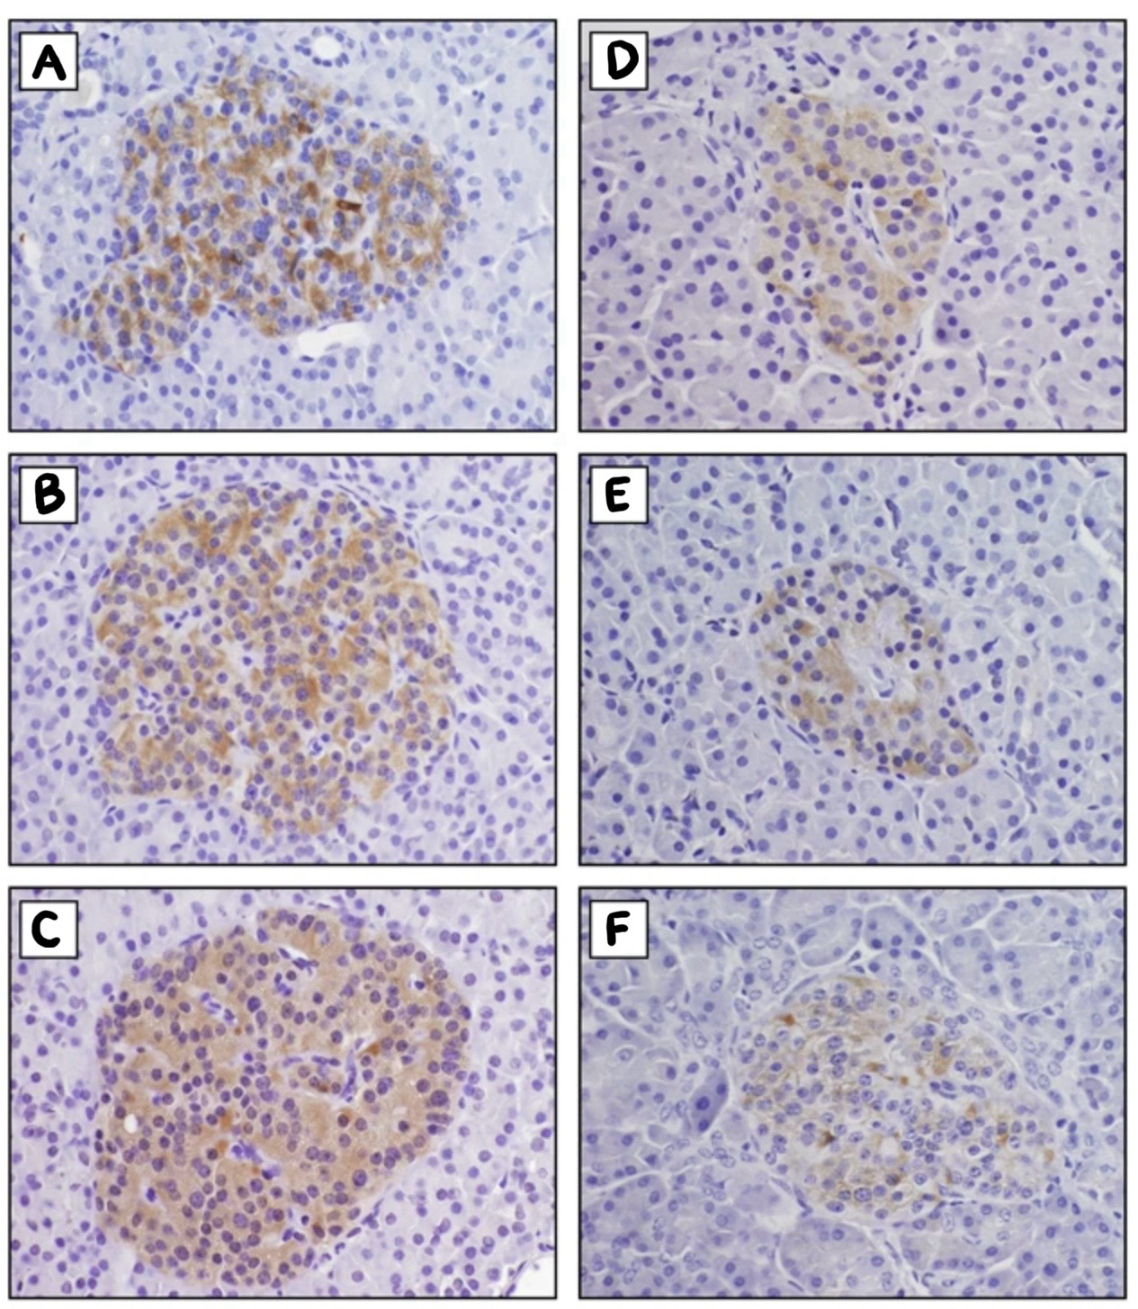
Concurrent Hyperinsulinemic Hypoglycemia and Central Adrenal Insufficiency: A Case Report
Peyton Saiontz, M.S., Tyler Hernandez, M.D., Lauren Ziegenbein, M.D., Stephany Nguyen, M.D., Ross Dies, M.D., Michael Modica, M.D. LSU Department of Internal Medicine
Introduction
Case Presentation
Hypoglycemia is defined as blood sugar <70 mg/mL, with severe hypoglycemia defined as BG <55 mg/mL.
Manifestations include diaphoresis, tremulousness, presyncope, syncope, headache, tachycardia, confusion, seizures, and death.
Etiologies of hypoglycemia include low cortisol (eg. adrenal insufficiency), and hyperinsulinism (eg. ingestion of excessive insulin or sulfonylureas, insulinoma, and noninsulinoma pancreatogenous hypoglycemia syndrome (NIPHS)).
In endogenous hyperinsulinemic hypoglycemia (insulinoma and NIPHS), C peptide and insulin are elevated or inappropriately normal during a hypoglycemic episode, beta hydroxybuterate levels are low, and sulfonylurea testing is negative.
A 65-year-old man with a history of Roux-en-Y gastric bypass (RYGB) in 2005 presented following a near-syncopal episode. Over the preceding 2 months, he experienced progressive anorexia, decreased oral intake, a 20 lb weight loss, fatigue, and dyspnea. On the morning of presentation, while seated, he experienced acute diaphoresis, lightheadedness, and visual dimming. On arrival, he was hypotensive to 50/30 mmHg and hypoglycemic to 59 mg/dL. Recurrent hypoglycemia was noted during admission. A low morning cortisol with an inappropriately normal cosyntropin stimulation test confirmed secondary adrenal insufficiency, and oral hydrocortisone was initiated. Despite adequate glucocorticoid replacement, hypoglycemia persisted with a noted postprandial pattern. During a hypoglycemic episode (BG <55 mg/dL), C-peptide was elevated (2.1 ng/mL), plasma insulin was elevated (8.3 uU/mL), and beta-hydroxybutyrate was suppressed (0.1 mmol/L), confirming hyperinsulinism. Sulfonylurea screening was negative, narrowing the differential to endogenous hyperinsulinism. Acarbose and a lowcarbohydrate diet were started, resulting in the resolution of his hypoglycemic episodes. Given the postprandial pattern and RYGB history, he was tentatively diagnosed with NIPHS. Discussions regarding further imaging and selective arterial calcium stimulation testing for definitive localization are ongoing.
Discussion and Conclusions
IHC stained islets from patients with nesidioblastosis (A, B, C) and controls (E, F, G). Beta cells are stained brown. In A, B, and C, islets are larger, and beta cells are larger and more numerous compared to controls.
The main causes of endogenous hyperinsulinism in adults are insulinoma and noninsulinoma pancreatogenous hypoglycemia syndrome (NIPHS).
In NIPHS, hyperinsulinemic hypoglycemia is caused by diffuse, non-neoplastic beta cell hypertrophy and hyperplasia. It is associated with a history of RYGB. No pancreatic tumor is visualized on imaging. Hypoglycemic episodes in NIPHS are commonly postprandial, though they may occur at any time. Nesidioblastosis refers to the histologic finding of diffuse, non-neoplastic beta cell hypertrophy and hyperplasia. The terms NIPHS and nesidioblastosis are often used interchangeably, however, “nesidioblastosis” properly describes a histologic appearance and does not necessarily indicate islet dysfunction, as these changes have been observed in asymptomatic individuals at autopsy.
Insulinoma is a neoplastic beta cell proliferation forming a discrete tumor that autonomously secretes insulin, classically causing fasting hypoglycemia. Most are identifiable on imaging.
When imaging is negative, selective arterial calcium stimulation testing (SACST) can aid in diagnosis. In SACST, calcium gluconate is injected into arteries supplying different pancreatic regions while hepatic venous insulin is sampled; a >twofold rise in hepatic venous insulin constitutes a positive response. In NIPHS, positive responses are observed after injection of multiple arteries, whereas insulinoma produces a focal response.
First-line management of NIPHS consists of dietary modification and acarbose, which attenuate postprandial blood glucose spikes. Refractory cases may require diazoxide, octreotide, or graded pancreatectomy. Insulinoma is typically treated with surgical resection.
This case highlights the importance of considering NIPHS in RYGB patients and demonstrates the efficacy of non-surgical management as first-line therapy.
References
Izumo W, Higuchi R, Shiihara M, et al. Clinically Adult-Onset Nesidioblastosis with Repeated Severe Hypoglycemia, Successfully Treated by Two Times Pancreatectomies. A Rare Case Report. Clin Exp Gastroenterol. 2025;18:163-170. Published 2025 Jul 8. doi:10.2147/CEG.S520986
Gottsponer, Josephine A, Baker, David L, Osborn, Tamara, Estrada, Martha M, Giorgakis, Emmanouil, Burdine, Lyle J, Patel, Raj B. Non-insulinoma pancreatogenous hypoglycemia syndrome due to nesidioblastosis following bariatric Roux-en-Y gastric bypass, Journal of Surgical Case Reports, Volume 2023, Issue 2, February 2023, https://doi.org/10.1093/jscr/rjad050
Rumilla, K., Erickson, L., Service, F. et al. Hyperinsulinemic hypoglycemia with nesidioblastosis: histologic features and growth factor expression. Mod Pathol 22, 239–245 (2009). https://doi.org/10.1038/modpathol.2008.169
Schwetz, Verena MD, PhD; Horvath, Karl MD; Kump, Patrizia MD; Lackner, Carolin MD; Perren, Aurel MD; Forrer, Flavio MD; Pieber, Thomas R. MD; Treiber, Gerlies MD; Sourij, Harald MD; Mader, Julia K. MD. Successful Medical Treatment of Adult Nesidioblastosis With Pasireotide over 3 Years: A Case Report. Medicine 95(14):p e3272, April 2016. | DOI: 10.1097/MD.0000000000003272
Service GJ, Thompson GB, Service FJ, Andrews JC, Collazo-Clavell ML, Lloyd RV. Hyperinsulinemic hypoglycemia with nesidioblastosis after gastric-bypass surgery. N Engl J Med. 2005;353(3):249–254. doi: 10.1056/NEJMoa043690
Thompson SM, Vella A, Thompson GB, et al. Selective arterial calcium stimulation with hepatic venous sampling differentiates insulinoma from nesidioblastosis. J Clin Endocrinol Metab. 2015;100(11):4189-4197

