Slide 1


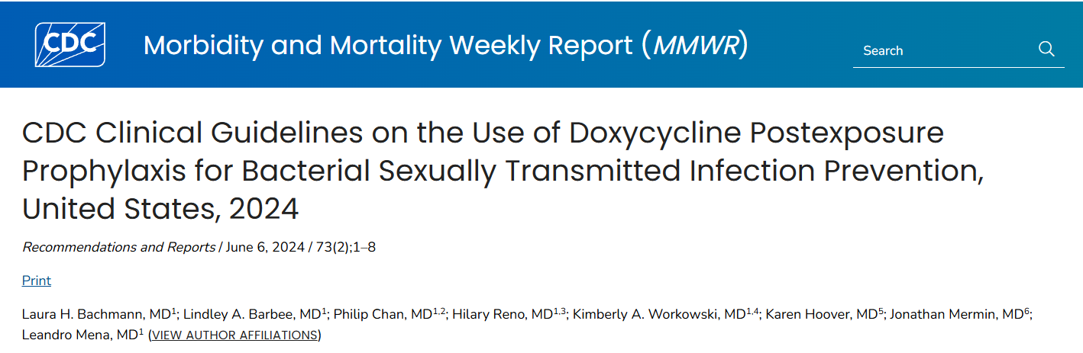
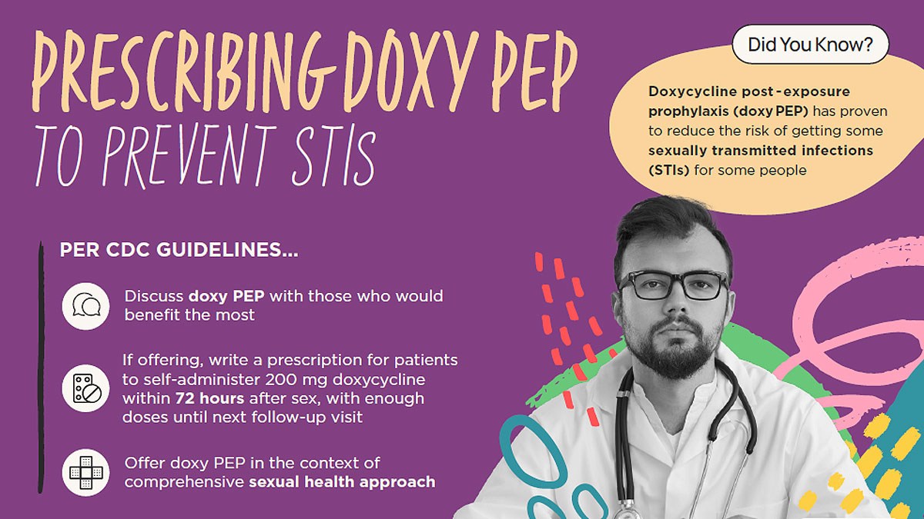
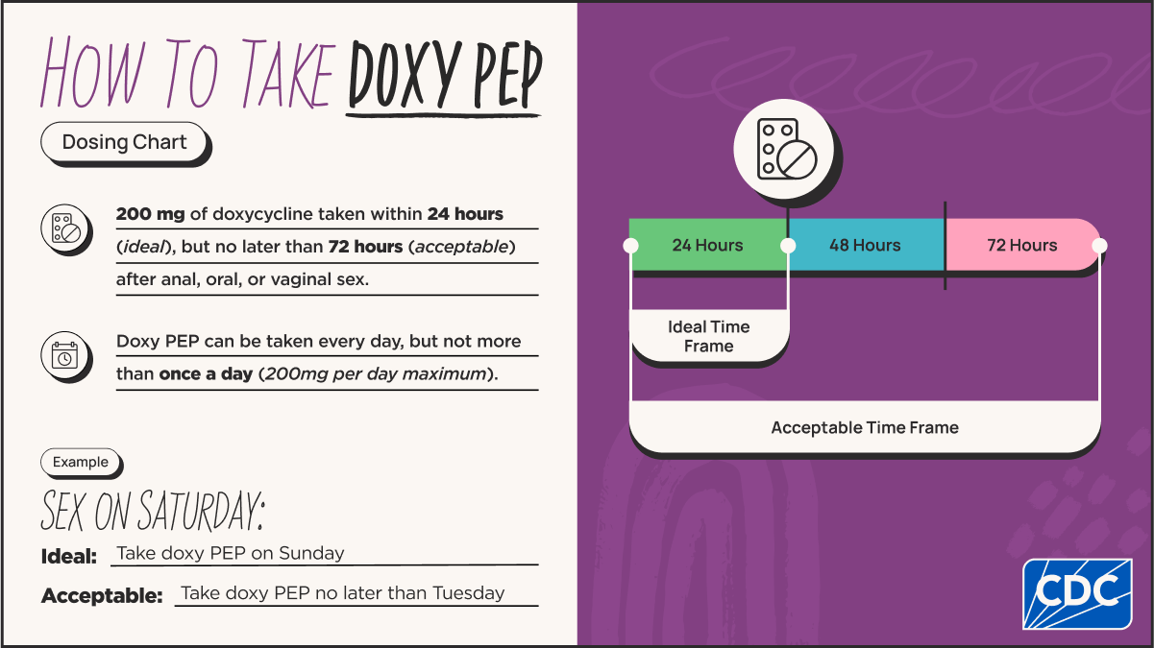






Beyond the doxy PEP Script:
A Call for Longitudinal STI Screening and Follow-up – Lessons Learned from HIV Outpatient Program
Mary Katherine Moore, MD, Emma Allemond, Jared Barrilleaux, Kaitlyn Calabresi, Mason Calico, Ross Hightower, Ivan Nguyen, Thoung Dien Nguyen-Bui, Meredith Clement, MD, Tat Yau, MD
Louisiana State University Health New Orleans School of Medicine
Background
The Centers for Disease Control and Prevention (CDC) recommends:
Gay, bisexual, and other men who have sex with men (MSM) and transgender women (TGW)
Who have had a bacterial sexually transmitted infection (STI) diagnosed in the past 12 months
Should receive counseling and engage in shared decision-making with their provider regarding doxycycline post-exposure prophylaxis (doxy PEP)
The purpose of this study is to evaluate the eligibility for and utilization of doxy PEP among people with HIV (PWH) at the HIV Outpatient Program (HOP)
Methods
The target population (MSM and TGW) was identified among all PWH clients served at HOP in 2023.
Patient characteristics were evaluated over a two-year period:
Determine doxy PEP eligibility
Utilization of doxy PEP
Subsequent STI monitoring
Barriers to doxy PEP
Results
Patient Characteristics | Number
Total Number | 456
Age range Median age (year) | 19 – 85 51
Gender Male Transgender female Non-binary | 426 (93.4%) 29 (6.4%) 1 (0.2%)
Ethnicity African American Asian Caucasian Hispanic | 281 (61.6%) 5 (1.1%) 146 (32%) 22 (4.8%)
Doxy PEP prescribed Yes No | 67 (14.7%) 389 (85.3%)
Patients who received doxy PEP | Number
Total Number | 67 (100%)
Initiation of doxy PEP discussion Request by patients Offer by providers Both | 13 (19.4%) 48 (71.6%) 6 (9%)
CD4 count at the initiation of doxy PEP CD4 count less than 200 cells/mm³ CD4 count more than 200 cells/mm³ | 64 (95.5%) 3 (4.5%)
Viral suppression at the initiation of doxy PEP HIV-1 PCR less than 200 copies/mL HIV-1 PCR more than 200 copies/mL | 61 (91%) 6 (9%)
History of bacteria STI Within 12 months prior to doxy PEP More than 12 months prior to doxy PEP No documentation | 32 (47.8%) 30 (44.8%) 5 (7.6%)
Follow up STI testing within 6 months Yes Tested positive for STI Chlamydia Gonorrhea Syphilis No Initiation of doxy PEP within 6 months Lost to follow up No testing ordered or performed Not sexually active | 46 (68.7%) 6 (13%) 2 (4.3%) 3 (6.5%) 1 (2.2%) 21 (31.3%) 8 (38.1%) 6 (28.6%) 6 (28.6%) 1 (4.7%)
Follow up STI testing after 6 months Yes Tested positive for STI Chlamydia Gonorrhea Syphilis No Initiation of doxy PEP within 6 months Lost to follow up No testing ordered or performed Not sexually active | 46 (68.7%) 9 (19.5%) 3 (6.5%) 8 (17.4%) 3 (6.5%) 21 (31.3%) 14 (66.7%) 4 (19%) 2 (9.5%) 1 (4.8%)
Total of 456 patients identified in 2023:
426 were male
29 were transgender female
1 was gender non-binary
67 patients received doxy PEP:
32 had a documented STI within 12 months
Most patients (96%) had a CD4 count above 200 and virally suppressed (91%)
46 patients who had follow-up STI testing within 6 months of initiating doxy PEP – 6 tested positive
Beyond the 6-month mark – 9 tested positive
Non-adherence to the doxy PEP regimen was the most common factor associated with subsequent positive tests
389 patients who never received doxy PEP
Total of 75 patients eligible for doxy PEP during the study
Documented counseling offered to 6
24 clients were lost to follow-up
41 had no documentation acknowledging their eligibility for the intervention
Patients who did not receive doxy PEP | Number
Total Number | 389 (100%)
History of bacteria STI More than 12 months prior to 2023 Within 12 months in the year 2023* During the follow-up period* No STI documented *Eligible for doxy PEP | 216 (55.5%) 44 (11.3%) 45 (11.6%) 154 (39.6%)
Those who were eligible for doxy PEP: Discussion offered by provider Lost to follow up Not sexually active or reported monogamous relationship Refusal to doxy PEP No documentation acknowledging eligibility of doxy PEP | 75 (19.3%) 6 (8%) 24 (32%) 3 (4%) 1 (1.3%) 41 (54.7%)
Conclusion
This study highlights the urgent need to combat the STI epidemic:
Increase awareness of doxy PEP
Improve clinical documentation
Maintain longitudinal STI monitoring
Non-adherence is the primary reason for STI detection after doxy PEP initiation
Loss to follow-up remains the most significant barrier to discussing the intervention with eligible patients

