Slide 1


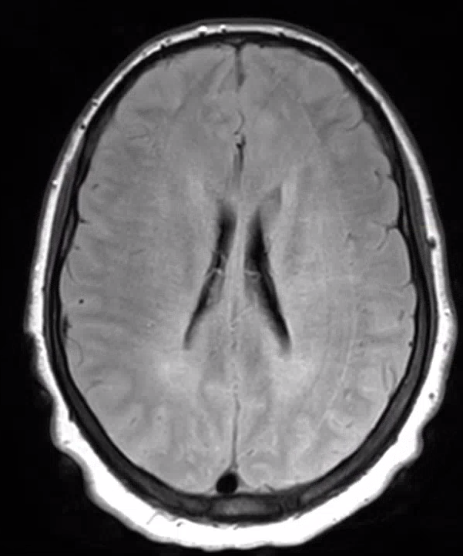
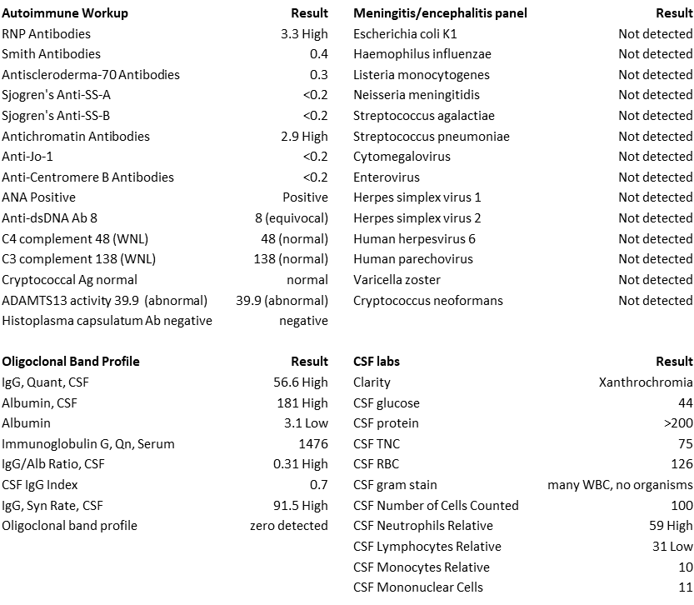
Toxic Encephalopathy and Associations with Calcineurin Inhibitors Josh FitzPatrick, Gurtaj Mahil DO, Hanna Almoaswes MD, Caroline Neck MD, Salena Sinnasonne, Philip Doyle, Daniel Holmes MD ¹Louisiana State University Health Sciences Center, New Orleans, LA
Introduction
Imaging
Cyclosporine MOA
Toxic encephalopathy is a syndrome of acute AMS often exhibiting fevers, focal deficits, and aphasia resulting from toxins, medications, or metabolic disturbances
Common causes include antineoplastic agents and calcineurin inhibitors
Lab findings include elevated CSF protein and pleocytosis
Imaging findings include T2/FLAIR hyperintensities in white matter, particularly within the corpus callosum, frontal, and parietal lobes
Voclosporin is a calcineurin inhibitor that inhibits the production of IL-2 → inhibits T cell activation
Next gen analog of cyclosporin with FDA approval in 2021 for lupus nephritis
PRES (posterior reversible encephalopathy syndrome) has a similar presentation to toxic encephalopathy but is characterized by vasogenic edema of the parieto-occipital regions
Figure 1: MRI T2 axial flair view of exhibiting T2 hyperintensities of the periventricular white matter, external capsule, and corpus callosum
Cyclosporine → inhibits adrenomedullin, cAMP, Protein kinase A → endothelial cell toxicity and increased membrane permeability → release of endothelin (vasoconstriction), prostacyclin, Thromboxane A2 → Disruption of Blood-brain Barrier
Oligodendrocytes have increased sensitivity to cyclosporine damage → apoptosis → characteristic imaging findings in white matter including the corpus callosum (toxic encephalopathy) and posterior leukoencephalopathy (PRES)
Discussion
Differential
Lupus – less likely due to normal complement and no improvement with steroids
PRES – lack of characteristic MRI findings, commonly lacks pleocytosis on lumbar puncture
Suspect toxic leukoencephalopathy secondary to voclosporin
No current documented literature of voclosporin and toxic encephalopathy
Other calcineurin inhibitors (cyclosporine and tacrolimus) have a documented association with toxic encephalopathy in addition to PRES
Voclosporin has associations with PRES in dosages of 23.7 or 39.5mg BID.
We propose that voclosporin has a similar pathophysiology of causing encephalopathy compared to cyclosporine
Case Description
Lab Workup
39 y.o. female with a PMH of lupus, b/l blindness secondary to lupus, and CKD stage 5
Presentation: Presented with AMS and fever following a RUE AVF graft
Home Medications: voclosporin, Imuran, Plaquenil, corticosteroids
Voclosporin dosage of 7.9 mg BID for 3 months
Imaging – negative for PRES, hyperintensities in white matter regions of frontal lobe, corpus callosum
Lab workup – pleocytosis and elevated protein on lumbar puncture. ANA +, normal complement levels. Remaining infectious and autoimmune workup negative
Hospital course – Initially required intubation, cooling blankets, and ICU admission. Voclosporin discontinued upon admission. Treated with broad spectrum antibiotics and steroids without improvement and discontinued following negative labs. ICU LOS was 3 weeks. Patient developed muscle weakness and no improvement in AMS. Received hemodialysis in response to AKI and CKD. Patient was able to be extubated following 2 sessions of dialysis and stepped down to floor. Improvement in AMS occurred 3 days following dialysis with improving muscle weakness
References
Arriens, C. et al. Update on the Efficacy and Safety Profile of Voclosporin: An Integrated Analysis of Clinical Trials in Lupus Nephritis. Arthritis Care & Research 75, 1399–1408 (2023).
Filley, C. M. & Kleinschmidt-DeMasters, B. K. Toxic Leukoencephalopathy. N Engl J Med 345, 425–432 (2001).
Geocadin, R. G. Posterior Reversible Encephalopathy Syndrome. N Engl J Med 388, 2171–2178 (2023).
Gu, B., Lv, B. & Tang, J. Phase IV safety evaluation of voclosporin in lupus nephritis patients using the FAERS database for a 42-month period (2021 – 2024). CP (2025) doi:10.5414/CP204726.
Inoha, S. et al. Magnetic resonance imaging in cases with encephalopathy secondary to immunosuppressive agents. Journal of Clinical Neuroscience 9, 305–307 (2002).
Mammoser, A. Calcineurin Inhibitor Encephalopathy. Semin Neurol 32, 517–524 (2013).
Rovin, B. H. et al. A randomized, controlled double-blind study comparing the efficacy and safety of dose-ranging voclosporin with placebo in achieving remission in patients with active lupus nephritis. Kidney International 95, 219–231 (2019).
Rubio, J. & Kyttaris, V. Journal Club: Efficacy and Safety of Voclosporin Versus Placebo for Lupus Nephritis (AURORA 1): A Double‐Blind, Randomized, Multicenter, Placebo‐Controlled, Phase 3 Trial. ACR Open Rheumatology 3, 827–831 (2021).
Shah, V. R. & Bankole, A. Voclosporin. in StatPearls (StatPearls Publishing, Treasure Island (FL), 2025).
Smeralda, C. L., Gigli, G. L., Vogrig, A., Marini, A. & Valente, M. Tacrolimus-induced severe headache associated with diffuse leukoencephalopathy: Evidence for an immune-mediated pathogenesis. Journal of Neuroimmunology 330, 55–58 (2019).
Wang, Z., Lang, Y., Liu, X., Wang, Y. & Shao, L. Post-marketing safety surveillance of voclosporin: an observational, pharmacovigilance study leveraging faers database study on the safety of voclosporin. Front Pharmacol 16, 1506760 (2025).
Zhang, J. et al. Clinical adverse events to voclosporin: a real-world drug safety study based on FDA Adverse Event Reporting System. Clinical and Experimental Rheumatology (2025) doi:10.55563/clinexprheumatol/qhyux8.

