Slide 1


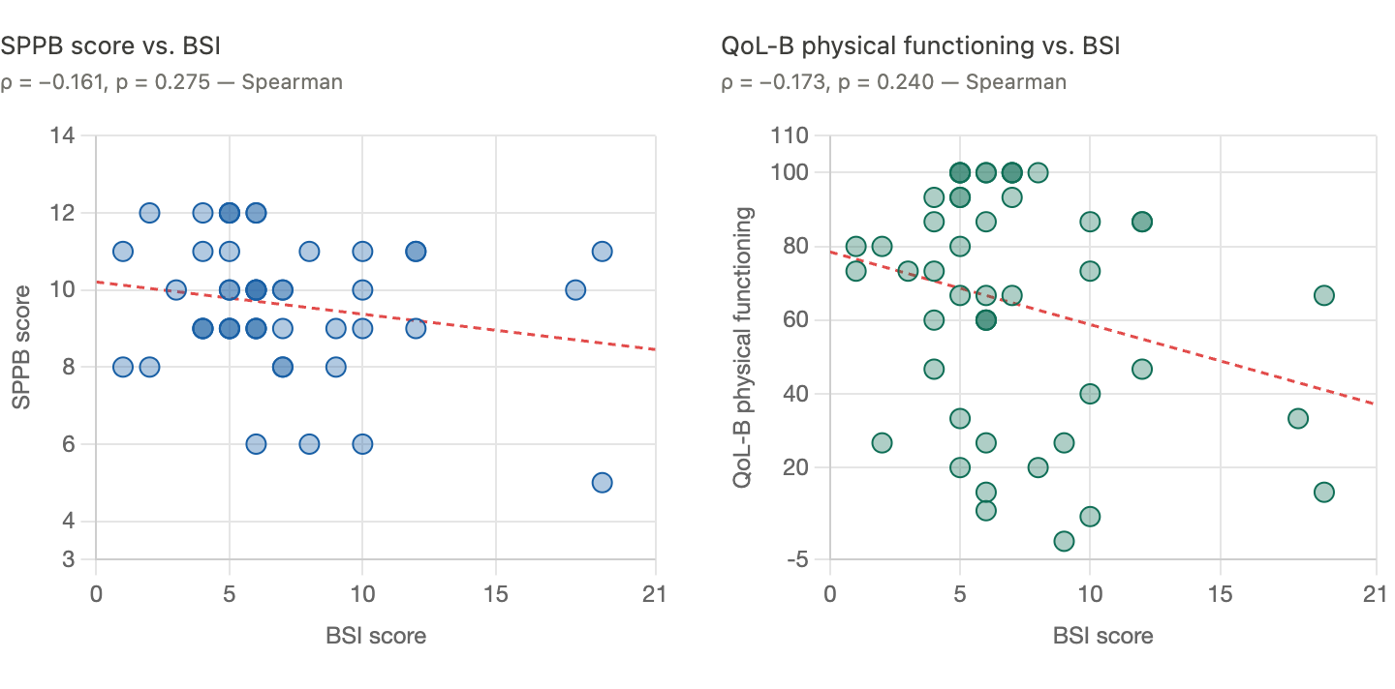

Functional Performance and Patient-Reported Burden in Bronchiectasis: Associations with Bronchiectasis Severity
John Schaefer M.S., David Welsh M.D., Shelby MacRae M.D.
Rationale
Hypothesis
Bronchiectasis disease severity is commonly assessed using clinical indices such as the BSI, while patient-reported instruments capture subjective burden. The relationship between objective physical performance and disease severity remains poorly characterized, and functional assessment may reflect a clinically meaningful dimension beyond existing indices.
Poorer objective physical function, as measured by the Short Physical Performance Battery (SPPB), is associated with higher bronchiectasis disease severity as measured by the BSI
Results
SPPB score vs. BSI
ρ = -0.161, p = 0.275
QoL-B vs. BSI
ρ = -0.173, p = 0.240
QoL-B score
SPPB score
BSI score
BSI score
Summary
Patient Demographics
SPPB and QoL-B Physical Functioning show inverse relationships with BSI, consistent with poorer physical function is associated with greater disease severity
Total patients – n 48 | n (%)
Age, years – median 72.0 | White 39 (81.3%)
Female – n (%) 37 (77.1%) | Asian 3 (6.3%)
BMI kg/m² - median 21.9 | Hispanic or Latino 4 (8.3%)
Tobacco exposure – n (%) 18 (37.5%) | Black 1 (2.1%)
BSI severity: Mild 10 (20.8%) · Moderate 26 (54.2%) · Severe 12 (25.0%) | Am. Indian/Alaskan 1 (2.1%) Native
More Info

