Slide 1


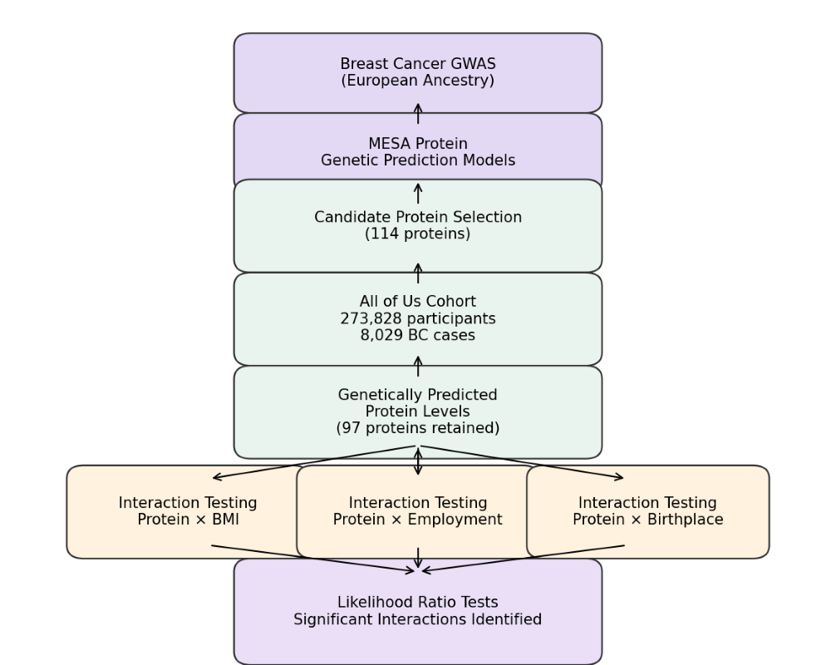
The Modulating Effect of Metabolic and Socioeconomic Factors on Protein Levels for Breast Cancer Risk: An Interaction Analysis in the All of Us Cohort
Amjila Bam¹, Shuai Liu², Lang Wu^{1,2#}, Jingjing Zhu^{2,3#} (#joint corresponding authors)
1. School of Public Health, LSUHSC; 2. LSU-LCMC Health Cancer Center; 3. Bioinformatics and Genomics Core, LSUHSC
Background
Results
Breast cancer (BC) is a malignant condition characterized by the uncontrolled growth of abnormal cells within the milk-producing lobules or ducts of the breast, leading to tumor formation.
According to the latest update (February 2024) from the National Library of Medicine (NLM), and the key statistics for breast cancer by the American Cancer Society, breast cancer is the most frequently diagnosed cancer among women and 30% of all new cancers each year in the United States, respectively. While DNA‑level alterations define tumor potential, mRNA expression reflects the tumor’s active biological state and is highly responsive to cellular signaling and external stressors.
While specific protein biomarkers have been linked to BC susceptibility, the predictive utility of these proteins may not be uniform across diverse physiological and socioeconomic contexts.
Factors such as obesity and lifestyle-related stressors may dynamically modulate how the proteins influence oncogenesis.
This study aimed to identify context-specific proteins whose association with BC risk depends on an individual’s Body Mass Index (BMI), employment status, or birth origin to refine risk assessment strategies.
Using MESA-derived protein genetic prediction models and large-scale GWAS summary statistics of BC risk, we identified candidate proteins with genetically regulated expression to be associated with BC risk in European population. In the All of Us study, we analyzed a cohort of 273,828 participants (8,029 BC cases and 265,799 controls).
Table 1. Baseline distribution of breast cancer cases and non-breast cancer controls by key metabolic, socioeconomic, and demographic factors.
BMI‑Dependent Protein Effects
Factors |  | Breast Cancer cases (N=8,029) | Non-Breast Cancer controls (N=265,799)
BMI | Underweight (<18.5) | 88 | 3356
 | Normal (18.5-24.9) | 2546 | 78578
 | Overweight (25-29.9) | 2492 | 85228
 | Obese (>=30) | 2903 | 98637
Employment Status | Employed | 3149 | 135572
 | Non-employed | 4880 | 130227
Birthplace | USA | 7591 | 251982
 | Other | 438 | 13817
seq.8427.118 demonstrated a BMI‑dependent association with breast cancer risk.
This result suggests that metabolic state modifies the relationship between seq.8427.118 and breast cancer susceptibility, consistent with a role for obesity‑related biological processes in shaping protein‑associated risk.
Employment Status–Dependent Protein Effects
We identified nine significant protein – context interaction effects, demonstrating that the associations between protein biomarkers and breast cancer risk vary across metabolic, socioeconomic, and demographic contexts.
These interactions indicate that protein effects on breast cancer risk are not uniform, but are instead modified by BMI, employment status, and birthplace.
Employment status significantly modified the associations between breast cancer risk and three proteins: seq.9196.8, seq.17441.4, and seq.18212.43.For seq.9196.8, employment status appeared to amplify the protein’s association with breast cancer risk.
In contrast, employment status attenuated the associations observed for seq.17441.4 and seq.18212.43, indicating heterogeneity in how socioeconomic context influences protein effects.
Together, these results suggest that employment status, potentially reflecting occupational, behavioral, or chronic stress–related factors, plays an important role in modifying protein–breast cancer risk relationships.
Methodology and Data Analysis
Protein genetic prediction models were developed using data of the Multi-Ethnic Study of Atherosclerosis (MESA).
Large-scale breast cancer GWAS summary statistics from European populations were used to identify proteins with genetically regulated expression linked to BC risk.
The primary interaction analysis was conducted in the All of Us Research Program, including 273,828 participants (8,029 breast cancer cases and 265,799 controls).
Genetically predicted protein levels for 114 candidate proteins were calculated using whole-genome sequencing data of All of Us.
Multivariable logistic regression models were used to test interactions between each protein of interest and three contextual factors: BMI, employment status (employed vs. not employed), and birthplace (US-born vs. non-US-born).
Likelihood Ratio Tests (LRTs) were used to compare full models containing protein – context interactions with reduced models containing only main effects.
All models were adjusted for baseline covariates and ten genetic principal components to control for population stratification.
After quality control, 97 proteins were retained, resulting in a total of 291 interaction models tested.
All analyses were conducted using Jupyter Notebook integrated within the All of Us Researcher Workbench.
Table 2. Protein – context interaction effects modifying breast cancer risk by BMI, employment status, and birthplace.
Factors | Proteins | Protein p-value | Interaction Coefficient | Interaction p-value | LRT p-value
BMI | seq.8427.118 | 0.014 | 0.680 | 0.008 | 1.45e-02
Employment Status | seq.9196.8 | 0.031 | 0.847 | 0.047 | 5.16e-08
 | seq.17441.4 | 0.045 | -0.693 | 0.021 | 1.46e-02
 | seq.18212.43 | 0.001 | -2.163 | 0.001 | 3.67e-02
Birthplace | seq.9196.8 | 0.000 | 3.217 | 0.000 | 1.19e-06
 | seq.21940.12 | 0.018 | 0.501 | 0.034 | 8.94e-03
 | seq.4407.10 | 0.010 | 0.235 | 0.019 | 1.54e-02
 | seq.5088.175 | 0.019 | 0.563 | 0.031 | 1.18e-02
 | seq.5659.11 | 0.014 | 4.238 | 0.019 | 5.37e-08
Birthplace‑Dependent Protein Effects
Birthplace (US‑born vs non‑US‑born) significantly modified the associations between breast cancer risk and five proteins: seq.9196.8, seq.21940.12, seq.4407.10, seq.5088.175, and seq.5659.11.For each of these proteins, birthplace influenced the magnitude and direction of the protein-breast cancer risk association.
Notably, seq.9196.8 demonstrated interaction effects with both employment status and birthplace, indicating that this protein may be particularly sensitive to multiple contextual dimensions.
These findings suggest that early‑life, environmental, or migration‑related exposures may shape how genetically regulated protein expression translates into breast cancer risk.
Discussion and Conclusion
These findings demonstrate that protein associations with breast cancer risk are strongly context dependent, rather than uniform across the population.
The BMI‑specific interaction observed for seq.8427.118 suggests that metabolic state may modulate protein‑mediated oncogenic pathways, potentially through obesity‑related hormonal or inflammatory mechanisms.
Employment status modified risk associations for multiple proteins, with both positive and negative interaction coefficients, indicating that socioeconomic or occupational factors may differentially amplify or attenuate protein effects.
Birthplace‑dependent interactions, particularly the strong effects observed for seq.9196.8 and seq.5659.11, suggest that early‑life, environmental, or migration‑related exposures may influence how protein expression translates into disease risk.
The recurrence of seq.9196.8 across multiple contexts highlights this protein as a potentially highly context‑sensitive biomarker, whose predictive utility may vary substantially depending on socioeconomic and geographic background.
Importantly, the presence of statistically significant LRT results across all reported interactions confirms that including interaction terms improves breast cancer risk models beyond main effects alone.
Together, these results support a framework in which breast cancer protein risk is filtered through metabolic and socioeconomic context, emphasizing the limitations of one‑size‑fits‑all biomarker models.
Incorporating such context‑specific interaction effects into polyproteomic risk scores may enhance the accuracy and equity of breast cancer risk stratification.
Limitations and Future Work
The analysis focused on individuals of European ancestry, which may limit the generalizability of findings to other ancestral populations.
Employment status and birthplace were measured using broad categories and may not fully capture underlying socioeconomic or environmental exposures.
Multiple testing and modest interaction effect sizes may introduce the possibility of false-positive findings.
Future work should validate these protein–context interactions in independent and ancestrally diverse cohorts.
Additional studies should explore finer-grained contextual variables, such as job type, duration of employment, migration history, and longitudinal BMI changes.
Acknowledgement
This study was supported by National Human Genome Research Institute/National Institute on Minority Health and Health Disparities (NHGRI/NIMHD) U54 HG013243 and National Cancer Institute R01CA263494 and U01CA293883
Figure 1. AI generated overview of the analytical workflow used to identify protein – context interactions associated with breast cancer risk in the All of Us cohort.
Text

