Slide 1


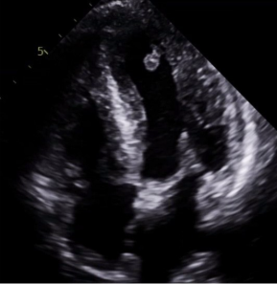
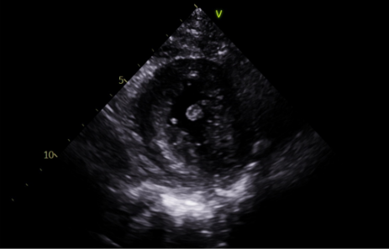
Nonvalvular Papillary Fibroelastoma Mitchel Capella, MD; Sepehr Sadeghi, DO; Allison Borst, MD; Ashley Van, MD; Erika Haviland, DO; Neeraj Jain, MD LSU Health Sciences Center Departments of Internal Medicine and Cardiology
Background
Decision-Making
Primary cardiac tumor differential diagnosis in adults includes myxoma, lipoma, thrombus, and papillary fibroelastoma, among others. Given its small, mobile, and pedunculated appearance, papillary fibroelastoma was most likely. Cardiac MRI was utilized to better characterize the mass. It revealed an enhancing 0.6 cm pedunculated mass in the left ventricle, most consistent with papillary fibroelastoma. Cardiothoracic surgery was consulted with plans for outpatient follow up and consideration of surgical intervention.
Primary benign cardiac tumors are rare, with papillary fibroelastomas (PFEs) being second most common after myxomas. More than 70% of PFEs originate from valvular endocardium, while nonvalvular PFEs are distinctly rare.
Case Report
A 61-year-old female with history of hypertension was hospitalized for superior mesenteric artery occlusion. She was incidentally found to have a cardiac mass on transthoracic echocardiogram. The mass was round, mobile, and attached to a stalk originating from the lateral wall of the left ventricle. It measured 0.75 cm in diameter. There was preserved left ventricular function and no valvular abnormalities. She had no cardiac symptoms.
Apical 4-chamber view with left ventricular PFE
Conclusion
Papillary fibroelastomas are benign entities but should be considered for removal if they are symptomatic or have high-risk features including left-sided location, mobility, or size greater than 1 cm.
Reference
Papillary fibroelastoma of the aortic valve: operative approaches upon incidental discovery. Gopaldas RR, Atluri PV, Blaustein AS, Bakaeen FG, Huh J, Chu D. Tex Heart Inst J. 2009;36(2):160-3. PMCID: PMC2676606
Parasternal short axis view of the same PFE

