Slide 1

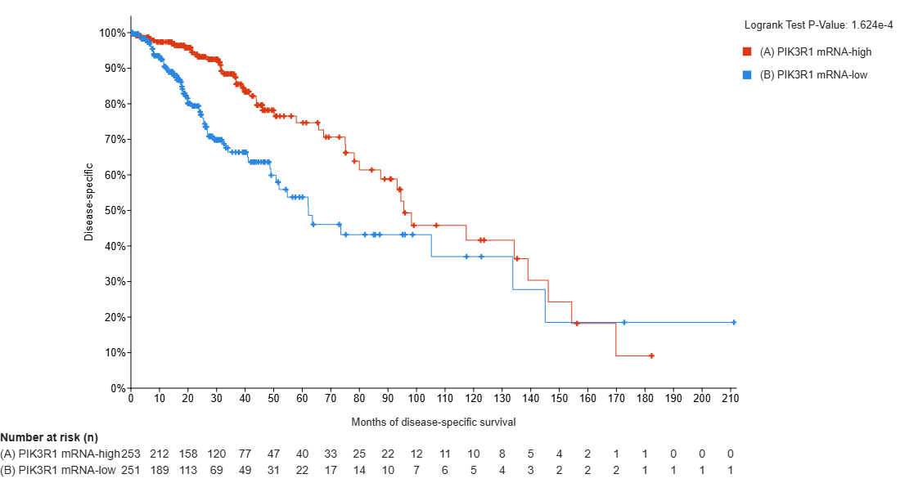
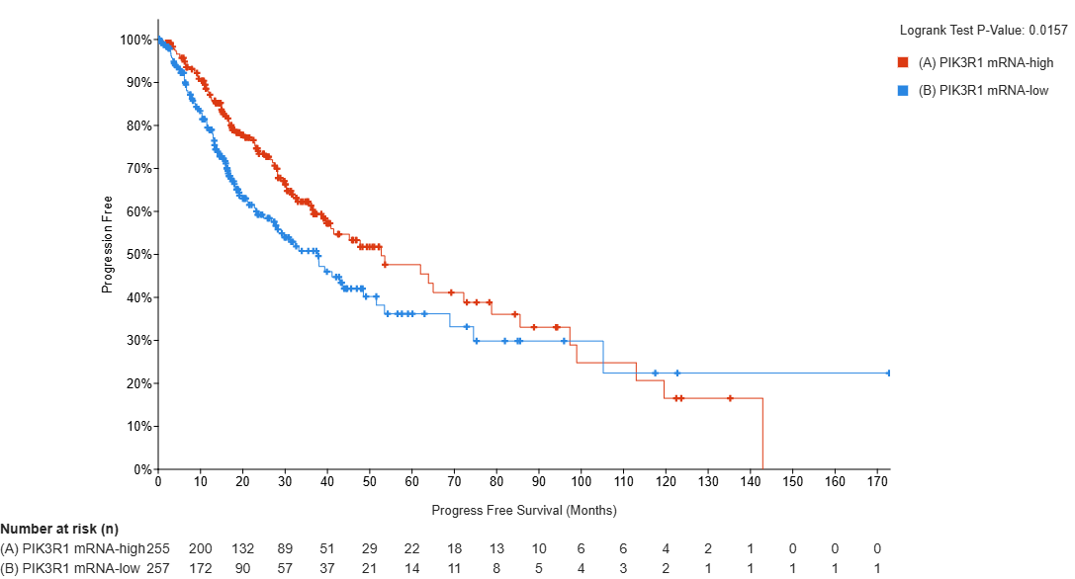
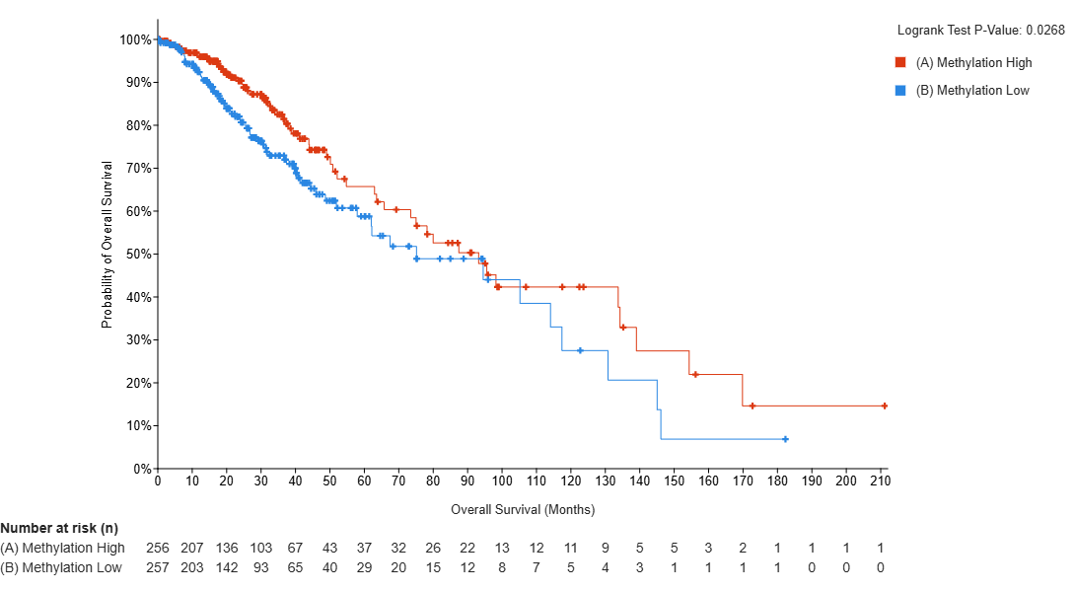
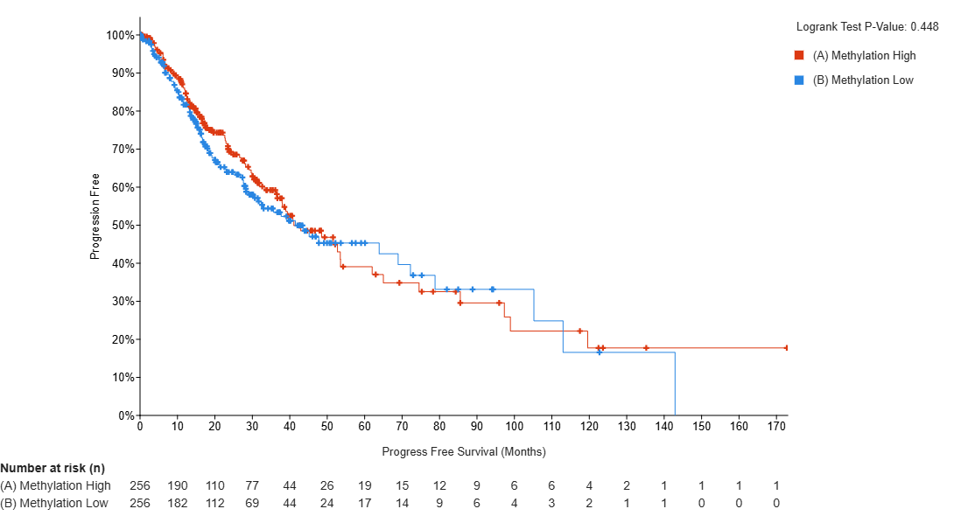
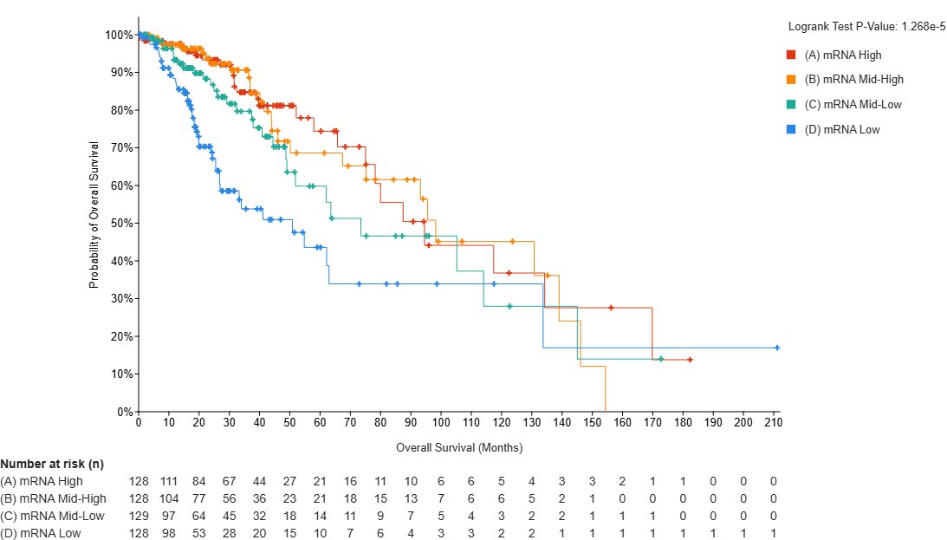
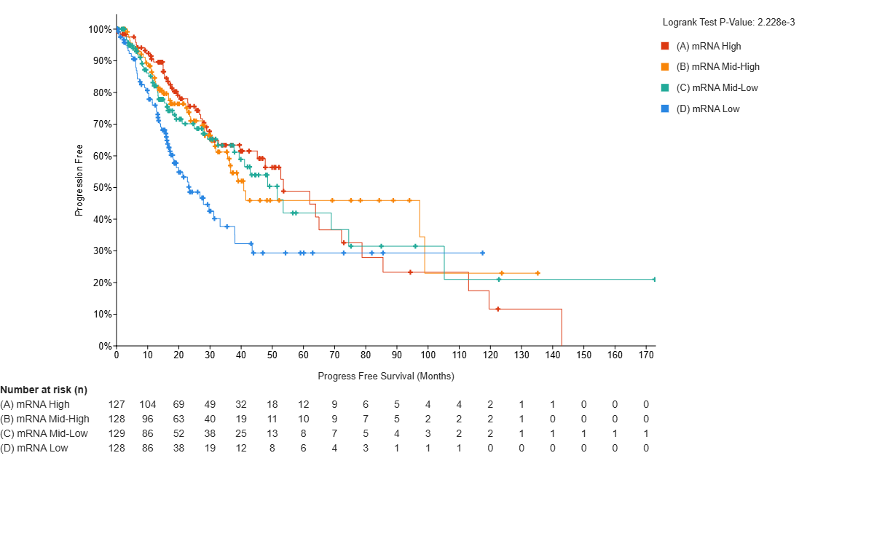
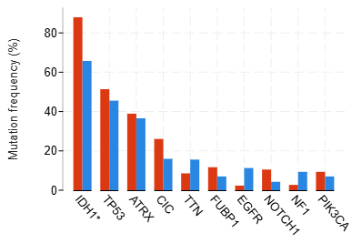
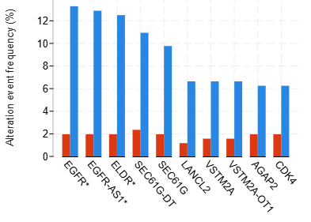
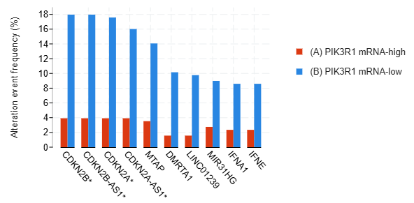
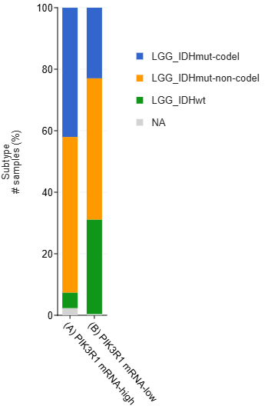
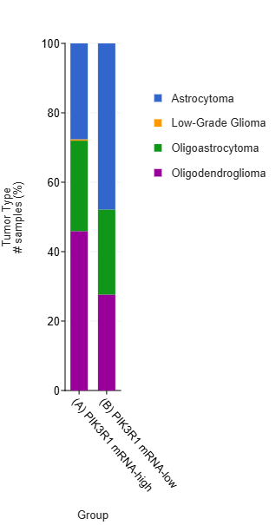
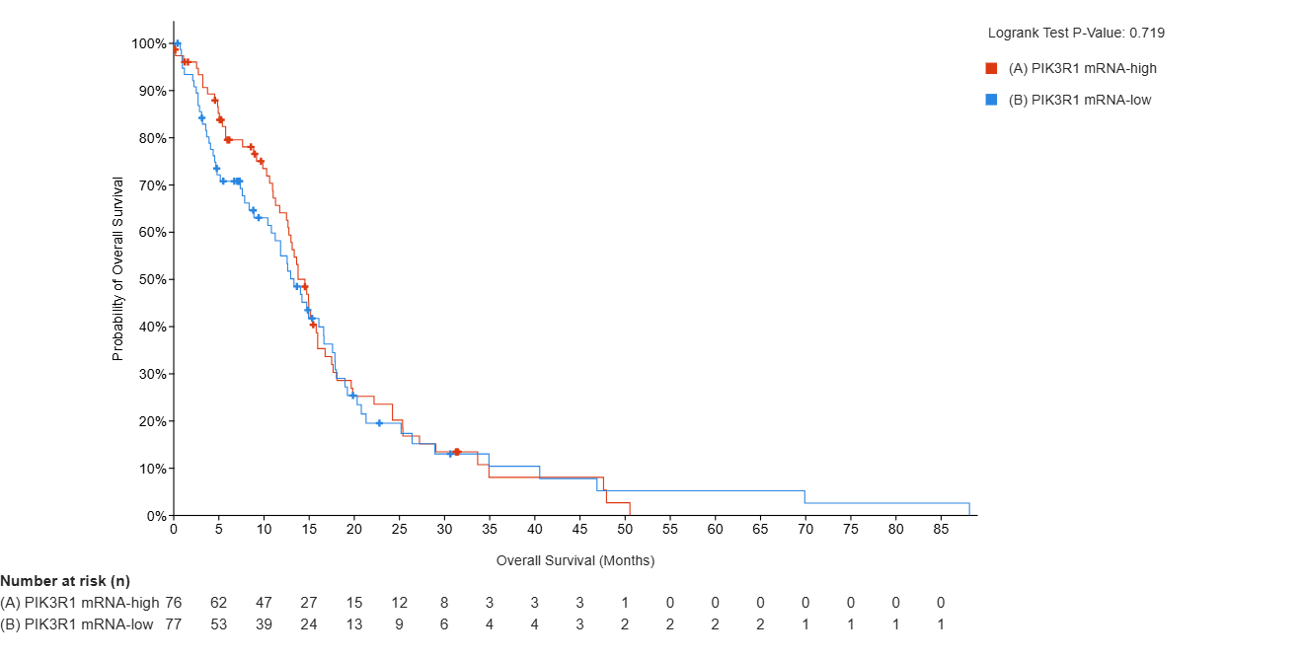
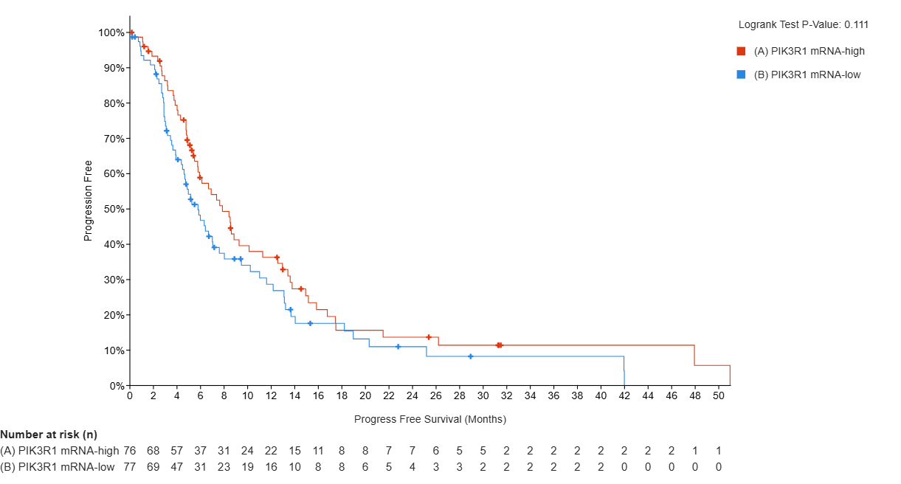
Differential Prognostic Impact of PIK3R1 Expression Across Glioma Grades: A TCGA PanCancer Atlas Analysis
¹Shuang R. Chen, ²Monika Rak, ³Hyunmin Ko, ²Won Seok Yang, ²Steven D Scahill, ³Guilia Monticone, ³Lucio Miele, ³Sun Young Kim
¹Department of Hematology Oncology, School of Medicine, ²Department of Interdisciplinary Oncology,
³Department of Genetics, LSU LCMC Health Cancer Center, New Orleans, LA, USA
BACKGROUND AND OBJECTIVES
Gliomas represent a diverse category of primary brain tumors from indolent lower-grade gliomas (LGG) to glioblastoma (GBM), the most aggressive form associated with rapid clinical deterioration and limited survival
Aberrant activation of the PI3K/AKT pathway is a hallmark of glioma pathogenesis
PIK3R1 encodes the p85 regulatory subunit of PI3K: controls pathway activity through its interaction with the p110 catalytic component.
PIK3R1 alterations have been described in various malignancies, their clinical significance in glioma has not been comprehensively established
We investigated the mutational landscape, expression patterns, and clinical significance of PIK3R1 across LGG and GBM to clarify its biological and prognostic roles
METHODS
A comprehensive analysis of PIK3R1 alterations and their clinical correlations was performed on the TCGA PanCancer Atlas glioma cohorts via cBioPortal
Kaplan–Meier survival modeling and expression distribution mapping were conducted to determine the grade-specific impact of PIK3R1 on patient outcomes
RESULTS
Low Grade Glioma
PIK3R1 mRNA expression
High vs Low: Disease-Specific Survival Progression Free Survival
High vs Mid-high vs Mid-low vs Low: Overall Survival Progression Free Survival
Tumor classification
Tumor subtype and type:
PIK3R1 Methylation
High vs Low: Overall Survival Progression-Free Survival
Comutations Copy number amplifications Copy number deletions
Glioblastoma
PIK3R1 mRNA expression
Overall survival Progression Free Survival
CONCLUSIONS
PIK3R1 mutations were identified in Low Grade Glioma (~4–5%) and Glioblastoma (~7–8%)
Recurrent hotspot alterations were enriched within the inter-SH2 (iSH2) region, a key regulatory interface for p110 interaction
Mutation status was not associated with overall survival in LGG (p = 0.853) or GBM (p = 0.818)
Transcriptional expression of PIK3R1 demonstrated a distinct grade-dependent prognostic association in LGG
In LGG, increased mRNA expression levels were significantly linked to prolonged survival and displayed a graded survival advantage across increasing expression strata
These findings suggest a biological role for PIK3R1 driven more by expression dynamics than by mutational events
Increased mRNA expression was associated with low mutational events in EGFR, ELDR, CDKN2B, CDKN2A, which may be associated with less aggressive disease
Given the relatively low mutation frequency and potential confounding by LGG molecular subtypes, further studies using larger cohorts and multivariate analyses are warranted
ACKNOWLEDGEMENT
Thank you to Dr. Sun Young Kim for her mentorship and guidance and Hyunmin Ko, Dr. Kim’s lab, and the Department of Genetics and Interdisciplinary Oncology for their collaboration and support for this project.

