Slide 1

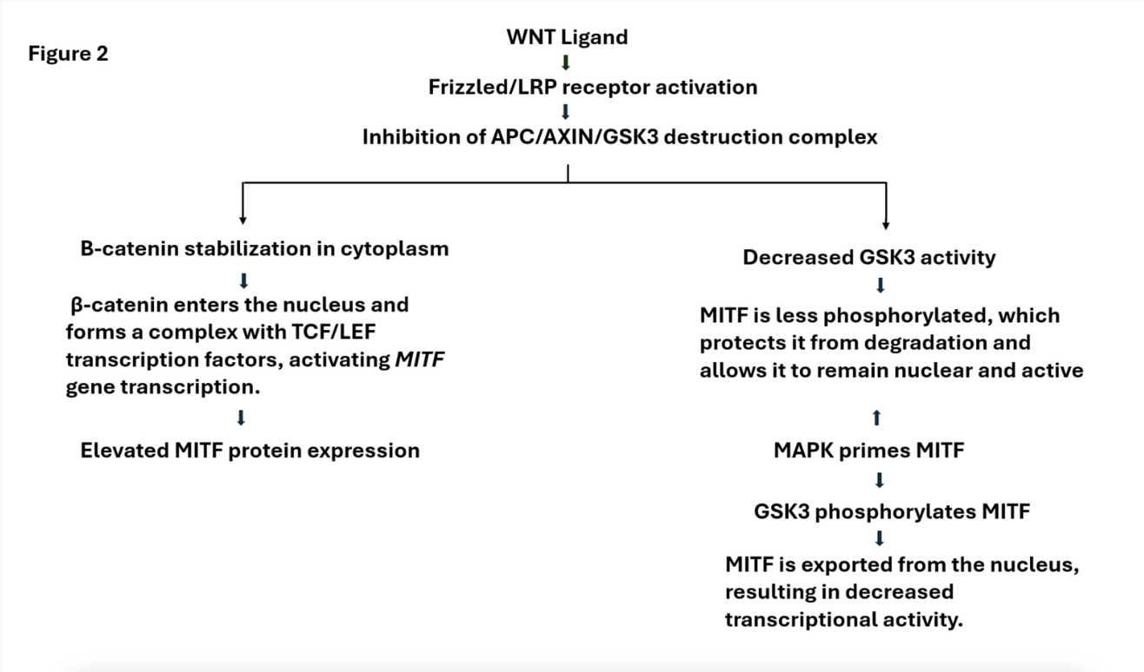

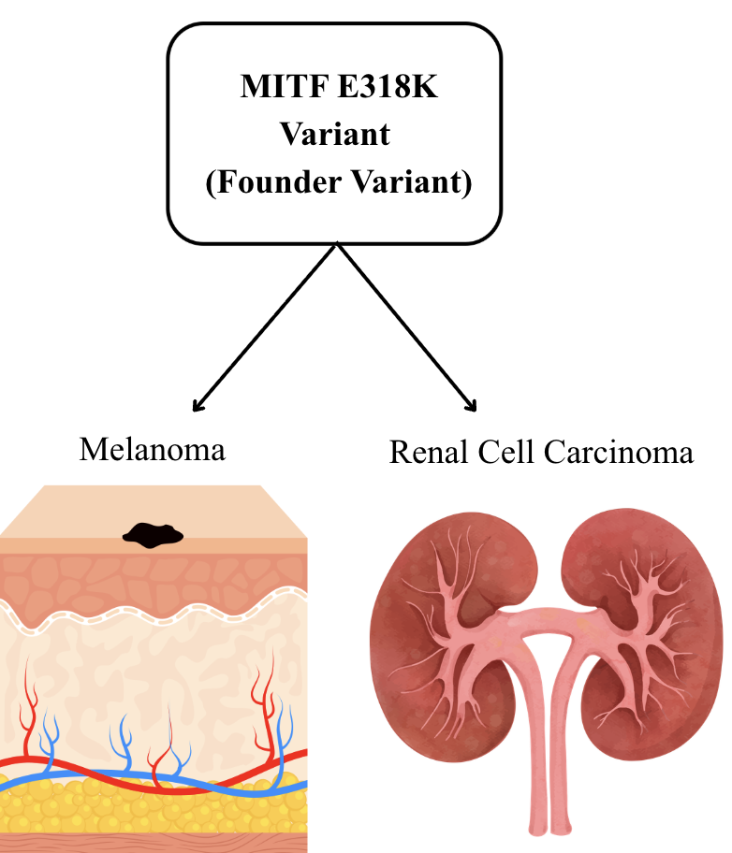

Germline APC I1307K and MITF E318K variants in a patient with high-grade serous ovarian carcinoma: A case report
Samantha C Covey¹ , Michelle M De Jesus Ortiz² , Amelia Jernigan³, Ridin Balakrishnan², Sun Young Kim⁵, Lucio Miele⁵
¹School of Medicine, ²Department of Pathology, ³Department of Obstetrics and Gynecology, ⁴Department of Genetics and ⁵Department of Interdisciplinary Oncology, Louisiana Cancer Research Center, Louisiana State University, New Orleans, LA, USA
Background
Presentation of dysuria and vaginal bleeding at age 74
Endometrial stripe with trace fluid (4 × 14mm) and a cystic and solid right adnexal mass inseparable from the right ovary (11.6 × 9.2 × 8.1cm)
APC I1307K and MITF E318K are both founder variants linked to distinct carcinomas. APC I1307K allele is a variant linked to increased colorectal cancer risk through the creation of a hypermutable region that is predisposed to somatic mutations rather than classical tumor‑suppressor inactivation [1-3]. While MITF E318K is a gain‑of‑function variant that acts through altered transcriptional regulation, promoting cell proliferation and survival in melanoma and renal cell carcinoma [4]. Although neither of these variants are linked to ovarian cancer risk, we hypothesize that a co-occurrence of APC I1307K and MITF E318K may reflect a polygenic modifier effect suggested by a unique presentation of a 76-year-old woman with high grade serous ovarian carcinoma (HGSOC) whose pathological and molecular findings revealed germline variants APC I1307K and MITF E318K.
Optimal cytoreductive surgery
Mass was confirmed to be HGSOC
Chemotherapy
Completed six cycles of carboplatin and paclitaxel
Maintenance with PARP inhibitor therapy
Figure 3. . WNT/β‑catenin pathway
Metastatic Findings
Liver biopsy confirmed metastatic ovarian carcinoma
Conclusions
HGSOC
Variant interplay at the level of GSK3β is not yet characterized
Limited clinical data on potential association between ovarian cancer and MITF
Important to investigate atypical variant combinations and comprehensive germline testing and profiling
Figure 1. . Potential Polygenic modifier effect of APC I1307K and MITF E318K
Treatment options
Retreatment with platinum-based chemotherapy
Potential enrollment in a clinical trial
Methods
Figure 2. . Clinical History
We report a detailed clinical, pathologic, and molecular characterization of a patient who developed HGSOC with later hepatic metastases. Histopathologic review, immunohistochemistry, tumor-only next-generation sequencing, and comprehensive germline genetic testing including RNA sequencing were performed to define the molecular basis of disease.
Somatic & Germline Testing
Somatic testing was positive for TP53, FGFR2, MITF, APC, and FAT1 gene deletion. TP53 is known to be somatic in high-grade serous ovarian carcinoma and was confirmed to be somatic in this case with germline testing. Only MITF and APC variants were positive in germline testing. The APC variant showed a variant allele frequency (VAF) of only 16% on tumor testing, far below the expected 50%. However, because this APC variant is a well‑established founder variant, we proceeded with germline testing, which ultimately confirmed its presence.
Discussion
References
Although APC and MITF do not interact directly, they both influence shared pathways, with APC playing a pivotal role in forming the destruction complex in the WNT/β‑catenin pathway while MITF is regulated by different component of the destruction complex, GSK3β, to synergistically produce controlled proliferation in a normal cell [5-8]. Although neither of these variants are linked to ovarian cancer risk, we hypothesize that a co-occurrence of APC I1307K and MITF E318K may reflect a polygenic modifier effect. Co-occurrence of APC I1307K and MITF E318K variants may potentiate tumor activity at the level of GSK3β where each of their pathways meet.
This interaction has not been characterized and may explain the result in atypical cancers for these mutations including ovarian cancer, although this must be interpreted with caution as the features of this particular case of HGOSC, including metastasis, may have been unrelated to these variants [9]. There is limited data, but some clinical evidence may suggest an association between MITF E318K and gynecologic malignancies [10]. Oliveira et al. reported that among six MITF E318K carriers, one individual was diagnosed with ovarian/fallopian tube cancer alongside other gynecologic carcinomas including breast and cervical cancer, and two first-degree relatives of MITF E318K carriers had ovarian cancer [10]. Overall, this case highlights the importance of investigating atypical variant combinations and performing comprehensive germline profiling.
1. Valle, L., et al., Position statement of the International Society for Gastrointestinal Hereditary Tumours (InSiGHT) on APC I1307K and cancer risk. J Med Genet, 2023. 60(11): p. 1035– 1043.
2. Syngal, S., et al., Phenotypic characteristics associated with the APC gene I1307K mutation in Ashkenazi Jewish patients with colorectal polyps. JAMA, 2000. 284(7): p. 857–60.
Shur, S., et al., A review of APC somatic mosaicism and specific APC variants - I1307K and promotor variants. Fam Cancer, 2025. 24(2): p. 39.
Bertolotto, C., et al., A SUMOylation-defective MITF germline mutation predisposes to melanoma and renal carcinoma. Nature, 2011. 480(7375): p. 94–8.
Ngeow, K.C., et al., BRAF/MAPK and GSK3 signaling converges to control MITF nuclear export. Proc Natl Acad Sci U S A, 2018. 115(37): p. E8668–E8677.
Ploper, D., et al., MITF drives endolysosomal biogenesis and potentiates Wnt signaling in melanoma cells. Proc Natl Acad Sci U S A, 2015. 112(5): p. E420–9.
Li, C., et al., When You Come to a Fork in the Road, Take It: Wnt Signaling Activates Multiple Pathways through the APC/Axin/GSK-3 Complex. Cells, 2023. 12(18).
Rachmin, I. and D.E. Fisher, Microphthalmia-associated transcription factor phosphorylation: Cross talk between GSK3 and MAPK signaling. Pigment Cell Melanoma Res, 2019. 32(3): p. 345–347.
Narayanan, B., et al., Growth kinetics of high-grade serous ovarian cancer: implications for early detection. Br J Cancer, 2025. 133(4): p. 533–538.
Oliveira, D., et al., Developing a DNA Methylation Signature to Differentiate High-Grade Serous Ovarian Carcinomas from Benign Ovarian Tumors. Mol Diagn Ther, 2024. 28(6): p. 821–834.
Case Presentation
Presentation & Relevant Past Medical History
The patient presented to clinic with dysuria and vaginal bleeding and upon further evaluation, discovered an endometrial stripe with trace fluid (4 × 14mm) and a cystic and solid right adnexal mass inseparable from the right ovary (11.6 × 9.2 × 8.1cm). The patient reported menopause starting at age 50 and denied use of hormone replacement therapy. Past medical history consisted of a tubulovillous adenoma detected during a colonoscopy at age 62 with following colonoscopies showing no abnormalities and no history of abnormal Papanicolaou smears or mammograms. History of cancer in the family consisted of only her son, who had a pilocytic astrocytoma at age 12 with reoccurrence at age 15. After discovering metastatic findings, The patient was offered continued treatment options, but the final treatment plan will be determined following further discussion.

