Slide 1

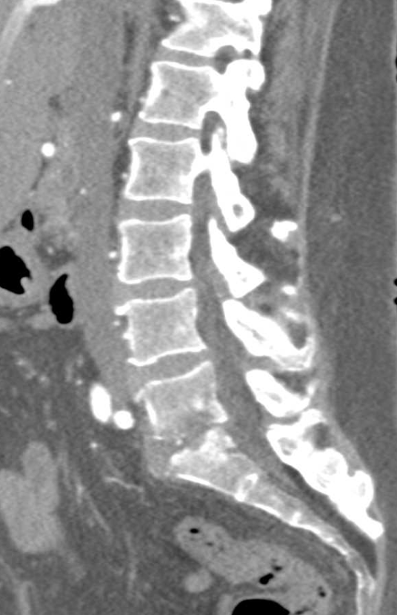
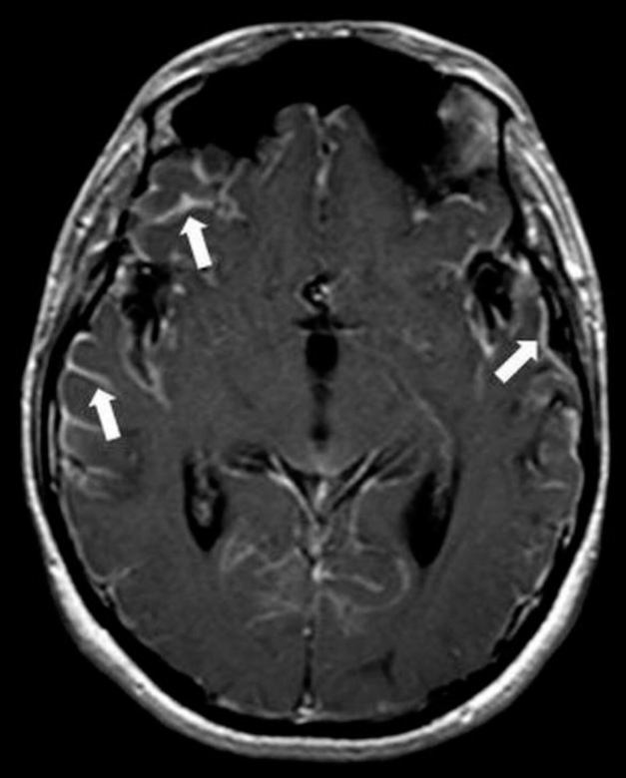
Meningitis Complications
in a Patient with AIDS
Meagan Kelly, BSE¹, Travis Quillin, BS², Alex Anderson, MD¹, Sophia Courcelle, MD¹,
Jeffery White, MD¹, Mary Katherine Moore, MD¹, Victoria McCray, MD¹, Luke Yesbeck, DO¹
1. LSU Health New Orleans 2. Burrell College of Osteopathic Medicine
Introduction
Discussion
Streptococcus pneumoniae is the most common cause of community-acquired bacterial meningitis in adults.
Neurologic complications occur more frequently in those with HIV, including focal neurologic deficits and altered consciousness.
The incidence of invasive pneumococcal disease in HIV-infected patients is elevated at 173 cases per 100,000 population in the U.S., compared to 3.8 per 100,000 in adults aged 18-34 years and 36.4 per 100,000 in those ≥65 years in the general population, representing a 19-fold increased risk. Risk factors for invasive pneumococcal disease in patients with HIV include CD4 count <500 cells/mm³, lack of antiretroviral therapy, detectable HIV viral load, lack of pneumococcal vaccination, alcohol use, smoking, and liver disease. In comparison to those without HIV, patients with HIV present with fewer classic meningeal symptoms (headache, neck stiffness) but higher rates of hypoglycorrhachia, elevated CSF protein, and abnormal neuroimaging. HIV-infected patients more frequently have seizures and bacteremia compared to uninfected individuals. Neurologic sequelae in survivors occur more often in those with HIV and include hearing loss, hemiparesis, aphasia, and ataxia.
Case Presentation
A 60-year-old transgender woman with a past medical history of HIV/AIDS (CD4 92/CD4% 6.1, VL<50), treated chronic hepatitis C, chronic pain, anxiety, and neuropathy presented with acute altered mental status. She was previously independent in activities of daily living and was found down and aphasic after one day of decreased oral intake and a few days of diarrhea.
On initial exam, she was cachectic and ill-appearing with hypertension, tachycardia, and c-spine tenderness. Her eyes were open but not tracking with preserved pupillary reflexes. Labs were significant for leukocytosis, lactic acidosis, and thrombocytopenia. Empiric coverage for meningitis was initiated with vancomycin, ampicillin, ceftriaxone, acyclovir, and dexamethasone. CT head showed mild ventricular dilatation, and CT abdomen and pelvis (Figure 1) showed concern for L5 osteomyelitis. Blood cultures grew Streptococcus pneumoniae. MRI of the brain (Figure 2) and lumbar spine revealed leptomeningitis with purulent material throughout the subarachnoid spaces and ventricles. Lumbar puncture findings were consistent with pneumococcal bacterial meningitis, and the patient was continued on ceftriaxone monotherapy.
During hospitalization, the patient developed worsening neurologic status and was stroke activated with MRI showing multifocal embolic infarcts involving the bilateral basal ganglia and left temporal lobe. Her course was further complicated by nonconvulsive status epilepticus requiring management in the neuro ICU. Upon further imaging, an MRI of the brain demonstrated progressive inflammatory and ischemic changes involving the pons, basal ganglia, and deep white matter. Despite ongoing treatment, the patient developed progressive hypoxemia without clear radiographic pulmonary pathology and experienced clinical deterioration. She died on hospital day 27 from complications of severe disseminated pneumococcal infection.
Conclusion
This patient’s course demonstrates the severe neurologic complications that can occur with pneumococcal meningitis in the setting of immunocompromise. The case reveals the aggressive and often fatal nature of invasive disease in patients with HIV/AIDS despite prompt treatment.
References
Domingo P, Suarez-Lozano I, Torres F, Pomar V, Ribera E, Galindo MJ, Cosin J, Garcia-Alcalde ML, Vidal F, Lopez-Aldeguer J, Roca B, Gonzalez J, Lozano F, Garrido M; VACH Cohort Study Group. Bacterial meningitis in HIV-1-infected patients in the era of highly active antiretroviral therapy. J Acquir Immune Defic Syndr. 2009 Aug 15;51(5):582-7. doi: 10.1097/QAI.0b013e3181adcb01. PMID: 19512939.
Gordon SB, Chaponda M, Walsh AL, Whitty CJ, Gordon MA, Machili CE, Gilks CF, Boeree MJ, Kampondeni S, Read RC, Molyneux ME. Pneumococcal disease in HIV-infected Malawian adults: acute mortality and long-term survival. AIDS. 2002 Jul 5;16(10):1409-17. doi: 10.1097/00002030-200207050-00013. PMID: 12131218; PMCID: PMC5068550.
Sadlier C, O'Connell S, Kelleher M, Bergin C. Incidence and risk factors for invasive pneumococcal disease in HIV-positive individuals in the era of highly active antiretroviral therapy. Int J STD AIDS. 2019 Apr;30(5):472-478. doi: 10.1177/0956462418817034. Epub 2019 Feb 4. PMID: 30999829.
Vigil KJ, Salazar L, Hasbun R. Community-Acquired Meningitis in HIV-Infected Patients in the United States. AIDS Patient Care STDS. 2018 Feb;32(2):42-47. doi: 10.1089/apc.2017.0286. PMID: 29432047; PMCID: PMC5808382.
Figure 1: CT of the abdomen and pelvis showing L5 osteomyelitis.
Figure 2: MRI of the brain showing leptomeningitis with purulent material throughout the subarachnoid spaces and ventricles.

