Slide 1


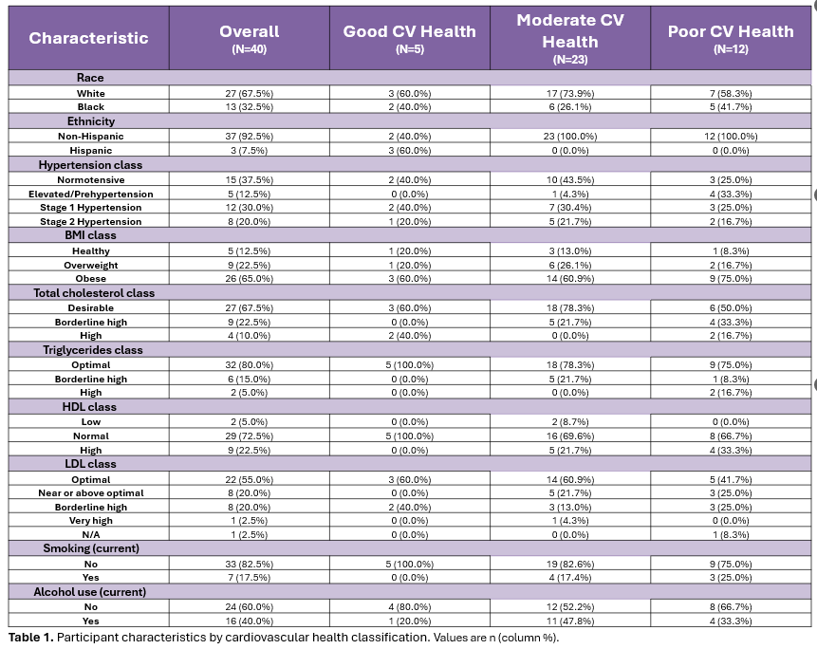
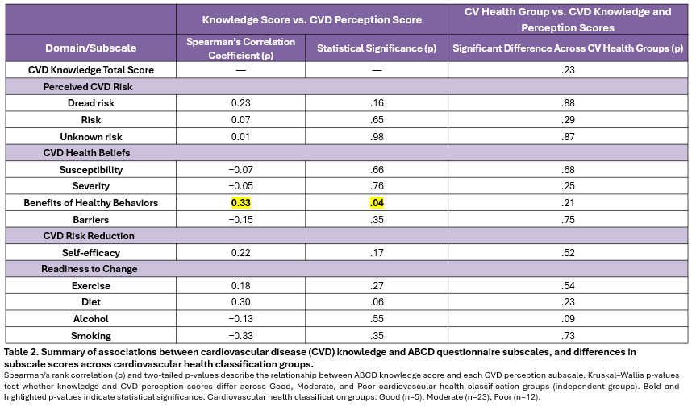
Cardiovascular Disease Risk Knowledge and Risk Perception Among Women with a History of Preeclampsia
Madelaine L. Pickens, MS3¹; Andrea P. Martinez Santana, MS3¹; J. Hunter Collins, PhD²; Ashley Edwards, PhD²; Edward Veillon, Jr., MD²; Elizabeth F. Sutton, PhD²
¹LSU Health - New Orleans, School of Medicine, New Orleans, LA, 70112
²Woman’s Hospital, Baton Rouge, LA, 70817
Introduction
Demographics and Health Metrics
Results
Preeclampsia is associated with an increased risk of cardiovascular disease (CVD), the leading cause of death for women in the U.S. and may represent the earliest warning sign of CVD risk in a woman's life.
However, many women with a history of preeclampsia have limited CVD risk awareness, and knowledge alone may not be enough to drive behavior change without a sense of personal risk and confidence to act.
We assessed CVD risk knowledge and related perceptions using the Attitudes and Beliefs about Cardiovascular Disease (ABCD) Risk Questionnaire among women with a history of preeclampsia and explored whether these measures differed by cardiovascular health classification.
Greater CVD risk knowledge was associated with stronger perceived benefits of healthy behaviors (ρ = 0.33, p = .040).
CVD risk knowledge was not significantly correlated with perceived risk (dread risk ρ = 0.23, p = .159; risk ρ = 0.07, p = .654; unknown risk ρ = 0.01, p = .977), other health beliefs (susceptibility ρ = −0.07, p = .657; severity ρ = −0.05, p = .759; barriers ρ = −0.15, p = .352), self-efficacy (ρ = 0.22, p = .171), or readiness to change (all p > .05).
No significant differences in knowledge or subscale scores were observed across CV health classification groups (all p > .05).
Discussion
In this cohort, CVD risk knowledge was associated with recognizing the benefits of preventive behaviors but was not linked to perceived personal risk, susceptibility, self-efficacy, or readiness to change, suggesting a gap between CVD risk knowledge and risk perception.
Notably, scores did not differ across CV health classification groups, suggesting that greater cardiometabolic burden did not translate into increased CVD risk knowledge or risk perception.
Limitations include small sample size and limited power for group comparisons. Future studies should include larger sample sizes and evaluate whether targeted counseling improves risk awareness and encourage CVD risk reduction after preeclampsia.
Methods
A prospective observational study of women with a history of preeclampsia between 5-10 years postpartum was conducted at Woman’s Hospital in Baton Rouge, Louisiana in 2023.
We analyzed questionnaire data from participants (n = 40) collected in REDCap and calculated a Knowledge Score (0–15; higher = more CVD risk knowledge) and subscale scores for perceptions of CVD risk, health beliefs, risk reduction, and readiness to change.
Health data were also collected from the participants to determine their cardiovascular health. CV health classification was determined by the number of metabolic syndrome criteria that were met out of the 5 possible conditions (0=Good, 1-2=Moderate, ≥3=Poor).
Spearman correlations assessed associations between Knowledge Scores and CVD perception scores. Kruskal–Wallis tests compared scores across CV health classification groups (Good n = 5, Moderate n = 23, Poor n = 12).
CVD Risk: Knowledge and Perception
References
Oliver-Williams C, Johnson JD, Vladutiu CJ. Maternal Cardiovascular Disease After Pre-Eclampsia and Gestational Hypertension: A Narrative Review. American Journal of Lifestyle Medicine. 2023;17(1):8-17. doi:10.1177/15598276211037964
Bellamy L, Casas JP, Hingorani AD, Williams DJ. Pre-eclampsia and risk of cardiovascular disease and cancer in later life: systematic review and meta-analysis. BMJ. 2007;335(7627):974. doi:10.1136/bmj.39335.385301.
Okoth K, Chandan JS, Marshall T, et al. Association between the reproductive health of young women and cardiovascular disease in later life: umbrella review. BMJ. 2020;371:m3502. Published 2020 Oct 7. doi:10.1136/bmj.m3502.
Charlton F, Tooher J, Rye KA, Hennessy A. Cardiovascular Risk, Lipids and Pregnancy: Preeclampsia and the Risk of Later Life Cardiovascular Disease. Heart, Lung and Circulation. 2014;23(3):203-212. doi:10.1016/j.hlc.2013.10.087.
Paauw ND, Lely AT. Cardiovascular Sequels During and After Preeclampsia. In: Kerkhof PLM, Miller VM, eds. Sex-Specific Analysis of Cardiovascular Function. Vol 1065. Advances in Experimental Medicine and Biology. Springer International Publishing; 2018:455-470. doi:10.1007/978-3-319-77932-4_28.
Haukkamaa L, Salminen M, Laivuori H, Leinonen H, Hiilesmaa V, Kaaja R. Risk for subsequent coronary artery disease after preeclampsia. The American Journal of Cardiology. 2004;93(6):805-808. doi:10.1016/j.amjcard.2003.11.065
Smith GN, Walker MC, Liu A, et al. A history of preeclampsia identifies women who have underlying cardiovascular risk factors. Am J Obstet Gynecol. 2009;200(1):58.e1-58.e588. doi:10.1016/j.ajog.2008.06.035
Drost JT, Arpaci G, Ottervanger JP, et al. Cardiovascular risk factors in women 10 years post early preeclampsia: the Preeclampsia Risk EValuation in FEMales study (PREVFEM). Eur J Prev Cardiolog. 2012;19(5):1138-1144. doi:10.1177/1741826711421079
Melchiorre K, Sutherland GR, Liberati M, Thilaganathan B. Preeclampsia Is Associated With Persistent Postpartum Cardiovascular Impairment. Hypertension. 2011;58(4):709-715. doi:10.1161/HYPERTENSIONAHA.111.176537
Neerukonda S, Shariati F, Hart T, Stewart M, Elkayam U, Qamruddin S. Cardiovascular effects of preeclampsia. Current Opinion in Cardiology. 2020;35(4):357-359. doi:10.1097/HCO.0000000000000756
Wu P, Haththotuwa R, Kwok CS, et al. Preeclampsia and Future Cardiovascular Health: A Systematic Review and Meta-Analysis. Circ Cardiovasc Qual Outcomes. 2017;10(2):e003497. doi:10.1161/CIRCOUTCOMES.116.003497
Chen CW, Jaffe IZ, Karumanchi SA. Pre-eclampsia and cardiovascular disease. Cardiovascular Research. 2014;101(4):579-586. doi:10.1093/cvr/cvu018

