Slide 1

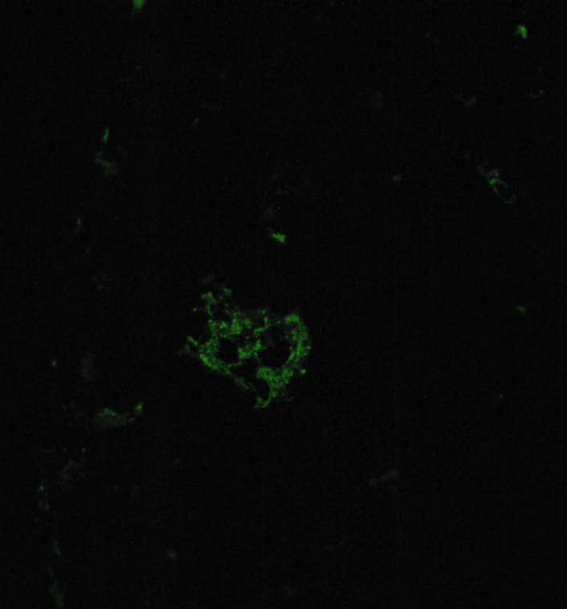
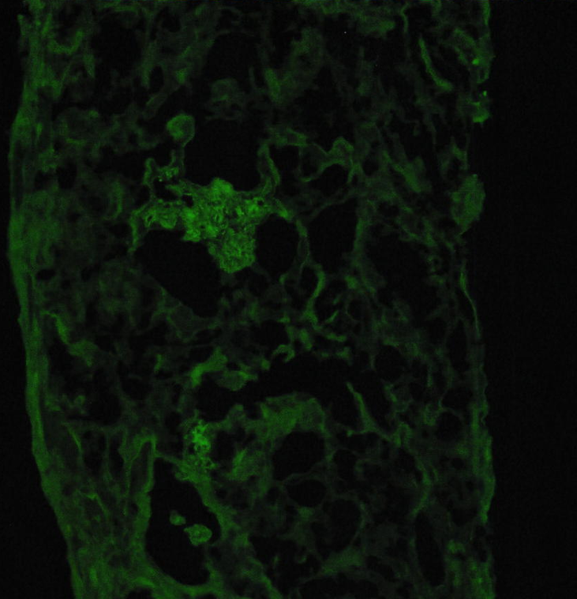
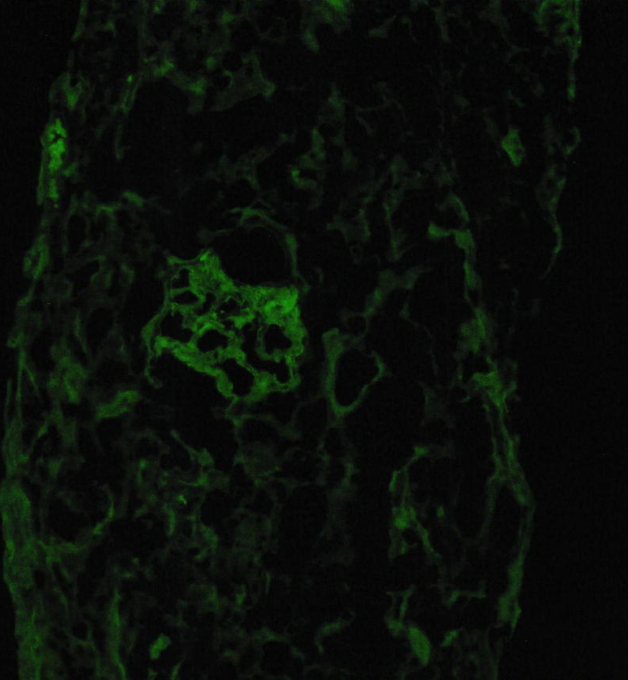
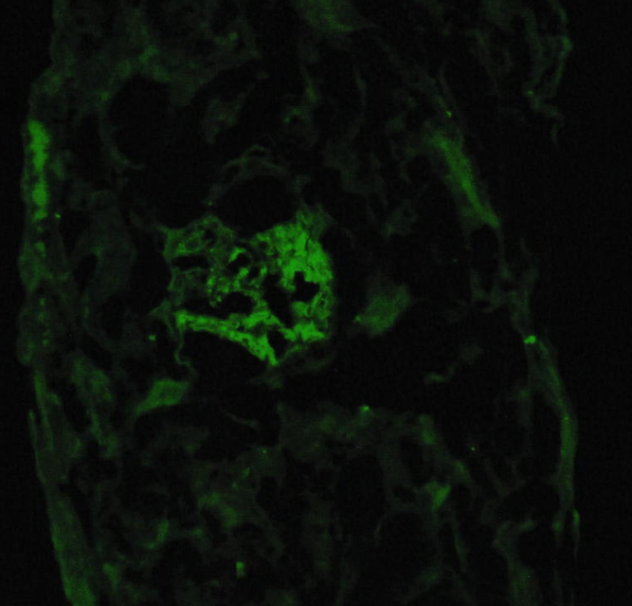
A Mysterious Biopsy: Acute Renal Failure of Uncertain Etiology in an HIV-Positive Patient with Plasmablastic Lymphoma
Madelaine Pickens, MS3¹; Jessica Pickens, MS2¹; Isabella Bartholomew, MS1¹; Michael Millet, MD²; Siddhartha Bajracharya, MD²; Rajesh Mohandas, MD²
¹LSU Health – New Orleans, School of Medicine
²LSU Health – New Orleans, Department of Nephrology
Introduction
Renal Biopsy
Human immunodeficiency virus (HIV) infection causes severe impairment of cellular immunity, resulting in an increased risk of malignancy, most commonly lymphomas.
Plasmablastic lymphoma is an aggressive subtype usually diagnosed in EBV positive patients with HIV.
Both HIV and lymphomas are associated with increased risk of kidney injury due to a variety of mechanisms.
Case Presentation
C3
IgG
A 37-year-old male with a history of recently-diagnosed HIV with unclear adherence to antiretroviral therapy (ART), GERD, hypertension, and hyperlipidemia presented to the emergency department complaining of intermittent abdominal pain, fatigue, and dyspnea for about one week.
He was found to be hypotensive with an elevated WBC count and anemia, which was responsive to intravenous fluids, pressors, and blood transfusions. Workup revealed acute pancreatitis and choledocholithiasis.
The nephrology service was consulted for acute kidney injury (AKI). Urinalysis was significant for microscopic hematuria and nephrotic-range proteinuria. The patient was initiated on hemodialysis, and a renal biopsy was planned. A biopsy of a left superior palatal mass was positive for plasmablastic lymphoma, and the patient was initiated on chemotherapy.
Further workup revealed negative ANCA and hepatitis serologies, and serum complement was normal. A week after the renal biopsy, blood cultures were positive for Klebsiella pneumoniae, he developed acute respiratory distress syndrome and shock, and he expired despite mechanical ventilation, pressors, and maximal supportive care.
kappa
lambda
Renal biopsy results. Immunofluorescence demonstrated C3 (2+), IgG (1+), kappa (1+), and lambda (2+) staining, a complement-dominant pattern. (See pathology photos above.) The renal biopsy light microscopy also revealed a thickened basement membrane, mild mesangial proliferation, and lymphocytic infiltrate. Electron microscopy showed subepithelial electron-dense deposits. (Light microscopy and electron microscopy images were unable to be obtained.)
Discussion
HIV infection has been associated with renal injury both through direct viral infection of the kidney parenchyma or via sequelae of immune dysregulation.
While the nephrotic-range proteinuria, rapid progression to renal failure, and very low CD4 counts are consistent with HIV-Associated Nephropathy (HIVAN), the lack of collapsing focal and segmental sclerosis on renal biopsy is not typical.
The introduction of ART has reduced the incidence of HIVAN, increasing the relative proportion of HIV-Associated Immune Complex Kidney Disease (HIVICK).
HIVICK is characterized by the deposition of immune complexes containing HIV antigens, antibodies, and complement within glomeruli that results in kidney injury with variable biopsy findings.
HIV also causes immune dysregulation, and infiltration of CD138+ plasma cells can also cause acute interstitial nephritis, but minimal plasma cell infiltration seen on biopsy argues against this possibility.
Lymphomas can also directly infiltrate the kidney and cause worsening kidney function. However, the lymphocytic infiltration was modest and would not explain an AKI requiring dialysis.
Our patient’s renal biopsy was initially attributed to post-infectious glomerulonephritis (PIGN) due to the subepithelial deposits on electron microscopy. However, there was no documented infection at the time of the renal biopsy, and Klebsiella pneumoniae bacteremia was detected one week later. This temporal relationship is inconsistent with the diagnostic criteria for PIGN.
C3 glomerulopathy is not typically associated with prominent sub-epithelial deposits, but complement deposits can mimic sub-epithelial humps, and it can often be difficult to distinguish C3 glomerulopathy from PIGN. To further complicate this patient’s renal diagnosis, C3 deposits have also been reported in the context of acute HIV and HIVICK.
In our patient, it is likely that the renal injury was multifactorial, with pathology confounded by initiation of antiretroviral therapy and pancreatitis with shock.
Labs
Urinalysis
Protein: 70 mg/dL (N=0)
Blood: 0.5 mg/dL (N=0)
RBC: 26-50/hpf (N=0)
WBC: TNTC (N=0)
Glucose, ketones: negative
Urine studies
Total protein: 221 mg/dL (nephrotic range)
Protein/Cr ratio: 8,435 mg/g (N < 200)
Immunologic Workup
HIV viral load: 80 copies/ml
CD4 count: 21 /cu mm (N > 500)
Kappa/Lambda Ratio: 8.75 (N < 1.65)
SPEP: M Spike
c-ANCA, p-ANCA: negative
C3 and C4: normal
Hepatitis panel: negative
References
Azagew AW, Abate HK, Ferede YM, Mekonnen CK. Acute kidney injury and its predictors among HIV-positive patients in Africa: Systematic review and meta-analysis. PLoS One. 2024;19(2):e0298302. Published 2024 Feb 9. doi:10.1371/journal.pone.0298302
Booth JW, Hamzah L, Jose S, et al. Clinical characteristics and outcomes of HIV-associated immune complex kidney disease. Nephrol Dial Transplant. 2016;31(12):2099-2107. doi:10.1093/ndt/gfv436
Cassano Cassano R, Bonadio AG, Del Giudice ML, Giannese D, Galimberti S, Buda G. Light chain deposition disease: pathogenesis, clinical characteristics and treatment strategies. Ann Hematol. 2025;104(4):2083-2093. doi:10.1007/s00277-024-05911-9
Ozeki T, Ito S, Sugiura T, Yokoe Y, Yasuda K. IgG-type lymphoplasmacytic lymphoma with light chain deposition disease. CEN Case Rep. 2026;15(1):9. Published 2026 Jan 3. doi:10.1007/s13730-025-01063-5
Rivera FB, Ansay MFM, Golbin JM, et al. HIV-Associated Nephropathy in 2022. Glomerular Dis. 2022;3(1):1-11. Published 2022 Oct 24. doi:10.1159/000526868

