Slide 1

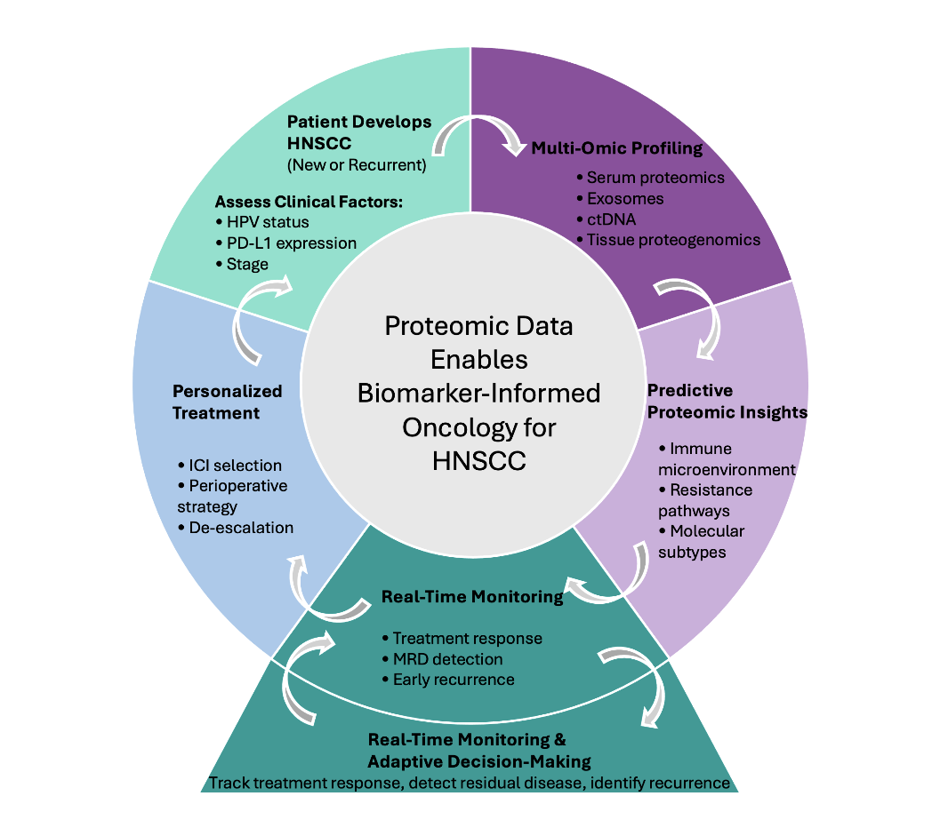
Precision Medicine in Head and Neck Squamous Cell Carcinoma: A Narrative Review
Ethan Leoni B.S.¹, Ethan Abbenante B.S.¹, Sagar Kansara M.D.¹
1: Department of Otolaryngology- Head & Neck Surgery, LSUHSC School of Medicine
Background
Methods
Head and neck squamous cell carcinoma (HNSCC) is diagnosed in approximately 890,000 new cases per year, with survival rates improving only modestly over the past four decades¹. Current multimodal treatment strategies rely on staging criteria that fail to account for molecular differences between tumors, limiting the ability of physicians to predict which patients will respond to treatment. Recent landmark trials have demonstrated the benefits of perioperative immunotherapy², but the lack of predictive biomarkers prevents tailoring treatment to a patient’s tumor. This narrative review examines the current state of proteomics in HNSCC, focusing on its potential to predict treatment response, guide the aggressiveness of treatment, and personalize therapy for patients with unique biomarkers.
A narrative review of literature within the past 10 years was conducted through PubMed and Google Scholar using search terms “single cell RNAseq for HNSCC,” “proteomics HNSCC,” “scRNA seq HNSCC,” “tumor microenvironment HNSCC,” “spatial transcriptomics HNSCC,” "artificial intelligence head and neck cancer", and “biomarkers HNSCC immunotherapy.”
Results
Proteomic approaches show significant promise across multiple clinical applications in HNSCC treatment. Serum proteomics can identify patients likely to respond to treatment before initiation. Single-cell RNA sequencing has revealed the immune environment differs between HPV-positive and HPV-negative tumors and identified molecular subtypes with treatment implications. Spatial proteomics have identified structures such as tertiary lymphoid structure, dendritic cell networks, and neutrophil-associated protein signatures which have demonstrated stronger predictive insight of immunotherapy success than traditional bulk biomarkers. Similarly, panels that evaluate multiple biomarkers perform better than relying on a single marker such as the PD-L1 combined positive score. Despite strong evidence, some obstacles to proteomic use in clinical practice include a lack of standardized protocols for biomarker treatment, limited prospective validation studies, small sample size studies, high costs, and limited elucidation of regulatory pathways in protein synthesis.
Table 1. Summary of Multi-Omic Biomarkers in HNSCC
Biomarker / Signature​ | Study​ | Omic Platform​ | Predictive Performance​
Four-cytokine serum score (CXCL1, MCP-4, IL-6, CD40)​ | Saif et al. (2025)​ | Olink Target 96 Immuno-Oncology panel​ | C-index 0.71 (discovery), 0.79 (validation) for OS; adjusted HR 2.07 (95% CI 1.26–3.41)​
CD8+ T cell subsets (CD103− Tcm [c03] and CD28− Temra [c17]) combined with plasma proteins IL-5 and MMP7​ | Zhang et al. (2025)​ | Mass cytometry (CyTOF) + Olink 92-plex targeted proteomics​ | AUC 0.9219 for neoadjuvant ICI response​
13 CRT-specific downregulated serum proteins (incl. FASLG, IL-12, TNFSF14) and longitudinal markers (CCL20, ARG1, CCL17)​ | Astradsson et al. (2022)​ | 83-protein Olink immuno-oncology panel​ | Identified chemoradiation-specific immune remodeling signatures​
MMP-9, chemerin, actin (salivary proteins)​ | Khijmatgar et al. (2024)​ | Network meta-analysis of 37 studies (primary detection methods used were UPLC-MS and RT-qPCR)​ | MMP-9/chemerin: sensitivity 0.94, accuracy 0.93; actin: sensitivity 0.91​
Buffy coat and saliva proteomic signatures (CD11b, SRSF3, TRA2A)​ | Busso-Lopes et al. (2022)​ | Mass spectrometry (~2,035 protein groups/sample)​ | Buffy coat AUC 0.953 (sens. 93.3%); saliva AUC 0.919 (sens. 83.4%) for nodal metastasis​
Plasma small extracellular vesicles (TCR/CD3+ and PD-L1+ CD3-)​ | Zandberg et al. (2024)​ | Flow cytometry-based EV phenotyping​ | High levels associated with improved OS (HR 0.16, p=0.007) and PFS (HR 0.16, p=0.005); high PD-L1 on tumor-enriched CD3(-) sEVs also significantly predicted better OS (p=0.005) and PFS (p=0.04)​
Personalized RaDaR ctDNA assay​ | Flach et al. (2026)​ | Tumor-informed ctDNA (plasma + saliva)​ | 91.3% recurrence detection with lead times up to 500 days before clinical relapse; 237-fold increased recurrence risk if positive post-treatment​
CCR7+ dendritic cell niches at tumor periphery​ | Oh et al. (2025)​ | 21-protein multiplex spatial proteomics (FAST imaging)​ | Multiparametric spatial scores (MPSS) of DC niches outperformed standard PD-L1 scoring to predict overall survival to pembrolizumab​
TLS density and presence within 100 μm of tumor edge​ | Ruiz-Torres et al. (2025)​ | Custom multiplex immunofluorescence (mIF) with machine learning​ | TLS density was the leading predictor of ICB response (80% accuracy for predicting both response and 1-year overall survival)​
Spatial PD-1/PD-L1 interaction mapping (40 nm resolution)​ | Naei et al. (2025)​ | In situ proximity ligation assay (isPLA) with multiplex spatial proteomics​ | Identified macrophage barriers in non-responders; B/T cell clusters in responders​
Compartmentalized immune checkpoint and TNFR superfamily biomarkers​ | Sadeghirad et al. (2023)​ | NanoString GeoMx DSP + Akoya PhenoCycler-Fusion​ | Responders: high PD-L1/B7-H3, low VISTA; survival correlated with spatially compartmentalized 4-1BB, CD40, CD27​
Three intrinsic consensus molecular subtypes (iCMS1–3)​ | Dai et al. (2023)​ | Integrated scRNA-seq + bulk RNA-seq​ | iCMS1: worst survival, EGFR-sensitive; iCMS2: best survival, PD-1-sensitive; iCMS3: 5-FU/MEK/STAT3-sensitive​
Neutrophil risk score (NRS)​ | Cui et al. (2025)​ | scRNA-seq + bulk RNA-seq validation​ | High NRS: poorer prognosis; low NRS: better immune complex inhibitor response; OLR1 identified as tumor-promoting gene​
11-gene M2 TAM signature + CD276 (B7-H3)​ | Wang et al. (2025)​ | scRNA-seq + bulk RNA-seq validation​ | Independent predictor of survival (superior to traditional clinical indicators); high-risk tumors show elevated CD276 (B7-H3) targetability.​
Three proteogenomic subclasses (CIN, Basal, Immune)​ | Huang et al. (2021) / CPTAC​ | Integrated DNA, RNA, protein, phosphoprotein profiling​ | Identified subclass-specific therapeutic vulnerabilities not evident from genomics alone (CIN to CDK4/6 inhibitors; Basal to EGFR mAbs; Immune to immunotherapy).​
PIK3CA mutation-specific drug sensitivities​ | Swaney et al. (2021)​ | Affinity purification–mass spectrometry (AP-MS) PPI network mapping​ | Helical domain mutations sensitize to PI3Ki via HERPUD1 interaction; kinase domain does not​
CMTM6 protein expression + CTLA-4/FOXP3 gene signatures​ | Becker et al. (2023)​ | NanoString (RNA) + IHC (protein)​ | High CMTM6improved OS (prognostic) and predicts favorable RT response; low CTLA-4/FOXP3 predicts ICI response​
TP53 mutations in HPV-positive tumors (~10% prevalence)​ | Gencel-Augusto et al. (2025)​ | TCGA multi-omics (genomic, transcriptomic, methylation) + CRISPRi functional models​ | Eliminates HPV-associated survival advantage; identifies high-risk subgroup that is sensitive to PI3K inhibitors ​
Six sialylated N-glycans correlated with metastatic status​ | Carnielli et al. (2023)​ | Quantitative N-glycomics and N-glycoproteomics (LC-MS/MS)​ | Accurately predict lymph node metastasis; core-fucosylated glycans (40a/46a) and a fibronectin N-glycopeptide strongly associate with poor survival.​
Figure 1. Use of Biomarkers in Individualized Care Plan for HNSCC Patients
Conclusion
Proteomics in HNSCC is a powerful tool that can reshape how we approach treatment of patients with HNSCC with biomarker-driven care. However, clinical implementation requires prospective validation studies, standardized protocols, and multi-omics integration to fully develop individualized treatments for HNSCC patients.
References
1: Barsouk, A.; Aluru, J.S.; Rawla, P.; Saginala, K.; Barsouk, A. Epidemiology, Risk Factors, and Prevention of Head and Neck Squamous Cell Carcinoma. Med. Sci. 2023, 11, 42, doi:10.3390/medsci11020042.
2: Uppaluri, R.; Haddad, R.I.; Tao, Y.; Le Tourneau, C.; Lee, N.Y.; Westra, W.; Chernock, R.; Tahara, M.; Harrington, K.J.; Klochikhin, A.L.; et al. Neoadjuvant and Adjuvant Pembrolizumab in Locally Advanced Head and Neck Cancer. N. Engl. J. Med. 2025, 393, 37–50, doi:10.1056/NEJMoa2415434.

