Slide 1

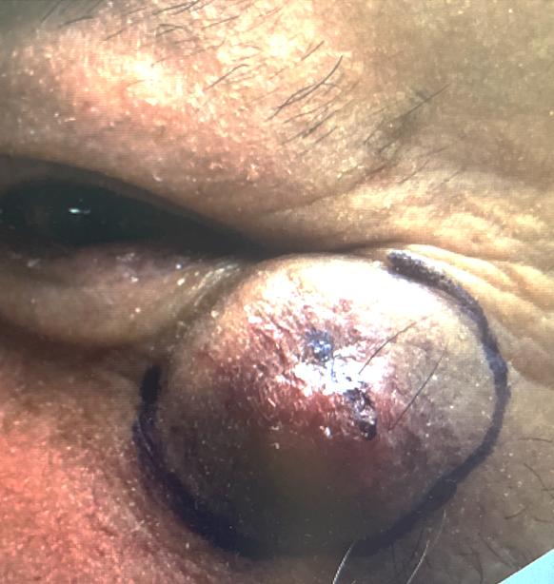
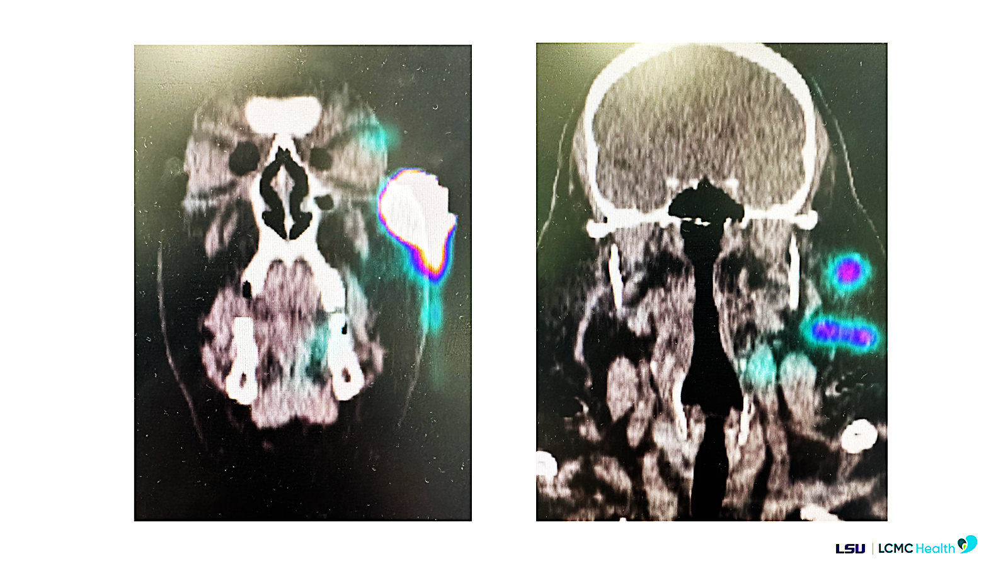
Current Trends in Clinical Trials for
Merkel Cell Carcinoma (MCC)
Tilak Patel, MD¹ ; Rachel Butz Crow, BS² ; Brian Boulmay, MD¹ ; Vilija Vaitaitis, MD³
¹ Section of Hematology-Oncology, ² School of Medicine, ³ Department of Otolaryngology
Louisiana State University Health Sciences Center - New Orleans, LA
BACKGROUND
MCC has an increasing incidence with a high mortality rate. Clinical research has made significant advancements in the management of MCC,
shifting standard of care from chemotherapy to immunotherapy. However, further investigations
are needed to improve patient outcomes in those with advanced or refractory disease.
MCC is a rare, aggressive neuroendocrine cutaneous malignancy with high rates of metastasis, recurrence, and mortality
Approximately 1600 cases per year in the U.S.
Incidence is rising due to an aging population and increasing UV sun exposure
Majority of cases are associated with the Merkel cell polyomavirus
Treatment has historically included surgery, radiation, and cytotoxic chemotherapy
Chemotherapy had beneficial initial response rates but no durable remission beyond 1 year
Immune checkpoint inhibitors have demonstrated more favorable outcomes
Current research is focusing on improving outcomes in advanced or refractory disease
RESULTS
Anti-PD-1/PD-L1 antibodies:
avelumab ORR 33%
pembrolizumab ORR 56% (24% complete)
nivolumab ORR 60%
retifanlimab ORR 52% (18% complete)
Effective regardless of viral status
Most responders in remission at 1 year
2-year survival rates around 60-70%
CTLA-4 blockade:
nivolumab + ipilimumab
Naïve ORR 100% (41% complete)
Previous immunotherapy ORR 31%
Adding radiation did not significantly improve response rates
Adjuvant Immunotherapy:
vs. Observation in resected MCC:
ipilimumab no improvement DFS
nivolumab 2-yr DFS improved 10%
pembrolizumab ongoing
avelumab in MCC with nodal metastasis after surgery and radiation ongoing
Potential future molecular targets:
Inosine monophosphate dehydrogenase 2
Nicotinamide N-methyltransferase
A
B
C
(A) Clinical photograph of a MCC tumor that appears erythematous and well-circumscribed; (B,C) Coronal computed tomography images showing radiotracer uptake by the MCC tumor.
METHODS
A literature review was completed, including the following clinical trials:
JAVELIN Merkel 200, KEYNOTE-017,
CheckMate 358, PODIUM-201, ADMEC, ADMEC-O, STAMP, ADAM, Hypofractionated Radiation Therapy for MCC, Testing the Addition of
Radiation Therapy to Immunotherapy for Patients With Stage III-IV MCC, GoTHAM, CARTA,
Intratumoral PH-762 for Cutaneous Carcinoma
Objective response rate (ORR) was used to describe treatment efficacy
CONCLUSIONS
CLINICAL SIGNIFICANCE
Immune checkpoint blockade is now first-line for unresectable and metastatic MCC
No checkpoint inhibitor has been approved for adjuvant MCC, pending ongoing phase III trials
Ongoing investigations are evaluating adjuvant radiation, intra-tumoral injections, IMPDH2 and NNMT inhibition, innate immune activators, and multi-checkpoint blockade

