Slide 1


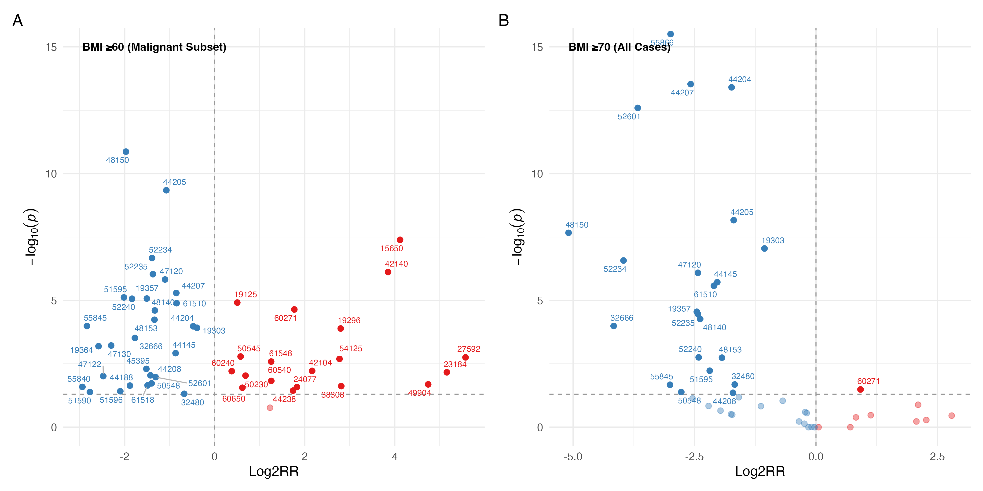
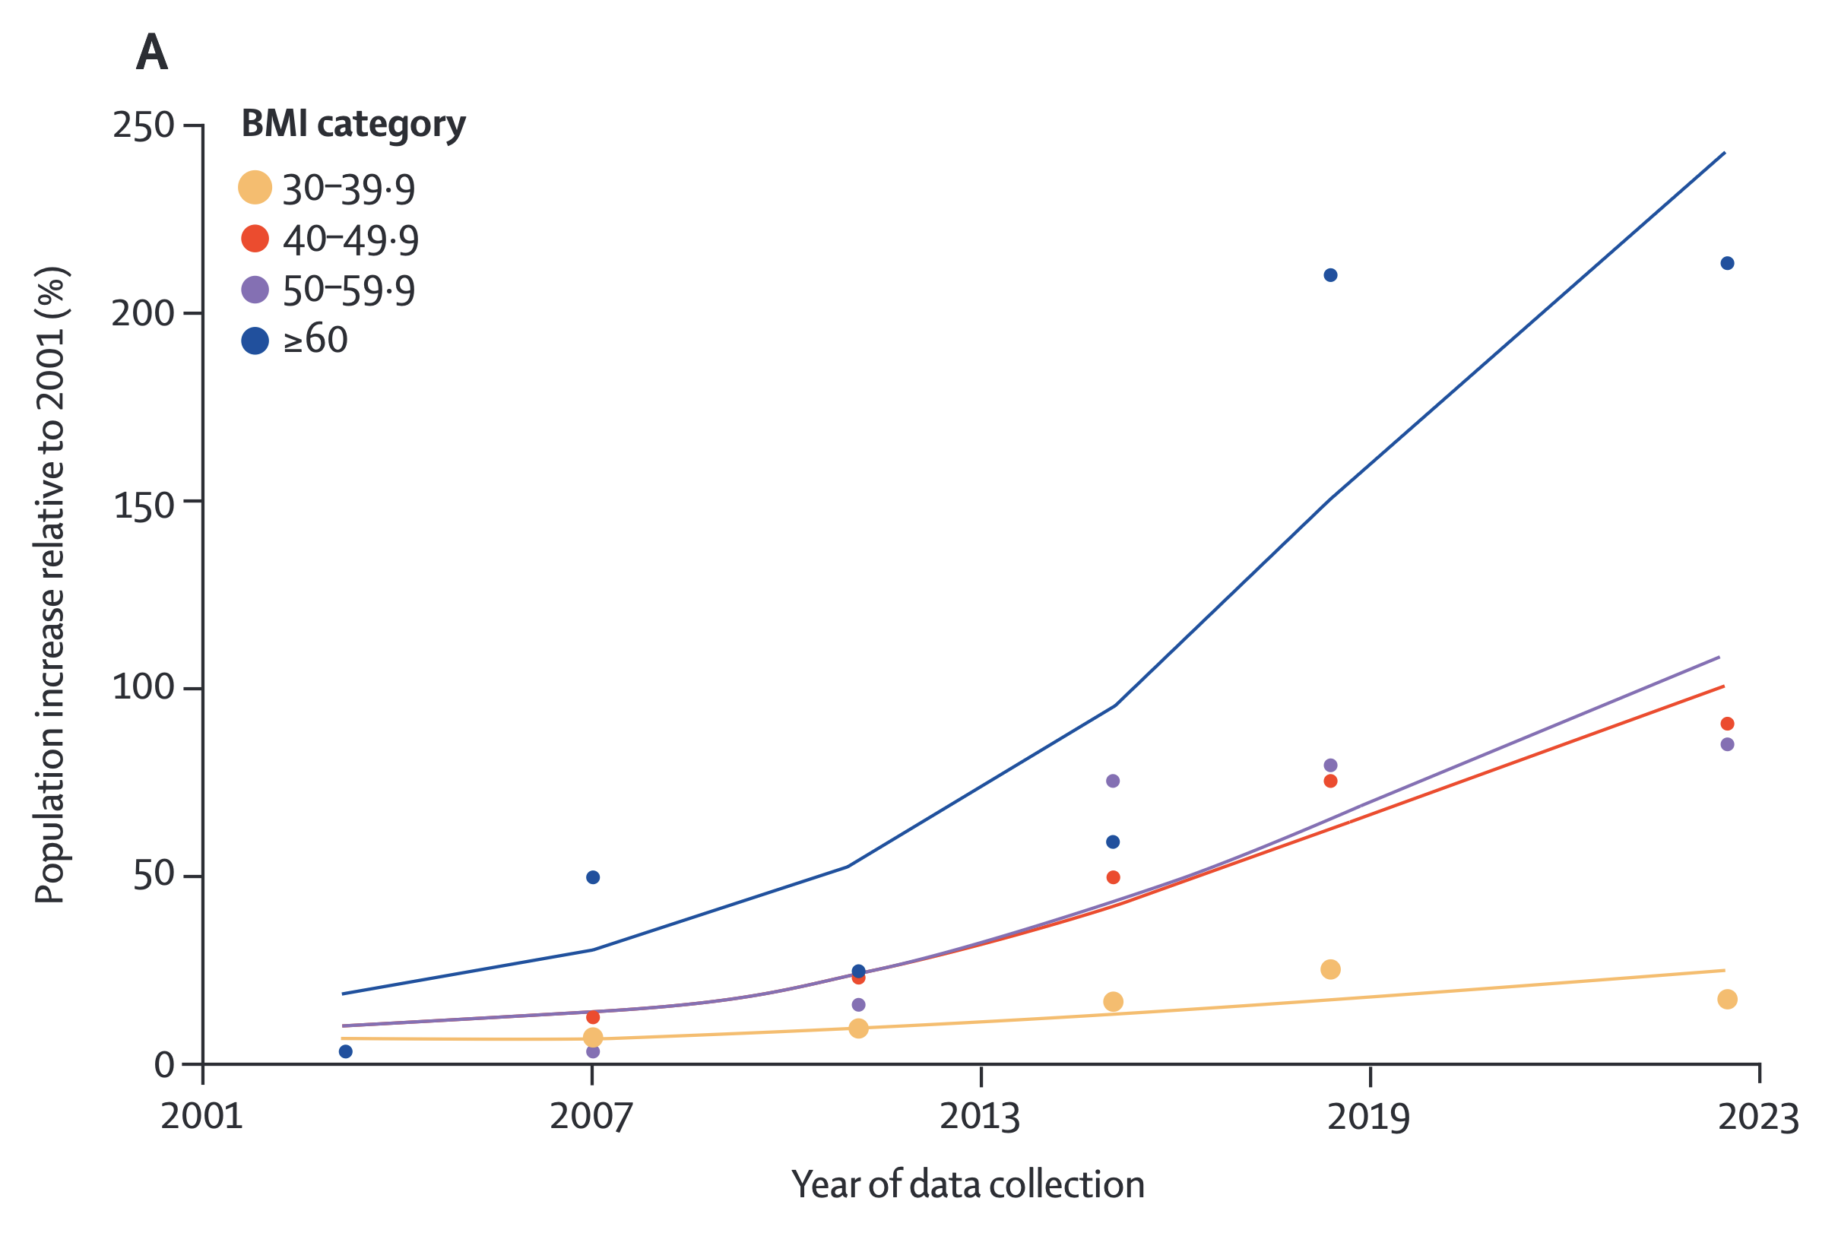
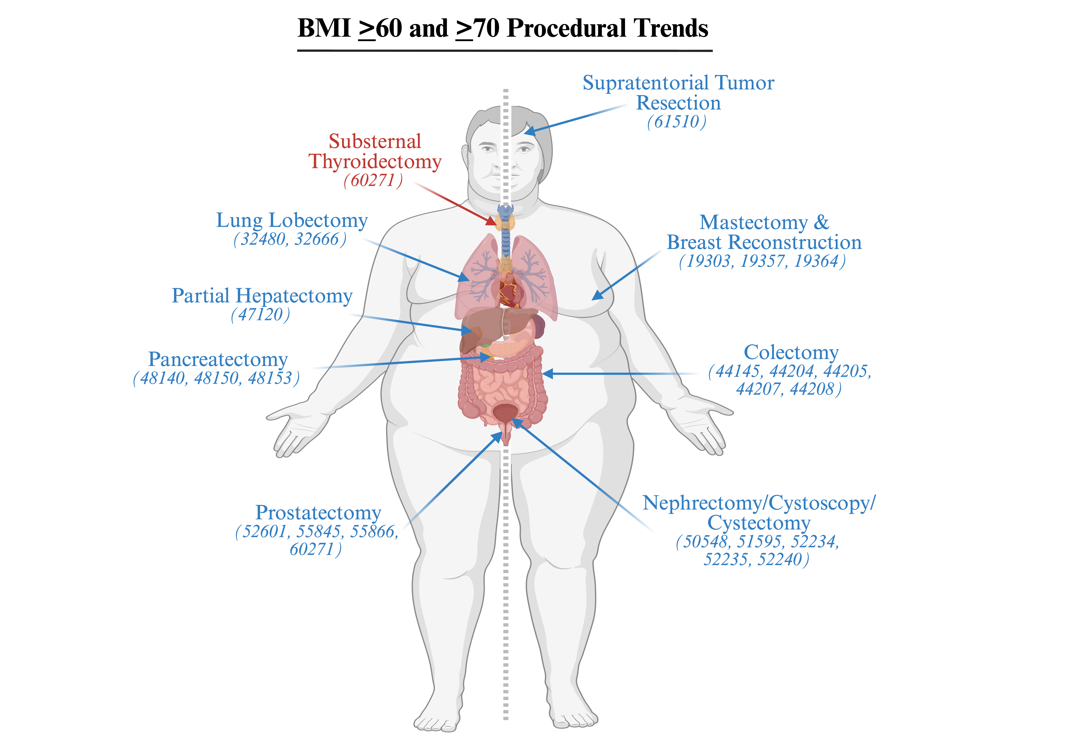
BMI > 60 and >70 Associated with Decreased Access to Oncologic Surgical Care: NSQIP Analysis (2005-2022)
John M. Gunaldo BS¹, Michael Kachmar DO^{1,2,4}, Jake E. Doiron PhD¹, Florina Corpodean MD^{1,2}, Carlos Galvani MD^{1,3}, Michael W. Cook MD^{1,3}, Mohammad Al Efishat MD^{1,4}, John M Lyons MD^{1,4}, Philip R. Schauer MD^{1,2,4}, Vance L. Albaugh MD, PhD^{1,2,4,5}
Introduction
Results
  The BMI ≥60 population has increased more than 200% from 2001 – 2023 yet remains underrepresented in clinical research.¹
  Obesity is associated with an increased risk of developing many cancers.²
    Uterine: RR 7.1
    Esophageal Adenocarcinoma: RR 4.8
    Liver: RR 1.8
    Kidney: 1.8
  Obese patients experience worse cancer outcomes, including:
    A 5 kg/m² increase in BMI associated with 15% higher risk of mortality for prostate cancer patients³
    Female breast cancer patients with obesity experience up to 11% decrease in overall survival⁴
  Surgery is often critical for cancer treatment, but surgical access is frequently limited for patients with extreme obesity.⁵
  31/52 oncologic operations performed significantly less for patients with BMI >60
  23/52 surgical operations performed significantly less for patients with BMI >70
  Relative reduction in colectomies, prostatectomies, mastectomies, and pancreatectomies for patients with a BMI >60
A
C
RR<1
RR=1
RR>1
          Brain Lesion Removal
          (61510, 61518)
      Breast Reconstruction/Mastectomy
      (19303, 19357, 19364)
      Lung Lobectomy
      (32480, 32666)
    Hepatectomy
    (47120, 47122, 47130)
  Pancreatectomy
  (48140, 48150, 48153)
  Colostomy/Colectomy/Proctectomy
  (44145, 44188, 44204, 44205, 44207,
  44208, 45395)
    Cystoscopy/Cystectomy
    (50548, 51590, 51595, 51596, 52234,
    52235, 52240)
        Prostatectomy
        (52601, 55840, 55845, 55866)
          Miscellaneous:
          Laparoscopic Nephroureterectomy (50548)
Diaphragm Imbrication
(39545)
Omentectomy
(49255)
Oral Lesion Excision/
Uvulectomy
    (42104, 42140)
Endocrine Tumor Removal:
Thyroid, Adrenal, Pituitary
(60240, 60271, 60540, 60650, 61548)
Breast Lesion Excision/Catheter Placement
(19125, 19296)
Nephrectomy/Nephroureterectomy
(50230, 50545)
Bone Tumor Resection/ Amputation
(23184, 24077, 27592)
Miscellaneous:
Pedicle Skin Flap (15650)
Penis Amputation (54125)
Unlisted Intestinal Laparoscopy (44238)
Omental Flap (49904)
Lymphangiotomy (38308)
B
D
RR<1
RR=1
RR>1
Breast Reconstruction/Mastectomy
(19303, 19357, 19364)
Lung Lobectomy
(32480, 32666)
Pancreatectomy
(48140, 48150, 48153)
Colectomy
(44145, 44204, 44205, 44207, 44208)
Cystoscopy
(52234, 52235, 52240)
Prostatectomy
(52601, 55845, 55866)
Miscellaneous:
Supratentorial Brain Tumor Removal (61510)
Partial Right Hepatectomy (47120)
Total Nephroureterectomy (50548)
Complete Cystectomy with Sigmoid Conduit (51590)
Oral Lesion Excision/Uvulectomy
(42104,42140)
Endocrine Tumor Removal: Thyroid, Adrenal, Pituitary
(60240, 60271, 60540, 60650, 61548)
Bone Tumor Resection/Amputation
(23184,24077, 27592)
Breast Lesion Excision/Catheter Placement
(19125,19296)
Extensive/Total Hepatectomy
(47122,47130)
Colostomy/Unlisted Intestinal Laparoscopy/Proctectomy
(44188, 44238,45395)
Omentectomy/Omental Flap
(49255,49904)
Nephrectomy/Cystectomy
(50230,50545,51590,51596)
Miscellaneous:
Radical Retropubic Prostatectomy (55840)
Infratentorial Brain Tumor Removal (61518)
Penile Amputation (54125)
Diaphragm Imbrication (39545)
Pedicle Skim Flap (15650)
Lymphangiotomy (38308)
Miscellaneous:
Substernal Thyroidectomy (60271)
Figure 1. Disproportionate Increase in BMI>60 population relative to other BMI thresholds.¹
Figure 2. Surgical CPT Codes for BMI >60 and >70 Versus General NSQIP Database. Volcano plots and Venn diagrams illustrating oncologic procedural CPT code distribution for BMI >60 (A, C) and unspecified procedural CPT codes for BMI >70 (B, D). CPT codes plotted according to respective log₂(RR) and –log₁₀(p-value). Dashed Y-axis line designates p<0.05. Figure E illustrates which procedures patients with a BMI >60 and >70 were less likely to receive compared to the general population.
Methods
  Retrospective cross-sectional study using NSQIP data (2005–2022)
  CPT codes screened for oncologic relevance using keywords and diagnosis fields
  Compared oncologic surgical rates in patients with BMI ≥60 vs 2,055,241 oncologic procedures
  Compared general surgical rates in patients with BMI ≥70 vs 11,634,075 common oncologic surgical procedures
  Statistical methods include relative risk (RR) calculation, two-sided tests of proportion, and paired t-tests
Conclusions
  Patients with BMI >60 and >70 are underrepresented in numerous oncologic procedures
  Most significant reductions for BMI >60
    Partial pancreatectomies (48150)
    Laparoscopic colectomies with partial ileum removal (44205)
    Cystoscopy for small tumor removal (52234)
  Both BMI >60 and >70 analyses showed reductions in highly invasive procedures requiring gastrointestinal restructuring
  Future efforts should prioritize anthropometric data collection to better quantify surgical disparities and outcomes
Institutions
BMI>60
received 38.6%
less oncologic procedures
BMI>70
received 64.2%
less common oncologic
procedures
¹Department of Surgery, Louisiana State University Health Sciences Center, New Orleans, LA, USA
²Metamor Institute, Pennington Biomedical Research Center at Louisiana State University, Baton Rouge, LA, USA
³University Medical Center, New Orleans, LA, USA
⁴Our Lady of the Lake Regional Medical Center, Baton Rouge, LA, USA
⁵Baton Rouge General Hospital, Baton Rouge, LA, USA
References
Kachmar et al. Lancet Diabetes Endocrinol. 2025, 13(6), 463-465.
Lauby-Secretan et al. N Engl J Med. 2016, 375(8), 794-8.
Cao et al. Cancer Prev Res (Phila). 2011, 4(4), 486-501.
Protani et al. Breast Cancer Res Treat. 2010, 123(3), 627-35.
Mee et al. Br J Radiol. 2023, 96(1152), 20230334.

