Slide 1


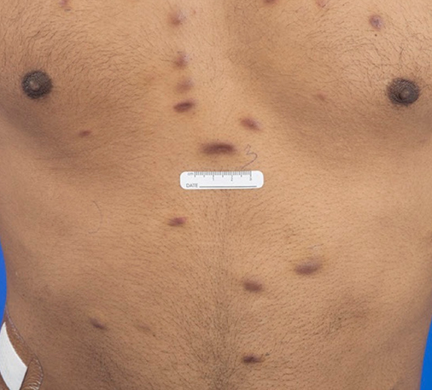
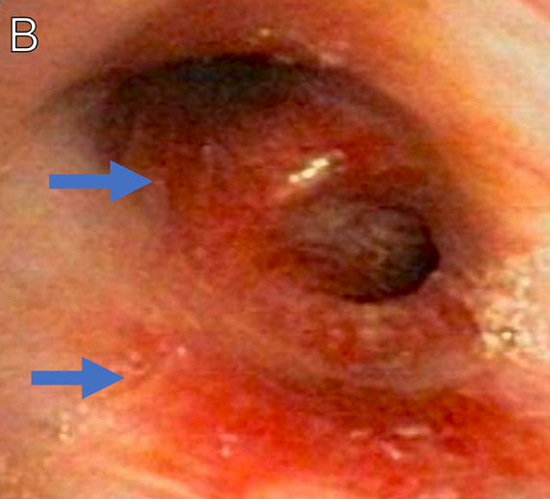
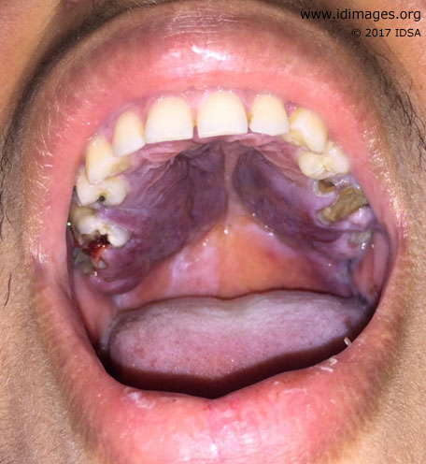
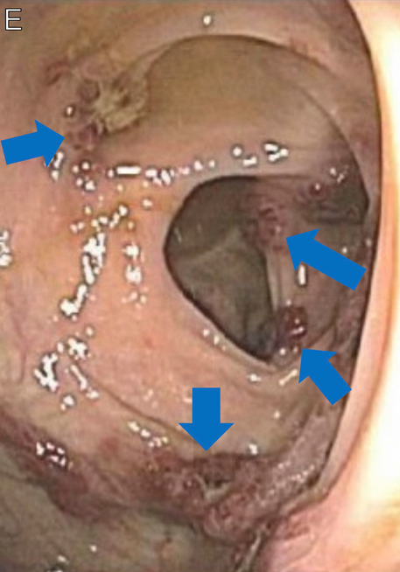
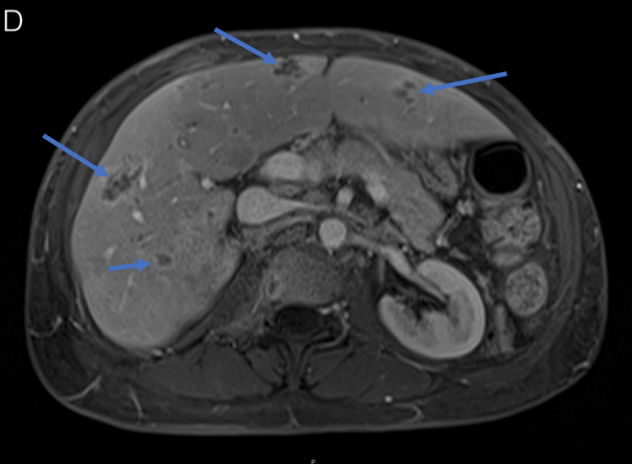
Kaposi Sarcoma: A Decade of Experience at the HIV Outpatient Program in Louisiana
Nali Gillespie, MD, Blane Edwards, MD, Mary Katherine Moore, MD, Sidney Mejia, MD, Kaitlyn Allen, Zari Montegut, James Kinchen, MPH, Paula Seal, MD, MPH, Tat Yau, MD, MPH
Louisiana State University Health New Orleans
Background
Methods
We describe the 10‑year clinical trends and outcomes of PWH with KS receiving care at the HIV Outpatient Program (HOP) at University Medical Center New Orleans (UMCNO).
Kaposi sarcoma (KS) is an AIDS‑defining malignancy associated with Human Herpesvirus 8 (HHV‑8).
It presents with a wide range of manifestations, from localized lesions to disseminated multi-system involvement.
Antiretroviral therapy (ART) is the cornerstone of KS management, with chemotherapy considered when appropriate.
In 2022, Louisiana ranked 4th in the United States for new HIV diagnoses.
As of June 2025, nearly half (47%) of people with HIV (PWH) in Louisiana had an AIDS diagnosis.
Figure 2. Oral lesion of Kaposi Sarcoma.
From: Idimages.org
We conducted retrospective chart review of PWH followed at HOP who were diagnosed with KS between 2015 and 2025.
Demographic variables included age at diagnosis, sex, ethnicity, HIV risk factor, and additional variables such as ART adherence, viral suppression status, staging of KS, Eastern Cooperative Oncology Group (ECOG) score, and 5‑year overall survival were evaluated.
Figure 1. Clinical manifestation of Kaposi Sarcoma. Cutaneous violaceous patches of KS (top left), hyperemic lesions found in bronchoscopy (top middle), colonic involvement of KS found in colonoscopy (bottom left), and hepatic involvement of KS demonstrated by CT scan (bottom right). From “Visual Guide to Opportunistic Infections in People With HIV.” Epling et al, 2025. Top Antivir Med. 2025 Sep;33(4s):605-650.
Patient Characteristics | Numbers
Total number | 37
Gender Female Male Transgender female | 3 (8.1%) 31 (83.8%) 3 (8.1%)
Ethnicity African American Asian Caucasian Hispanic | 28 (75.7%) 7 (18.9%) 1 (2.7%) 1 (2.7%)
HIV Risk Factor Gay, bisexual, and other men who have sex with men (GBM) Heterosexual Intravenous drug use | 26 (70.3%) 8 (21.6%) 3 (8.1%)
CD4 when diagnosed with Kaposi Sarcoma CD4 less than 200 CD4 more than 200 | 25 (69%) 11 (31%)
HIV Suppression when diagnosed with Kaposi Sarcoma Yes (HIV-1 PCR less than 200 copies/mL) No (HIV-1 PCR more than 200 copies/mL) | 4 (11.1%) 32 (88.9%)
Other AIDS-defining illnesses when diagnosed with KS Yes No | 22 (59.5%) 15 (40.5%)
Results
Achieving viral suppression after KS diagnosis was associated with a 3.4‑fold higher likelihood of remission (RR 3.39; 0.91–12.6) and an 83% lower risk of death (RR 0.17; 0.06–0.52).
Chemotherapy use was associated with a 3.1‑fold increased likelihood of remission (RR 3.05; 1.05–8.9).
The combination of viral suppression and chemotherapy was associated with a 3.2‑fold higher likelihood of remission (RR 3.24; 1.26–8.31).
A total of 37 PWH with KS were identified: 31 male, 3 female, and 3 transgender female.
Most patients were African American (28, 76%) and men who have sex with men (MSM) (26, 70%).
At diagnosis, 72% had CD4 count less than 200, and 89% were not virally suppressed (HIV-1 PCR >200 copies/mL).
KS manifestations included: cutaneous (25, 68%), mucosal (12, 32%), lymph node (8, 22%), respiratory (7, 19%), visceral (6, 16%), and bone involvement (2, 5%).
21 patients (57%) received chemotherapy, most commonly doxorubicin (16), followed by paclitaxel (6).
21 patients (57%) achieved remission, and the five‑year survival was 57%.
Manifestation of Kaposi Sarcoma Cutaneous Lymph node Mucosal Visceral Respiratory Skeletal | 25 (67.6%) 8 (21.6%) 12 (32.4%) 6 (16.2%) 7 (18.9%) 2 (5.4%)
ACTG Staging System (TIS Staging) Good risk Poor risk | 3 (8.1%) 34 (91.9%)
ECOG Performance Status Grade 0-1 Grade 2 or above | 33 (89.2%) 4 (10.8%)
Chemotherapy Yes Doxorubicin Doxorubicin with rituximab Paclitaxel No | 21 (56.8%) 16 (43.2%) 2 (5.4%) 6 (16.2%) 16 (43.2%)
Remission Yes No | 21 (56.8%) 16 (43.2%)
HIV Suppression 6-12 months after diagnosed with KS Yes (HIV-1 PCR less than 200 copies/mL) No (HIV-1 PCR more than 200 copies/mL) | 23 (65.7%) 12 (34.3%)
5-Year Survival Alive Deceased | 16 (57.1%) 12 (42.9%)
Viral Suppression | KS Remission | No Remission | Alive | Deceased
Yes | 13 (86.7%) | 10 (50%) | 20 (87%) | 3 (25%)
No | 2 (13.3%) | 10 (50%) | 3 (13.3%) | 9 (75%)
 | RR = 3.39 (95% CI: 0.91 – 12.6) |  | RR = 0.17* (95% CI: 0.06 – 0.52)
Table 3a. Clinical outcomes of PWH with KS stratified by viral suppression status
Chemotherapy | KS Remission | No Remission | Alive | Deceased
Yes | 12 (80%) | 9 (40.9%) | 4 (33.3%) | 11 (68.8%)
No | 3 (20%) | 13 (59.1%) | 8 (66.7%) | 5 (31.2%)
 | RR = 3.05* (95% CI: 1.05 – 8.9) |  | RR = 1.91 (95% CI: 0.9 – 4.05)
Types of Kaposi Sarcoma | Chemotherapy | Remission | Viral Suppression | 5-year survival
Cutaneous (25) | Yes: 15 (60%) | 9 (60%) | 13 (87%) | 80% (12)
 | No: 10 (40%) | 1 (10%) | 4 (40%) | 40% (4)
Lymph Node (8) | Yes: 4 (50%) | 0 (0%) | 3 (75%) | 75% (3)
 | No: 4 (50%) | 2 (50%) | 2 (50%) | 75% (3)
Mucosal (12) | Yes: 6 (50%) | 4 (67%) | 6 (100%) | 100% (6)
 | No: 6 (50%) | 1 (17%) | 2 (33%) | 33% (2)
Visceral (6) | Yes: 3 (50%) | 1 (33%) | 2 (67%) | 67% (2)
 | No: 3 (50%) | 1 (33%) | 2 (67%) | 67% (2)
Respiratory (7) | Yes: 6 (86%) | 3 (50%) | 5 (83%) | 100% (6)
 | No: 1 (14%) | 0 (0%) | 0 (0%) | 0% (0)
Skeletal (2) | Yes: 1 (50%) | 0 (0%) | 1 (100%) | Unknown
 | No: 1 (50%) | 0 (0%) | 0 (0%) | 0% (0)
Table 3b. Clinical outcomes of PWH with KS stratified by use of chemotherapy
Chemotherapy and viral suppression | KS Remission | No Remission | Alive | Deceased
Yes | 11 (73.3%) | 6 (27.3%) | 2 (15.4%) | 15 (62.5%)
No | 4 (26.7%) | 16 (72.7%) | 11 (84.6%) | 9 (37.5%)
 | RR = 3.24* (95% CI: 1.26 – 8.31) |  | RR = 1.96* (95% CI: 1.17- 3.28)
Figure 1. Clinical Outcomes and Relative Risk (RR) for Remission and 5-Year Mortality by Use of Chemotherapy and Viral Suppression Status
Table 3c. Clinical outcomes of PWH with KS stratified by both viral suppression status and use of chemotherapy
Table 1. Patient Characteristics of PWH and KS at HOP from 2015 to 2025
Table 2. Clinical Outcomes of PWH with Various Manifestation of KS
`
`
Conclusion
This study characterizes KS among PWH in New Orleans, a unique city in the Deep South for the past decade.
Although there was an apparent association between mortality and chemotherapy (and chemotherapy with viral suppression), all mortality cases in our study were determined not to be related to complications of KS.
Findings highlight that ART adherence leading to viral suppression, along with appropriate chemotherapy, are critical components of effective KS management.

