Slide 1

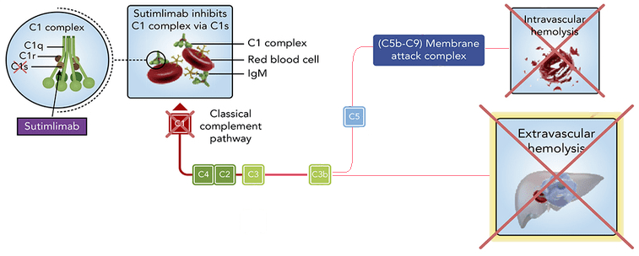
Sutimlimab Therapy in Cold Agglutinin Disease
James Amoss BS, Jeff Amoss BA, Seth Vignes MD, Kyle Hoppens MD
Introduction
Cold agglutinin disease (CAD) is a form of autoimmune hemolytic anemia caused by a proliferation of low grade clonal B-cells that produce monoclonal IgM cold agglutinins. IgM binds erythrocyte surface antigens at low temperatures, leading to activation of the classical complement pathway. This results in C3 deposition on erythrocytes and subsequent extravascular hemolysis and occasionally intravascular hemolysis with the formation of the membrane attack complex. Multiple therapies are available for CAD, including complement targeted and B-cell directed therapy. Sutimlimab, a monoclonal antibody directed against complement protein C1s, selectively inhibits classical pathway activation and represents a potential approach to disrupt the mechanism of hemolysis in CAD.
Figure 1. Sutimlimab mechanism of action and disruption of classical complement pathway. Image source: Enjaymo.com
Discussion
Sutimlimab selectively inhibits C1 complement proteins, preventing initiation of the classical complement pathway when IgM binds to surface antigens of erythrocytes. By interrupting complement activation at its initial step, sutimlimab targets the primary mechanism of hemolysis in CAD and provides an alternative to therapies directed at interfering with monoclonal antibody production by B-cells. The quick and sustained improvement in hemoglobin observed in this case is consistent with clinical trial data demonstrating that classical complement inhibition can effectively prevent hemolysis and restore hemoglobin levels.
Case Presentation
A 53-year-old woman with a two-year history of CAD managed without transfusions developed severe fatigue, dark urine, and myalgias traveling abroad. While returning to the United States, she experienced a syncopal episode boarding the final flight of her trip and was transported to the emergency department. Laboratory evaluation revealed a hemoglobin level of 3.3 g/dL, and ECG demonstrated ST segment depression in the lateral precordial leads. She was emergently transfused with five units of packed red blood cells, resulting in resolution of the ST segment changes, and was discharged after her hemoglobin level remained stable.
Following this episode, she began treatment with four-week cycles of rituximab. After two treatment cycles, she remained intermittently transfusion dependent. Treatment was transitioned to sutimlimab following lack of improvement with rituximab and was administered every two weeks. Four weeks after starting sutimlimab, her hemoglobin increased to 14.2 g/dL. Eight months later, her hemoglobin remained within the normal range on sutimlimab infusions administered every four weeks.
Conclusion
This case demonstrates the central role of complement mediated hemolysis in CAD and the clinical efficacy of targeted complement inhibition with sutimlimab.
References
Röth A, Barcellini W, D’Sa S, et al. Sutimlimab in Cold Agglutinin Disease. New England Journal of Medicine. 2021;384(14):1323-1334. doi:10.1056/NEJMoa2027760.
Dhillon, S. Sutimlimab: First Approval. Drugs 82, 817–823 (2022). https://doi.org/10.1007/s40265-022-01711-5
Moore DC, Arnall JR. Sutimlimab: A Complement C1s Inhibitor for the Management of Cold Agglutinin Disease-Associated Hemolysis. Ann Pharmacother. 2023 Aug;57(8):970-977. doi: 10.1177/10600280221138802.
Enjaymo®. Enjaymo (sutimlimab) official website. https://www.enjaymo.com

