Slide 1

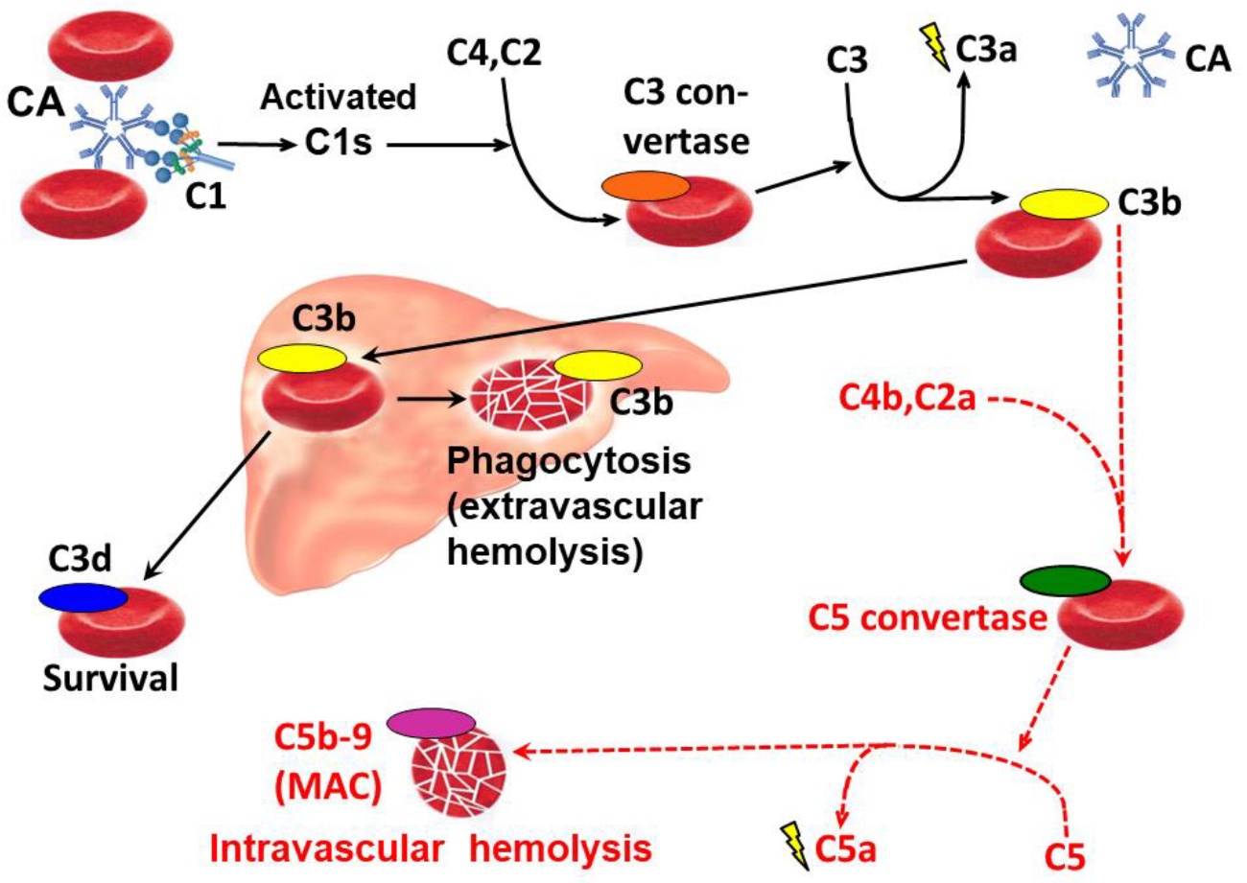
Cold Agglutinin Disease Unmasked by COVID-19 Vaccination
James Amoss, BS; Jeff Amoss, BA; Kyle Hoppens, MD; Seth Vignes, MD
Introduction
Cold agglutinin disease (CAD) is a primary chronic autoimmune hemolytic anemia caused by a low-grade clonal B-cell lymphoproliferative process that produces monoclonal IgM cold agglutinins. These agglutinins lead to complement mediated hemolysis in the absence of an underlying infection or malignancy. Cold agglutinin syndrome (CAS), in contrast, refers to secondary cold agglutinin mediated hemolysis occurring in association with an identifiable trigger, most commonly acute infections (EBV, CMV, Mycoplasma pneumoniae) or lymphoproliferative disorders. Typically, it is a transient process and resolves with treatment of the underlying malignancy or infection. Therefore, distinguishing CAD from CAS is important clinically, as CAD reflects a chronic intrinsic clonal process that may require targeted therapy, whereas CAS is usually transient and managed primarily by addressing the cause and providing supportive care.
Figure 1. Diagram of classical complement cascade in CAD. Image Source: Berentsen et al. 2022
Discussion
The timing of hemolysis shortly after COVID-19 vaccination in this patient suggests immune activation as a possible precipitating event rather than de novo onset of disease. CAD is characterized by monoclonal IgM production, a process that evolves over months to years and is unlikely to arise within days of vaccination. The identification of a clonal B-cell population supports the presence of a pre-existing lymphoproliferative process. COVID-19 vaccination induces marked immune responses, including transient B-cell stimulation and complement activation, which potentially amplified cold-reactive antibody activity and revealed clinically evident hemolysis.
Case Presentation
A 53-year-old previously healthy woman presented to the emergency department with a two-week history of dark urine, body aches, and severe fatigue. One week prior to symptom onset, she received her first dose of the Pfizer COVID-19 vaccination. In the ED, she was found to be severely anemic with a hemoglobin level of 6.9 g/dL and a mean corpuscular volume of 112 fL. Further evaluation revealed a reticulocyte count of 11.3% and a haptoglobin level <1 mg/dL. Direct antibody testing was positive for cold agglutinins. She was initially diagnosed with CAS presumed to be secondary to COVID-19 vaccination. She was treated conservatively without transfusions and demonstrated gradual improvement in hemoglobin over the ensuing weeks. However, over the next few months, she continued to have persistent moderate anemia with evidence of ongoing hemolysis. This prompted bone marrow evaluation to exclude CAD or an underlying lymphoproliferative disorder. Bone marrow biopsy demonstrated a small clonal B-cell population without evidence of lymphoproliferative malignancy, leading to a diagnosis of CAD.
References
Berentsen S, Vos JMI, Malecka A, Tjønnfjord GE, D'Sa S. The impact of individual clinical features in cold agglutinin disease: hemolytic versus non-hemolytic symptoms. Expert Rev Hematol. 2024;17(8):479-492. doi:10.1080/17474086.2024.2372333
Patil NR, Herc ES, Girgis M. Cold Agglutinin Disease and Autoimmune Hemolytic Anemia with Pulmonary Embolism as a Presentation of COVID-19 Infection. Hematol Oncol Stem Cell Ther. 2022;15(4):213-216. Published 2022 Dec 23. doi:10.1016/j.hemonc.2020.06.005
Berentsen S, Barcellini W, D’Sa S, Jilma B. Role of complement in cold agglutinin disease and targets for complement inhibitors. Front Immunol. 2022;13:362608055. doi:10.3389/fimmu.2022.362608055.

