Slide 1

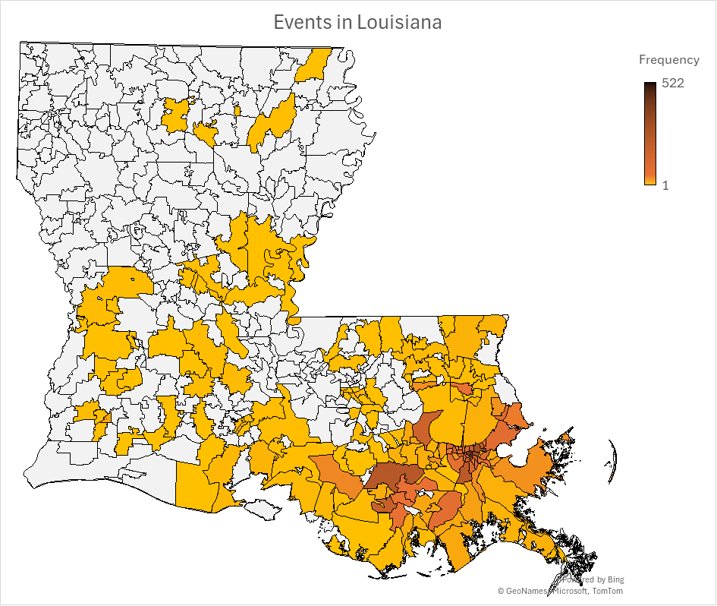
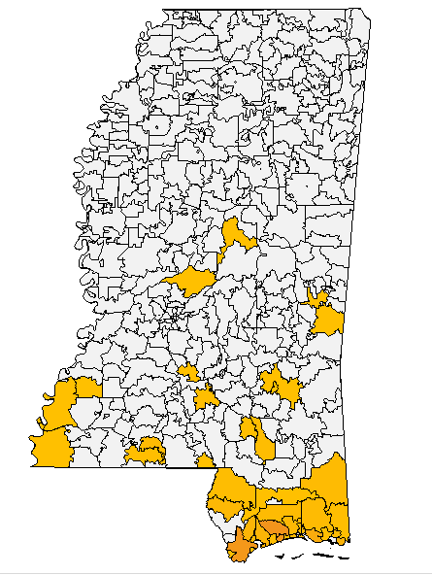
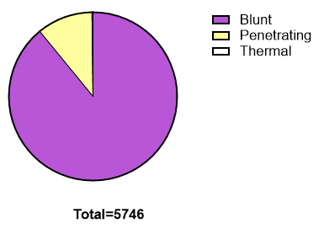
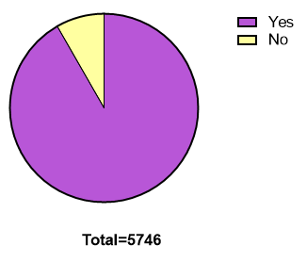
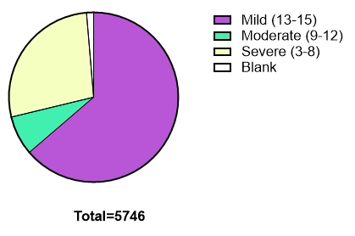
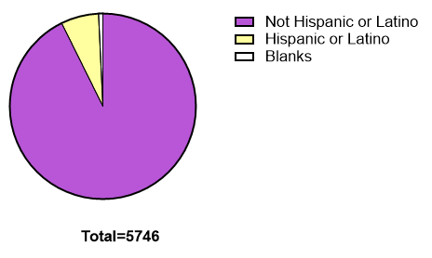
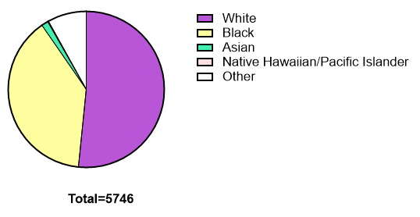
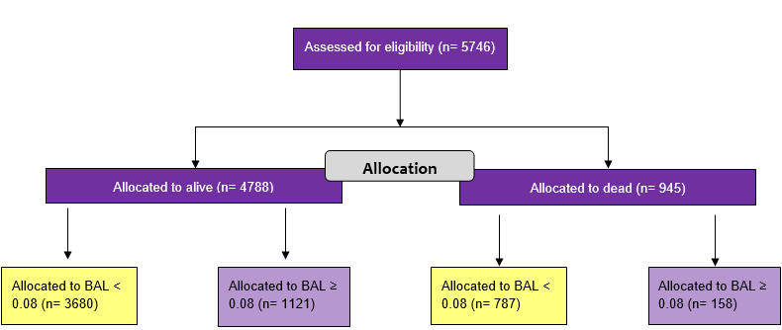
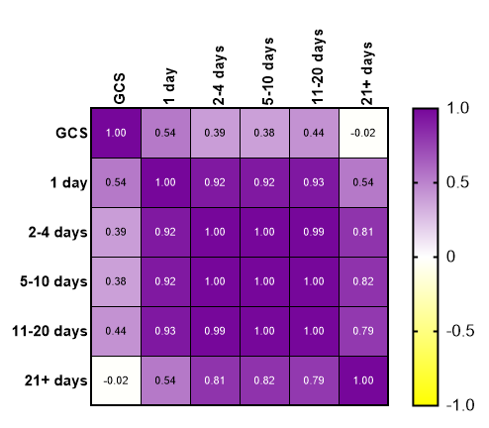
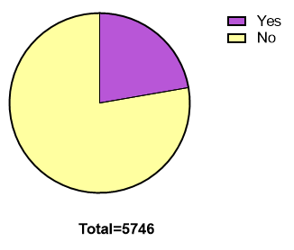
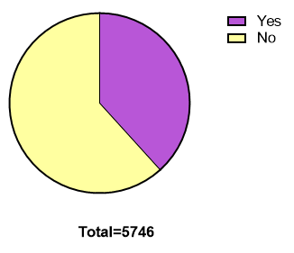
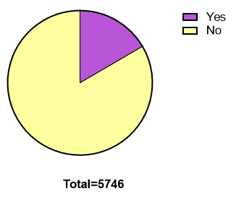
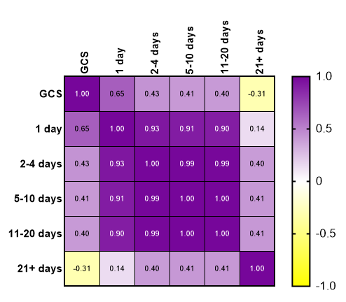
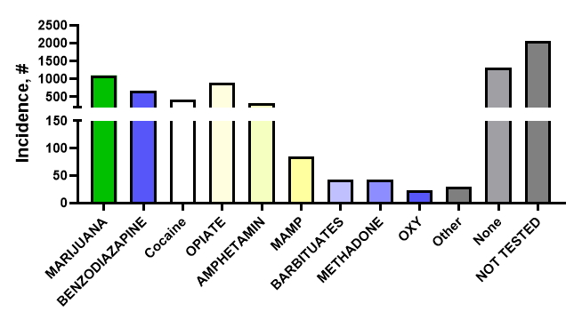
Epidemiologic and Sociodemographic Characterization of Traumatic Brain Injury at a Level I Trauma Center in New Orleans
Tanner Hoole B.A., Xavier Chapa-Dubocq Ph.D.
INTRODUCTION / METHODS
Traumatic brain injury (TBI) is a leading cause of death and disability in the United States, with a disproportionate burden in urban regions due to factors such as interpersonal violence, alcohol misuse, and motor vehicle collisions^{1,2}. In Louisiana, particularly in the New Orleans metropolitan area, these risk factors likely contribute to a uniquely high-risk landscape.
This is the first retrospective observational profile of TBI cases treated at University Medical Center New Orleans (UMCNO), the region’s primary Level I trauma center. Data was obtained from the UMCNO trauma registry from 2016 to 2025.
The study population included all patients presenting with TBI during the study period. Variables extracted include patient demographics (age, sex, race/ethnicity), injury location, temporal trends, injury characteristics (mechanism and injury type), toxicology data (ethanol and drug screening), and injury severity as measured by the Glasgow Coma Scale (GCS).
This presentation highlights the correlation between Blood Alcohol Levels (BALs) over 0.08% (the legal limit) and the Length of Stay (LOS) in the hospital following a TBI.
Figure 1: Longitudinal Trends and Geographic Mapping of TBI Incidence. A) TBI cases increased from 2016 to 2019, followed by a decline in 2020, then plateaued from 2021 to 2025 at levels comparable to 2019. (B) Heat map of TBI injury location by ZIP code.
RESULTS
Demographics
Emergency Assessment
A. Sex (at birth)
A. Injury Type
B. CT Scan
C. GCS
B. Ethnicity
C. Race
Figure 3: Injury Mechanisms, Imaging Assessment, and TBI Severity Distribution in the Cohort. A) Blunt injuries accounted for the majority of cases (89.1%), followed by penetrating injuries (10.7%) and thermal injuries (0.2%). (B) CT scan upon admission. (C) TBI severity classification based on the Glasgow Coma Scale (GCS) scores indicated that 63.7% of cases were mild, 7.5% moderate, 27.4% severe, and 1.4% unidentified (blank).
Figure 2: Demographic Characteristics of the TBI Cohort. (A) TBI patients were 27.9% female (at birth) and 72.1% male (at birth) and (B) predominantly non-Hispanic (92.7%), with 6.6% Hispanic and 0.7% not reported. (C) Racial distribution included 51.6% White, 38.8% Black, 1.4% Asian, 0.2% Native Hawaiian/Pacific Islander, and 8.0% classified as other.
Alcohol Status and Length of Stay–GCS Relationships
A. Initial review of population for alcohol studies
B. Correlation Matrices
-Alcohol
Substance Use Patterns
A. BAL over 0.08%
B. Substance use excluding Alcohol
C. Multi-substance use
excluding Alcohol
LOS
C. GCS Severity vs LOS
+Alcohol
Figure 4: High Prevalence of Alcohol and Drug Exposure, Including Polysubstance Use, in TBI Patients. (A) BAL over 0.08% was detected in 22.3% of patients and (B) approximately 38% tested positive for at least one drugs at the time of assessment. (C) 16.6% presented with polysubstance exposure with (D) various substances.
D. Results of drug screen at UMCNO
LOS
Figure 5: Alcohol Status Is Associated with Injury Severity and Length of Stay Outcomes. (A) Allocation diagram dividing the population based on survival and BALs ≥ 0.08. (B) Correlation Matrices for GCS and LOS for Alcohol negative (BAL < 0.08) and positive (BAL ≥ 0.08). (C) Fisher’s Exact Test comparing the GCS rating ratio of Alcohol positive: Alcohol negative. The ratio was increased for both 1 day Length of Stay (LOS) (P<0.01) and 21+ days LOS (P<0.05).
CONCLUSION
Summary of Results
Future Studies
Among 5,746 TB cases at UMCNO (2016–2025), overall case volume increased over time, with a transient decline in 2020 followed by stabilization.
Alcohol use at the time of injury was significantly associated with prolonged hospital length of stay (≥21 days), but not with increased TBI severity as measured by the GCS.
TBI cases are disproportionately concentrated in urban and peri-urban areas, suggesting a role for urban environmental and socioeconomic factors.
Correlate continuous BALs with GCS scores and LOS to define dose-dependent clinical relationships.
Incorporate the Abbreviated Injury Scale (AIS) as a complementary index of injury severity.
Integrate clinical findings with mechanistic studies to inform targeted therapeutic and prevention strategies for substance-associated TBI, including contributions from cannabis.
Strengthen translational alignment with ongoing preclinical studies investigating alcohol-related mitochondrial dysfunction following TBI.
References
Faul M, Sasser SM, Lairet J, Mould-Millman NK, Sugerman D. Trauma center staffing, infrastructure, and patient characteristics that influence trauma center need. West J Emerg Med. 2015 Jan;16(1):98–106.
Härtl R, Gerber LM, Iacono L, Ni Q, Lyons K, Ghajar J. Direct transport within an organized state trauma system reduces mortality in patients with severe traumatic brain injury. J Trauma. 2006 June;60(6):1250–6; discussion 1256.
Bukur M, Castelo Branco B, Inaba K, Cestero R, Kobayashi L, Tang A, et al. The impact of American College of Surgeons trauma center designation and outcomes after early thoracotomy: a National Trauma Databank analysis. Am Surg. 2012 Jan;78(1):36–41.
Chapa-Dubocq XR, Vita S, Guzmán-Hernández R, Molina PE. Traumatic brain injury and alcohol: A narrative review of the role of mitochondrial dysfunction and ferroptosis in neurocognitive outcomes. Alcohol Clin Exp Res (Hoboken). 2026 Mar;50(3):e70267.

