Slide 1


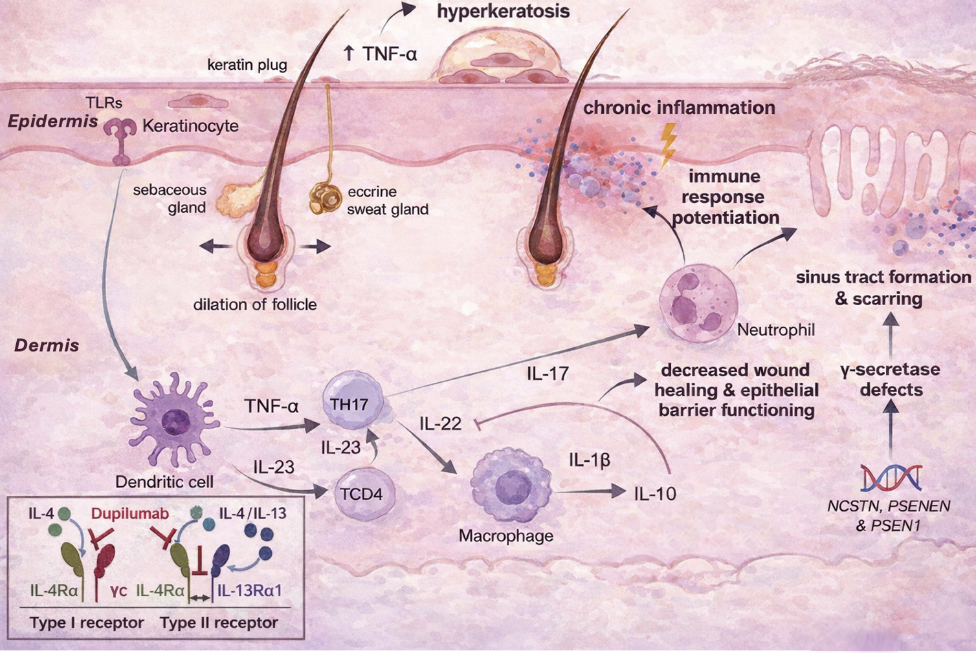
The Use of Dupilumab in Treatment of
Hidradenitis Suppurativa:
A Scoping Review of Emerging Evidence
Victoria Bourgeois, BS¹ · Hayley Sumich, BS¹ · Christopher James Haas, MD, FAAD²
¹Louisiana State University Health Sciences Center, School of Medicine — New Orleans, Louisiana
²Department of Dermatology, Louisiana State University Health Sciences Center, School of Medicine — New Orleans, Louisiana
INTRODUCTION
MECHANISM OF DISEASE & DUPILUMAB'S ROLE
Hidradenitis suppurativa (HS) is a chronic, painful inflammatory skin disease characterized by recurrent nodules, abscesses, and draining sinus tracts. Pathophysiology begins with follicular occlusion leading to rupture, triggering a robust innate and adaptive immune response.
Key pro-inflammatory mediators include
TNF-α, IL-1, IL-17, and critically, IL-4 / IL-13— cytokines driving acute inflammation and fibrotic tissue remodeling. Repeated cycles produce epithelialized tunnels (sinus tracts) resistant to conventional therapy. Dupilumab (Dupixent®) is a monoclonal antibody targeting the shared IL-4Rα subunit, simultaneously blocking both IL-4 and IL-13 signaling — a novel mechanism to potentially interrupt the fibrotic cascade driving sinus tract progression. Objective: To synthesize existing literature on dupilumab in HS with specific focus on clinical outcomes and prevention of sinus tract formation.
METHODS
A scoping review was conducted without date restrictions across four databases:
Figure 1. Pathophysiology of hidradenitis suppurativa and mechanism of dupilumab action. Inset (lower left): dupilumab blocks the shared IL-4Rα subunit, simultaneously inhibiting Type I (IL-4) and Type II (IL-4/IL-13) receptor signaling — disrupting the inflammatory-fibrotic cascade. Adapted from BioRender.com.
PubMed
Embase
Although IL-17/TNF-α pathways predominate, emerging evidence suggests a contributory role of IL-4/IL-13 signaling, supporting the use of IL-4Rα blockade (dupilumab) as a targeted adjunct.
Google Scholar
Cochrane Library
Key search terms: "dupilumab," "IL-13 inhibitor," "hidradenitis suppurativa," "acne inversa," "sinus tract" Two independent reviewers screened all records for relevance and English language eligibility. Data were extracted regarding clinical outcomes, with specific attention to sinus tract formation and disease modification.
RESULTS
CONCLUSION
5 studies included
Dupilumab demonstrates promising but variable early efficacy in hidradenitis suppurativa; most cases reported clinical improvement, while one documented treatment failure highlights the heterogeneity of patient response. Its potential to modulate the fibrotic cascade through targeted IL-4/IL-13 pathway blockade warrants further investigation.
Current evidence is limited to case reports and case series, representing a
significant gap in high-quality data. Prospective, randomized trials are essential to establish dupilumab's role in HS management, optimal dosing strategy, and long-term outcomes.
case reports & case series
Study Type | Primary Clinical Outcome
Case reports | Reduction in nodule & abscess burden
Case reports | Reduction in nodule, abscess & sinus tract burden
All studies | Generally favorable safety profile; variable response noted
PRISMA FLOW DIAGRAM
Records identified via databases (PubMed = 20, Embase = 119)
n = 139
15 duplicates
removed
After duplicate removal n = 124
Inflammatory nodule burden reduced across most reported cases
"IL-4/IL-13 blockade via dupilumab may represent a targeted approach to preventing sinus tract formation — the most debilitating and irreversible sequela of hidradenitis suppurativa."
Subset of patients demonstrated arrest or regression of sinus tract progression
Records screened n = 124
Excluded n = 116
• Not relevant: 111
• Not English: 5
Generally favorable tolerability; one case reported treatment failure (Kluger, 2023)
Responses seen in patients with prior biologic failure (adalimumab)
ACKNOWLEDGMENTS
Full-text assessed for eligibility n = 8
Excluded n = 3
• Full text not available: 3
Concurrent atopic dermatitis noted; consistent with shared IL-4/IL-13 pathophysiology
The authors acknowledge the LSUHSC Department of Dermatology for support in the development of this work.
Evidence Gap: Existing literature consists entirely of case-level data — no randomized controlled trials or prospective cohort studies currently address dupilumab's specific role in sinus tract prevention in HS.
REFERENCES
Studies included in scoping review n = 5
Cho MK, Shin JU, Kim DH, Lee HJ. Severe atopic dermatitis and concurrent severe hidradenitis suppurativa successfully treated with dupilumab. Clin Exp Dermatol. 2022;47(12):2303–2305. 2. Gambardella A, et al. Atopic dermatitis and hidradenitis suppurativa successfully treated with dupilumab. J Eur Acad Dermatol Venereol. 2020;34:e284–e286. 3. Molinelli E, et al. Successful and safe use of dupilumab in severe atopic dermatitis and concomitant HS. Dermatol Ther. 2022;35(8):e15645. 4. McCormack S, et al. Alternate immune pathways in HS responding to dupilumab. Case Rep Dermatol Med. 2023;2023:5189034. 5. Kluger N. Failure of dupilumab in a severe case of hidradenitis suppurativa. Ann Dermatol Venereol. 2023;150(3):241–242. doi:10.1016/j.annder.2023.03.006
LSU Health New Orleans, School of Medicine · Department of Dermatology · MRD 2026

