Slide 1
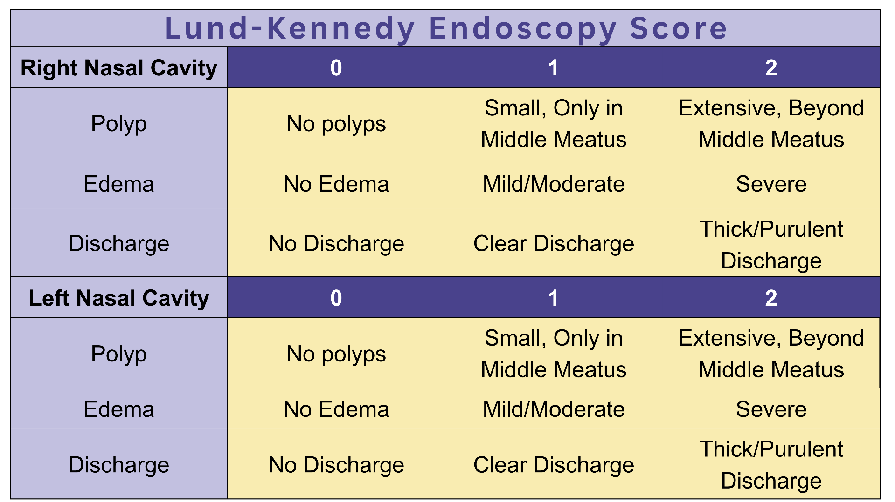
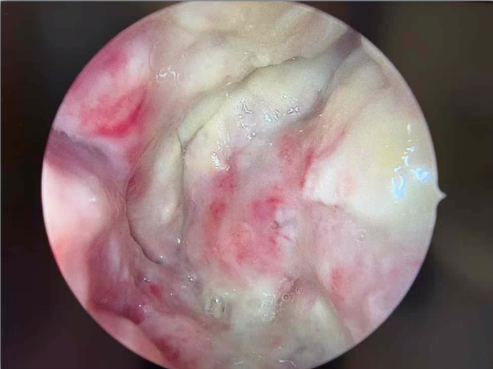
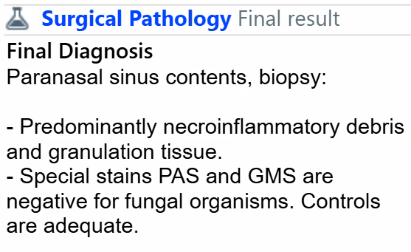
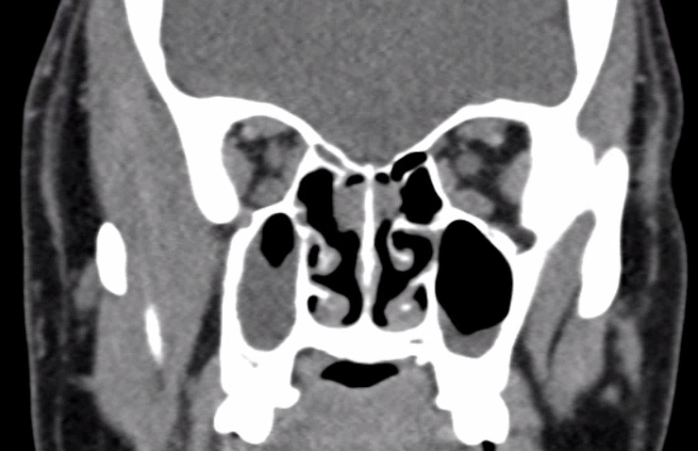
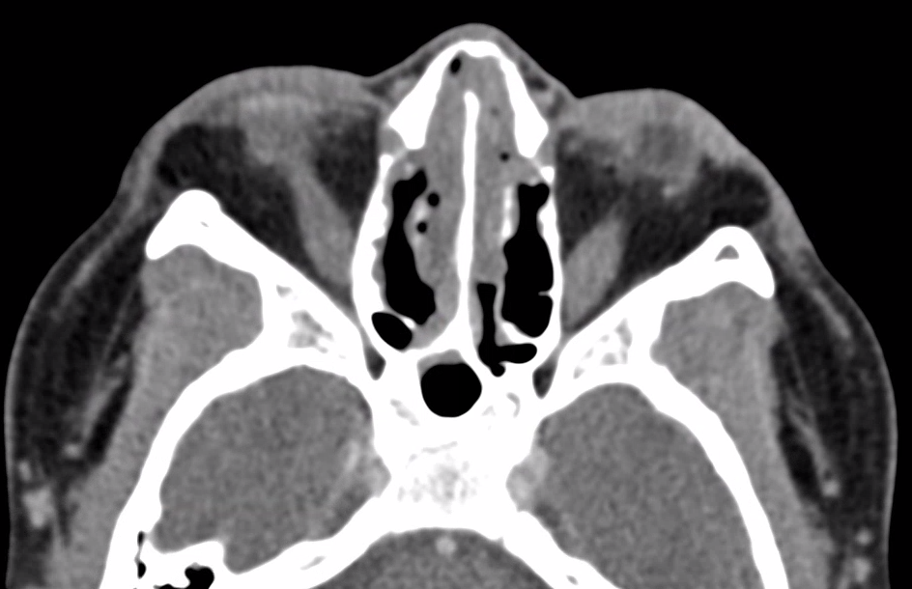
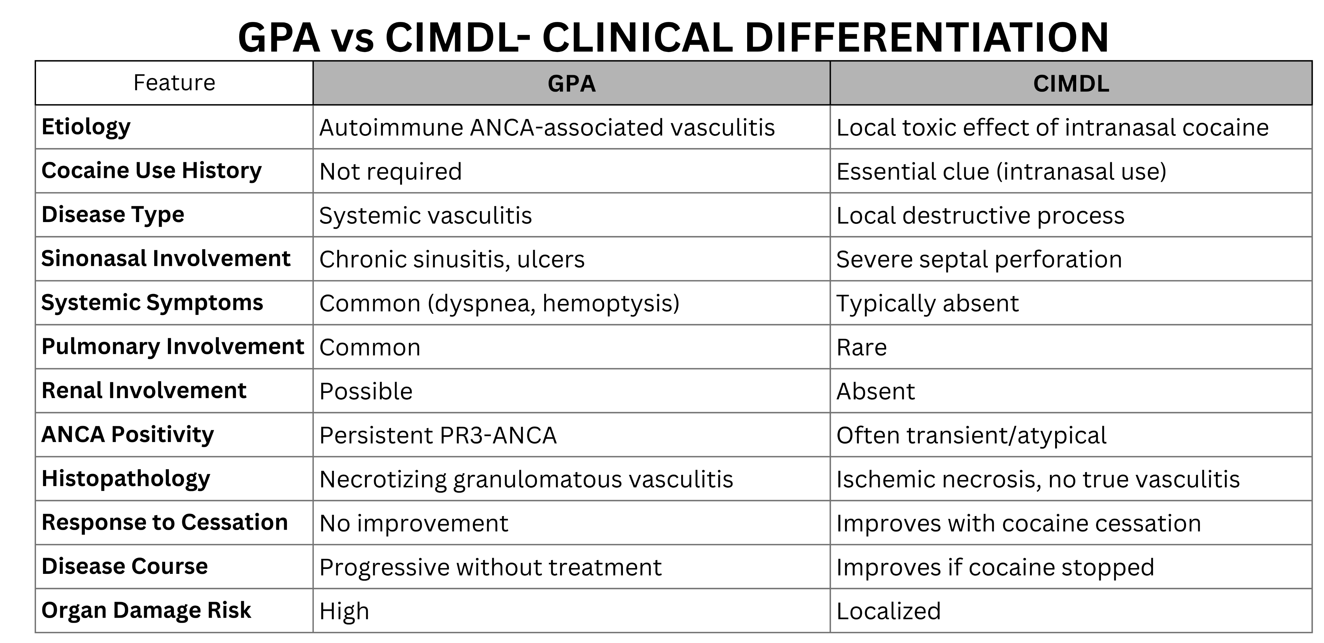
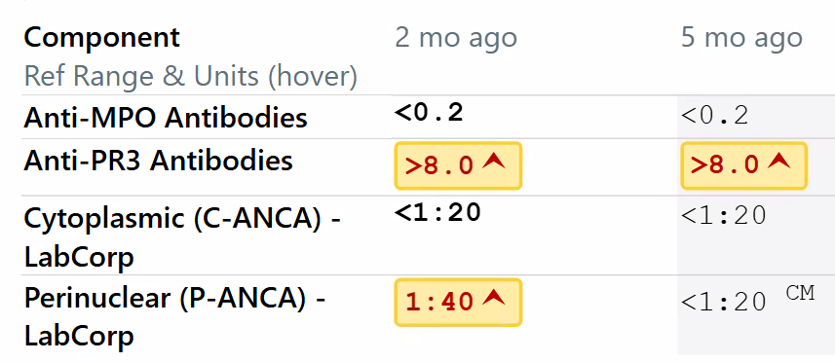

Recognizing Granulomatosis with Polyangiitis in the Setting of
Intranasal Cocaine Use with a Multidisciplinary Approach
Elise Peyroux1, Hanna Almoaswes M.D.2, Keisha Patel1, Nadjel Opamen M.D.2, Sanjay Kamboj M.D.2
1School of Medicine, Louisiana State University Health Sciences Center, New Orleans, LA;
2Department of Medicine, Louisiana State University Health Sciences Center, New Orleans, LA
Introduction
Granulomatosis with polyangiitis (GPA) is a rare, necrotizing small-vessel Antineutrophil Cytoplasmic Antibody (ANCA)-associated vasculitis, characterized by granulomatous inflammation primarily affecting the upper respiratory tract, lungs, and kidneys. It is strongly associated with proteinase-3 antineutrophil cytoplasmic antibodies (PR3-ANCA) and can be found in 70-90% of patients with generalized GPA, and around 60-70% of those with limited GPA without systemic involvement. Clinically, most commonly (90%) presents with upper airway involvement, including chronic sinusitis, nasal congestion, epistaxis, and crusting^{1,2}. As disease systemically progresses, patients may develop nasal septal perforation with saddle-nose deformity, pulmonary nodules, hemoptysis, and glomerulonephritis. Diagnosis of GPA is based on a combination of clinical presentation, serologic testing, imaging, and histopathology, rather than a single definitive test. As stated, PR3-ANCA does have a high specificity for GPA, but it is not entirely diagnostic by itself. Histological findings of necrotizing granulomatous inflammation and vasculitis remain the gold standard when obtainable, though biopsy results may be nonspecific, particularly in limited disease.
A major diagnostic challenge arises from conditions that mimic GPA, particularly in patients presenting with isolated sinonasal involvement. One of the most important mimickers is cocaine-induced midline destructive lesions (CIMDL), also referred to as ENT pseudo-GPA. Chronic intranasal cocaine use can cause ischemia, mucosal necrosis, and progressive destruction of midline structures, leading to septal perforation and chronic sinusitis that are clinically and radiographically indistinguishable from GPA^{3,4}. To further enhance the challenge in deciphering the source of nasal destruction, cocaine use has also been associated with positive ANCA serologies, including PR3-ANCA, likely due to immune activation^{4,5}. This overlap in both clinical presentation and laboratory findings makes it particularly difficult to distinguish between true autoimmune vasculitis and drug-induced disease.
Accurate differentiation between GPA and cocaine-induced disease is critical because management strategies differ significantly. GPA requires prompt immunosuppressive therapy to prevent irreversible organ damage and reduce mortality, whereas cocaine-induced disease is primarily managed through cessation of exposure and supportive care. Misclassification may therefore lead to either unnecessary immunosuppression or delayed treatment of a potentially life-threatening vasculitis.
Table 1: Lund-Kennedy Endoscopy Score
Figure 2: Endoscopic View of Nasal Polyp
Figure 3: Biopsy results of Sinus Contents
IMPRESSION:
Chronic sinusitis, Post surgical changes of bilateral antrostomy,
Sinonasal polyps, Probable pharyngeal polyposis
Figure 4 & Figure 5: CT of the Maxillofacial area with contrast
Case Presentation
Table 2: Comparison Table of Granulomatosis with Polyangiitis (GPA) to Cocaine-Induced Midline Destructive Lesions (CIMDL).
A 50-year-old woman with a history of hypertension and hyperlipidemia, and a social history notable for intranasal cocaine use for over a decade, presented to an otolaryngology clinic with progressive nasal obstruction, anosmia, rhinorrhea, facial pressure, and postnasal drip that had worsened over several years. Several years prior, she had undergone endoscopic sinus surgery for nasal polyps, with symptomatic improvement lasting only a few months. After discontinuing topical steroid therapy and being lost to follow-up, her symptoms gradually returned and progressed. At the time of presentation to otolaryngology, diagnostic nasal endoscopy demonstrated severe grade 4 bilateral nasal polyposis, diffuse mucosal edema with boggy turbinates and thick mucopurulent secretions, with a Lund–Kennedy score of 12, consistent with severe inflammatory disease. During this evaluation, a large nasal septal perforation was identified. In the context of her history, this finding was initially attributed to cocaine-induced midline destructive lesions (CIMDL). At this time, she was referred to Allergy/Immunology to manage chronic rhinitis for further evaluation. She was initiated on topical therapies, including corticosteroid nasal rinses.
Computed tomography of the Maxillofacial area with contrast was ordered and later revealed chronic sinusitis with probable pharyngeal polyposis and postsurgical changes from bilateral antrostomy. Histopathologic evaluation of sinonasal tissue showed necrotic inflammatory debris and granulation tissue, without evidence of fungal infection. Lab evaluation revealed elevated anti-proteinase 3 (PR3) antibody level (>8.0), with negative myeloperoxidase (MPO) antibodies and initially negative c-ANCA and p-ANCA by immunofluorescence. Though the immunofluorescence pattern was negative, the positive antigen specific immunoassay result of PR3-ANCA was of concern for an ANCA-associated vasculitis, so the patient was referred to Rheumatology for evaluation of possible systemic inflammatory disease in the upcoming months.
Over the ensuing weeks, serial ENT follow-up demonstrated objective improvement in endoscopic findings, with resolution of visible polyposis but persistent mucosal edema and secretions. Her Lund–Kennedy scores improved from 12 to 8 and subsequently to 6, reflecting decreasing but ongoing inflammatory activity. Despite improvement in sinonasal findings, she developed new lower respiratory symptoms, including intermittent dyspnea and chronic cough requiring bronchodilator use, along with a single episode of mild hemoptysis. At rheumatologic evaluation, repeat laboratory testing demonstrated persistent high-titer PR3 antibody elevation, with new development of positive p-ANCA, while MPO antibodies remained negative. There was no associated eosinophilia, and infectious workup was still negative. These evolving serologic findings further increased suspicion for ANCA-associated vasculitis, yet still not showing signs of renal involvement.
Through a coordinated multidisciplinary approach involving otolaryngology, allergy/immunology, and rheumatology, and the combination of chronic refractory sinonasal disease, nasal septal perforation, persistent PR3 elevation, new pulmonary symptoms, and evolving p-ANCA serologies, the likelihood for limited granulomatosis with polyangiitis was high. The decision was made to initiate methotrexate with folic acid supplementation. Over subsequent weeks, the patient reported improvement in respiratory symptoms and overall clinical stability, and she continues to undergo close follow-up across specialties with plans for ongoing monitoring of symptoms and serologic markers.
Discussion
This case highlights the diagnostic challenge of distinguishing granulomatosis with polyangiitis (GPA) from cocaine-induced midline destructive lesions (CIMDL). The patient’s 10-year history of intranasal cocaine use and presence of nasal septal perforation initially supported cocaine-induced disease, a known cause of sinonasal destruction due to vasoconstriction and ischemic injury. Additionally, cocaine exposure has been associated with ANCA positivity, including PR3, further complicating interpretation.
Emerging evidence suggests that cocaine may not only mimic vasculitis but may also trigger or unmask ANCA-associated vasculitis in susceptible individuals. Proposed mechanisms include chronic mucosal injury leading to antigen exposure, immune dysregulation, and neutrophil activation with autoantibody formation. This may result in persistent or evolving ANCA positivity rather than the transient patterns more typically seen in isolated drug-induced disease.
However, several features raised concern for an underlying vasculitis process. The patient demonstrated persistently elevated PR3 antibodies, rather than transient serologic findings, along with progression of symptoms despite cessation of cocaine use prior to the initial ENT visit. She also developed new respiratory symptoms, including dyspnea and a single episode of hemoptysis, suggesting evolving systemic involvement. Notably, she lacked renal manifestations, but this does not exclude GPA, as limited disease may initially spare the kidneys.
This case demonstrates the risk of premature diagnostic anchoring in patients with known cocaine use. A key clinical takeaway is that cocaine use does not exclude ANCA-associated vasculitis. Instead, diagnosis should rely on longitudinal assessment, integrating clinical progression, repeat serologies, and multidisciplinary evaluation. Early recognition is critical, as delayed treatment of GPA can lead to irreversible organ damage, whereas cocaine-induced disease is managed with cessation alone.
Conclusion
Granulomatosis with polyangiitis (GPA) remains a critical do-not-miss diagnosis, particularly when presenting with destructive sinonasal disease. This case emphasizes that even in patients with a clear alternative explanation, such as intranasal cocaine use, clinicians must keep their differential diagnosis broad until disease pathophysiology is truly confirmed.
In regions where cocaine use is prevalent, there is an increased risk of potential bias, leading to missed or delayed recognition of GPA. Awareness across multiple specialties, including ENT, allergy/immunology, rheumatology, and primary care, is essential to ensure timely referral, appropriate workup, and early treatment. Ultimately, recognizing GPA requires looking beyond a single risk factor and instead focusing on the overall clinical trajectory, ensuring that subtle but significant patterns are not overlooked. While prior case reports have highlighted this diagnostic overlap, the accumulation of additional cases remains important to expand the evidence base and support future investigations, including case series and broader analyses⁶.
Figure 1: Lab Results from the Anti-Neutrophil Cytoplasmic Antibody panel. Elevated anti-proteinase 3 (PR3) antibody level (>8.0).
Contact
References
Elise A. Peyroux
epeyro@lsuhsc.edu
Dr. Sanjay Kamboj
skambo@lsuhsc.edu
Lutalo, P. M., & D'Cruz, D. P. (2014). Diagnosis and classification of granulomatosis with polyangiitis (aka Wegener's granulomatosis). Journal of autoimmunity, 48-49, 94–98. https://doi.org/10.1016/j.jaut.2014.01.028
Kronbichler, A., Bajema, I. M., Bruchfeld, A., Mastroianni Kirsztajn, G., & Stone, J. H. (2024). Diagnosis and management of ANCA-associated vasculitis. Lancet (London, England), 403(10427), 683–698. https://doi.org/10.1016/S0140-6736(23)01736-1
Armengot M, Garćia-Lliberós A, Gómez MJ, Navarro A, Martorell A. Sinonasal Involvement in Systemic Vasculitides and Cocaine-Induced Midline Destructive Lesions: Diagnostic Controversies. Allergy & Rhinology. 2013;4(2). doi:10.2500/ar.2013.4.0051
Pendolino, A. L., Benshetrit, G., Navaratnam, A. V., To, C., Bandino, F., Scarpa, B., Kwame, I., Ludwig, D. R., McAdoo, S., Kuchai, R., Gane, S., Saleh, H., Pusey, C. D., Randhawa, P. S., & Andrews, P. J. (2024). The role of ANCA in the management of cocaine-induced midline destructive lesions or ENT pseudo-granulomatosis with polyangiitis: a London multicentre case series. The Laryngoscope, 134(6), 2609–2616. https://doi.org/10.1002/lary.31219
Iorio, L., Davanzo, F., Cazzador, D., Codirenzi, M., Fiorin, E., Zanatta, E., Nicolai, P., Doria, A., & Padoan, R. (2024). Cocaine- and Levamisole-Induced Vasculitis: Defining the Spectrum of Autoimmune Manifestations. Journal of clinical medicine, 13(17), 5116. https://doi.org/10.3390/jcm13175116
Major T, Nagy G, Szabó J, et al. Granulomatosis with polyangiitis or its mimic? A case report. Journal of International Medical Research. 2024;52(4). doi:10.1177/03000605241237876

