Slide 1


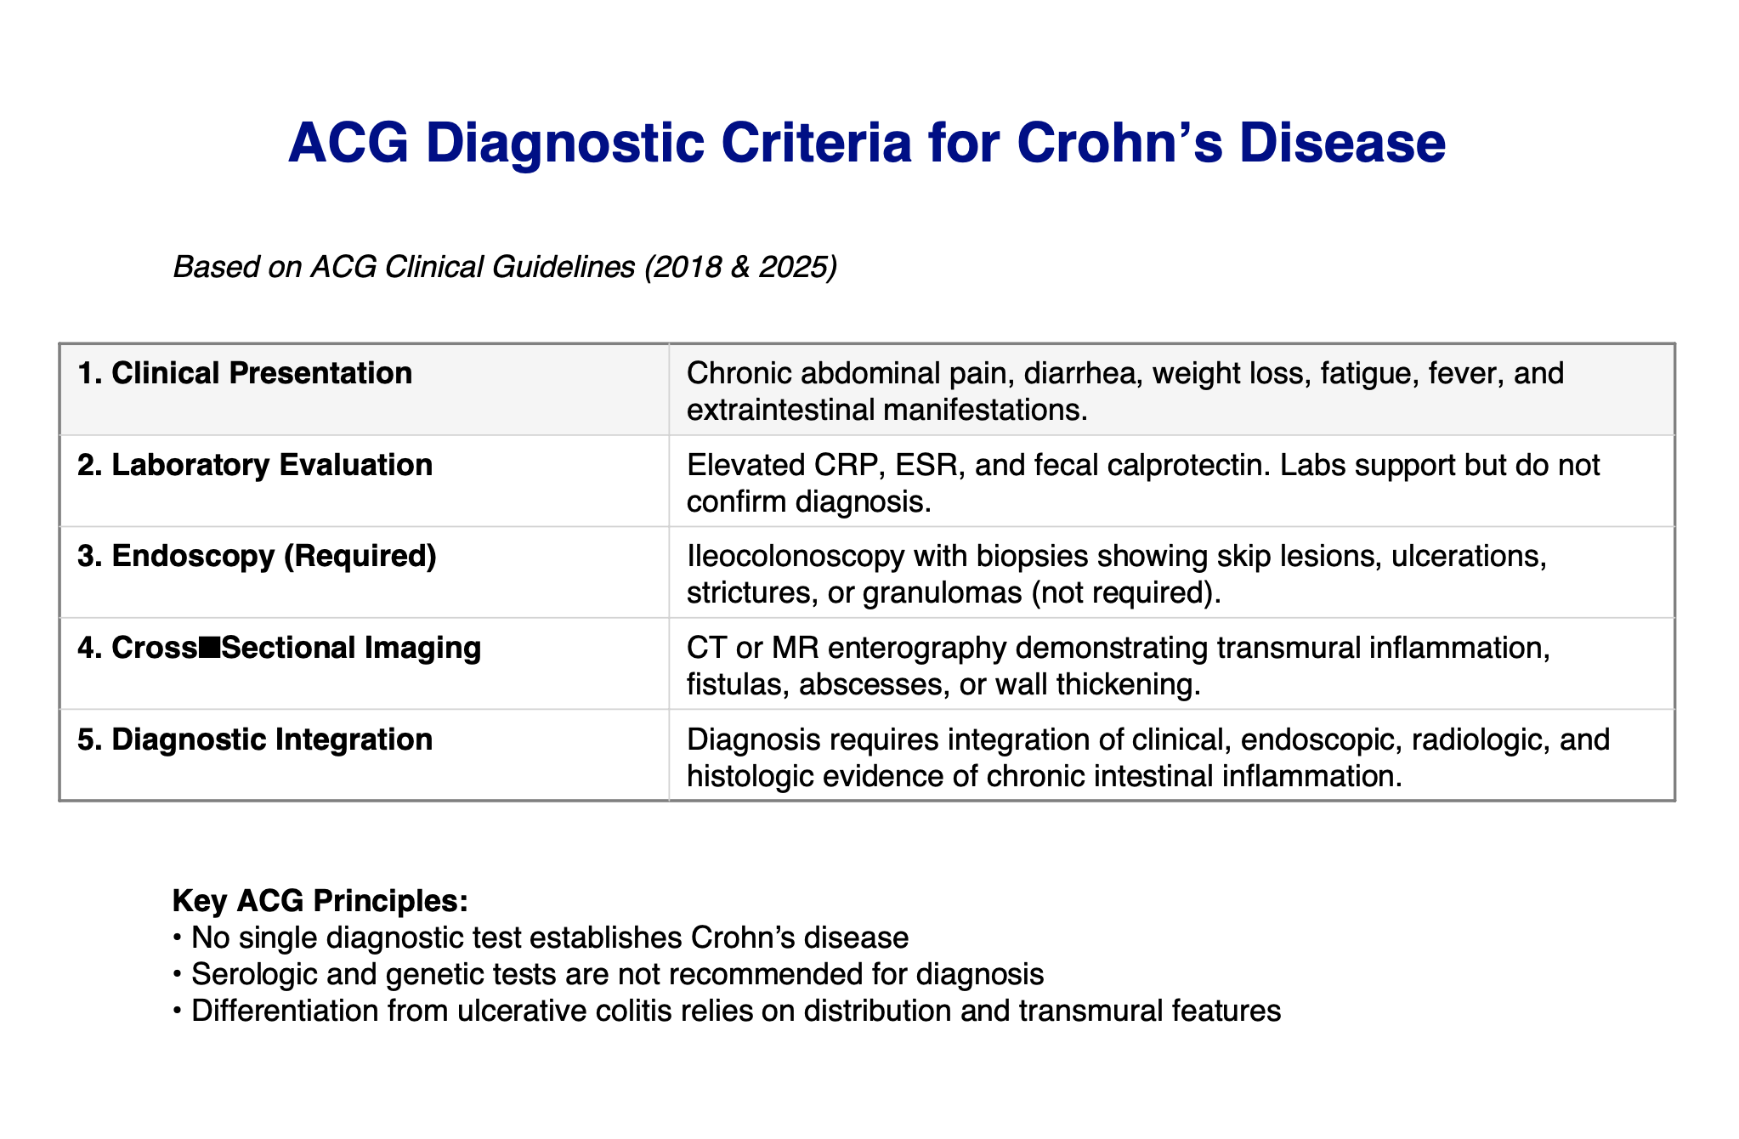
To Steroid or Not to Steroid: Decision-Making in Crohn’s Flares Hanna Almoaswes M.D., Pranaya Pakala M.D., Autumn Collins M.D., Gurtaj Mahil D.O., Farhan Mohiuddin M.D., Dr. Hope Oddo Moise M.D. Department of Medicine, Louisiana State University Health Sciences Center, New Orleans, LA
Introduction
Case Report
Discussion
Crohn’s disease is a chronic, relapsing inflammatory bowel disease characterized by transmural inflammation, most commonly involving the terminal ileum and proximal colon. Symptoms include abdominal pain, chronic diarrhea, weight loss, and fatigue. Complications may include strictures, fistulas, and bowel obstruction. Treatment is typically guided by disease severity and phenotype, with biologic therapies forming the cornerstone of moderate to severe disease management. Corticosteroids are reserved for short-term induction therapy due to significant adverse effects and lack of long-term benefit.
A 71-year-old man with hypertension, Crohn's disease on ustekinumab and mesalamine, prior small bowel obstruction, and bilateral inguinal hernia repair presented with gradually worsening, sharp, non-radiating epigastric pain. He reported nausea without vomiting, melena, appetite changes, fever, or recent illness. His baseline Crohn's associated diarrhea was unchanged.
Laboratory workup showed: fecal calprotectin 673 micrograms/gram, CK 521 U/L, CRP 1.4mg/dL, and without leukocytosis, anemia, or lactic acidosis. Stool studies, including Clostridium difficile and enteric pathogen panel were negative. Computed tomography (CT) of the abdomen/pelvis showed enteritis with stricture formation; CT enterography showed multisegmented small bowel wall thickening and a 4 cm upstream dilation. Endoscopy was notably only for a diaphragmatic hernia. Colonoscopy revealed significant inflammation in the terminal ileum. Biopsy of the ileum showed chronic villous blunting; sigmoid colon biopsies showed chronic inactive colitis and a tubular adenoma. No granulomas or dysplasia/malignancy were noted.
Given the absence of systemic hemodynamic instability or surgical urgency, corticosteroid therapy was deferred. The patient experienced significant improvement in abdominal pain and nausea with just home mesalamine and supportive therapy. He was discharged with plans to initiate infliximab and undergo repeat colonoscopy within 6 months to monitor a subepithelial lesion.
Guideline-based management of Crohn's disease recommends biological agents such as TNF inhibitors like infliximab as first-line therapy for moderate to severe disease. While steroids are effective for short-term relief, they do not impact long-term remission outcomes compared to optimization of biologic therapy guided by endoscopic assessment. They are reserved for life-threatening flares or those with impending surgical complications due to their unfavorable safety profile such as increased risk of infection, osteoporosis, adrenal suppression, weight gain, and symptoms relapse. In this case, symptomatic treatment without steroids in a stable patient avoided unnecessary risk. This case highlights a prudent, guideline-aligned approach to managing a Crohn's flare, emphasizing early optimization of biologic therapy and endoscopic reassessment over short-term steroid use.
References
Newer Biologic and Small-Molecule Therapies for Inflammatory Bowel Disease Baumgart, Daniel C., and Catherine Le Berre. Newer Biologic and Small-Molecule Therapies for Inflammatory Bowel Disease. New England Journal of Medicine, vol. 385, no. 14, 29 Sept. 2021, pp. 1302–1315, doi:10.1056/NEJMra1907607. NEJM.org, https://www.nejm.org/doi/full/10.1056/NEJMra1907607?utm_source=openevidence.
Crohn’s Disease (PubMed PMID 27914655) Torres, Joana, et al. “Crohn’s Disease.” Lancet, vol. 389, no. 10080, 29 Apr. 2017, pp. 1741–1755, doi:10.1016/S0140-6736(16)31711-1. PubMed, https://pubmed.ncbi.nlm.nih.gov/27914655/.
AGA Technical Review on Moderate to Severe Luminal and Fistulizing Crohn’s Disease (PubMed PMID 34051985) Singh, Siddharth, et al. “AGA Technical Review on the Medical Management of Moderate to Severe Luminal and Fistulizing Crohn’s Disease.” Gastroenterology, vol. 160, no. 7, 2021, pp. 2512–2556.e9, doi:10.1053/j.gastro.2021.04.023. PubMed, https://pubmed.ncbi.nlm.nih.gov/34051985/
AGA Clinical Practice Guideline on Moderate to Severe Luminal and Fistulizing Crohn’s Disease (PMC8988893) Feuerstein, Joseph D., et al. “American Gastroenterological Association Clinical Practice Guideline on the Medical Management of Moderate to Severe Luminal and Fistulizing Crohn’s Disease.” Gastroenterology, vol. 160, no. 7, June 2021, pp. 2496–2508, doi:10.1053/j.gastro.2021.04.022. PubMed Central, https://pmc.ncbi.nlm.nih.gov/articles/PMC8988893/.
“Normal colon vs colon with Crohn’s disease.” Crohn’s Disease, AGA GI Patient Center, American Gastroenterological Association, patient.gastro.org/crohns-disease/. Accessed 7 Feb. 2026.
Lichtenstein, Gary R., et al. ACG Clinical Guideline: Management of Crohn’s Disease in Adults. The American Journal of Gastroenterology, vol. 113, no. 4, 2018, pp. 481–517, doi:10.1038/ajg.2018.27.

