Slide 1

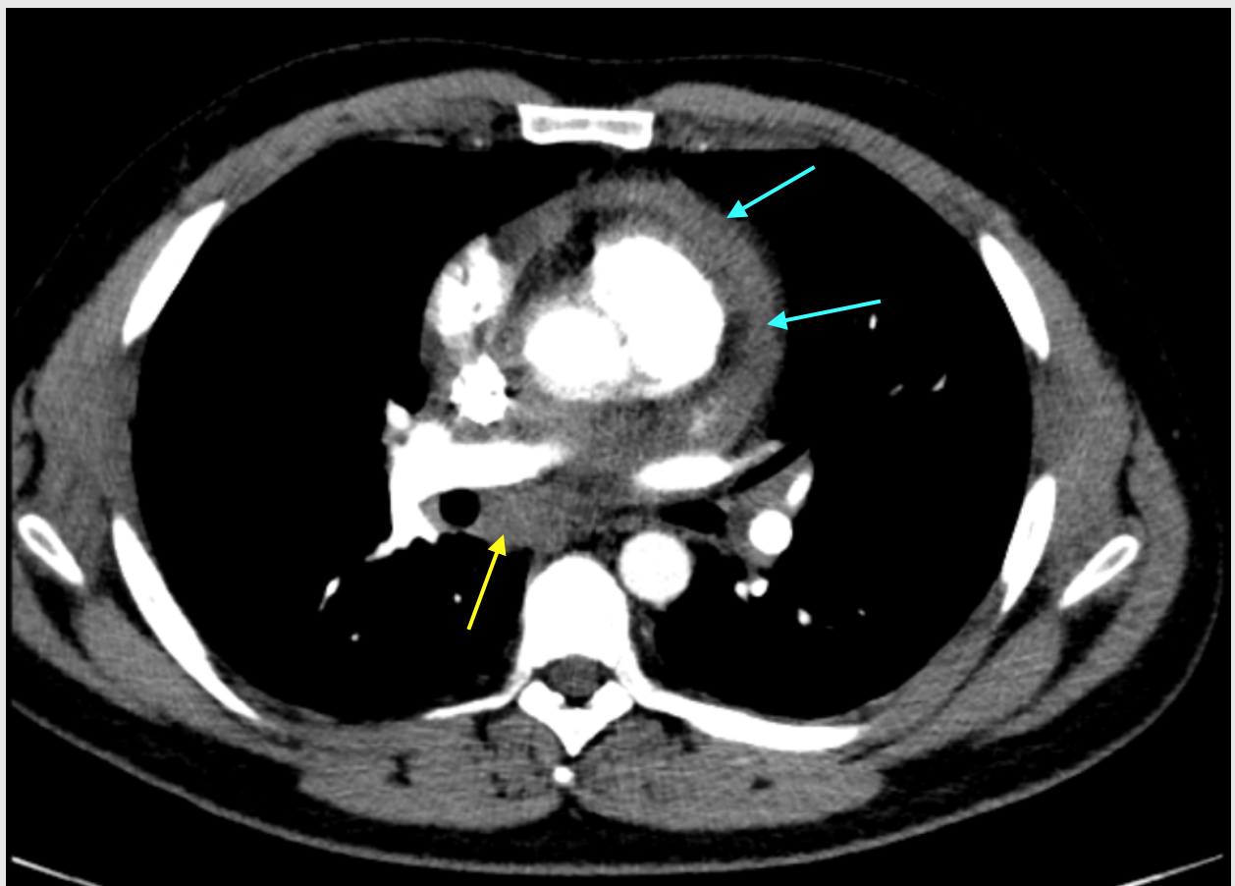
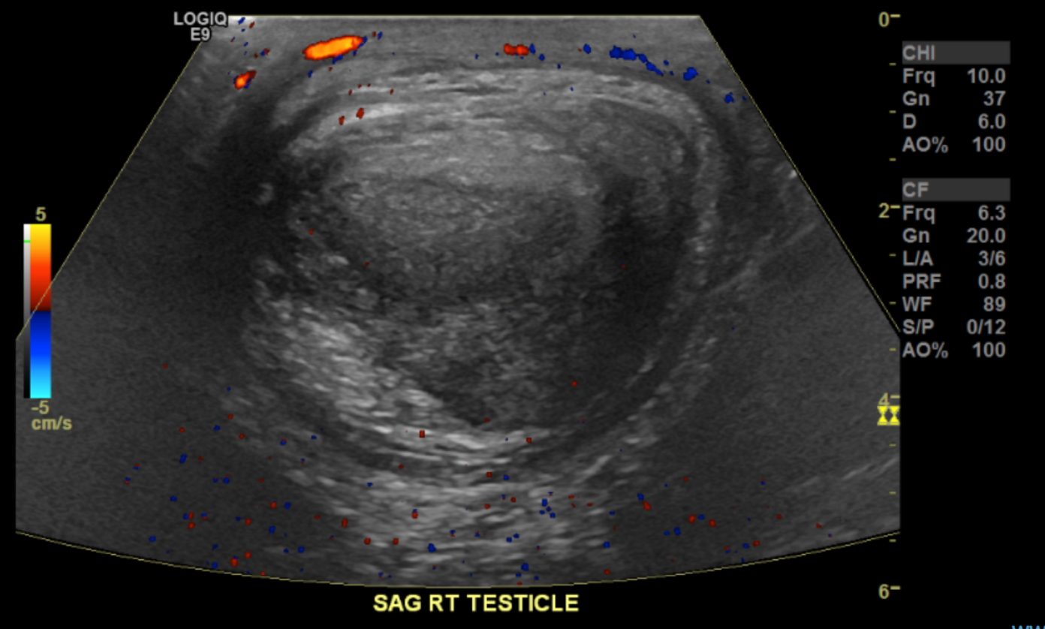
Case of Testicular Sarcoidosis Presenting as a Testicular Mass: A Rare Mimicker of Malignancy
Ashley Vo B.S., Roxana Apostol M.D.
Introduction
Sarcoidosis is a multisystem granulomatous disorder of unclear etiology characterized by non-caseating granulomas and most commonly involves the lungs, where bilateral hilar lymphadenopathy is a classic finding.
Genitourinary involvement is very rare, with testicular sarcoidosis reported in fewer than 0.2% of cases, typically affecting men in the second to fourth decades of life.
Figure 2. Axial CT of the chest at the level of the mainstem bronchi demonstrating enlarged subcarinal lymph nodes (yellow) and pericardial thickening (blue).
Case Presentation
Discussion
A 29-year-old incarcerated male with no significant past medical history presented with a one-year history of testicular swelling that had recently become painful, along with shortness of breath and palpitations. He denied trauma, dysuria, or systemic symptoms including fever, weight loss, or night sweats. Physical examination revealed a firm, non-tender right intratesticular mass. Scrotal ultrasound demonstrated a 1-cm right intratesticular lesion, raising concern for neoplasm. Subsequent CT of the chest, abdomen, and pelvis revealed thoracic and abdominal lymphadenopathy, pericardial effusion, and a right scrotal mass.
Right inguinal testicular biopsy was done and findings showed non-caseating granulomas consistent with sarcoidosis. The presence of multisystem involvement also supported sarcoidosis as the unifying diagnosis. The patient underwent drainage of the pericardial effusion, was started on oral corticosteroids, and later transitioned to methotrexate with a steroid taper with rheumatology. Follow-up scrotal ultrasound 9 months later showed stable testicular lesions.
Patients with testicular sarcoidosis often present with painless scrotal or epididymal nodules, which may closely mimic testicular malignancy clinically and on imaging. Because of this overlap, distinguishing sarcoidosis from germ cell tumors is essential to avoid unnecessary orchiectomy. Diagnosis is based on a combination of clinical features, imaging, and histopathology. Ultrasound is first-line modality for scrotal evaluation and crucial for identifying lesions that warrant further assessment. Cross-sectional imaging of the chest or abdomen may reveal evidence of systemic sarcoidosis, which can increase diagnostic confidence. Ultimately, tissue sampling demonstrating non-caseating granulomas is required to confirm the diagnosis after excluding infectious or neoplastic causes.
Conclusion
Testicular sarcoidosis is a rare manifestation that can mimic malignancy, making accurate diagnosis essential to avoid unnecessary surgical intervention. Early recognition and appropriate workup allow for conservative management.
References
Ballet B, Roelandt M, Lockefeer F, Thüer D. Testicular sarcoidosis: diagnostic approach and management strategies. Cureus. 2021;13(1):e12715. doi:10.7759/cureus.12715
Rao PK, Sabanegh ES. Genitourinary sarcoidosis. Rev Urol. 2009; 11(2):108-113.
Figure 1. Right testicle Doppler ultrasound demonstrating well-circumscribed heterogenous mass without internal vascularity.

