Slide 1

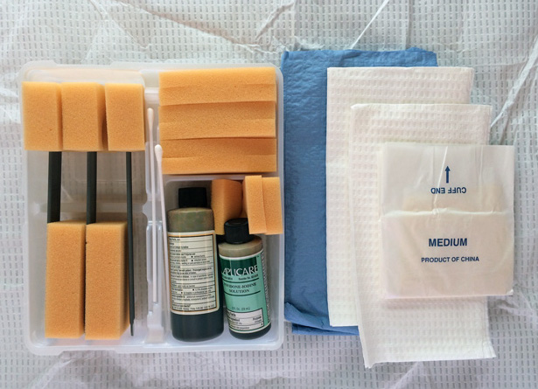
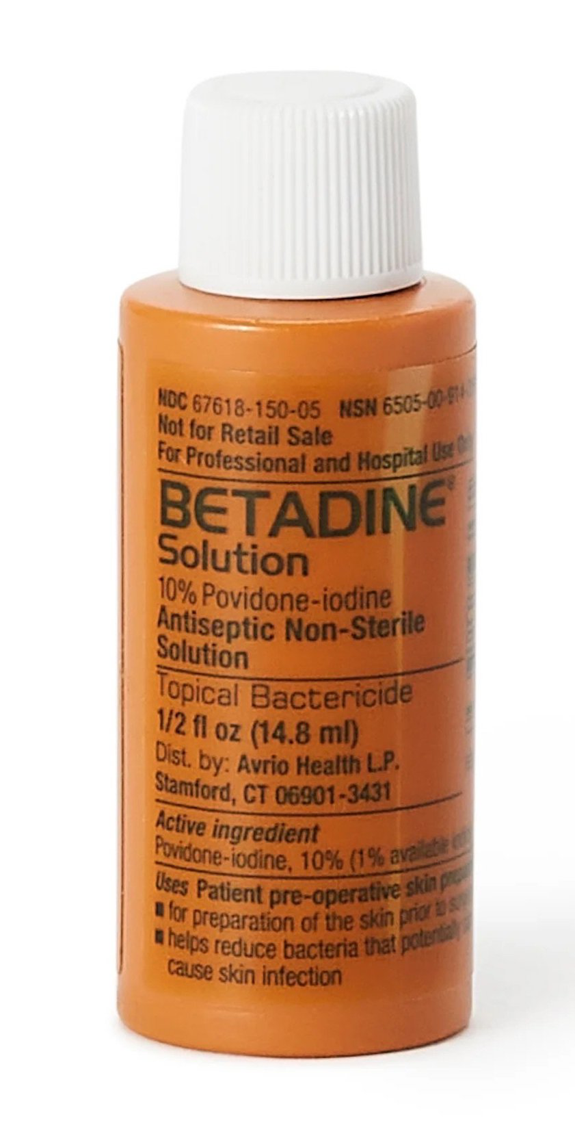
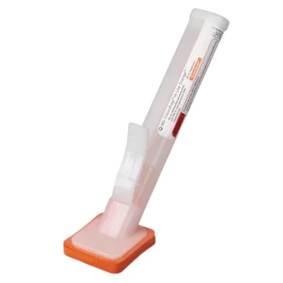
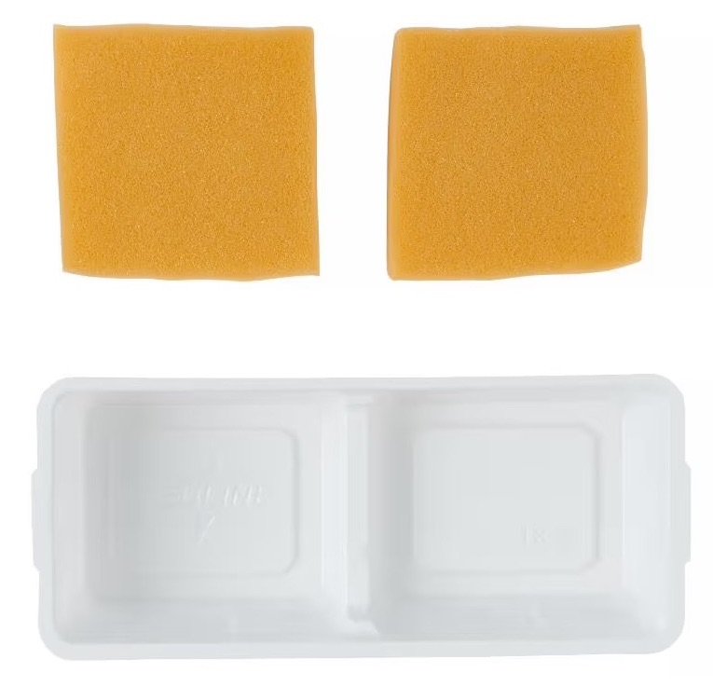
An Evaluation Of Surgical Skin Preparations For Children Undergoing Penile Surgery
Malcolm Sundell B.A., Jordyn Fong M.S., Christopher Roth M.D.
BACKGROUND
RESULTS
Post-operative infection is rare following circumcision and other corrective penile surgeries. Recent studies have demonstrated skin preparation with povidone iodine to be noninferior to chlorhexidine in preventing surgical site infections in cardiac and abdominal surgeries. Direct comparisons of these two agents in the context of penile surgery remain limited. Because surgical packaging of single-use materials is a primary contributor to hospital waste and pollution, identification of the cheapest and most sustainable option also carries great economic and environmental implications.
METHODS
Figure 1. Postoperative bacterial infection rates by skin preparation type. Prep 1 had 4 infections among 102 cases (3.9%), Prep 2 had 4 infections among 228 cases (1.8%), and Prep 3 had 2 infections among 115 cases (1.7%). There was no statistically significant difference between groups (χ², p = 0.430).
A total of 445 pediatric penile surgeries were included in this retrospective study. Cases were grouped by skin preparation used: standard povidone-iodine (Prep 1), custom povidone-iodine (Prep 2), and chlorhexidine (Prep 3). Analysis was performed to evaluate the association between surgical skin preparation type and the rate of postoperative infection, as well as the association between preparation used and dermatitis requiring an antifungal.
PREPARATION TYPES
Figure 2. Candidal dermatitis infection rates by skin preparation type. Prep 1 had 4 infections among 102 cases (3.9%), Prep 2 had 6 infections among 228 cases (2.6%), and Prep 3 had 2 infections among 115 cases (1.7%). There was no statistically significant difference between groups (χ², p = 0.610).
Prep 1: Full Betadine Paint & Scrub
CONCLUSIONS
Our results show no difference in outcomes between prep types and suggest use of the most economical and environmentally sustainable option, our custom povidone-iodine preparation.
FUTURE CONSIDERATIONS
Further investigation through prospective study may clarify whether surgical skin preparation type influences postoperative infection risk.
Prep 2: 2oz Betadine + sponges
Prep 3: chlorhexidine applicator

