Slide 1

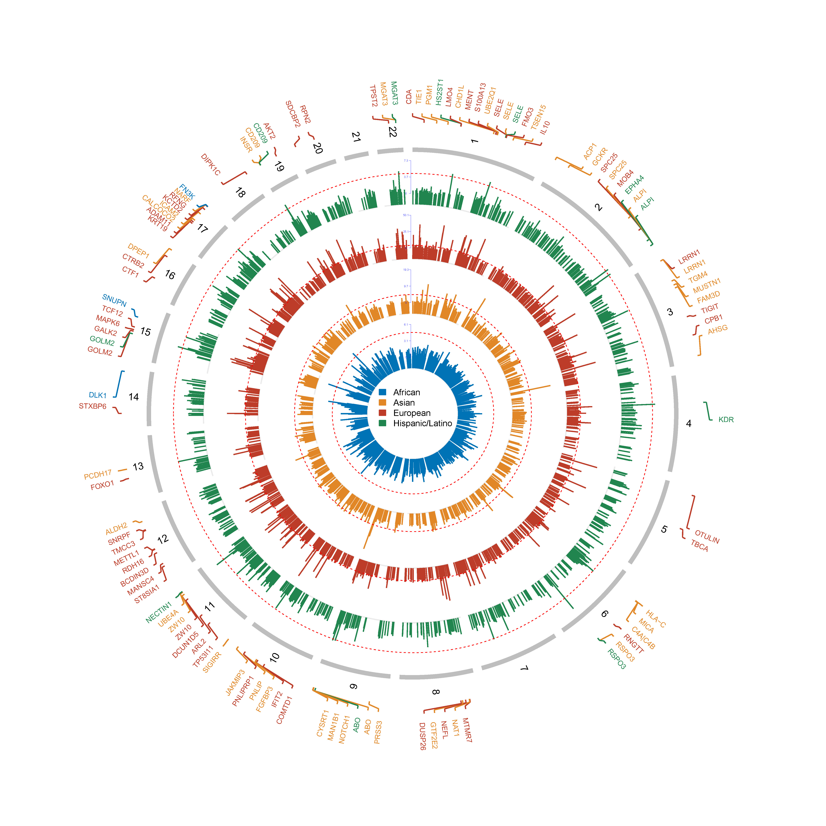
Cross-population genetic analysis of the circulating proteome implicates novel proteins for Type 2 Diabetes
Shuai Liu¹, Jingjing Zhu^{1,2#}, Lang Wu^{1#}
1. Department of Interdisciplinary Oncology and Department of Genetics, LSU-LCMC Health Cancer Center, School of Medicine, Louisiana State University Health Sciences Center, New Orleans, LA, USA
2. Bioinformatics and Genomics Core, School of Medicine, Louisiana State University Health Sciences Center, New Orleans, LA, USA
^{# co-corresponding authors}
INTRODUCTION
Type 2 diabetes (T2D): a noteworthy global public health concern affecting millions of individuals worldwide.
Several proteins have been reported to be associated with T2D risk for their measured abundances in blood, such as Mannan-binding lectin serine peptidase (MASP), adiponectin, gelsolin, and WFIKKN2.
Existing epidemiologic studies on T2D risk associated protein biomarkers are limited by relatively small sample sizes and potential selection bias, uncontrolled confounding, and reverse causation, which are commonly encountered in conventional epidemiological studies.
Most previous T2D GWAS studies were focused on Non-Hispanic White individuals, which provided limited insights into its genetic basis in non-European individuals.
OBJECTIVE
Identify novel circulating proteins with genetically regulated expression in blood to be associated with T2D risk in African, Asian, European, and Hispanic/Latino populations
METHODS
Protein genetic prediction model building for each population of interest using cis- and trans- SNPs with adjustment for site, age, sex, body mass index, smoking status, pack-years of cigarette smoking, and the top ten principal components
Multi-Ethnic Study of Atherosclerosis (MESA) cohort¹: 902 African subjects, 407 Asian subjects, 1,839 European subjects, and 829 Hispanic/Latino subjects, with interval validation
models with internal performance R² ≥ 0.01 were selected for the disease association analyses
External validation for European models (INTERVAL cohort, N = 3,301)
Assess associations between genetically predicted protein levels and T2D risk using
most comprehensive population-stratified T2D GWAS summary statistics ²
African population: 50,251 cases and 103,909 controls; Asian population: 88,109 cases and 339,395 controls;
European population: 242,283 cases and 1,569,734 controls; Hispanic/Latino population: 29,375 cases and 59,368 controls
Meta-analysis for the cross-population associated proteins
Robustness analysis using two-stage constrained maximum likelihood (2ScML) method and Summary-data-based Mendelian Randomization (SMR)
Protein Protein Interaction (PPI); Ingenuity Pathway Analysis (IPA);
Drug repurposing analysis using DrugBank dataset
RESULTS
Protein prediction models with internal cross-validation R² ≥ 0.01:
  1,918 in African group; 1,280 in Asian group; 2,392 European group; 1,610 in Hispanic/Latino group.
Proteins significantly associated with T2D risk at Bonferroni-corrected p < 0.05:
  three proteins in African; 42 proteins in Asian; 237 proteins in European, and 13 in Hispanic/Latino
Meta-analysis in the cross-population analyses:
  344 proteins significantly associated with T2D risk, with 85 proteins not detected in any single population-specific PWAS
Robustness analysis
  Three proteins (100%) in African, 28 proteins (66.66%) in Asian, 202 proteins (85.23%) in European, and 12 proteins (92.30%) in Hispanic/Latino exhibited evidence for causality through either the 2ScML or SMR methods
Drug repurposing analysis
Drug repurposing analysis further identified 421 drugs targeting 68 T2D-associated proteins, including drugs targeting the insulin receptor (INSR) and insulin-like growth factor 1 receptor (IGF1R) both well-established regulators of glucose metabolism.
CONCLUSIONS
This multi-population PWAS provides a comprehensive characterization of circulating proteins associated with T2D risk and reveals both shared and population-specific protein signals. These findings improve our understanding of the molecular mechanisms underlying T2D and highlight potential targets for therapeutic development and drug repurposing.
REFERENCES
1. Bild, D. E., Bluemke, D. A., Burke, G. L., Detrano, R., Diez Roux, A. V., Folsom, A. R., ... & Tracy, R. P. (2002). Multi-ethnic study of atherosclerosis: objectives and design. American journal of epidemiology, 156(9), 871-881.
2. Suzuki, K., Hatzikotoulas, K., Southam, L., Taylor, H. J., Yin, X., Lorenz, K. M., ... & Kamanu, F. K. (2024). Genetic drivers of heterogeneity in type 2 diabetes pathophysiology. Nature, 627(8003), 347-357.

