Slide 1
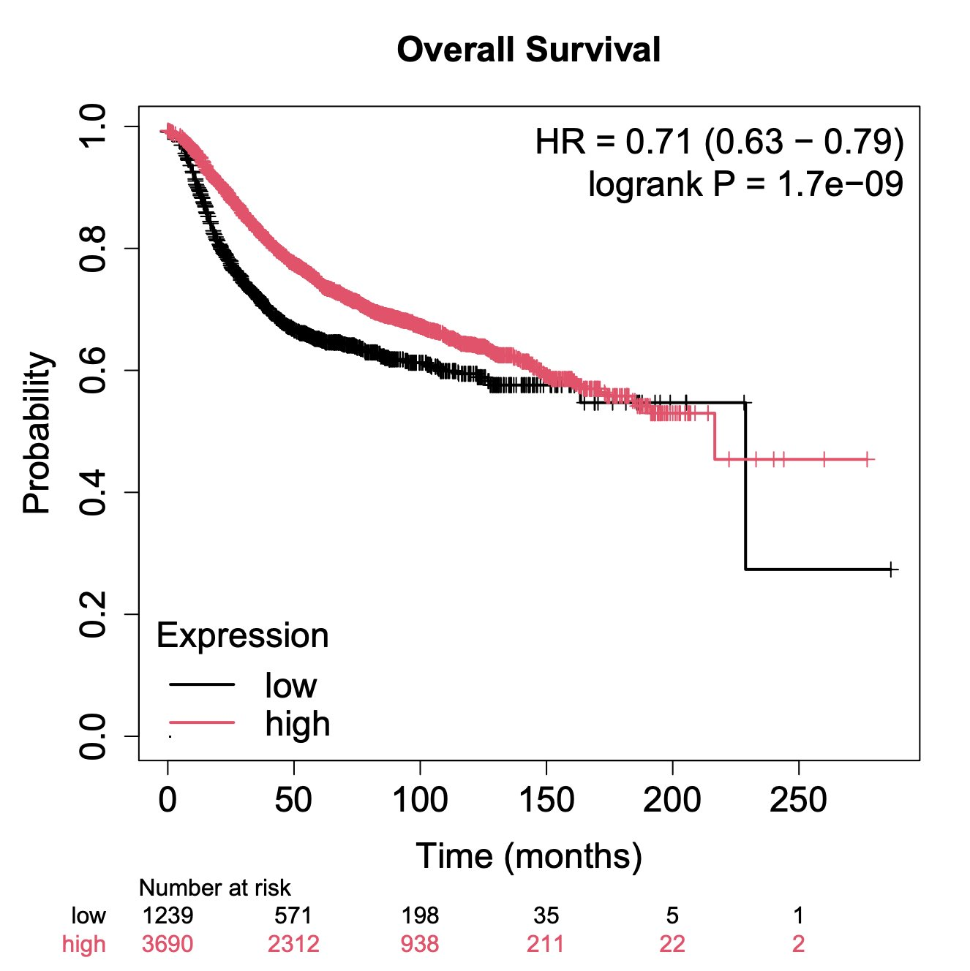
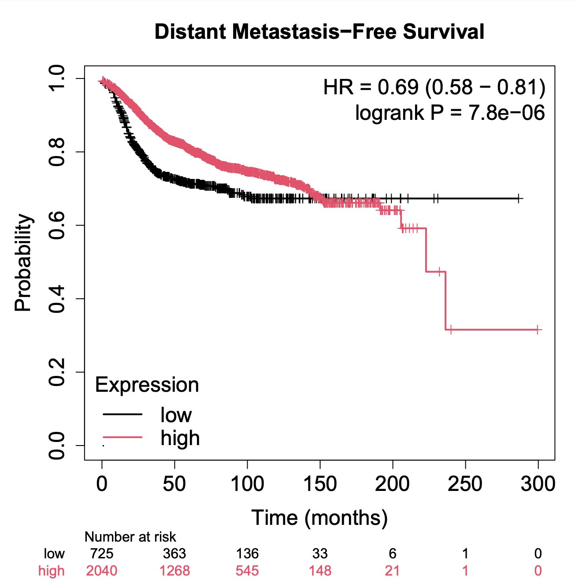
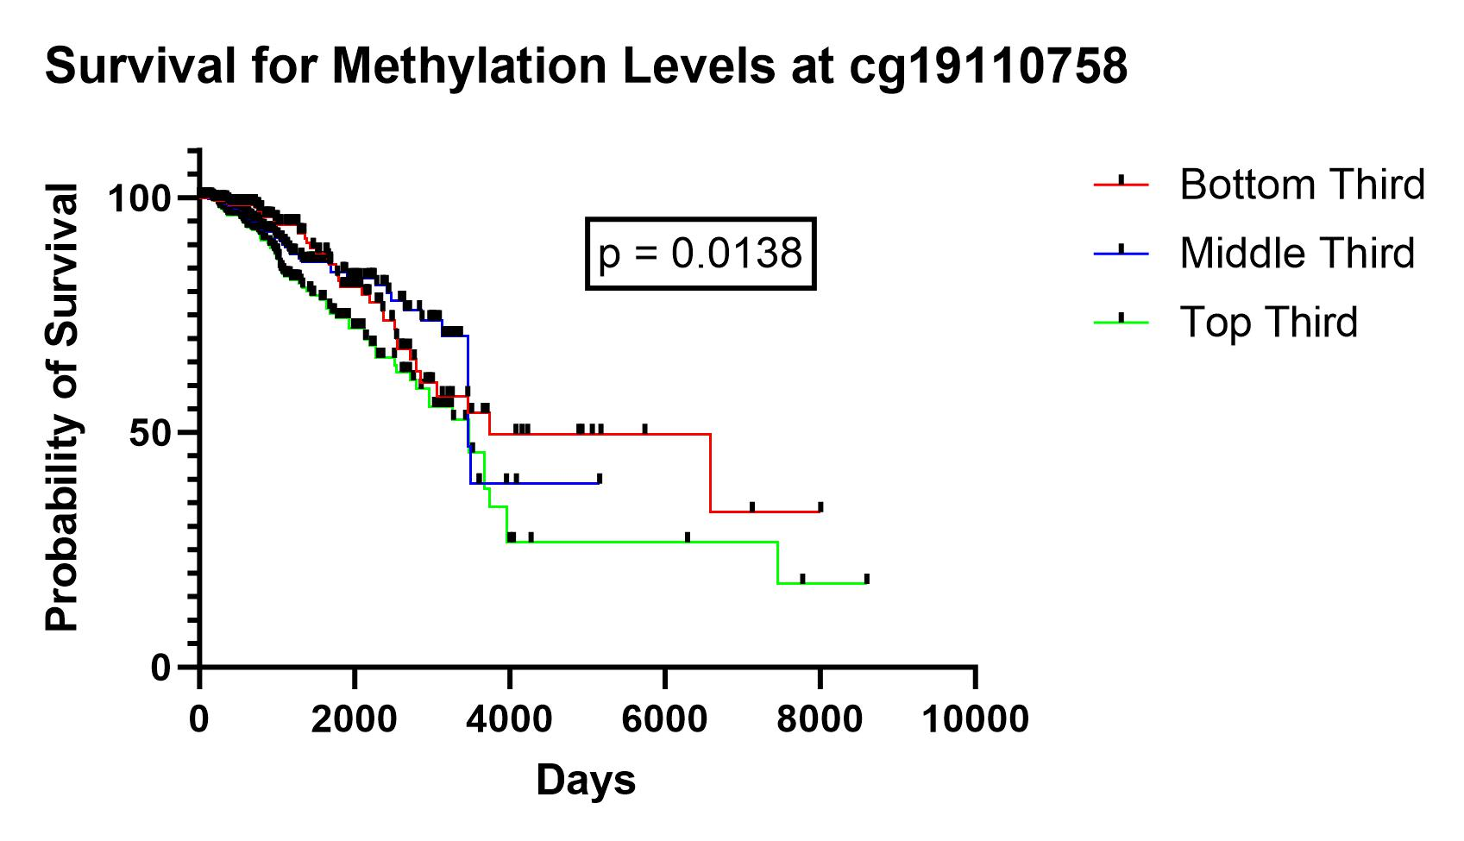
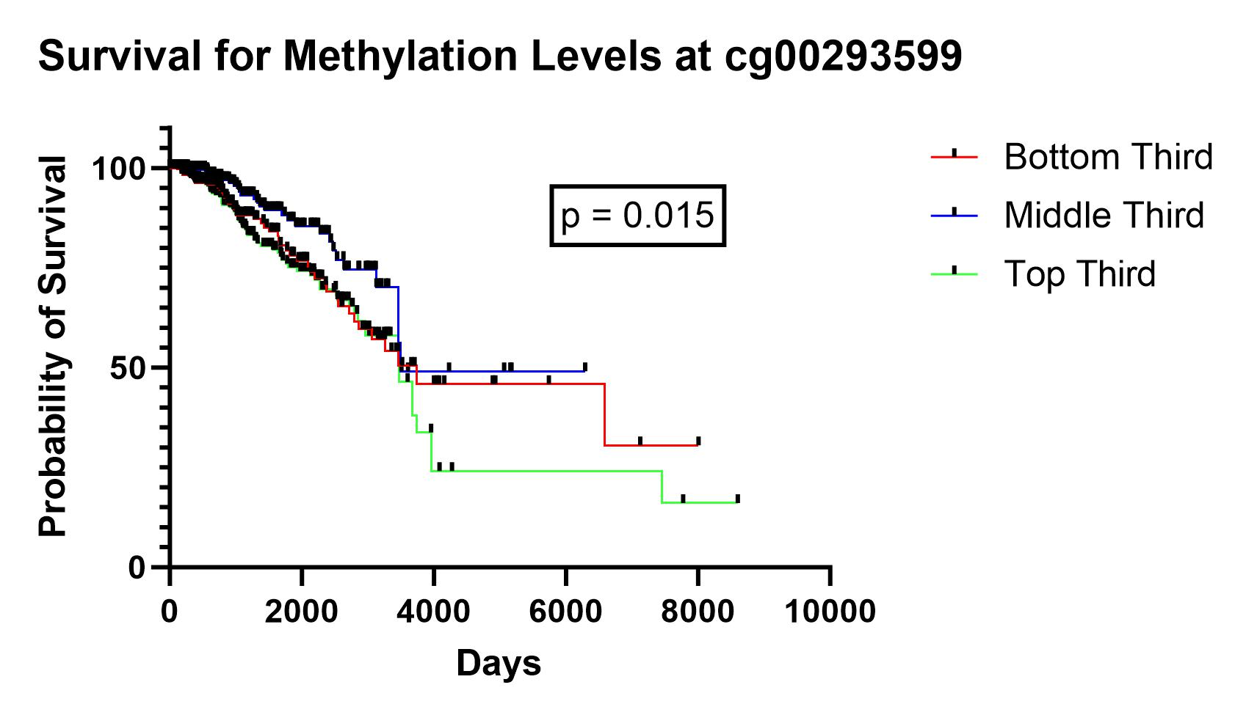
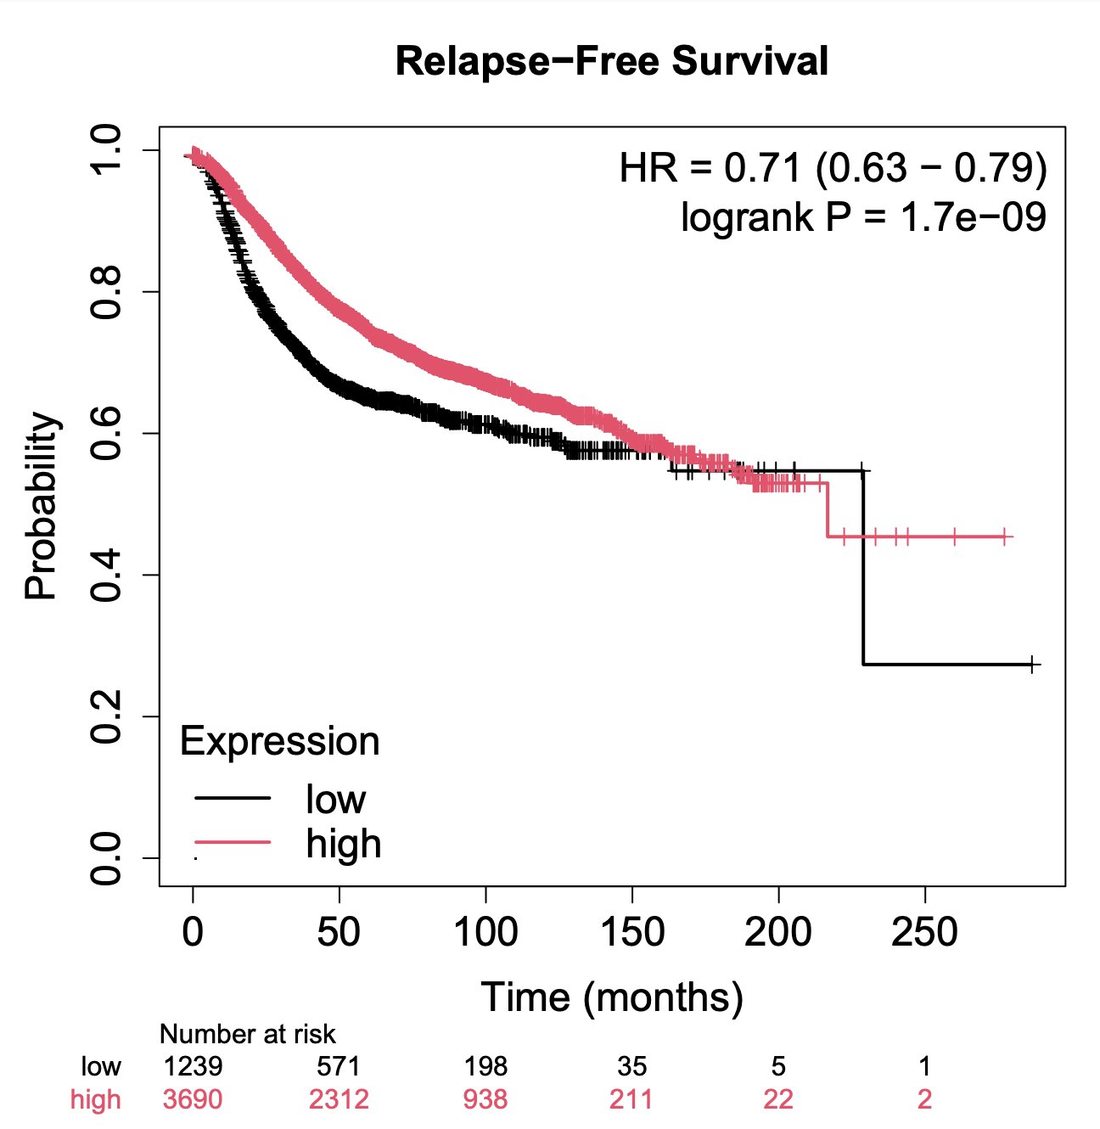
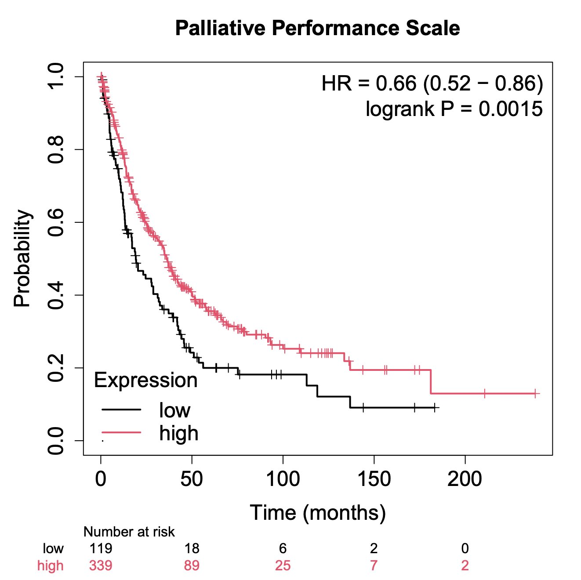
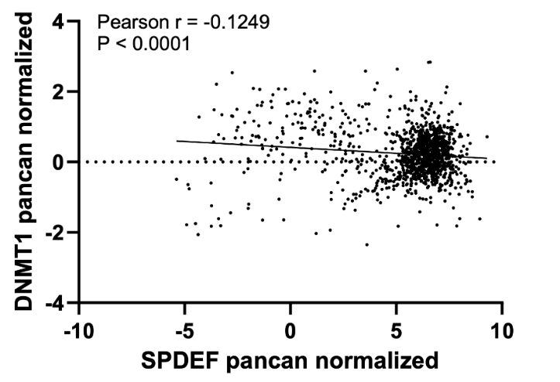
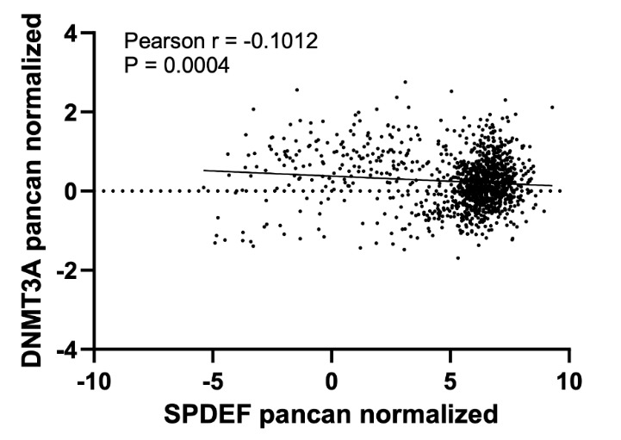
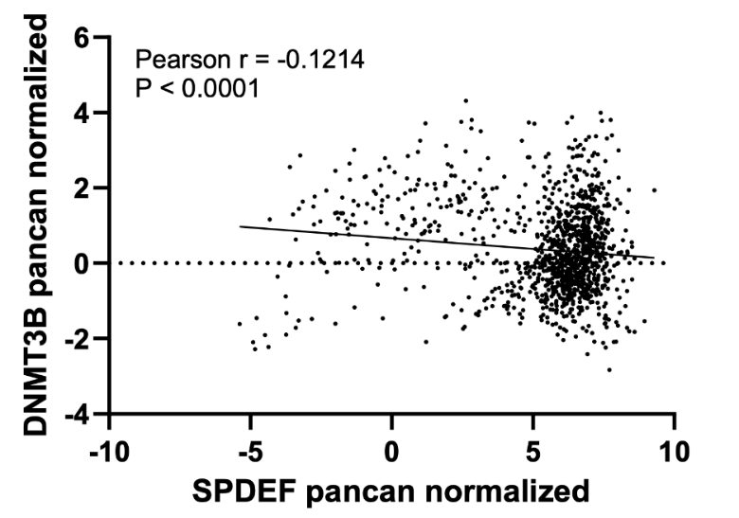
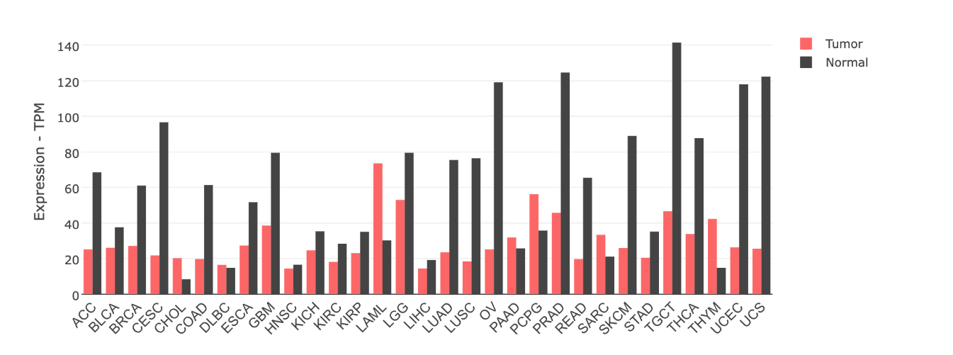
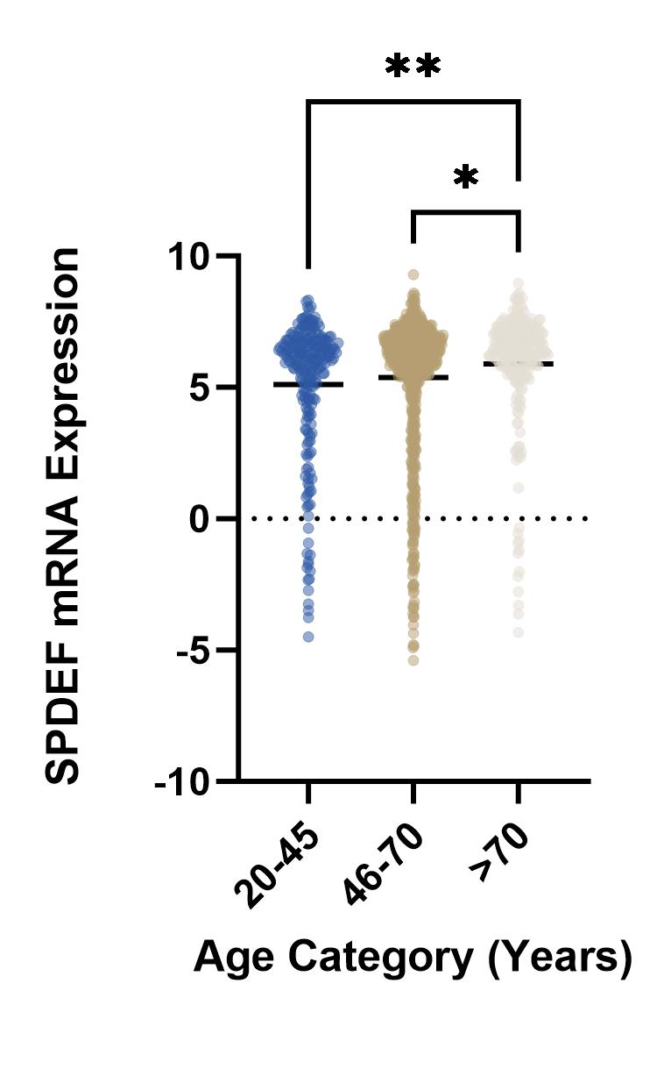
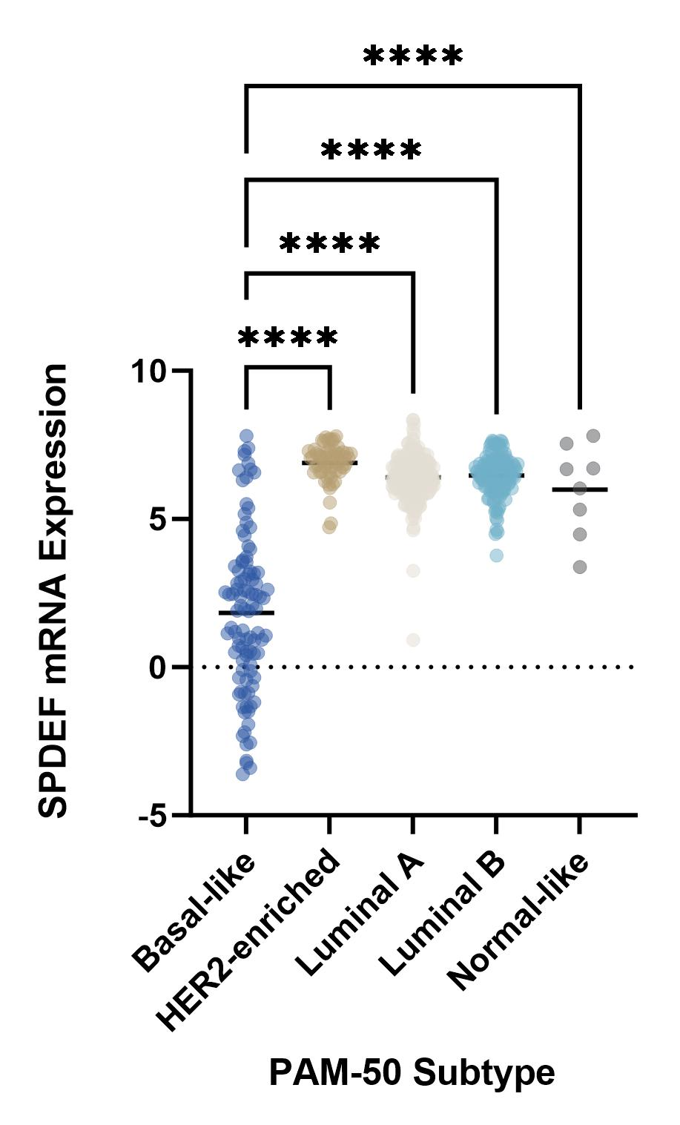
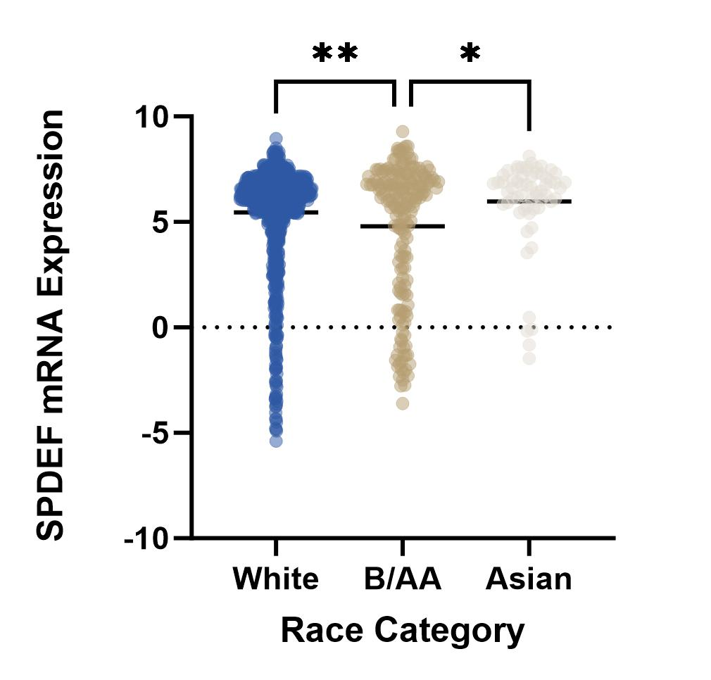
Assessing the Tumor Suppressive Impact and Regulatory
Mechanisms of SPDEF Expression in Breast Cancer
Maansi Solanky, B.A.; Maninder Khosla, B.S.; Suresh K. Alahari, PhD
LSU Health Sciences Center, New Orleans, LA 70112
Introduction
Results
Breast Cancer (BRCA) is the most commonly diagnosed cancer and second leading cause of cancer-related deaths in women in the United States (US).
Prostate-Derived Ets Factor/Sam Pointed Domain Ets Factor (SPDEF) is a transcription factor of the Ets family encoded by the gene SPDEF and associated with organs containing lumens such as the prostate, salivary gland, breast, colon, and uterus. SPDEF expression has been implicated with carcinogenesis in numerous tissue lineages with opposing associations; for instance, tumor suppressive effects have been reported in head/neck squamous cell carcinoma and prostate cancer while oncogenic effects have been reported in pancreatic adenocarcinoma and ovarian carcinoma.
The role of SPDEF expression in breast cancer has been less studied; thus, the objective of this project is to evaluate patterns between gene expression and breast cancer prognosis and survival.
A sequential approach was adopted to address the 3 following questions:
What does SPDEF expression mean for BRCA prognosis?
How does SPDEF have variable expression?
2 CpG islands – cg19110758 and cg00293599 – were isolated as putative regulatory sites that contribute to SPDEF methylation and BRCA outcomes.
What does SPDEF expression mean for BRCA prognosis?
Who exhibits variable SPDEF expression?
How does SPDEF have variable expression?
3 DNMTs were then selected as candidates for SPDEF hypermethylation, based on significantly negative relationships with SPDEF expression.
Methods
Both identified CpG islands exhibited the highest methylation levels in tumors with the Basal PAM-50 subtype.
All identified DNMTs exhibited the highest expression in the Basal PAM-50 subtype and at younger ages at initial pathologic diagnosis.
Tumor genome and patient demographic data were extracted from The Cancer Genome Atlas BRCA registry (n = 1247) available on the UCSC Xena database as well as the GEPIA2 database. Survival plots were obtained from KMplot.com. All data was retrospectively analyzed with statistical software on GraphPad Prism and considered significant if p < 0.05.
The following gene regulatory mechanisms were examined as potential sources of altered expression levels: mutations, copy number alterations, co-expression, and promoter methylation. Significant trends were obtained through the promoter methylation analysis; thus, only these findings have been included.
Within the promoter methylation analysis, 2 CpG islands were isolated as putative regulatory sites for SPDEF gene methylation in BRCA tumors based upon the criteria of being significantly associated with SPDEF mRNA expression as well as BRCA survival. This selection process is depicted in the below schematic.
In addition, 3 DNA methyltransferase (DNMT) genes were identified as candidates for SPDEF hypermethylation in BRCA tumors based upon a significantly negative association with SPDEF expression.
*
*
Low SPDEF mRNA expression is associated with poor survival outcomes.
Conclusions
12 CpG islands for SPDEF gene predicted by XENA
10 CpG islands associated with SPDEF mRNA expression
2 CpG islands associated with BRCA survival
SPDEF expression is significantly lower in tumor breast tissue as compared to normal breast tissue.
Who exhibits variable SPDEF expression?
SPDEF was identified as a breast cancer tumor suppressor gene, with low expression significantly associated with poorer survival and increased rates of distant metastasis and relapse. In addition, lower SPDEF expression was found in tumor breast tissue as compared with normal breast tissue.
Decreased expression was linked to a younger age at initial pathologic diagnosis, the Basal PAM-50 tumor subtype, as well as Black/African American race.
Analysis of gene regulatory mechanisms led to significant findings that suggest promoter methylation as a key determinant of SPDEF expression, particularly with the involvement of 2 CpG islands and 3 DNMT genes. Furthermore, the expression of identified promoter methylation components aligned with previously determined demographic patterns of SPDEF expression, thereby reinforcing the presence of their regulatory role and subsequent impact on breast cancer prognosis.
Ultimately, this enriched understanding of SPDEF’s tumorigenesis role, its predisposition for particular patient and tumor subsets, and its regulatory mechanisms can contribute to the quest for more targeted, temporally and locationally-specific treatment therapies.
*
*
Low SPDEF expression is associated with a younger age at initial pathologic diagnosis, the Basal-like PAM-50 subtype, and Black or African American race.

