Slide 1
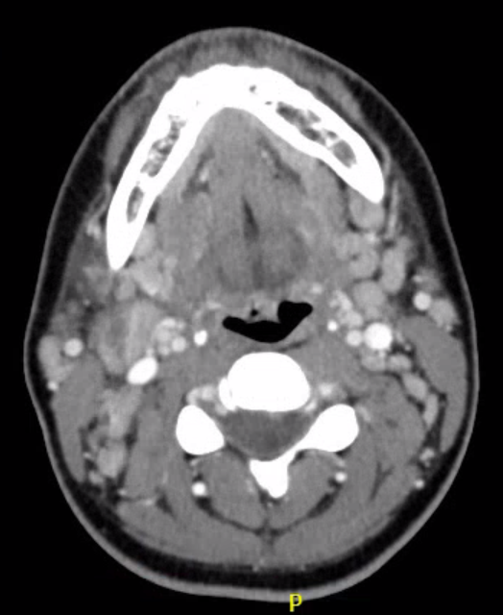
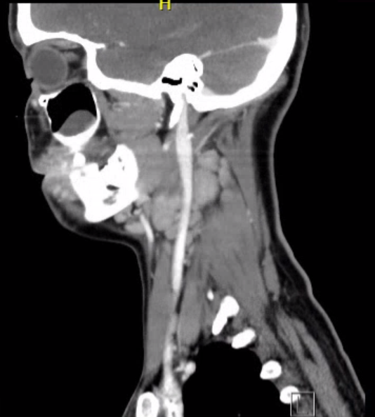
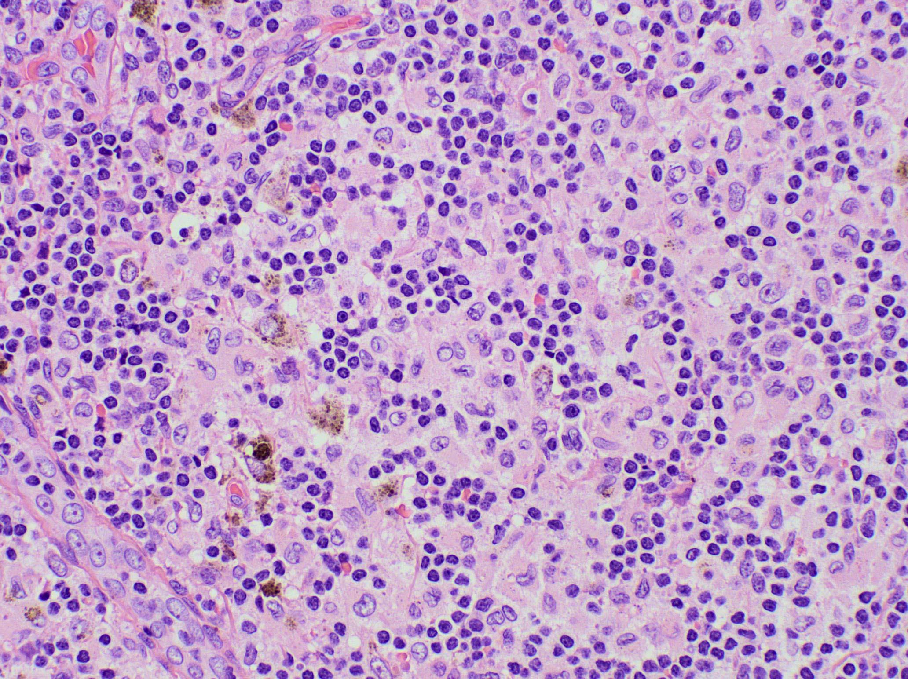
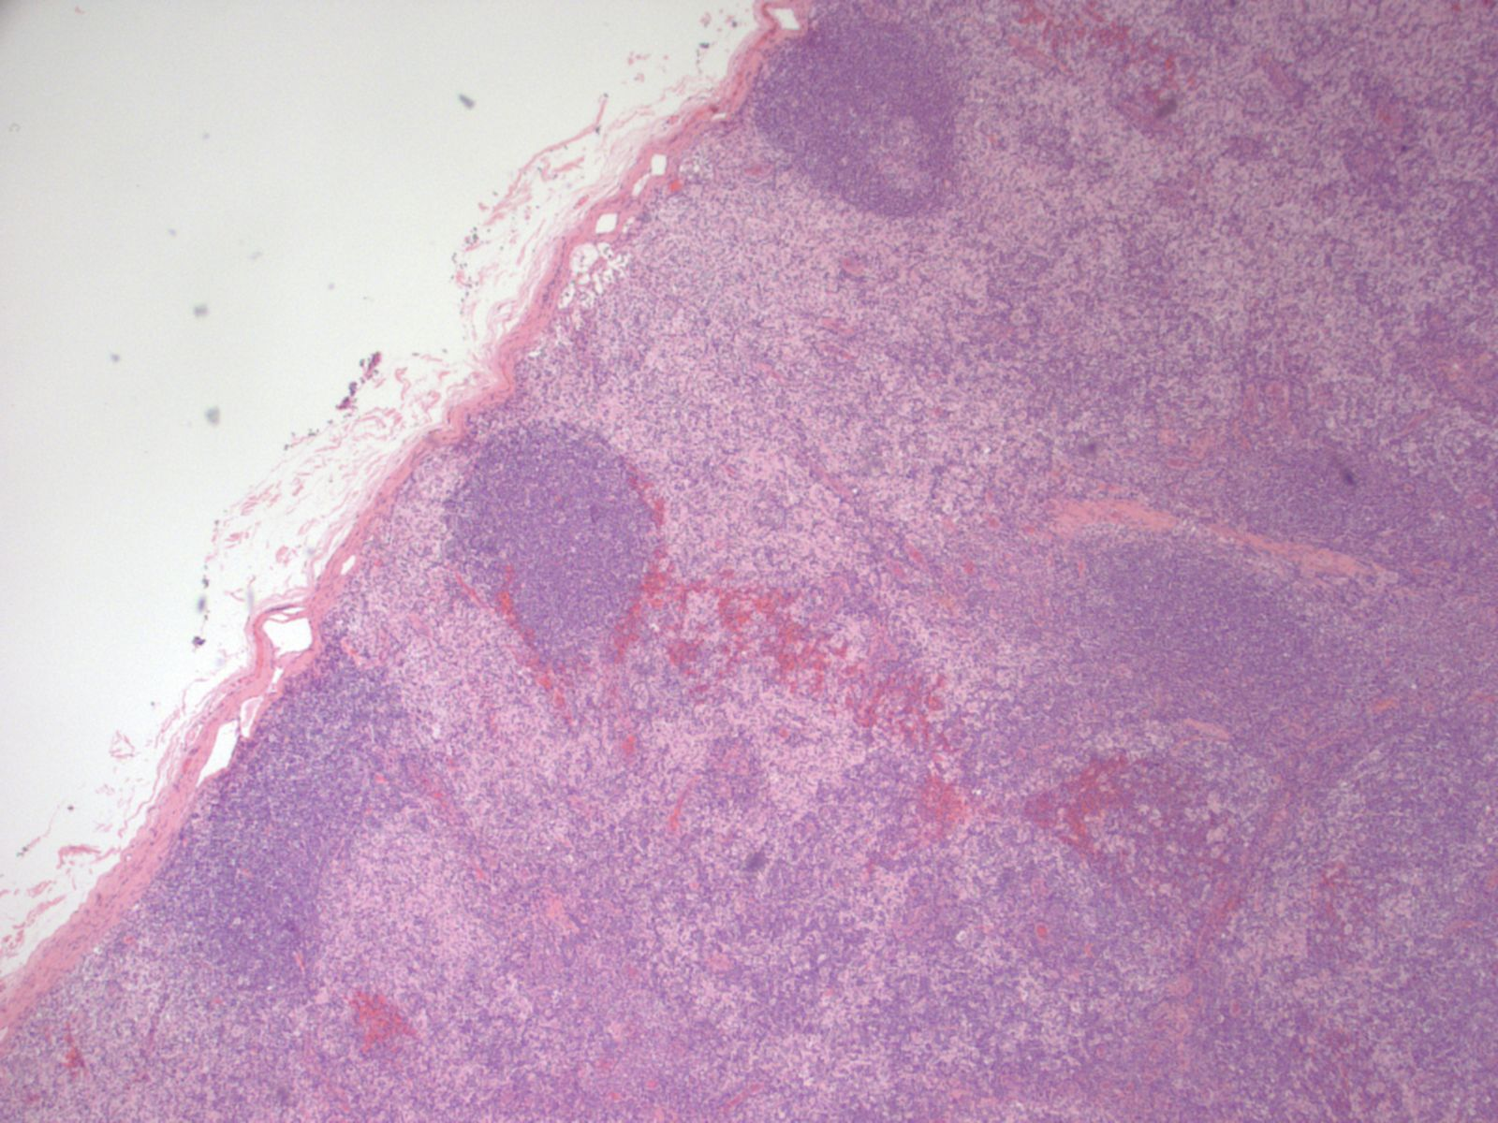
Ceftaroline Induced Leukopenia in a Patient with Dermatopathic Lymphadenopathy Treated for Suspected Osteomyelitis Kaitlyn G. Calabresi¹, Danielle L. Gilbert², Michelle Blyth² 1. Louisiana State University School of Medicine, New Orleans, LA 2. Louisiana State University Department of Medicine, Section of Infectious Diseases, New Orleans, LA
Introduction
Imaging
Dermatopathic Lymphadenopathy
In this patient, concomitant presentation of lymphadenopathy and neutropenia raised concern for possible autoimmune and infectious etiology of disease. Her presentation was best explained separately, by dermatopathic lymphadenopathy discovered on lymph node biopsy, and neutropenia suspected to be induced by IV ceftaroline.
CT neck: bilateral pharyngeal tonsils, possible inflammation without abscess, numerous cervical lymph nodes bilaterally, bilateral maxillary cysts / polyps
MRI of right foot: abnormal signal in the distal phalanx of the right great toe with fluid, uncertain if inflammatory or reflecting osteomyelitis
Dermatopathic lymphadenopathy is a rare benign lymph disorder that is associated with autoimmune disease and inflammatory skin conditions such as psoriasis, eczema, dermatitis, and mycosis fungoides. ¹
Presents as moderately enlarged, firm, moveable and nontender lymph nodes.⁵ Typically affecting axillary (78%) and inguinal lymph nodes (50%), with exclusive cervical presentation in only 7% of patients.¹
Associated with peripheral eosinophilia (35%).⁵
This patient had an unusual presentation, being a young woman with cervical lymphadenopathy with no history of a dermatologic condition or acute skin findings on exam.
Microscopy shows paracortical expansion with Langerhans cells, histiocytes, and melanophages with melanin pigment (Images from Pathology Outlines, Case 396).⁵
Case Description
The patient is a 23-year-old female with past medical history of mononucleosis several months prior to presentation, autoimmune hepatitis (2017), and chronic migraines. She was recently treated for presumed osteomyelitis of the right hallux following ingrown toenail removal with oral ciprofloxacin for 3 months in addition to IV ceftaroline via RUE PICC for 3 weeks without bone biopsy or cultures.
She presented to the emergency room with painful cervical adenopathy that started 1 week prior to presentation, with associated sore throat with odynophagia. She endorsed fevers, with a high of 104 at home, which occurred mostly at night. The patient denied sick contacts, recent travel or hiking. She has a cat at home but denied bites or scratches. She was not currently sexually active, denied tobacco, alcohol, and illicit drug use. Patient denied changes in weight, dyspnea, chest pain, changes in hearing or vision, rash, myalgia, or other areas of lymphadenopathy.
Physical Exam
HEENT: pharyngeal erythema, tonsillar hypertrophy, painful adenopathy in anterior and posterior right cervical chains.
Cardiac and lung exams unremarkable
Skin: no rash or erythema, 1cm non-tender mass on nailbed of right hallux
Labs
CBC: WBC 2.3 x10³, 16% bands, 49% neutrophils, 23% lymphocytes
ESR 8, CRP 5, procalcitonin 0.22
PBS: leukopenia with relative neutropenia and monocytosis, without atypical cells
Negative for strep, respiratory BioFire, Monospot, and HIV
No growth on blood cultures
Clinical Course
Given questionable osteomyelitis and rule out of infectious causes of LAD, ciprofloxacin and ceftaroline were held during the in-patient stay. Leukopenia resolved and CRP stabilized after holding antibiotics, to WBC 9.0 x10³ and CRP 2. Podiatry was consulted for bone biopsy and mass excision of the right hallux, finding a bony exostosis negative for inflammation or malignancy, cultures were also negative.
Excisional biopsy of three cervical lymph nodes by ENT revealed reactivity consistent with dermatopathic lymphadenopathy. No lymphoma, metastatic malignancy, or granuloma were identified. The patient was discharged following biopsy collection.
Discussion
The patient’s leukopenia is best explained by her ceftaroline course, with leukopenia resolving after antibiotic cessation. Of patients on ceftaroline therapy, there is a reported 12% incidence of neutropenia for regimens greater than 7 days.² In another case review of penicillin and cephalosporin homologues, 76% of leukopenia cases occurred in those receiving at least 150 mg/kg/day for at least 7 days.³ This patient received 27 mg/kg/day of ceftaroline for 3 weeks before admission.
Ceftaroline is not a recommended therapy for empiric osteomyelitis treatment. Thus, this patient’s management would have been improved by a more thorough initial evaluation with bone biopsy and culture with pathogen guided antibiotic management.⁴ In the absence of culture data, a trial of a different antibiotic regimen such as vancomycin and piperacillin-tazobactam for MRSA coverage would have been more appropriate.
CBC Findings
 | Day 1 | Day2 | Day 3 | Day 5 | Day 7
WBC (x${10}^{3}$) | 2.3 | 1.9 | 2.4 | 4.2 | 9.0
Neutrophils % | 49 | 36 | 22 | 21 | 53
Bands% | 16 | 25 | 10 | 8 | -
Lymphocytes % | 23 | 19 | 34 | 36 | 41
Monocytes % | 6 | 10 | 17 | 4 | 9
Eosinophils % | 1 | 4 | 3 | 10 | 2
Basophils % | 1 | 4 | 7 | - | -
ANC | 1.13 | 0.68 | 0.53 | 0.88 | 4.77
References
1. Garces S, Yin CC, Miranda RN, et al. Clinical, histopathologic, and immunoarchitectural features of dermatopathic lymphadenopathy: An update. Modern Pathology. 2020;33(6):1104–1121. https://doi.org/10.1038/s41379-019-0440-4. doi: 10.1038/s41379-019-0440-4.
2. Sullivan EL, Turner RB, O'Neal HRJ, Crum-Cianflone NF. Ceftaroline-associated neutropenia: Case series and literature review of incidence, risk factors, and outcomes. Open Forum Infect Dis. 2019;6(5):ofz168. doi: 10.1093/ofid/ofz168.
3. Homayouni H, Gross PA, Setia U, Lynch TJ. Leukopenia due to penicillin and cephalosporin homologues. Arch Intern Med. 1979;139(7):827–828.
4. Bury DC, Rogers TS, Dickman MM. Osteomyelitis: Diagnosis and treatment. Am Fam Physician. 2021;104(4):395–402.
5. Tam I, Torlakovic EE. Dermatopathic lymphadenopathy. PathologyOutlines.com website. https://www.pathologyoutlines.com/topic/lymphnodesdermatopathiclymphadenitis.html.

