Slide 1
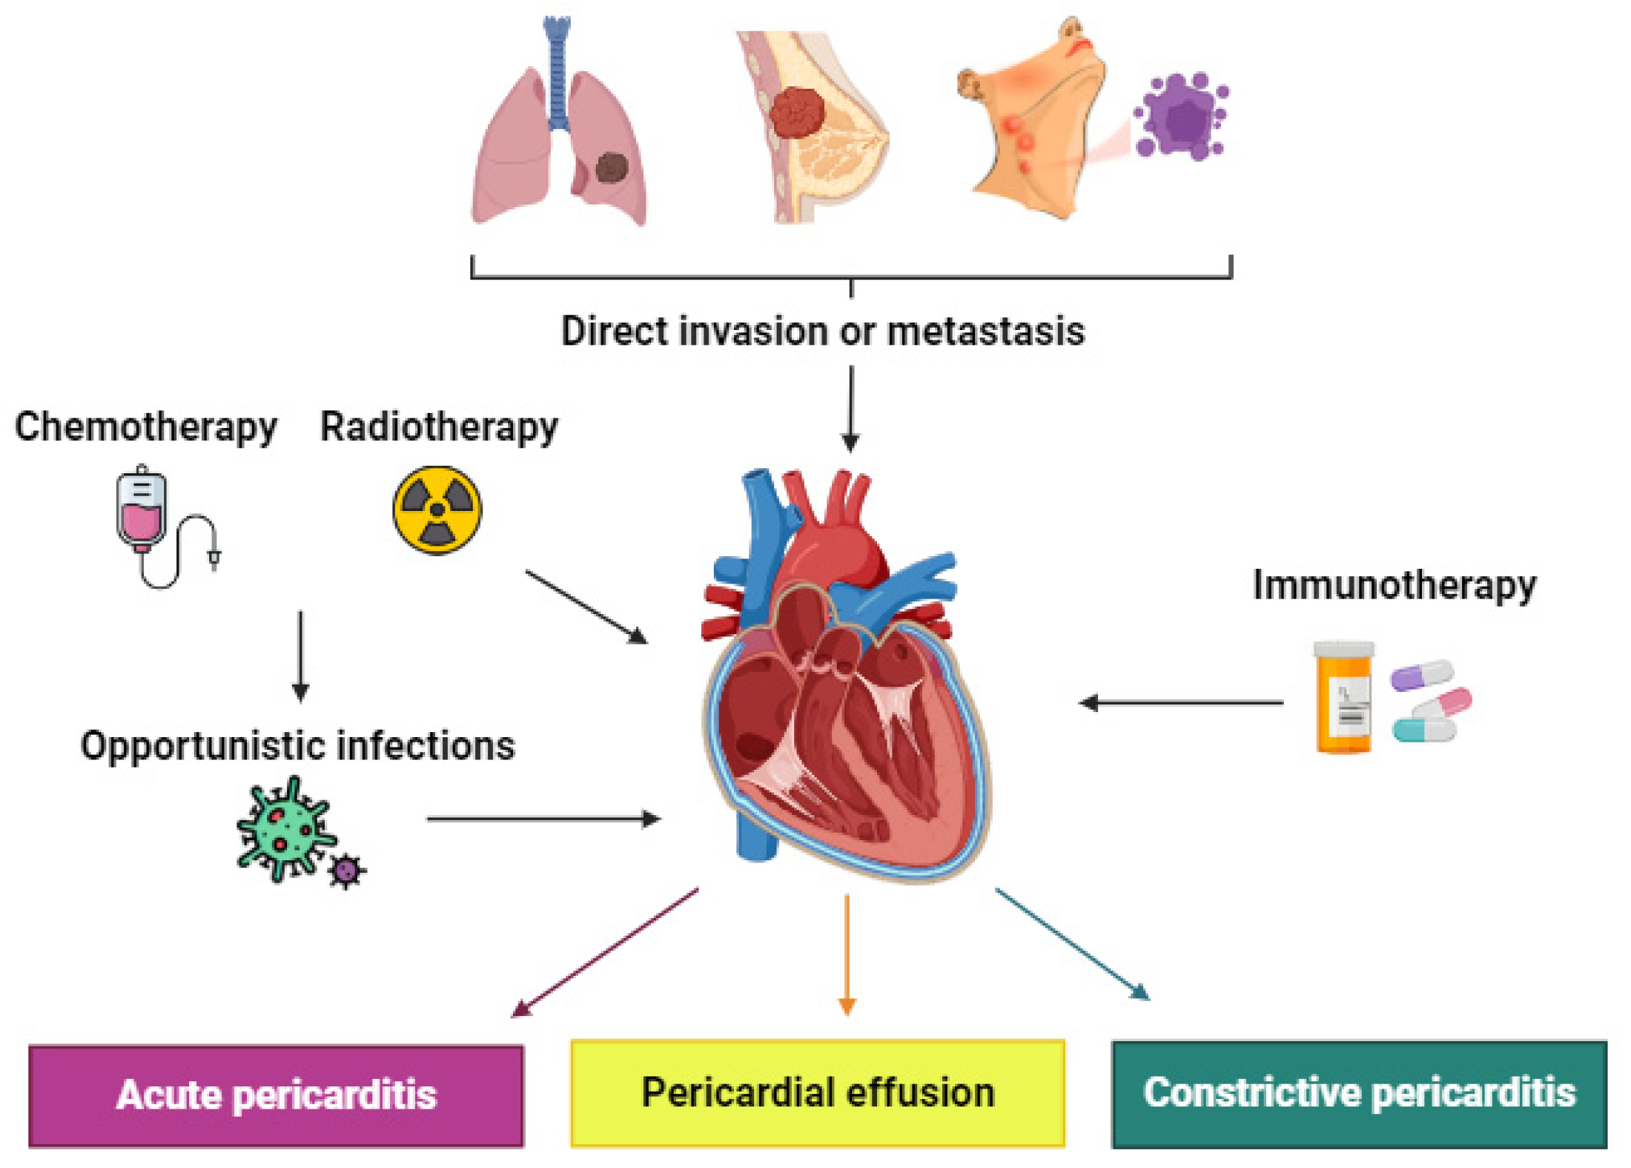
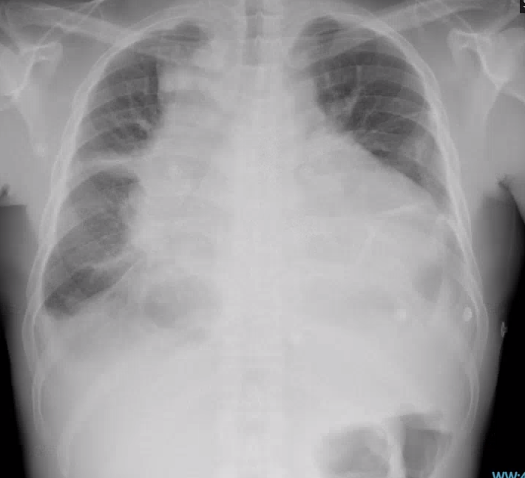
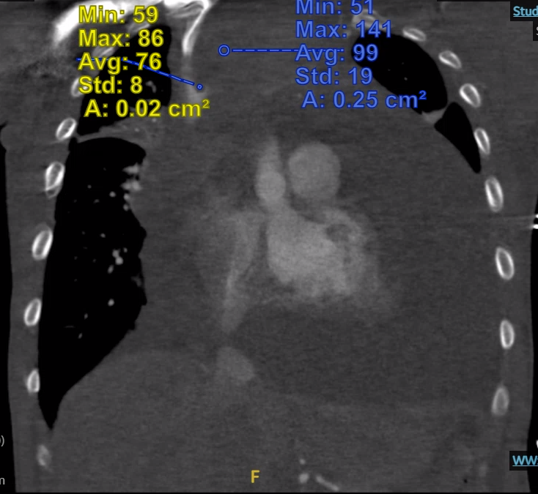
Cardiac Tamponade Unveiling Hodgkin Lymphoma: A Case Report of an Uncommon Presentation Humza Pirzadah, Archit Shukla, MD, Usman Chaudry, MD, Humza Malik, MD ¹Louisiana State University Health Sciences Center School of Medicine, New Orleans, LA,
Background
Hospital Workup
Discussion
Cardiac tamponade is a critical pericardial syndrome characterized by compromised ventricular filling and reduced cardiac output.
Malignancies contribute to approximately 23% of cardiac tamponade cases, with hematologic malignancies like Hodgkin’s lymphoma being notable causes.
Pericardial effusions are common in lymphomas; however, cardiac tamponade is a rare but serious development.
Initial Interventions
Highlighting the significance of electrical alternans, which is seen in up to 10% of tamponade cases and indicates a large pericardial effusion.
Emphasizing the necessity for rapid recognition and treatment of hemodynamically significant effusions to prevent fatal outcomes.
Discussing the rarity of cardiac tamponade in lymphoma patients and the importance of considering it in differential diagnoses, especially with atypical presentations in younger patients.
Diagnostic Intervention: Bedside ultrasound indicated a large pericardial effusion with right ventricular diastolic collapse, leading to an emergent pericardiocentesis which removed 1.5 liters of fluid.
Diagnosis:
Biopsy of a right posterior cervical lymph node confirmed Hodgkin lymphoma, mixed cellularity subtype, with EBV positivity.
Treatment:
Conclusion
Initiation of chemotherapy with scheduled close follow-up to monitor response and manage any further complications associated with cardiac tamponade or lymphoma.
This case significantly highlights the intersection between oncological and cardiac emergencies, advocating for a vigilant approach in patients with known malignancies who present with cardiac symptoms.
It stresses the need for incorporating specific cardiac diagnostic tests like echocardiography and ECG findings of electrical alternans in routine evaluations of lymphoma patients, potentially leading to earlier identification and management of life-threatening complications
Underscores the importance of educating clinicians on the potential for atypical manifestations of common oncological conditions, thereby improving patient outcomes through prompt and precise medical interventions.
Patient Data
Case Presentation
Patient Presentation
27-year-old male with schizophrenia presenting with exertional dyspnea, syncope, and early satiety.
Symptoms
Tachycardia, bilateral lower extremity edema, prominent axillary lymphadenopathy
References
Adler, Y., Ristić, A. D., Imazio, M., Brucato, A., Pankuweit, S., Burazor, I., Seferović, P. M., & Oh, J. K. (2023). Cardiac tamponade. Nature Reviews Disease Primers, 9(1). https://doi.org/10.1038/s41572-023-00446-1
Abouzeid W, Mirza N, Bellafiore P, Kiwan C, Paige A, Suleiman A, Khan A, Miller R. Surviving the Storm: Cardiac Tamponade and Effusive Constrictive Pericarditis Complicated by Pericardial Decompression Syndrome Induced by COVID-19 Infection in the Setting of Newly Diagnosed Acute Myeloid Leukemia (AML). Cureus. 2024 Mar 22;16(3):e56710. doi: 10.7759/cureus.56710. PMID: 38646402; PMCID: PMC11032651.
Adi O, Fong CP, Ahmad AH, Azil A, Ranga A, Panebianco N. Pericardial decompression syndrome: A complication of pericardiocentesis. Am J Emerg Med. 2021 Jul;45:688.e3-688.e7. doi: 10.1016/j.ajem.2021.01.022. Epub 2021 Jan 16. PMID: 33514476.
Adi O, Fong CP, Ahmad AH, Azil A, Ranga A, Panebianco N. Pericardial decompression syndrome: A complication of pericardiocentesis. Am J Emerg Med. 2021 Jul;45:688.e3-688.e7. doi: 10.1016/j.ajem.2021.01.022. Epub 2021 Jan 16. PMID: 33514476.
Ricarte Bratti JP, Brunette V, Lebon JS, Pellerin M, Lamarche Y. Venoarterial Extracorporeal Membrane Oxygenation Support for Severe Pericardial Decompression Syndrome: A Case Report. Crit Care Med. 2020 Jan;48(1):e74-e75. doi: 10.1097/CCM.0000000000004046. PMID: 31567343.
Lorenzo-Esteller L, Ramos-Polo R, Pons Riverola A, Morillas H, Berdejo J, Pernas S, Pomares H, Asiain L, Garay A, Martínez Pérez E, et al. Pericardial Disease in Patients with Cancer: Clinical Insights on Diagnosis and Treatment. Cancers. 2024; 16(20):3466. https://doi.org/10.3390/cancers16203466
Initial Findings
6.5cm pericardial effusion noted on CT Chest, TTE with appreciable right ventricular diastolic collapse. Electrical alternans on EKG. Also, 10.6 cm mixed cystic and solid anterior mediastinal mass
Figure 1: Chest X-Ray shows gross cardiomegaly suggesting cardiomyopathy and/or pericardial effusion. Pulmonary venous congestion suggesting fluid overload/cardiac decompensation. Also bilateral pleural effusions. CT Angio Chest shows 10.6 cm mixed cystic and solid anterior mediastinal mass. Large pericardial effusion as well as bilateral pleural effusions.

