Slide 1
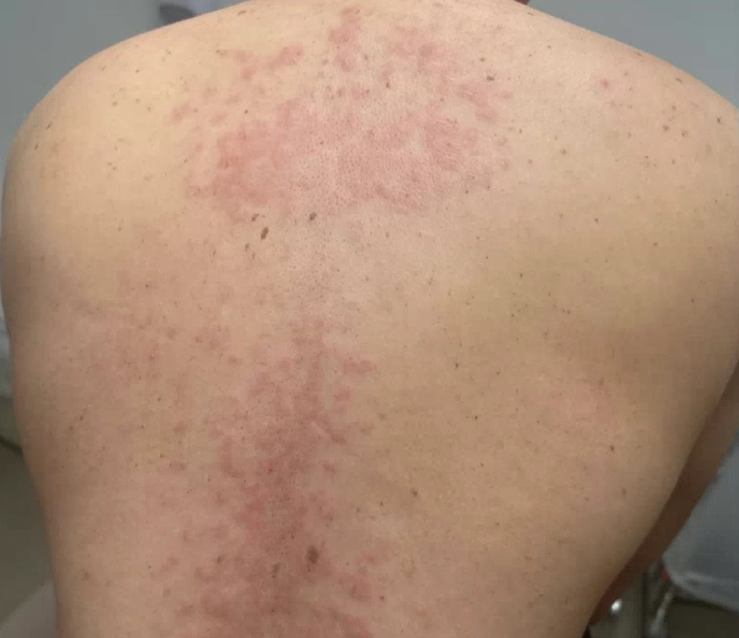
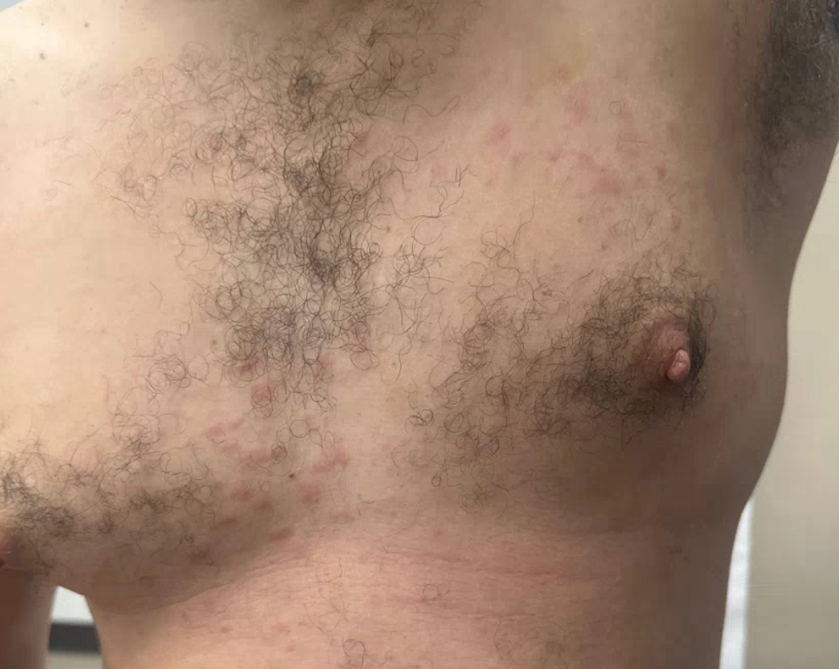
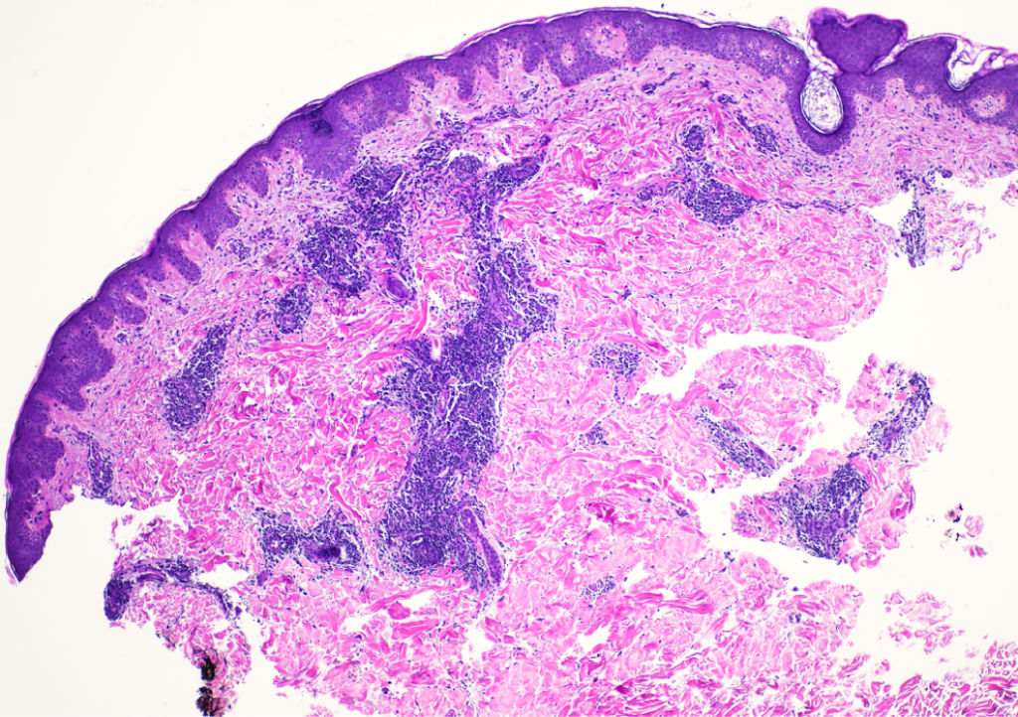
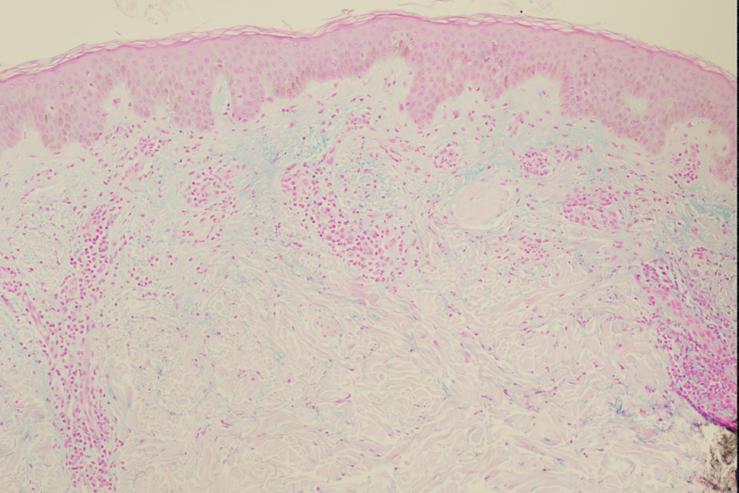
Refractory Dermatitis Evolving Into Lupus Spectrum Disease in the Setting of Dupilumab Use
.
Jonathan Joseph MD, Jordan Book BS, Jacob Kilgore MD, Nicholas Culotta MD
Introduction
Clinical and Pathological Images
Cutaneous Lupus Erythematosus (CLE) encompasses a broad range of skin disorders with diverse morphologic and histopathologic presentations [1,2].
Diagnosis can be complicated by clinical overlap with other inflammatory dermatoses, such as drug eruptions, eczematous processes, and urticarial conditions [3,4].
Hydroxychloroquine is a first-line therapy for lupus, but it may offer only partial or delayed responses, necessitating ongoing re-evaluation [5,6].
We present a case of a patient treated by an outside provider with dupilumab (initially for presumed atopic dermatitis) who later developed cutaneous lupus, suggesting dupilumab may have unmasked an underlying autoimmune process [7].
Dupilumab inhibits the Th2 pathway (via IL-4/IL-13 blockade), potentially shifting immune balance toward Th1/Th17 and promoting autoimmune conditions such as lupus [7-9].
Case reports of lupus-like phenomena emerging after dupilumab initiation support the possibility that suppressing Th2 pathways may inadvertently unmask or exacerbate Th1/Th17-driven diseases [7].
Figures 1 and 2. Clinical images featuring diffuse erythematous papules coalescing into plaques on the patient’s back and chest.
Case Description
Initial Presentation (September 25, 2023):
42-year-old male with a pruritic eruption starting on elbows and knees, spreading to arms, legs, trunk, and neck.
Treated in the ED with dexamethasone, prednisone, famotidine, and loratadine; eruption worsened after corticosteroid cessation.
Early October 2023:
Received dupilumab (loading dose) for presumed atopic dermatitis.
Developed fever of unknown origin and diarrhea, requiring hospitalization.
Skin eruption resolved except for injection-site reaction. Extensive workup ruled out malignancy and a definitive rheumatologic diagnosis.
November 2023:
Recurrence of eruption after patient ran out of topical steroids (triamcinolone, hydrocortisone) and hydroxyzine (Figures 1, 2).
Punch biopsy of the right chest: superficial and deep perivascular dermatitis, initially thought to be a drug eruption.
Discontinued hydrochlorothiazide despite an atypical clinical picture.
January 2024:
Another flare prompted a second biopsy (on the back): lymphocytic infiltrate with dermal mucin, suggestive of CLE (Figures 3, 4).
Began hydroxychloroquine (200 mg daily, increased to 200 mg twice daily), with partial skin improvement.
Up until this time point, serologies included negative anti-dsDNA, negative/fluctuating ANA, and intermittent positive anti-RNP/anti-Sm; concern remained for lupus-spectrum disease despite partial improvement with hydroxychloroquine.
April 1, 2024:
Patient reported intermittent urticarial lesions that resolved within 24 hours, with associated transient joint swelling in the wrists, knees, and fingers.
Third biopsy from the left shoulder: lichenoid and neutrophilic dermatitis, perivascular/periadnexal inflammation, dermal mucin, negative DIF.
Findings supported lupus or neutrophilic urticarial dermatosis (NUD). Sweet’s syndrome, urticarial vasculitis, or a drug-induced process were also considered.
Partial response to hydroxychloroquine favored a working diagnosis of tumid lupus with overlapping or atypical features.
June 2024:
Reported intermittent flares every few days.
Mild normocytic anemia and chronic leukocytosis, otherwise stable labs.
Continued hydroxychloroquine 200 mg twice daily with fewer skin flares.
September 2024:
Skin remained clear; no recurrences or systemic symptoms.
Physical exam revealed no active lesions or joint swelling.
Plan to continue hydroxychloroquine until February 2025 with possible taper if asymptomatic.
Current Status:
Patient returned to clinic in February of 2025 and remained clear, however, patient elected to continue hydroxychloroquine therapy after risk/benefit discussion for additional year.
Clinical course most consistent with tumid lupus or a lupus-related neutrophilic dermatosis responsive to hydroxychloroquine.
Figure 3. Histopathology consistent with cutaneous lupus erythematosus.
Figure 4. Alcian blue stain demonstrating dermal mucin in cutaneous lupus erythematosus.
Discussion
References
Initial atopic dermatitis diagnosis and transient improvement on dupilumab were complicated by fever and diarrhea, highlighting challenges in identifying lupus spectrum conditions and raising the possibility that dupilumab may unmask or worsen subclinical autoimmune processes [7].
Sequential biopsy results ranged from features suggestive of a drug eruption to consistent with cutaneous lupus, underscoring the dynamic nature of his disease.
Urticarial-like lesions, arthralgias, and a negative DIF complicated the picture, yet partial and sustained improvement on hydroxychloroquine supported a lupus spectrum disorder [5,6].
Despite atypical presentation, histologic findings of dermal mucin and nonscarring, photosensitive lesions favor tumid lupus or a similar lupus entity, reinforced by variable serologies (anti-RNP, anti-Sm) and the need for ongoing dermatologic, rheumatologic, and serologic surveillance [10,11].
Obermoser G, Sontheimer RD, Zelger B: Overview of common, rare and atypical manifestations of cutaneous lupus erythematosus and histopathological correlates. Lupus. 2010, 19:1050-70. 10.1177/0961203310370048
Fijałkowska A, Kądziela M, Żebrowska A: The spectrum of cutaneous manifestations in lupus erythematosus: a comprehensive review. J Clin Med. 2024, 13:2419. 10.3390/jcm13082419
Elmgren J, Nyberg F: Clinical aspects of cutaneous lupus erythematosus. Front Med (Lausanne). 2022, 9:984229. 10.3389/fmed.2022.984229
Petty AJ, Floyd L, Henderson C, Nicholas MW: Cutaneous lupus erythematosus: progress and challenges . Curr Allergy Asthma Rep. 2020, 20:12. 10.1007/s11882-020-00906-8
Teboul A, Arnaud L, Chasset F: Recent findings about antimalarials in cutaneous lupus erythematosus: what dermatologists should know. J Dermatol. 2024, 51:895-903. 10.1111/1346-8138.17177
Shipman WD, Vernice NA, Demetres M, Jorizzo JL: An update on the use of hydroxychloroquine in cutaneous lupus erythematosus: a systematic review. J Am Acad Dermatol. 2020, 82:709-22. 10.1016/j.jaad.2019.07.027
Okune M, Okiyama N, Fukuzono M, Sasaki K, Nomura T: Development of systemic lupus erythematosus after dupilumab treatment in a case of atopic dermatitis. J Dermatol. 2022, 49:556-9. 10.1111/1346- 8138.16322
Bridgewood C, Wittmann M, Macleod T, et al.: T helper 2 IL-4/IL-13 dual blockade with dupilumab is linked to some emergent T helper 17-type diseases, including seronegative arthritis and enthesitis/enthesopathy, but not to humoral autoimmune diseases. J Invest Dermatol. 2022, 142:2660-7. 10.1016/j.jid.2022.03.013
Camela E, Giampetruzzi AR, De Pità O, Pallotta S, Russo F: Dupilumab in real-life settings: a review of adverse events and their pathogenesis. Expert Opin Drug Saf. 2024, 23:439-47. 10.1080/14740338.2024.2326480
Vieira V, Del Pozo J, Yebra-Pimentel MT, Martínez W, Fonseca E: Lupus erythematosus tumidus: a series of 26 cases. Int J Dermatol. 2006, 45:512-7. 10.1111/j.1365-4632.2004.02574.x
11. Magaña M, Castellanos G, Meurehg CC, Magaña-Mainero MR: Lupus erythematosus tumidus: clinical and pathological features in a series of 20 patients. Am J Dermatopathol. 2022, 44:469-77. 10.1097/DAD.0000000000002019

