Slide 1
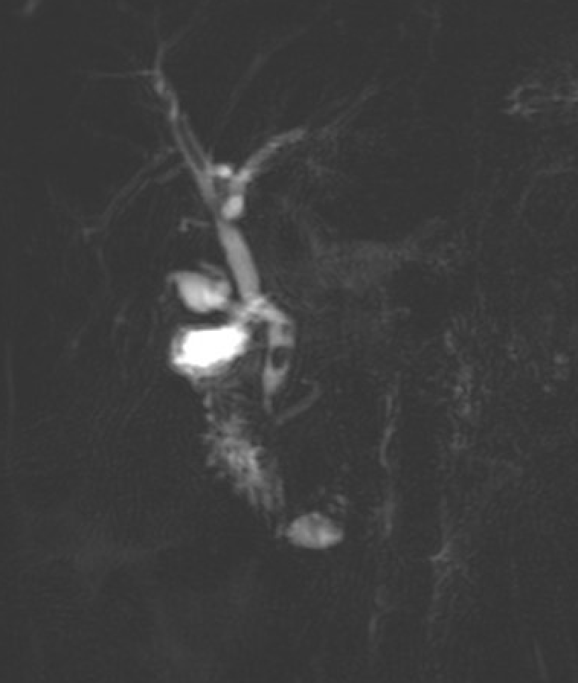
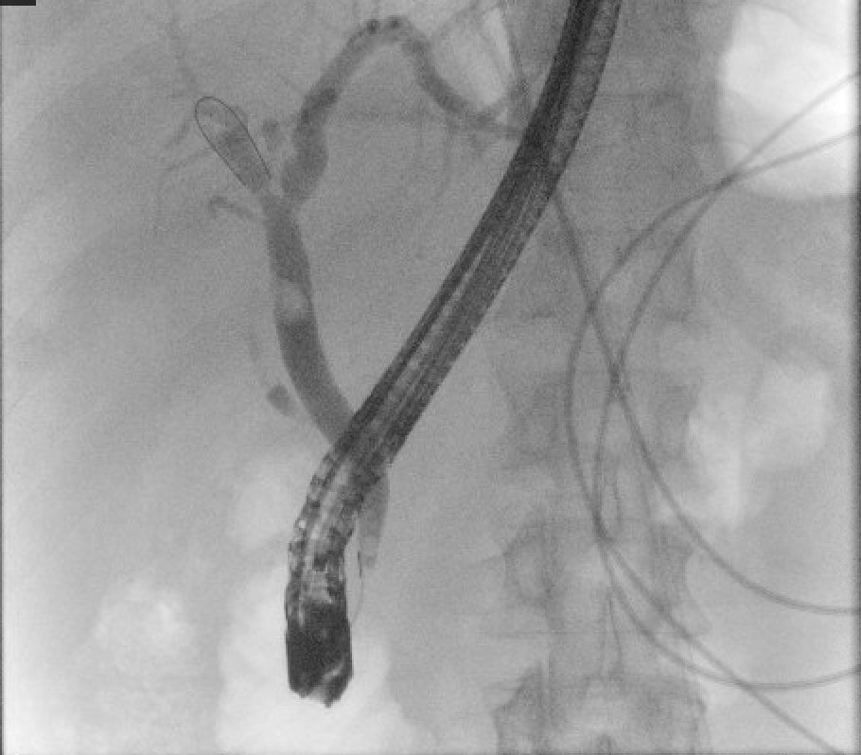
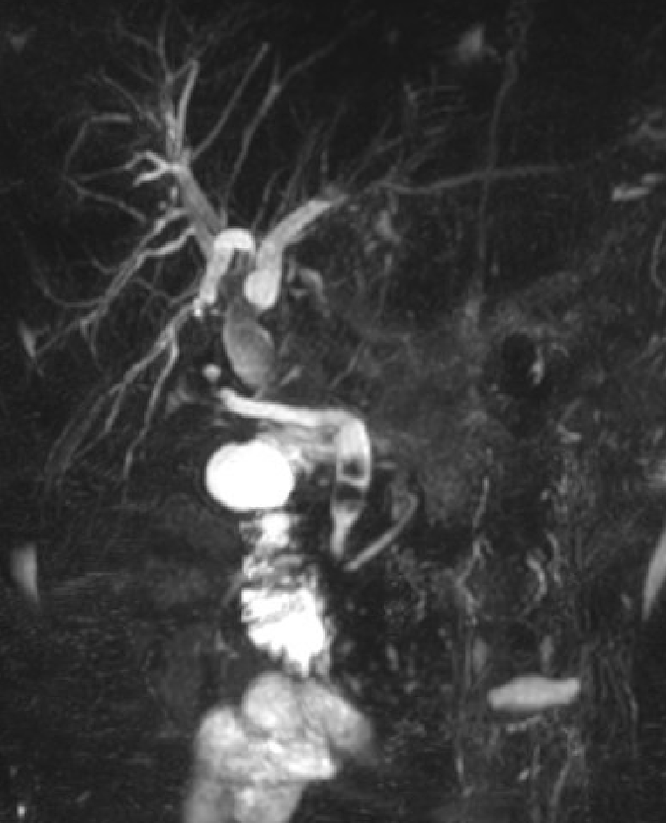
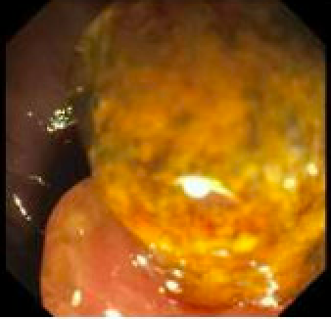
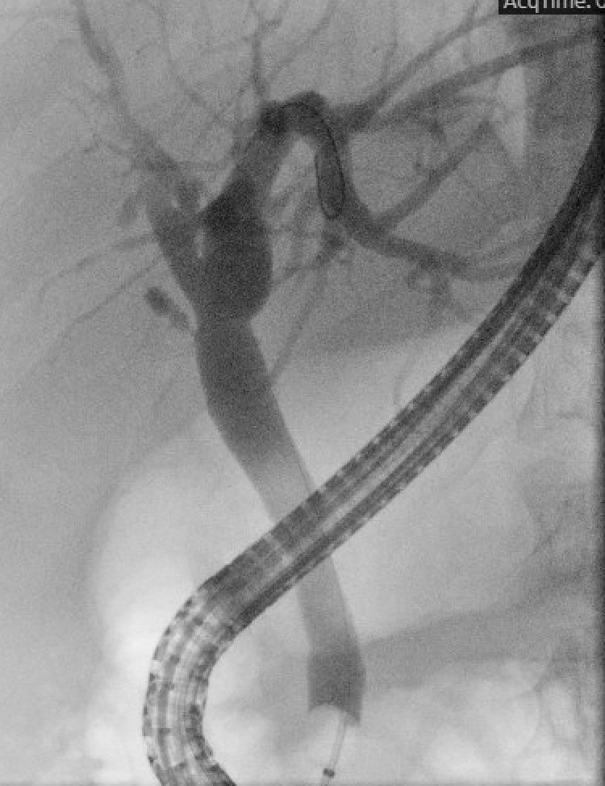
Recurrent Choledocholithiasis After Cholecystectomy and Endoscopic Treatment: A Case Report & Review of Risk Factors Wayne Wheeler MD¹, Connor Pate MD¹ , Kent Broussard MD², Stephen Landreneau MD FACG² ¹Department of Internal Medicine, LSU Health Sciences Center, New Orleans, LA ²Department of Gastroenterology, LSU Health Sciences Center, New Orleans, LA
Introduction
Gallstones in the common bile duct (CBD) defines choledocholithiasis.
Stones can form in the CBD or they can migrate to the CBD from the gallbladder, or less commonly, the intrahepatic biliary tree (hepatolithiasis).
Symptoms include episodic right upper quadrant (RUQ) abdominal pain, nausea, fever, jaundice, and weight loss.
Symptoms of biliary colic can quickly progress to pancreatitis, hepatitis, or most commonly, cholangitis ^{(1,2)}.
ERCP can be performed for diagnostic and therapeutic management.
Cholecystectomy is not always required and remains controversial for patients with primary choledocholithiasis
The recurrence of choledocholithiasis likely involves multiple mechanisms with some risk factors having been previously identified.
Case Description
38 year old male with no PMHx presented to the emergency department with right upper quadrant (RUQ) abdominal pain and jaundice.
Labs notable for acute cholestatic liver injury with a total bilirubin of 19.6 mg/dl.
Abdominal ultrasound of RUQ showed hepatosplenomegaly, normal biliary tree, and a CBD diameter within normal limits (3 mm).
MRCP revealed intrahepatic bile duct dilation with numerous calculi in the distal CBD (Figure 1).
ERCP further visualized two stones in the lower middle third of the CBD with the largest stone measured at 9 mm. A sphincterotomy and balloon extraction was performed, but only the smaller of the two stones was removed. A temporary plastic stent was then placed in the CBD.
Days later general surgery performed robotic assisted cholecystectomy which the patient tolerated well.
He was discharged home and followed up for repeat ERCP that showed one irregular-shaped stone was seen in the middle third of CBD (Figure 2). It was successfully removed following papillary dilation and balloon extraction. No remaining stones were seen on occlusion cholangiogram.
Five months later the patient represented to the hospital with similar symptoms of abdominal pain accompanied with nausea and emesis. His lab work showed mixed liver injury favoring cholestasis.
MRCP again showed a dilated CBD (1 cm) with a recurrence of choledocholithiasis (Figure 3).
ERCP extracted a large 12 mm obstructing stone along with sludge (Figure 4). No stones remained and a covered metal stent was placed into the ampulla.
Four weeks later the metal stent was successfully removed without stones or filling defects seen in the entire biliary tree (Figure 5).
Figure 1: MRCP with multiple stones in CBD.
Figure 2: Repeat ERCP with remaining large stone prior to extraction.
Figure 3: MRCP with recurrence of multiple stones 5 months after cholecystectomy and ERCP.
References
Spataro J, Tolaymat M, Kistler C, et al. Prevalence and Risk Factors for Choledocholithiasis After Cholecystectomy: 72. American Journal of Gastroenterology 112():p S32-S33, October 2017.
Simon M, Hassan IN, Ramasamy D, Wilson D. Primary Choledocholithiasis 15 Years Postcholecystectomy. Case Rep Med. 2020 Oct 26;2020:3265010.
Figueiredo JC, Haiman C, Porcel J, et al. Sex and ethnic/racial-specific risk factors for gallbladder disease. BMC Gastroenterol. 2017;17(1):153. Published 2017 Dec 8.
Kim, Dong Il, et al. "Risk factors for recurrence of primary bile duct stones after endoscopic biliary sphincterotomy." Gastrointestinal endoscopy 54.1 (2001): 42-48.
Zhang, Rongchun, et al. "Rate of duodenal-biliary reflux increases in patients with recurrent common bile duct stones: evidence from barium meal examination." Gastrointestinal endoscopy 82.4 (2015): 660-665.
Tsai, Tzung-Jiun, et al. "Role of endoscopic papillary balloon dilation in patients with recurrent bile duct stones after endoscopic sphincterotomy." Journal of the Chinese Medical Association 78.1 (2015): 56-61.
Saharia PC, Zuidema GD, Cameron JL. Primary common duct stones. Ann Surg. 1977;185:598–604.
Choi HH, Min S, Lee HK, Lee H. Risk factors of recurrence following common bile duct exploration for choledocholithiasis. J Minim Invasive Surg 2021;24:43-50.
Choe, Jung Wan, et al. "Incidence and risk factors for postoperative common bile duct stones in patients undergoing endoscopic extraction and subsequent cholecystectomy." Gastrointestinal Endoscopy 93.3 (2021): 608-615.
Mazen S. J. T., Jacobs M., Kistler C. A. Monjur complicated choledocholithiasis more common after cholecystectomy. EC Gastroneterology and Digestive System. 2018;5(12):1005–1010.
Keizman D, Shalom MI, Konikoff FM. An angulated common bile duct predisposes to recurrent symptomatic bile duct stones after endoscopic stone extraction. Surg Endosc. 2006;20(10):1594-1599.
Chae MK, Lee SH, Joo KR. Assessment of the possible risk factors for primary common bile duct stone recurrence after cholecystectomy. Surg Endosc. 2021;35(12):6497-6504.
Yoo ES, Yoo BM, Kim JH, et al. Evaluation of risk factors for recurrent primary common bile duct stone in patients with cholecystectomy. Scand J Gastroenterol. 2018;53(4):466-470.
Figure 4: Large 12 mm obstructing CBD stone removed on ERCP.
Figure 5: Biliary tree without obstruction during ERCP stent removal.
Discussion
The incidence of choledocholithiasis is estimated between 10-15% of the adult population in the United States ⁽³⁾. Primary choledocholithiasis is the formation of stones within the CBD and is generally due to biliary stasis ⁽⁴⁾. Some anatomic factors that promote biliary stasis include CBD dilation, periampullary diverticulum, biliary strictures, and papillary stenosis ^{(5,6)}. In the United States, secondary choledocholithiasis is the more common etiology and represents the travel of gallstones formed in gallbladder or intrahepatic biliary tree that arrest in the CBD ⁽⁷⁾. Management for choledocholithiasis depends on severity of clinical symptoms. Endoscopic ultrasound (EUS) and MRCP can confirm stone location prior to endoscopic or surgical management. However, a patient presenting with acute cholangitis may require urgent therapeutic management without prior imaging. Therapeutic options for choledocholithiasis include ERCP with or without elective cholecystectomy, laparoscopic cholecystectomy with cholangiography, or laparoscopic cholecystectomy with intraoperative or postoperative ERCP.
Following definitive surgical or endoscopic management, the recurrence of choledocholithiasis is estimated between 4-24% ⁽⁸⁾. One study of 278 patients reported a choledocholithiasis recurrence rate of 20 % following ERCP and cholecystectomy ⁽⁹⁾. 80% of cases with recurrence after cholecystectomy occur within the first 3 years following surgery ^{(1,10)}. Although the pathophysiology of recurrent CBD stones is not fully understood, some risk factors have been identified. Angulation of the CBD (< or = 145 degrees), CBD diameter (≥ 15 mm), prior open cholecystectomy, and CBD stone number (≥2) are associated with increased rates of symptomatic recurrence ⁽¹¹⁻¹³⁾. Albeit more rare, cases of stone recurrence more than ten years later have been reported. These cases were attributed to surgical clip migration and cystic duct remnants ⁽²⁾.
Our case represents an example of recurrent choledocholithiasis five months after definitive surgical and endoscopic removal of multiple common bile duct stones. The review of literature suggests CBD stone recurrence after ERCP and cholecystectomy occurs in 5-20% of cases. Clinicians should carefully review risk factors for recurrence and consider choledocholithiasis in patients presenting within the first three years following cholecystectomy.

