Slide 1
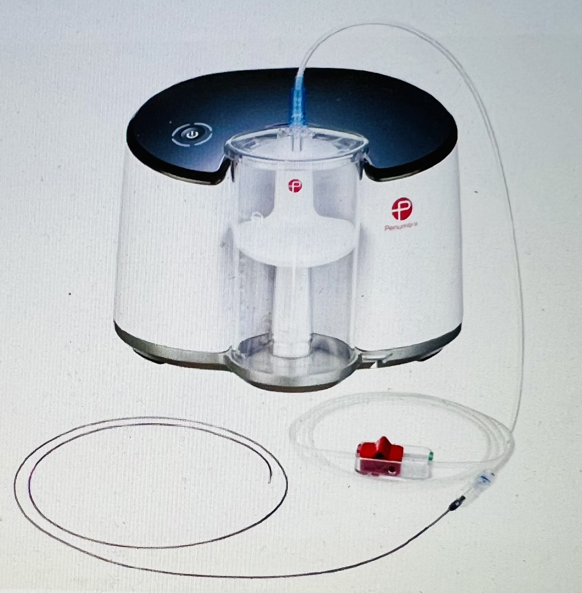
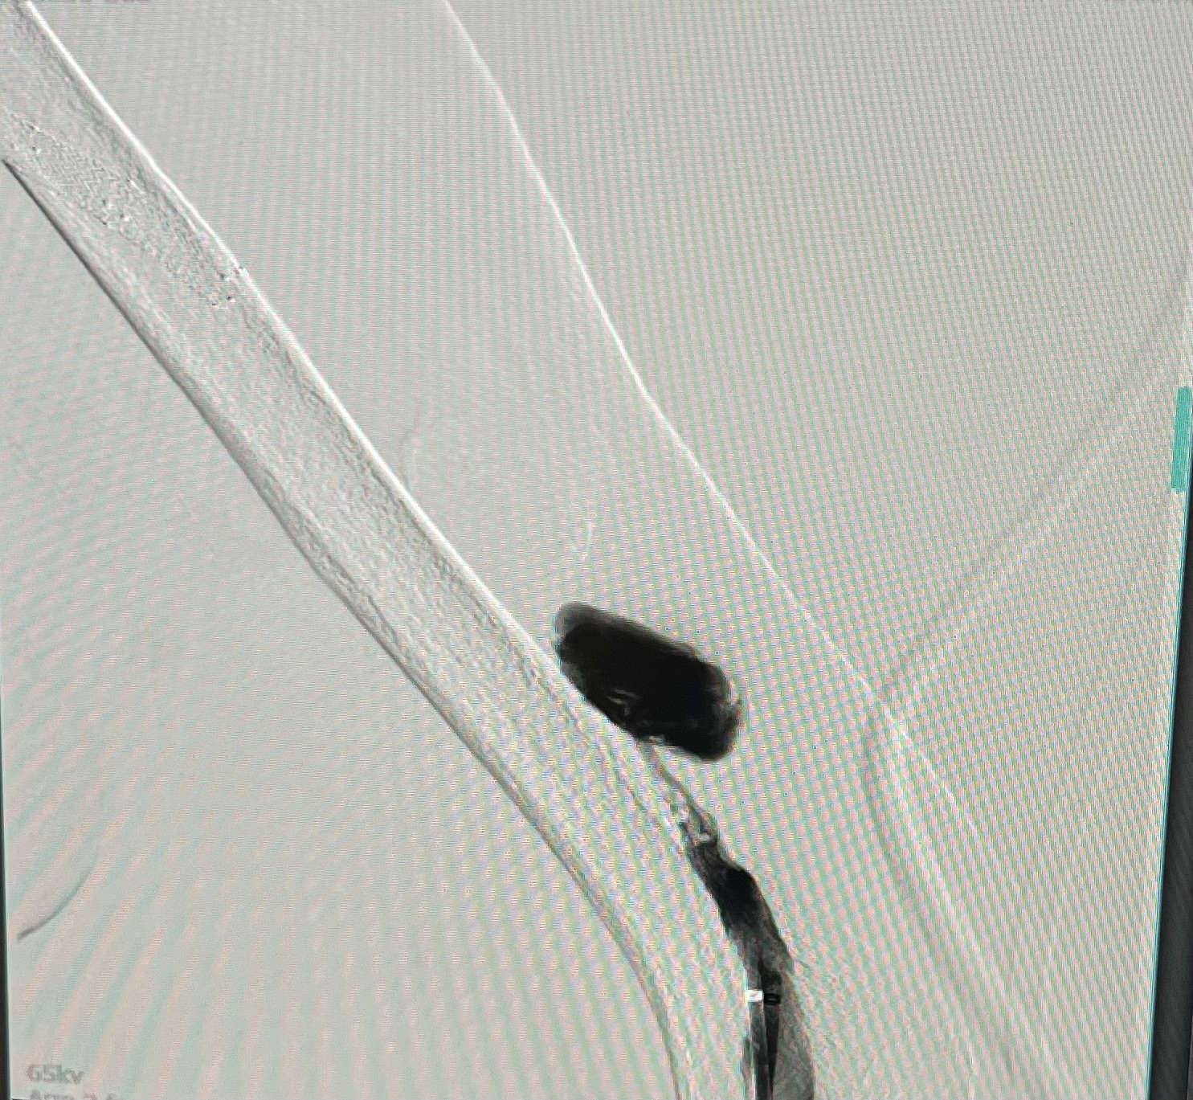
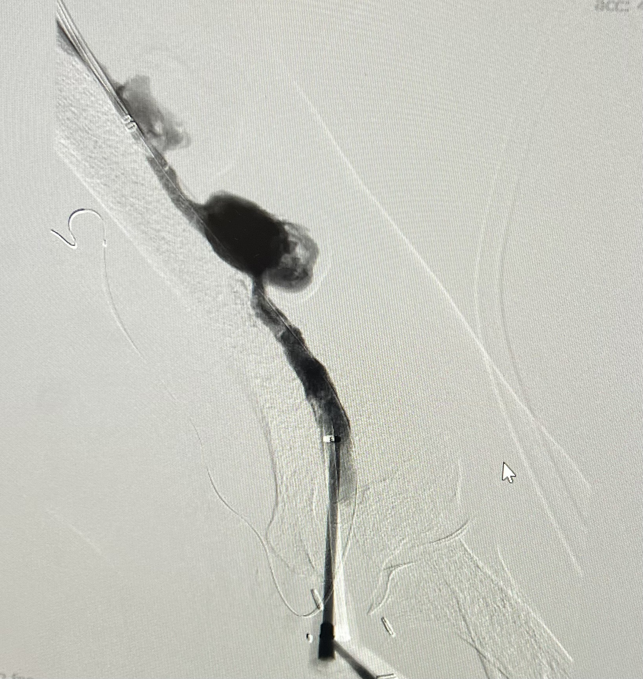
Vascular Access Abandonment Despite Use of a Novel Thrombectomy Device, the Penumbra CAT7D Nahida Baigam¹ MD, Farshid Yazdi¹ M.D. Department of Internal Medicine, Louisiana State University Health Sciences Center, New Orleans
Introduction
Discussion
The “End Stage Kidney Disease Life Plan” is a personalized and comprehensive map for dialysis modalities and access for the patient's lifetime. It must be periodically updated based on patient risk factors (1).
If a dialysis vascular access stops working, it can cause severe complications and higher healthcare costs (2).
In the United States, less than 50% of vascular accesses remain patent after three years. Despite the prolonged maturation time that delays immediate use, patency rates for AVFs range from 3 to 5 years, compared to 1 to 2 years for AV grafts. Furthermore, over 50% of accesses fail, with AVF failing after a median of 3-7 years and AVG after 1-1.5 years (3,4).
Penumbra CAT7D
The anatomical location of the thrombus and the clot burden can vary depending on the type of vascular access. In AVG, the thrombus usually extends the entire length of the synthetic graft, whereas, in a clotted AVF, the thrombus is usually located at the juxta-anastomotic segment (5, 7).
The timing is crucial, If thrombectomy is delayed for more than 2-3 days, it may cause a clot to adhere to the vessel wall and pose challenges compared with AVG thrombosis, which can be done up to 2 weeks after an episode of thrombosis (6, 8).
Other than medical thrombolysis with Tissue plasminogen activator(tPA), Urokinase, or streptokinase, several mechanical devices are used in this era, including a vacuum-assisted thrombectomy catheter and Penumbra CAT7D.
some studies showed the benefit of using these vacuum devices for AVF and AVG, with a 91.4% clinical success rate with one major complication of perforation, one thrombosis, and hematoma in one patient (7, 9) in some studies while other showed inferiority of one on other types like study comparing different modalities of mechanical thrombus aspiration found that Penumbra catheter performed statistically significantly lower than other devices like Angiojet and Trerotola (8,10).
Imaging
Case Discussion
AVF Before and after procedure:
86-year-old African American male with a long-term history of hypertension, diabetes mellitus-type 2, gout, and benign prostatic hypertrophy.
ESRD since 2015, his access has been in use for thrice weekly hemodialysis and AVF salvage being done for almost one decade, requiring several procedures, including a fistulogram, medical and or mechanical thrombectomies using different kinds of balloons for angioplasty.
A successful declot of his LUE brachiocephalic AV fistula was performed with angioplasty in the inflow and outflow portions of the fistula, as well as mechanical and pharmacologic thrombolysis using Fogarty balloon catheter and tPA, respectively. But his access thrombosed again during HD treatment the day after we performed the above procedure
We repeated the procedure the following day using a novel CAT7D aspiration device. We found stenosis at the proximal end of the outflow stent complex, the most common site for stenosis in a brachiocephalic AVF.
we also had difficulty within the canulation zone due to persistent recoil, which we believe is the culprit lesion causing re-thrombosis.
Unfortunately, however, the patient was started on dialysis, and within an hour of the start of treatment, the access was unable to achieve adequate circuit blood flow on dialysis.
Conclusions
Vascular access continues to be a challenging area of practice that requires a commitment of resources, time, and energy to complete the necessary studies to inform some of the issues better. Recent vascular access guidelines also mention it (1). Vascular access is a “lifeline” for End-stage renal disease (ESRD) patients on hemodialysis(HD).
As we know, Autogenous fistulas are associated with a longer time to catheter-free dialysis but better patency, lower infection risk, and lower mortality compared with prosthetic grafts in the general population (10).
Innovations in vascular access salvage are needed, supported by extensive clinical trials and discriminations between different available devices, for improved clinical outcomes and justified utilization based on a better understanding of these vascular gadgets.
Reference
Lok CE, Huber TS, Lee T, et al. National Kidney Foundation. KDOQI clinical practice guideline for vascular access: 2019 update. Am J Kidney Dis 2020;75(4, Suppl 2):S1–S164
Al Shakarchi J, Inston N, Jones RG, Maclaine G, Hollinworth D. Cost analysis of the hemodialysis reliable outflow (HeRO) Graft compared to the tunneled dialysis catheter. J Vasc Surg 2016;63(04): 1026–1033
Al-Jaishi AA, Oliver MJ, Thomas SM, et al. Patency rates of the arteriovenous fistula for hemodialysis: a systematic review and meta-analysis. Am J Kidney Dis 2014;63(03):464–478
Beathard GA. Management of complications of endovascular dialysis access procedures. Semin Dial 2003;16(04):309–313
Al-Jaishi AA, Liu AR, Lok CE, Zhang JC, Moist LM. Complications of the Arteriovenous Fistula: A Systematic Review. J Am Soc Nephrol. 2017 Jun;28(6):1839-1850.
Arhuidese IJ, Orandi BJ, Nejim B, Malas M. Utilization, patency, and complications associated with vascular access for hemodialysis in the United States. J Vasc Surg. 2018 Oct;68(4):1166-1174.
Kitrou PM, Katsanos K, Papadimatos P, Spiliopoulos S, Karnaba- tidis D. A survival guide for endovascular declotting in dialysis access: procedures, devices, and a statistical analysis of 3,000 cases. Expert Rev Med Devices 2018;15(04):283-291
Lawson JH, Niklason LE, Roy-Chaudhury P. Challenges and novel therapies for vascular access in haemodialysis. Nat Rev Nephrol 2020;16(10):586–602
Clement M, Stephen D, Yann B, Francois P, Nicolas Grenier, Jos B, Bella H. Mechanical Thrombectomy in Acute Thrombosis of Dialysis Arteriovenous Fistula and Grafts using a Vacuume-Assisted Thrombectomy Catheter: A multicenter study.JVIR.2018;29(7):993-997.
Adam H, Anthony G, Jessica S, Jordan B, Charles B, Amit D, and Abindra S. Comparing Patency Rates of Arteriovenous Dialysis Access following Percutaneous Thrombectomy Using Various Catheter Directed Therapies. Ann Vasc Surg 2023; 92: 131–141
Notes:
Title: Vascular Access Abandonment Despite Use of a Novel Thrombectomy Device, the Penumbra CAT7D
Authors: Nahida Baigam, MD, Farshid Yazdi, MD
Introduction:
The “End Stage Kidney Disease Life Plan” is a personalized and comprehensive map for dialysis modalities and access for the patient's lifetime. It must be periodically updated based on patient risk factors (1).
If a dialysis vascular access stops working, it can cause severe complications and higher healthcare costs (2).
In the United States, less than 50% of vascular accesses remain patent after three years. Despite the prolonged maturation time that delays immediate use, patency rates for AVFs range from 3 to 5 years, compared to 1 to 2 years for AV grafts. Furthermore, over 50% of accesses fail, with AVF failing after a median of 3-7 years and AVG after 1-1.5 years (3,4).
Case description:
86-year-old African American male with a long-term history of hypertension, diabetes mellitus-type 2, gout, and benign prostatic hypertrophy.
ESRD since 2015, his access has been in use for thrice weekly hemodialysis and AVF salvage being done for almost one decade, requiring several procedures, including a fistulogram, medical and or mechanical thrombectomies using different kinds of balloons for angioplasty.
A successful declot of his LUE brachiocephalic AV fistula was performed with angioplasty in the inflow and outflow portions of the fistula, as well as mechanical and pharmacologic thrombolysis using Fogarty balloon catheter and tPA, respectively. But his access thrombosed again during HD treatment the day after we performed the above procedure
We repeated the procedure the following day using a novel CAT7D aspiration device. We found stenosis at the proximal end of the outflow stent complex, the most common site for stenosis in a brachiocephalic AVF.
we also had difficulty within the canulation zone due to persistent recoil, which we believe is the culprit lesion causing re-thrombosis.
Unfortunately, however, the patient was started on dialysis, and within an hour of the start of treatment, the access was unable to achieve adequate circuit blood flow on dialysis.
Discussion: The anatomical location of the thrombus and the clot burden can vary depending on the type of vascular access. In AVG, the thrombus usually extends the entire length of the synthetic graft, whereas, in a clotted AVF, the thrombus is usually located at the juxta-anastomotic segment (5, 7).
The timing is crucial, If thrombectomy is delayed for more than 2-3 days, it may cause a clot to adhere to the vessel wall and pose challenges compared with AVG thrombosis, which can be done up to 2 weeks after an episode of thrombosis (6, 8).
Other than medical thrombolysis with Tissue plasminogen activator(tPA), Urokinase, or streptokinase, several mechanical devices are used in this era, including a vacuum-assisted thrombectomy catheter and Penumbra CAT7D.
some studies showed the benefit of using these vacuum devices for AVF and AVG, with a 91.4% clinical success rate with one major complication of perforation, one thrombosis, and hematoma in one patient (7, 9) in some studies while other showed inferiority of one on other types like study comparing different modalities of mechanical thrombus aspiration found that Penumbra catheter performed statistically significantly lower than other devices like Angiojet and Trerotola (8,10).
Conclusion:Vascular access continues to be a challenging area of practice that requires a commitment of resources, time, and energy to complete the necessary studies to inform some of the issues better. Recent vascular access guidelines also mention it (1). Vascular access is a “lifeline” for End-stage renal disease (ESRD) patients on hemodialysis(HD).
As we know, Autogenous fistulas are associated with a longer time to catheter-free dialysis but better patency, lower infection risk, and lower mortality compared with prosthetic grafts in the general population (10).
Innovations in vascular access salvage are needed, supported by extensive clinical trials and discriminations between different available devices, for improved clinical outcomes and justified utilization based on a better understanding of these vascular gadgets.
Reference:
Lok CE, Huber TS, Lee T, et al. National Kidney Foundation. KDOQI clinical practice guideline for vascular access: 2019 update. Am J Kidney Dis 2020;75(4, Suppl 2):S1–S164
Al Shakarchi J, Inston N, Jones RG, Maclaine G, Hollinworth D. Cost analysis of the hemodialysis reliable outflow (HeRO) Graft compared to the tunneled dialysis catheter. J Vasc Surg 2016;63(04): 1026–1033
Al-Jaishi AA, Oliver MJ, Thomas SM, et al. Patency rates of the arteriovenous fistula for hemodialysis: a systematic review and meta-analysis. Am J Kidney Dis 2014;63(03):464–478
Beathard GA. Management of complications of endovascular dialysis access procedures. Semin Dial 2003;16(04):309–313
Al-Jaishi AA, Liu AR, Lok CE, Zhang JC, Moist LM. Complications of the Arteriovenous Fistula: A Systematic Review. J Am Soc Nephrol. 2017 Jun;28(6):1839-1850.
Arhuidese IJ, Orandi BJ, Nejim B, Malas M. Utilization, patency, and complications associated with vascular access for hemodialysis in the United States. J Vasc Surg. 2018 Oct;68(4):1166-1174.
Kitrou PM, Katsanos K, Papadimatos P, Spiliopoulos S, Karnaba- tidis D. A survival guide for endovascular declotting in dialysis access: procedures, devices, and a statistical analysis of 3,000 cases. Expert Rev Med Devices 2018;15(04):283-291
Lawson JH, Niklason LE, Roy-Chaudhury P. Challenges and novel therapies for vascular access in haemodialysis. Nat Rev Nephrol 2020;16(10):586–602
Clement M, Stephen D, Yann B, Francois P, Nicolas Grenier, Jos B, Bella H. Mechanical Thrombectomy in Acute Thrombosis of Dialysis Arteriovenous Fistula and Grafts using a Vacuume-Assisted Thrombectomy Catheter: A multicenter study.JVIR.2018;29(7):993-997.
Adam H, Anthony G, Jessica S, Jordan B, Charles B, Amit D, and Abindra S. Comparing Patency Rates of Arteriovenous Dialysis Access following Percutaneous Thrombectomy Using Various Catheter Directed Therapies. Ann Vasc Surg 2023; 92: 131–141

