Slide 1
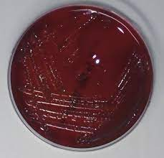
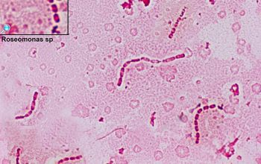
Roseomonas Mucosa, an Unwanted Valentine’s Day Gift
Asad Mussarat, MD; Alexandra Anderson, MD; Ashley Van, MD; Jamie Tran, MD; Chris VanDreumel, MD; Fernanda Correa, MD; Keenan Hurst; Mark Maier; Hope Oddo Moise, MD; Ross McCarron, MD;
Department of Internal Medicine; LSU Health Sciences Center, New Orleans, LA
Introduction
Discussion
Roseomonas mucosa is a rare slow-growing Gram-negative coccobacillus typically isolated from moist environments and skin flora. While it has low pathogenicity, it has been shown to be clinically significant in immunocompromised patients. It is particularly associated with peritoneal dialysis, catheter, and chemotherapy patients. There is limited literature focusing on the prevalence and clinical implications of this pathogen. Therefore, we presented a case of a 57-year-old patient whose battle with cancer was complicated by an infective Roseomonas mucosa.
Systematic review has suggested a 1% mortality associated with Roseomonas mucosa. The organism's inherent resistance to many antibiotics, coupled with its slow growth rate and unusual clinical presentations, often lead to delayed diagnosis and inappropriate treatment. While Roseomonas mucosa has been shown to be sensitive to carbapenems and fluoroquinolones and more resistant to B-lactam antibiotics, this patient showed gradual improvement on IV cefepime. With it being a rarely isolated pathogen, recommended treatment duration expands to up to three week, as in this patient.
Case Presentation
A 57-year-old female with a history of recurrent UTIs and multiple myeloma (treated with subsequent stem cell transplant and current chemotherapy) presented to the emergency department with a one-week duration of shortness of breath, body aches, sore throat, and cough. She had previously been evaluated at an outside facility where a chest x-ray was concerned for a left lower lung infiltration, but the patient’s symptoms failed to improve with a 7-day levofloxacin course. On cardiopulmonary exam, bibasilar crackles were detected on auscultation. This immunocompromised patient was started on empiric vancomycin and piperacillin-tazobactam for presumptive sepsis. Sputum cultures, urine cultures, respiratory infection PCR, and blood cultures were all negative. However, blood cultures later grew the gram-negative rods Roseomonas mucosa. Infectious Disease was consulted and recommended de-escalating antibiotics to cefepime. With follow up blood cultures negative one week later, current antibiotics were deemed sufficient, and the patient was discharged with home health to complete a 21-day course of IV cefepime
Conclusion
Clinicians should maintain a high index of suspicion for Roseomonas mucosa infection in immunocompromised patients presenting with respiratory symptoms, especially in the setting of treatment failure with conventional antibiotics. However, given its low incidence, further research is needed to elucidate optimal diagnostic and therapeutic strategies, as well as preventive measures, to effectively manage these infections and improve patient outcomes
References
Linde HJ, Hahn J, Holler E, Reischl U, Lehn N. Septicemia due to Roseomonas mucosa in a neutropenic patient with leukemia and review of bloodstream infections caused by Roseomonas species. J Clin Microbiol. 2003;41(7):3443-3445. doi:10.1128/jcm.41.7.3443-3445.2003
Barbier F, Ruppé E, Hernandez D, et al. Methicillin-resistant coagulase-negative staphylococci in the community: high homology of SCCmec IVa between Staphylococcus epidermidis and major clones of methicillin-resistant Staphylococcus aureus. J Infect Dis. 2010;202(2):270-281. doi:10.1086/653483
Brooke JS. Roseomonas. In: Mandell GL, Bennett JE, Dolin R, eds. Mandell, Douglas, and Bennett's Principles and Practice of Infectious Diseases. 8th ed. Elsevier Saunders; 2015:2723-2726.
Kämpfer P, Glaeser SP, Busse HJ, Huber B. Roseomonas, a new genus associated with bacteremia and other human infections. Pathogens. 2019;8(4):265. doi:10.3390/pathogens8040265

