Slide 1
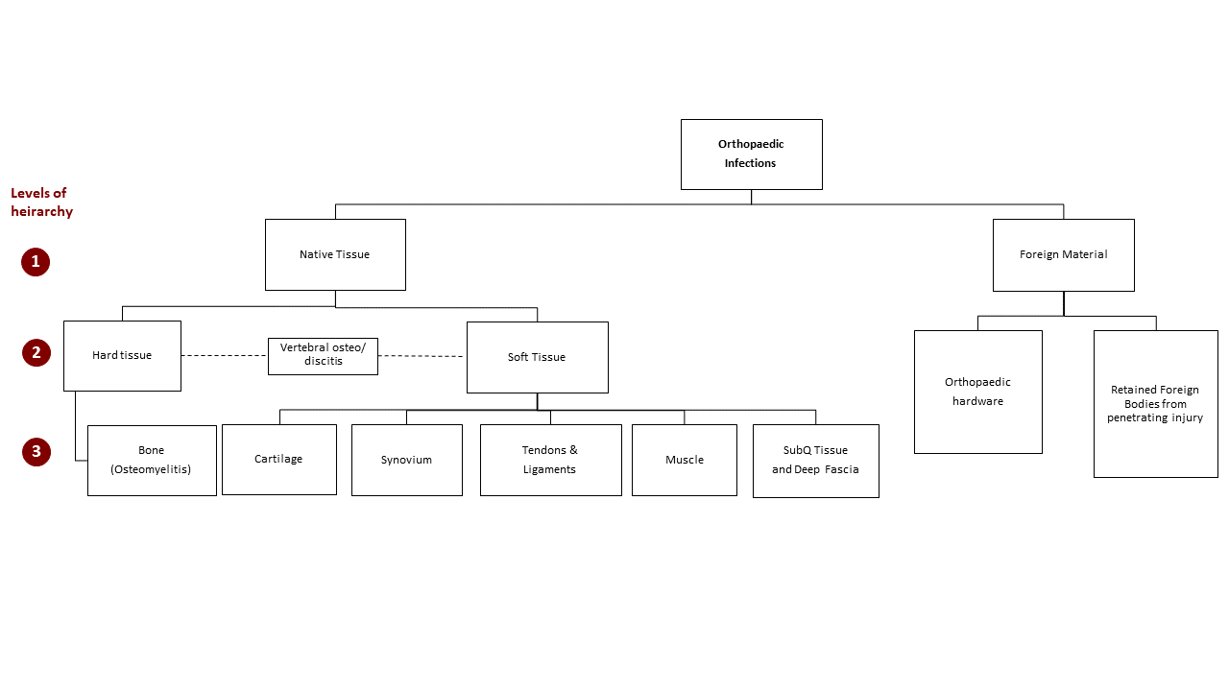
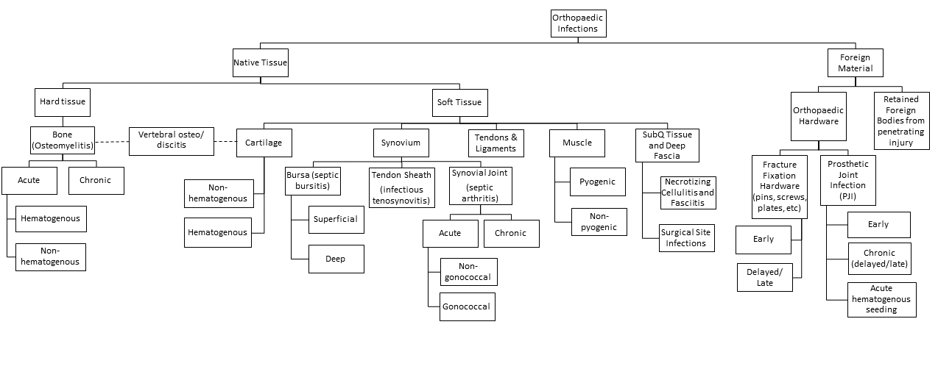
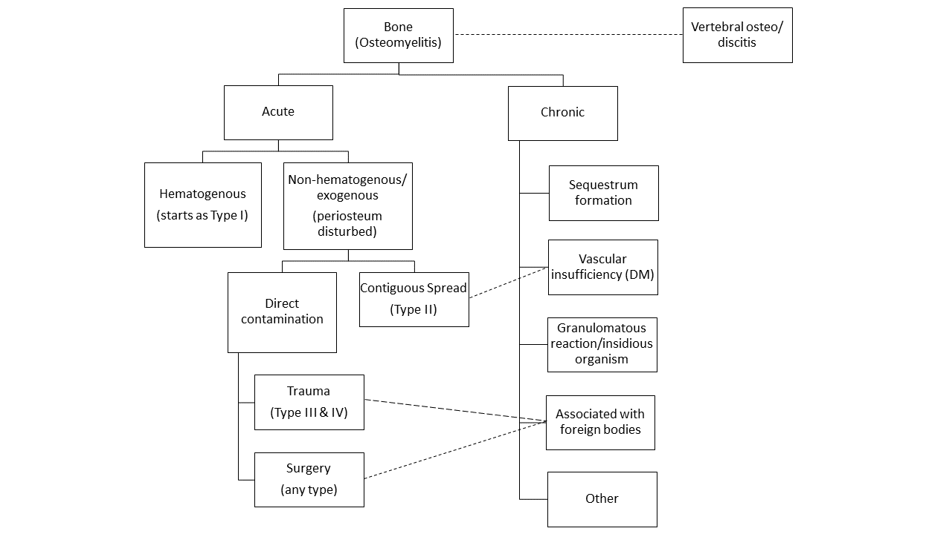
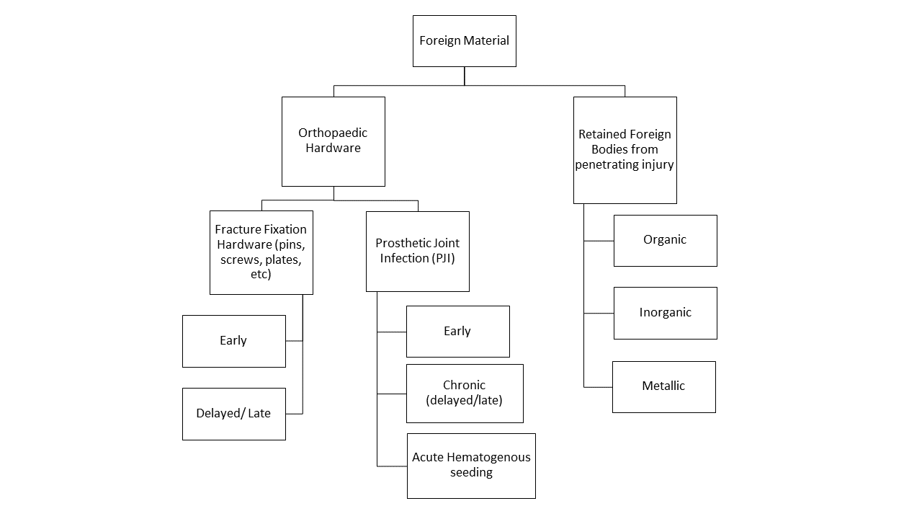
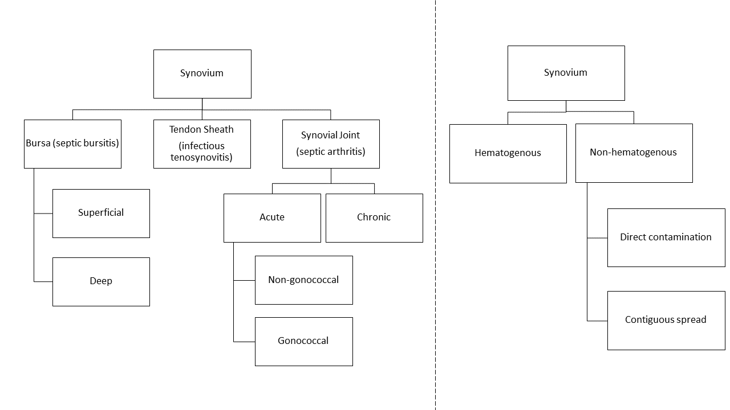
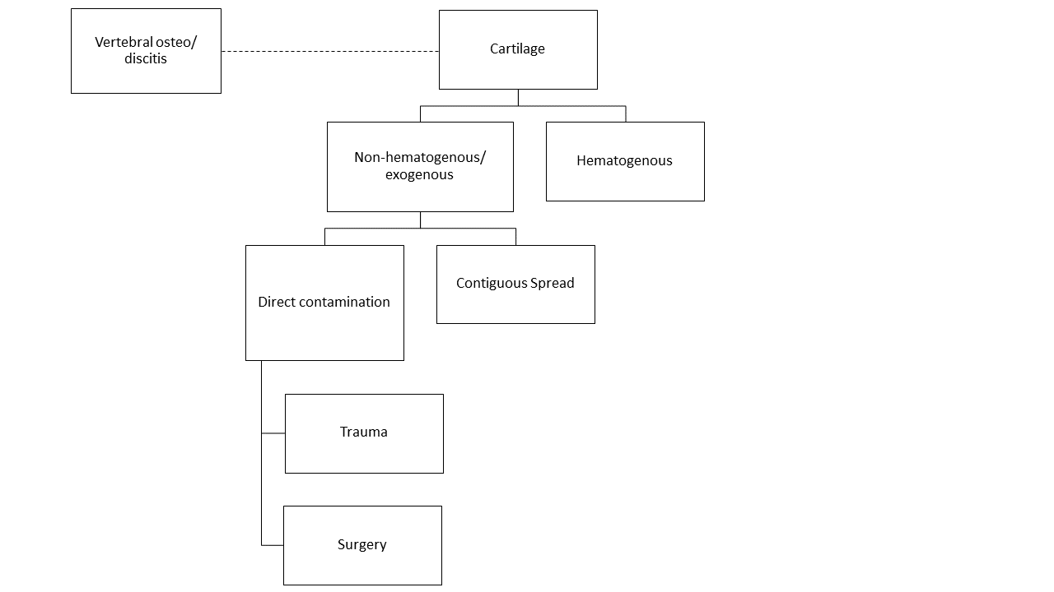
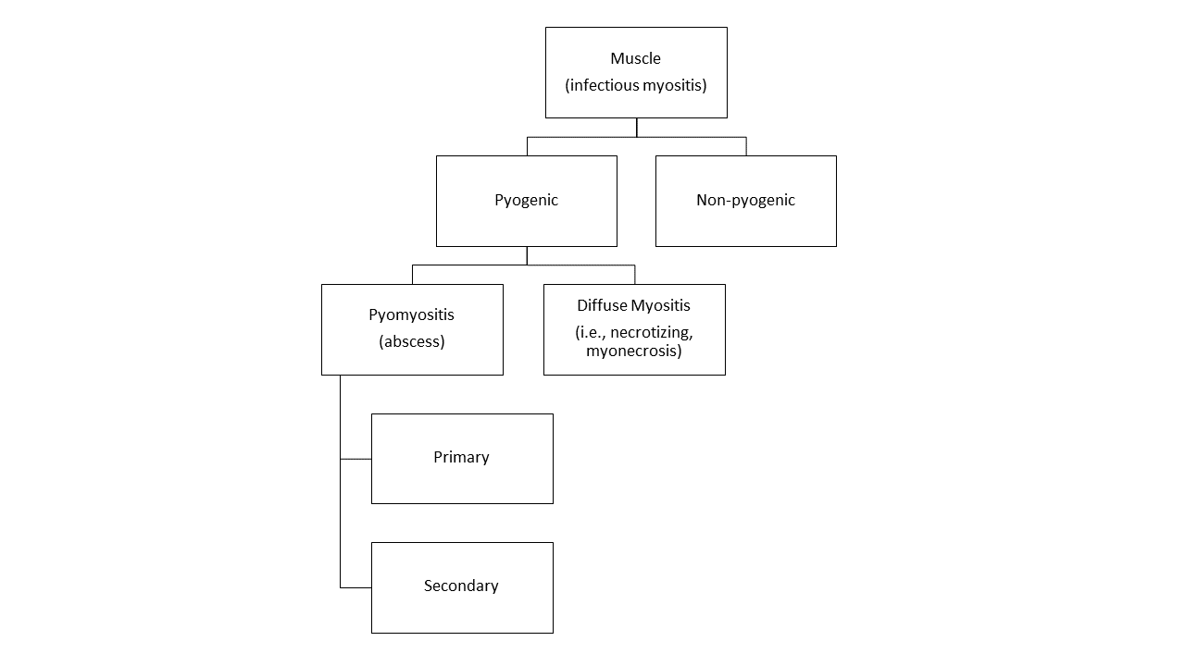
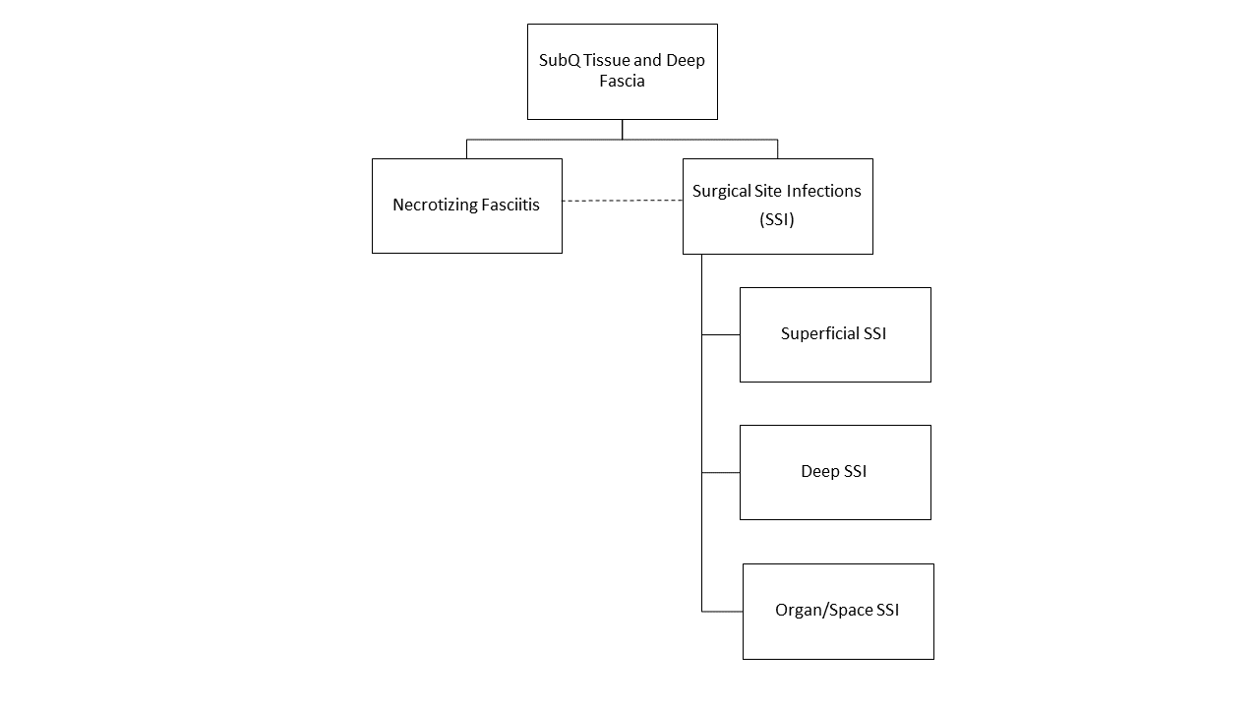
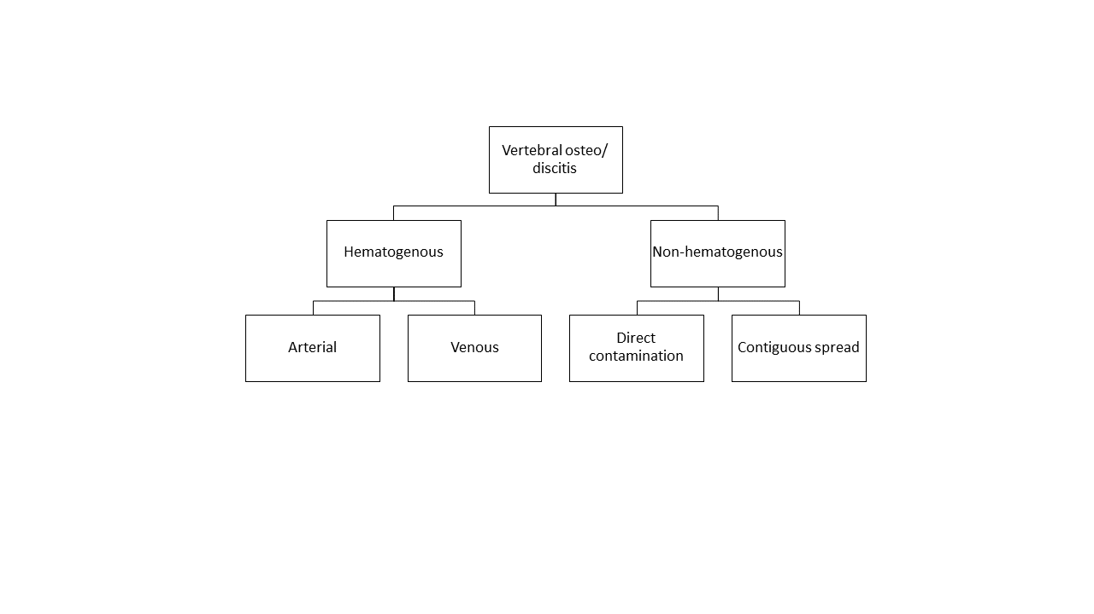
Understanding Orthopaedic Infections: A Conceptual Approach
Gregory Laborde ¹, Christopher J. Bloise ² , and George H. Karam ³
¹ School of Medicine, ² Department of Orthopaedic Surgery, and ³ Department of Internal Medicine, Louisiana State University Health Sciences Center – New Orleans
Introduction
Results
In a 1992 Internal Medicine Grand Rounds presentation that focused on medical education, Dr. Frank Griffin, Jr. made the comment that “understanding is the key to learning” (Griffin, 1992). His contention was that for information to be effectively retrieved, it must first be efficiently stored. Griffin said that the focus is usually on acquiring a “morass of details,” which precludes the commitment of time to consider concepts. Memorizing mounds of facts without having an effective conceptual framework to store them is often an unsuccessful learning style because memory frequently fails without understanding. To accomplish this goal, we offer a framework of ideas called “concept maps”. Of the many strategies for metacognition (that is, thinking about thinking), concept mapping is proven to improve meaningful and independent learning (Walvekar et al., 2021). We used this approach to guide understanding of common orthopaedic infections. This paper is not meant to serve as an approach on how to treat, but rather as a storage system with the ability to assist in understanding orthopaedic infections.
Methods
Concept maps are constructed using information from over 40 sources of orthopaedic or infectious disease literature. The sequential levels of each concept map are referred to as levels of hierarchy. Boxes of each level of hierarchy are designed to be a point of differentiation between a similar concept. Branches form lower levels of hierarchy to further divide specific concepts.
Using our hierarchical system, orthopaedic infections are first classified as either native tissue or foreign material. We further divide native tissue into hard and soft tissue. Foreign material is divided into hardware and retained foreign bodies. The next hierarchical level consists of various types of tissue or types of hardware that we further sub-classify using other specific characteristics.
Conclusion
As someone beginning a career in medicine, I was searching for a framework to organize the many concepts of orthopaedic infections. The production of these concept maps assisted me in efficiently learning the material while providing a strong foundation to continue my medical education. A prominent goal of this paper is to offer these maps to others in a similar position to help guide their understanding of orthopaedic infections. In conclusion, a conceptual approach is the key to learning material in a manner that allows effective storage and retrieval. This approach will ultimately lead to a better understanding of orthopaedic infections.
References
Griffin FM, Jr. Medical Education That Emphasizes Understanding and Preserves Individuality. University of Alabama Internal Medicine Grand Rounds, July 30, 1992.
Walvekar, P., Baliga, S., & Mahantshetti, G. (2021). Concept map as a teaching and learning tool for medical students. Journal of Education and Health Promotion, 10(1), 35. https://doi.org/10.4103/jehp.jehp_146_20

