Slide 1
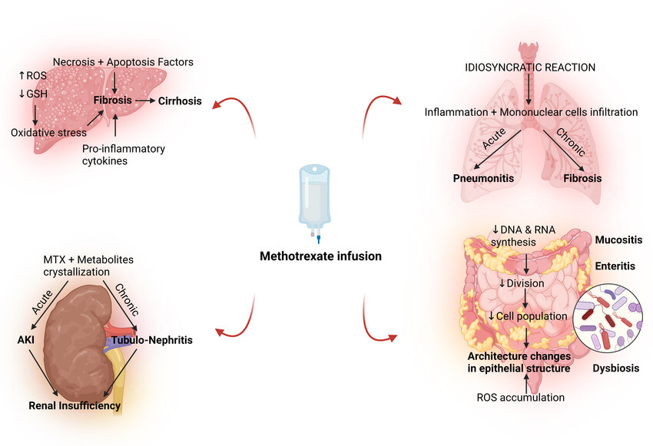
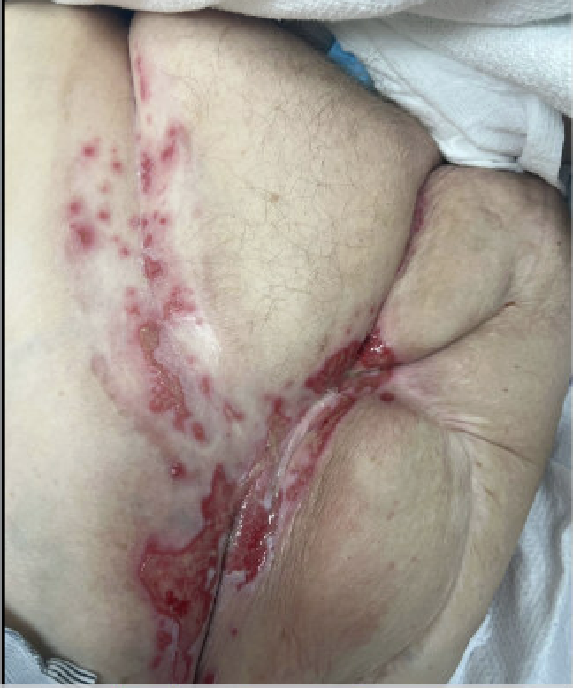
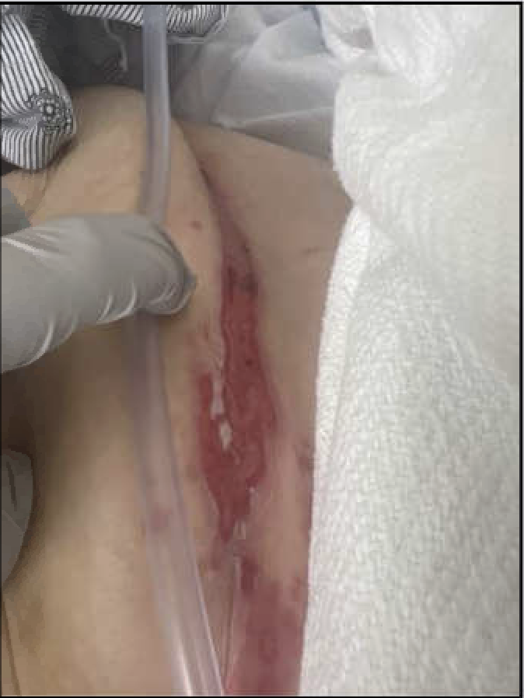
Methotrexate toxicity: The Systemic Impact on the Human Body
Asad Mussarat, MD; Luke Yesbeck, DO; Angus Harper, MD; Ahmed Fazal-ur-rehman; Rebecca Maitski; Seth Vignes, MD; Brian Mackel, MD
LSU Health Science Center, Department of Internal Medicine
The pathophysiology of MTX toxicity involves interference with folate metabolism, leading to impaired DNA synthesis and cell proliferation, prompting systemic adverse effects on multiple organ systems. Folate supplementation mitigates these effects by providing a substrate for essential cellular processes, thereby reducing the risk of adverse events. Close monitoring of serum MTX levels and renal function guides treatment decisions, with consideration given to dose adjustment or drug discontinuation in severe cases. Methotrexate toxicity is a potentially life-threatening complication of MTX therapy that requires prompt recognition and intervention. Clinicians should be vigilant for signs and symptoms of toxicity, particularly in patients with risk factors predisposing to adverse drug regarding the importance of folate supplementation and regular follow-up is essential for optimizing therapeutic outcomes and minimizing the risk of MTX toxicity.
Introduction
Discussion
Methotrexate toxicity encompasses a broad spectrum of adverse effects ranging from gastrointestinal symptoms to life-threatening complications such as myelosuppression. The incidence of MTX toxicity varies depending on factors such as pharmacokinetics, concomitant medications, and individual patient characteristics. We present a case of a 74-year-old female who has had multi-organ toxicity from methotrexate use.
Case Presentation
A 74-year-old female with PMH of psoriatic arthritis and recent right AKA, who presented with urinary incontinence and generalized weakness for 5 months. She had multiple UTIs within that time period. For the past month, she had bloody diarrhea, nausea, and vomiting. She later developed dysphagia and odynophagia one week prior to admission. She also reported bleeding from her gums, and slowly healing abrasions on her upper extremities from a fall one week prior. Patient’s medications include methotrexate (MTX), and hydroxychloroquine for seven years. Non-scrapable leukoplakia was present on the surface of her tongue, and mucosal injuries were appreciated on the upper and lower lip. The left lower extremity was erythematous while right lower extremity amputation site showed purulent, poorly healing wounds. She was had a low WBC of 3, hemoglobin 8.8, and a platelet 21.The ferritin level was 955. C-reactive protein was 19.1 mg/dL. The reticulocyte count was 0.59 %, and folic acid levels were 2.9 ng/mL. MTX levels were <.20 μmol/L (reference <0.01 μmol/L). Urine cultures were concerning for E. Coli. Superficial wound cultures from amputation stump were positive for Streptococcus agalactiae. With concerns for MTX toxicity, DMARDs were held and patient was started on a 7-day course of Leucovorin therapy and broad-spectrum antibiotics. The patient’s labs significantly improved closer to baseline within one week and her mucositis and wounds started to heal appropriately.
Figure 1: The pathophysiology of Methotrexate toxicity on multiple organ systems
.
References
1. Widemann BC, Adamson PC. Understanding and managing methotrexate nephrotoxicity. Oncologist. 2006;11(6):694-703.
2. Visser K, van der Heijde D. Optimal dosage and route of administration of methotrexate in rheumatoid arthritis: a systematic review of the literature. Ann Rheum Dis. 2009;68(7):1094-1099.
3. Chabner BA, Allegra CJ, Curt GA, et al. Polyglutamation of methotrexate. Is methotrexate a prodrug? J Clin Invest. 1985;76(3):907-912.
4. Marin G-E, Neag M-A, Burlacu C-C, Buzoianu A-D. The Protective Effects of Nutraceutical Components in Methotrexate-Induced Toxicity Models—An Overview. Microorganisms. 2022.
5. Weidmann, A., Foulkes, A.C., Kirkham, N. et al. Methotrexate Toxicity During Treatment of Chronic Plaque Psoriasis: A Case Report and Review of the Literature. Dermatol Ther (Heidelb) 4, 145–156 (2014).
6. Cronstein BN. Low-dose methotrexate: a mainstay in the treatment of rheumatoid arthritis. Pharmacol Rev. 2005;57(2):163-172.
Figure 2: Poorly healing chronic infected skin wounds

